Slide 2
Attendance Report Generation System
- - - By - - -
Shubh Sinha

Slide 3


Logical Architecture
Register Employee
Employee
Mongo
Get Employee
Process
Gateway
Eureka
Kafka Producer/ Consumer
MySql
Report
Kafka Enabled
Report Generation
Notes:
Gamified & Enganemnt

Slide 4
Business Context Diagram
Head
Employee
Employee-Info
Report Generation
Absentes
Swipe-Out
Swipe-In
Employee Attendance Report Generation System
Present
Half Day
Working Hour Calculation
Report Generation
Absent
Notes:
Gamified & Enganemnt

Slide 5
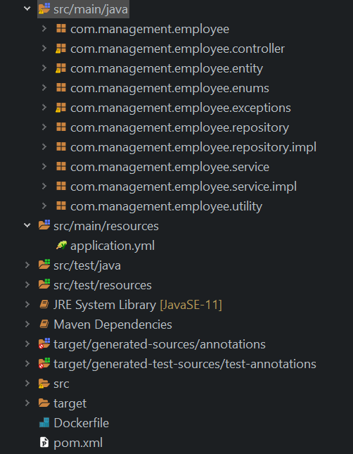
Package Structure
Microservices
Employee-tracking
Parent Service
Gateway
Eureka
Report-Generation
Kafka Enabled
Notes:
Gamified & Enganemnt

Slide 6







FLOW – AZURE CLOUD
Notes:
Gamified & Enganemnt

Slide 7
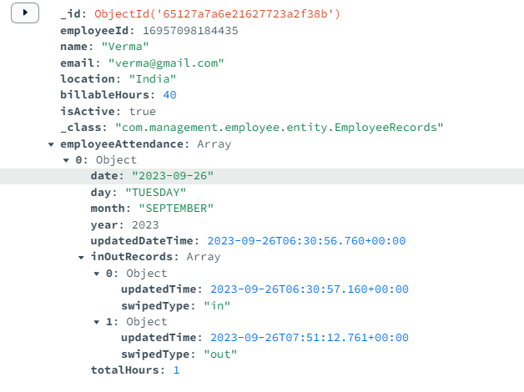
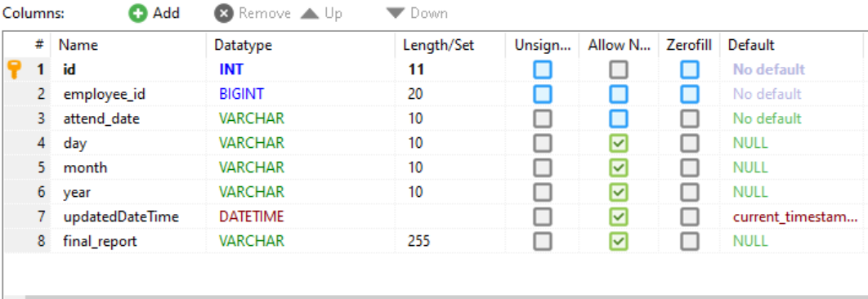
Database Structure
Employee -> employeeAttendance->InoutRecoords
Employee Report
Notes:
Gamified & Enganemnt

