Slide 1
MAVEN ANALYTICS
Retail Analytics 360
An End-to-End Power BI Dashboard for a Global Electronics Retailer
Data Cleaning · Data Modeling (Snowflake Schema) · Interactive Dashboard Design
Presented by: [SHUBH SRIVASTAVA]

Slide 2
THE CHALLENGE
Problem Statement
A global electronics retailer sells across multiple countries, stores, and product categories — but its sales, customer, product, and store data sits in disconnected raw tables. Leadership has no single, reliable view of performance.
Goal
Turn scattered retail data into one interactive source of truth for decision-making.
1
Fragmented Data
2
No Quick Insights
Sales, customers, products & stores live in separate raw files with no defined relationships.
Answering basic questions (top category, best market, repeat customers) needs manual, slow analysis.
3
Inconsistent Formats
4
No Central View
Prices as text, mixed currencies, missing values and unformatted dates block direct reporting.
No interactive, drill-down dashboard exists for management to monitor sales & profitability.
Retail Analytics 360 | Global Electronics Retailer | Maven Analytics
02

Slide 3
THE APPROACH
Solution
Built an end-to-end Power BI solution — from raw CSV files. I cleaned and organized the data, created a data model, and developed five interactive pages to analyze sales, customers, products, and overall business performance.
01
02
03
04
Collect
Clean
Model
Visualize
Imported raw Sales, Customers, Products, Stores & Exchange Rate tables (Maven Analytics dataset).
Power Query used to fix types, handle nulls, convert currency & standardize keys.
Built a Snowflake schema linking fact_sales to normalized dimension tables.
Designed a 5-page dashboard: Home, Sales, Customers, Products & Insights.
→
→
→
Retail Analytics 360 | Global Electronics Retailer | Maven Analytics
03

Slide 4
PREPARATION
Data Cleaning & Transformation
Performed in Power Query before modeling — typical steps applied to the raw Maven Analytics tables:
Removed duplicate & blank rows from Customers, Products and Sales tables
Converted Unit Cost / Unit Price from text ($) to proper numeric/currency fields
✓
✓
Converted Order Date, Delivery Date & Birthday columns to correct Date type
Merged the Exchange Rate table to derive unit_cost_usd / unit_price_usd for consistent reporting
✓
✓
Standardized Country / State naming so dimension tables join cleanly to fact_sales
Filled or flagged missing State Code values for a few countries
✓
✓
Removed rows with invalid, negative or zero quantity / cost values
Generated surrogate keys (customerkey, productkey, storekey, subcategorykey, categorykey) for relationships
✓
✓
Retail Analytics 360 | Global Electronics Retailer | Maven Analytics
04

Slide 5
SQL DEVELOPMENT
Building the Data Model in SQL
After collecting the raw dataset, SQL was used to prepare it for analysis. The data was structured into a central Fact Sales table and multiple Dimension tables, with the required relationships established between them, and cleaning & validation performed directly in SQL.
TABLES CREATED
Dim_Date
Dim_Product
Dim_Customer
Dim_Store
FACT TABLE
Fact_Sales
Every transaction row
Dim_Category
Dim_Subcategory
Dim_Currency
Fact_Sales connects to every dimension through shared surrogate keys — the foundation of the Snowflake schema.
1
2
3
4
Structure the Model
Define Relationships
Clean & Validate in SQL
Hand Off to Power BI
Separated raw data into one Fact Sales table and dimension tables for Date, Product, Customer, Store, Category, Subcategory & Currency.
Established primary/foreign key relationships linking Fact Sales to each dimension table.
Checked for missing values, removed duplicates, and validated data consistency using SQL queries.
Imported the structured Snowflake schema into Power BI for modeling, DAX measures & dashboard build.
Retail Analytics 360 | Global Electronics Retailer | Maven Analytics
05

Slide 6
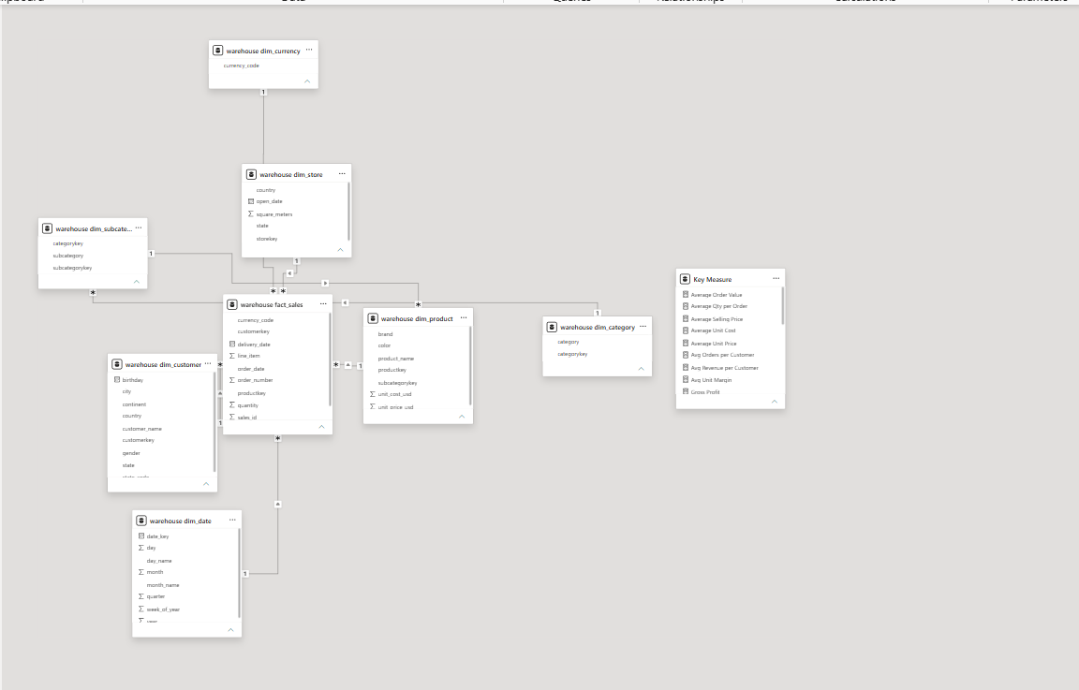
DATA MODELING
Data Model — Snowflake Schema
The model centers on warehouse_fact_sales, linked to normalized dimension tables. Product hierarchy is split into dim_product → dim_subcategory → dim_category, and dim_store connects out to dim_currency — the extra layers of linked lookup tables are what make this a Snowflake schema rather than a simple star schema.
Fact table
warehouse_fact_sales — order, quantity, pricing & delivery grain
Dimensions
dim_customer, dim_product, dim_store, dim_date, dim_category, dim_subcategory, dim_currency
Snowflaked
dim_product → dim_subcategory → dim_category | dim_store → dim_currency
Power BI Model View — Snowflake Schema
Key Measures
Gross Profit, Avg Order Value, Avg Unit Margin, Avg Orders/Customer & more
Retail Analytics 360 | Global Electronics Retailer | Maven Analytics
06

Slide 7
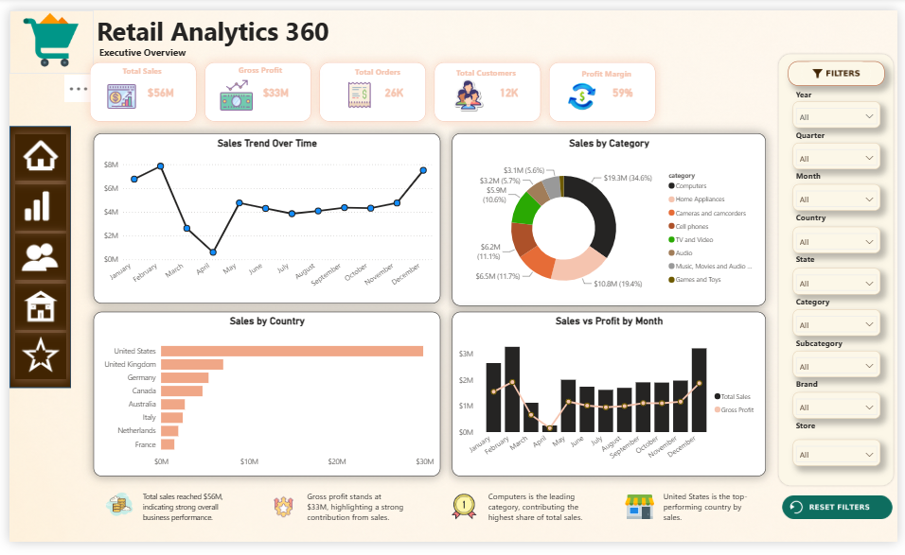
PAGE 1 OF 5
Home — Executive Overview
The Big Numbers
$56M total sales, $33M gross profit, 26K orders, 12K customers, 59% profit margin.
Trend at a Glance
Sales trend over time and Sales vs Profit by month, side by side.
Where It Comes From
Sales by Category (donut) and Sales by Country (bar) for quick context.
Auto Narrative
Callout tiles summarize the standout facts, e.g. Computers leads by category.
Retail Analytics 360 | Global Electronics Retailer | Maven Analytics
07

Slide 8
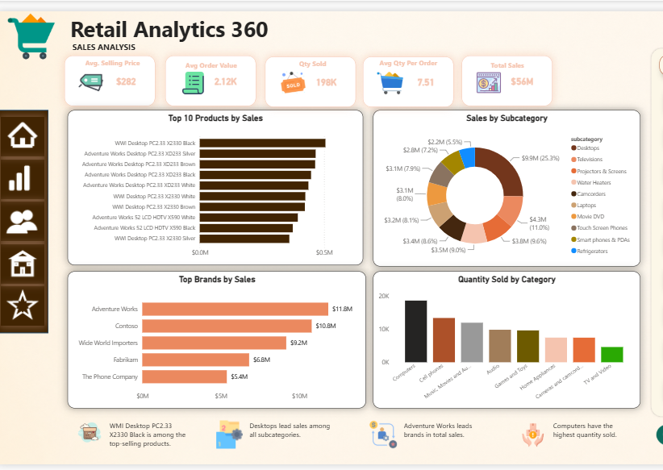
PAGE 2 OF 5
Sales Analysis
Order Economics
Avg. Selling Price $282, Avg. Order Value $2.12K, 198K units sold, 7.51 items/order.
Top Performers
Top 10 products by sales, led by WMI & Adventure Works Desktop PCs.
Category Mix
Sales by Subcategory donut — Desktops leads at 25.3% of sales.
Brand & Volume
Top brands by sales (Adventure Works, Contoso) and quantity sold by category.
Retail Analytics 360 | Global Electronics Retailer | Maven Analytics
08

Slide 9
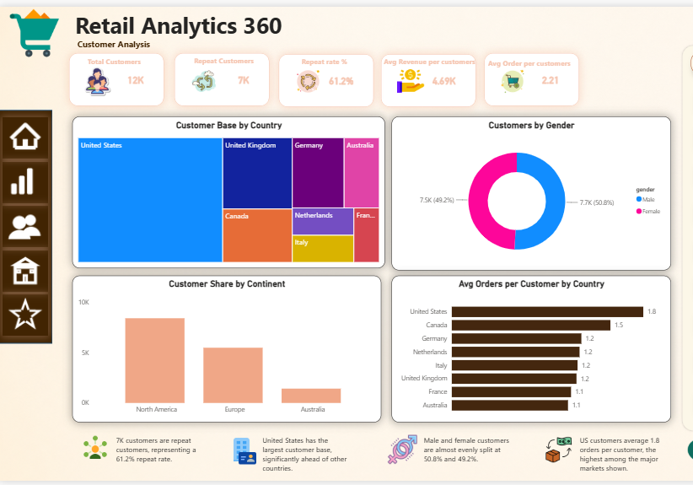
PAGE 3 OF 5
Customer Analysis
Customer Base
12K total customers, 7K repeat customers — a 61.2% repeat rate.
Value per Customer
Avg revenue/customer $4.69K and 2.21 avg orders per customer.
Geography & Gender
Customer base by country (US leads) and a near-even 50.8% / 49.2% gender split.
Engagement by Market
Customer share by continent and avg orders/customer by country.
Retail Analytics 360 | Global Electronics Retailer | Maven Analytics
09

Slide 10
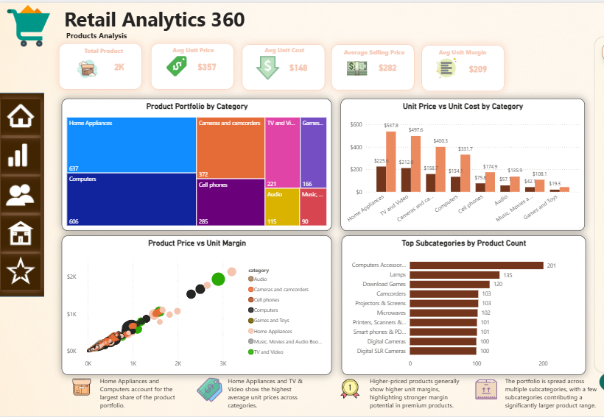
PAGE 4 OF 5
Products Analysis
Portfolio Size
2K total products, avg unit price $357, avg unit cost $148, avg margin $209.
Category Footprint
Product portfolio treemap — Home Appliances & Computers dominate the range.
Price vs Cost
Unit price vs unit cost compared across every category.
Margin Story
Price vs. margin scatter and top subcategories by product count.
Retail Analytics 360 | Global Electronics Retailer | Maven Analytics
10

Slide 11
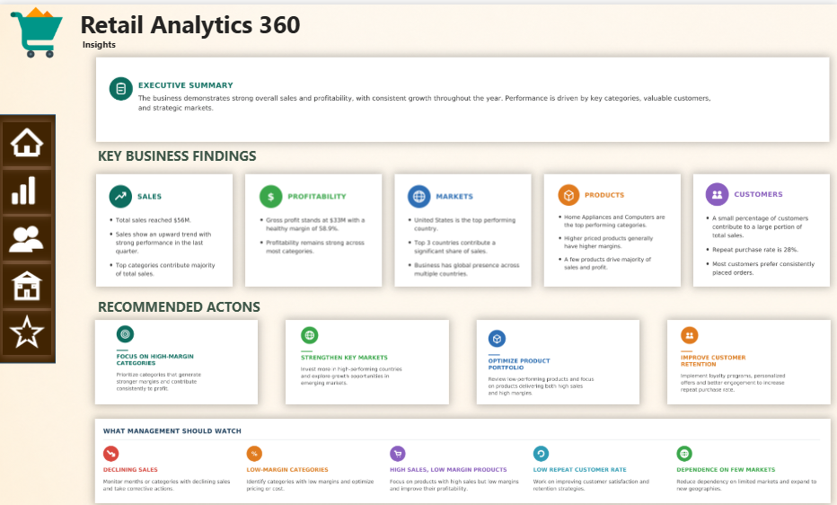
PAGE 5 OF 5
Insights
Executive Summary
Auto-written narrative on overall sales & profitability trends.
Key Findings
Grouped by Sales, Profitability, Markets, Products & Customers.
Recommended Actions
Focus on high-margin categories, key markets, product mix & retention.
Watch List
Flags: declining sales, low-margin categories, and market concentration risk.
Retail Analytics 360 | Global Electronics Retailer | Maven Analytics
11

Slide 12
THANK YOU
Questions & Discussion
Retail Analytics 360 | Built on the Maven Analytics Global Electronics Retailer dataset

