Slide 1

EXPLORATORY PROJECT
Driver drowsiness detection system and alarm activation

Slide 2
PROJECT Members:
Ayush Kumar (20095023)
Prabhat Kumar (20095110)
Shubham Kumar (20095144)
PROJECT MENTOR:
Dr. Amit K. Singh (Department of Electronics Engineering)

Slide 3
introduction
A major cause of road accidents throughout the world is driver drowsiness and fatigue.
With the help of machine learning, we have created a driver drowsiness detection system which will monitor the face of the driver and raise an alarm when his eyes close for a period of time or when he yawns.
We have used OpenCV and Haar cascades and pre-trained dlib library.
We have proposed a model using Raspberry Pi and 5MP raspberry pi camera module and buzzer and 16x2 LCD display.

Slide 4
Haar cascades in opencv
The algorithm first requires lots of positive and negative images (with and without faces) to train the classifier.
Each feature is a single value obtained by subtracting the sum of pixels under a white rectangle from the sum of pixels under the black rectangle.
The final classifier is a weighted sum of these weak classifiers. Together with other forms, it provides classification with 95% accuracy.

Slide 5
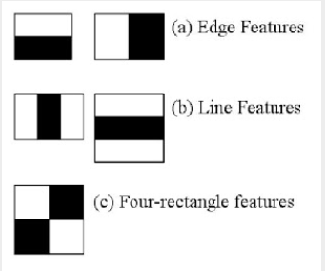
Haar cascade features

Slide 6
Dlib facial landmark detector
This is a training data set for labelled facial landmarks on an image. These landmarks specify (x,y) coordinates of a specific landmark.
An ensemble of regression tree models is used to estimate the facial landmark positions.
The end result is a facial landmark detector that can be used to detect facial landmarks in real-time with high quality predictions.

Slide 7
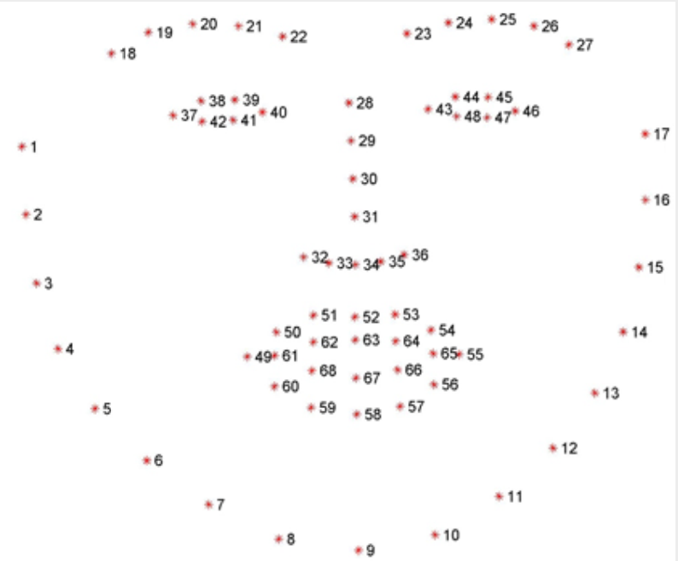
Dlib facial landmarks

Slide 8
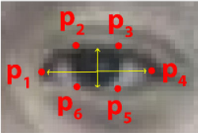
Eye aspect ratio (EAR)
Using the six coordinates associated with the eye, all going from p1 to p6, we can get the width and height of these coordinates.
We have an equation which reflects the relation between eyes open and closed, called the ear aspect ratio.

Slide 9
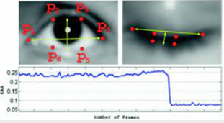

Eye aspect ratio (EAR)
When eye is open, EAR is almost constant. When the eye closes, the value of EAR decreases.

Slide 10
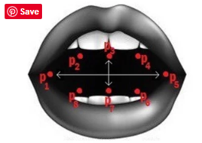
Mouth aspect ratio (MAR)
This is similar to EAR, which measures the ratio of length of the mouth to the width of the mouth.
Our hypothesis is that when a person is drowsy, he is likely to yawn, thus increasing MAR.

Slide 11
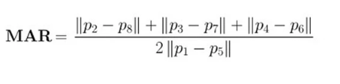
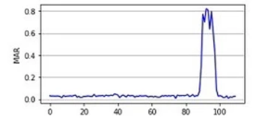
Mouth aspect ratio (MAR)
Yawn increases the MAR, thus indicating that the driver may be drowsy.

Slide 12
Overall model
Initially, we use a RasPi camera module which captures the video stream of the face.
Our program uses OpenCV and Haar Cascades for facial detection.
Using the appropriate landmarks, we calculate the eye aspect ratio (EAR) and mouth aspect ratio(MAR) of the driver’s face.

Slide 13
Overall model
We set the eye aspect ratio threshold to 0.25 and mouth aspect ratio threshold to 35.
If the mouth aspect ratio increases above the threshold value or the ear aspect ratio drops below the threshold value for some amount of time, as a momentary drop can just be a blink, an alarm is raised using the buzzer.

Slide 14
In case of drowsiness alert…
In case our program raises a drowsiness alert, we give a command to raspberry pi using serial communication which turns on a buzzer to alert the driver.
Modules used:
Rapsberry pi module, 12V DC motor to simulate wheels, buzzer, RasPi camera module and 16x2 LCD module.

Slide 15
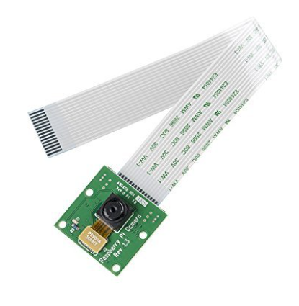
Raspi 5mp camera module
The RasPi camera module can be directly connected to the raspberry pi and is used to get live video feed of the driver’s face.

Slide 16
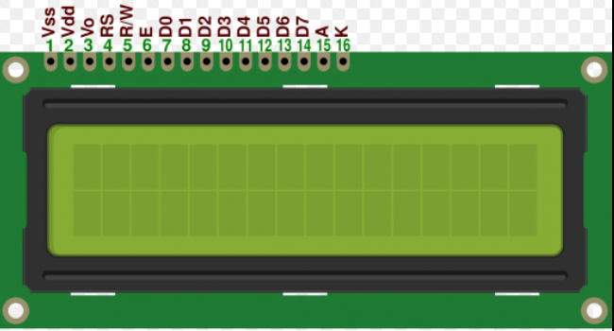
16x2 LCD module
We use 16x2 LCD module connected to the raspberry pi to output the current state of the driver (Active, Drowsy or sleeping).
We use pins D4-D7 to send input data to
the LCD module.

Slide 17
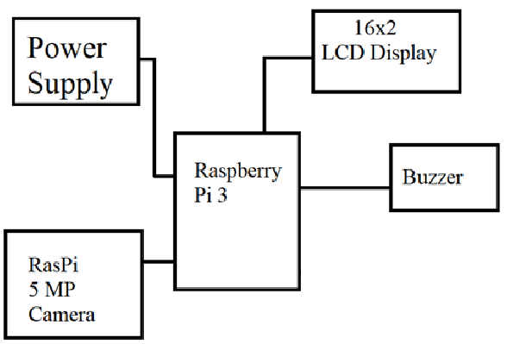
BLOCK Diagram

Slide 18
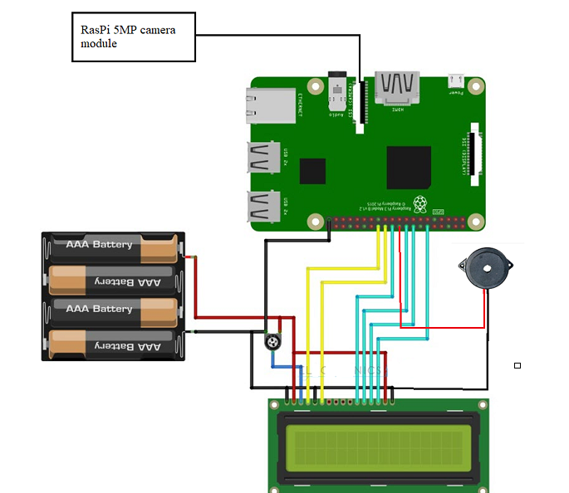
Circuit diagram

Slide 19
Results and conclusion
The system designed proved to be fast and effective.
Using Haar cascades, EAR and MAR gave us real time accurate results.
There were negligible false negatives and the alarm was raised successfully.
The results were satisfactory on online simulators.

Slide 20
THANK YOu

