Slide 1
Deep Neural Networks
Introduction

Slide 2
Machine Learning (Artificial Neural Network)
Artificial Neural Network (ANN) models relationships between a set of input data and output data.
ANN models are based on the observed behaviour of neural nets in our brains
Just as brain uses a network of interconnected neurons to parallelize the processing of input signals to trigger a response, ANN also make use of interconnected neurons to parallelly work on input signals and give an output
It is interesting to know how biological neurons function Ref:
Resting potential
Action potential
Threshold for action potential
Synapses and synaptic transmission

Slide 3
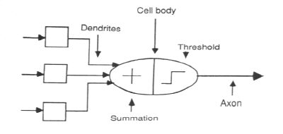
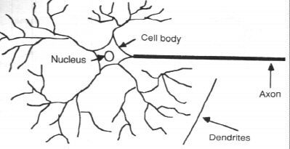
Machine Learning (Artificial Neural Network)
Artificial Neural Network (ANN) models relationships between a set of input data and output data.
Natural / Abstract neuron
https://youtu.be/ySgmZOTkQA8

Slide 4
Machine Learning (Artificial Neural Network) / Perceptron…
History artificial neuron
Rosenblatt defined a Perceptron as a simple mathematical model of biological neurons
It takes as inputs a set of binary values from senses / neighboring neurons.
Every input is multiplied by a weight (akin to the synaptic strength to each nearby neuron),
A threshold to evaluate the sum of weighted inputs against. Output a 1 (neuron firing) if the weighted sum is more than threshold, else a zero (neuron not firing)
Other than the inputs from sensors / neighboring neurons, they also get a special ‘bias’ input, which just has a value of 1
The bias is like intercept in a linear equation. Useful in generating more functions with the same inputs
This was an improvement of the work of Warren McCulloch and Walter Pitts, McColloch-Pitts neuron.
McColloch Pitts neuron had a fixed set of weights associated with inputs and as a result did not have the ability to learn. They had no bias term

Slide 5
Machine Learning (Artificial Neural Network) / Perceptron…
History artificial neuron (contd….
Rosenblatt’s neuron was inspired by a rule coined by Donald Hebb (researcher studying biological neurons), according to which learning in brain is stored in form of changes to the strength of relationships between two connected neurons “Neurons that fire together, wire together” Donald Hebb 1949
Rosenblatt’s neuron can model the basic OR/AND/NOT functions (building blocks of computing systems)
This was a big step towards the belief that making computers able to perform formal logical reasoning would essentially solve AI.

Slide 6
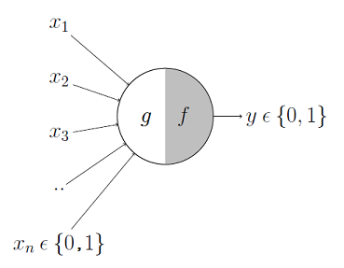
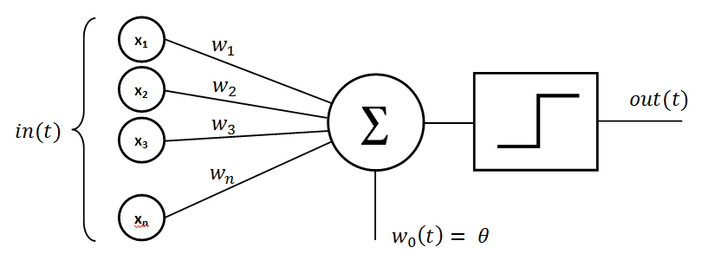
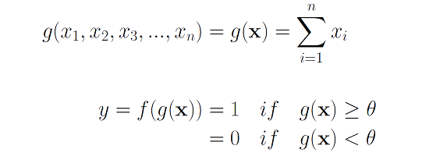
Warren McCulloch & Walter Pitts Neuron
Rosenblatt’s Perceptron
It has an Input layer that acts as dendrites
It has two parts, first part is weighted addition Each input is multiplied with a weight (which is typically initialized with some random value)
The sum is then passed through an activation function which yields a 1 if threshold is crossed
The step function can be defined in such a way that output can range from -1 to +1
It has an input layer that acts like dendrites
It has two parts, the first part, g is weighted addition of inputs. The weights are manually initialized and all have same weight
The weighted sum is passed through an activation function f which yields a 1 if threshold is crossed, else 0

Slide 7
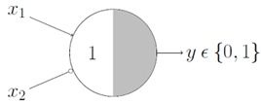
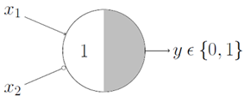
Warren McCulloch & Walter Pitts “AND”, “OR” Neuron
>
>=
AND
OR
In McCulloh Pitt neurons inputs and outputs are binary. The output is only one but inputs can be many
All inputs have same positive weights (not shown in the figure)
The inputs multiplied with corresponding weights are summed up and the result sent to a step function.
The threshold of the step function is fixed (for e.g. 1 for “AND” gate with two inputs each with weight 1)
The threshold has to be modified for a gate, for e.g. ‘AND’ gate depending on the number of inputs. What would the threshold for the “AND” gate be if the number of inputs is x1, x2, x3?

Slide 8

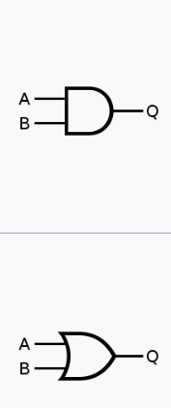
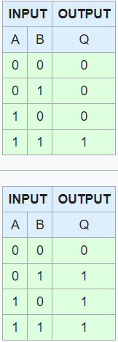
Boolean Gates and Artificial Neurons
The objective of research in artificial neuron was to develop a computing system that could learn to do tasks on it’s own without instruction how to do it
Most of the tasks that we do in our day to day life are classification. Hence, research was on to develop an artificial neuron that could classify
Since computing systems are based on Boolean gates which generated two classes , it was natural to check whether the artificial neurons can learn to mimic these gates such as the OR, AND gate

Slide 9
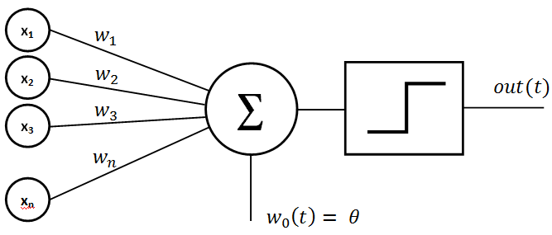
Rosenblatt Neuron / Perceptron
Weights for the inputs are not same, can be positive or negative
The output can be -1, 0, 1 unlike MCP neuron where the output is only 0 or 1
The neuron is associated with a learning rule that modifies the weight to ensure with same threshold, the neuron can behave like “AND” gate or “OR” gate with no need for any threshold modification
This neuron learns from the data. It has intelligence to learn the pattern from the data

Slide 10
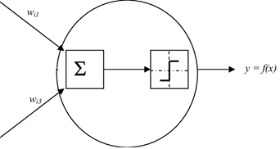
Machine Learning (Artificial Neural Network)
McCulloh Pitts Neuron
AND Gate
w[1] = 1
w[0] = 1
training_data = [
(array([0,0]), 0),
(array([0,1]), 0),
(array([1,0]), 0),
(array([1,1]), 1),
]
# Step function with threshold of >1. Anything below is 0
step_function = lambda x: 0 if x < 1 else 1
w[1] = 1
w[0] = 1
for x, _ in training_data:
result = dot(x, w)
print("{}: {} -> {}".format(x[:2], result, step_function(result)))
result
The McCulloch-Pitts model of a neuron is simple. However, this model is so simplistic that it only generates a binary output and also the weight and threshold values are fixed.

Slide 11
Machine Learning (Artificial Neural Network) / Perceptron…
Rosenblatt’s Neuron Functioning
The objective of the neuron is to extract the relationship between inputs and output from an example training set
The relationship has to be expressed in a mathematical function from. A mathematical function consists of sum of inputs multiplied with respective weights
For each example the weights have to be adjusted (increased or decreased) to achieve overall correct result across the dataset
Perceptron algorithm –
Start with a random set of weights for all the input variables and the bias
For the input data point, compute the output using the weights and the bias
If the calculated output does not match the expected output (from training data) modify the weights **
Go to the next example in the training set and repeat steps j - k until the Perceptron makes no more mistakes
** The relation between weight adjustment and errors and a learning rate will make the learning possible.
Learning is the process finding the right combination of weights that minimizes the errors in the training data set

Slide 12
Machine Learning (Artificial Neural Network) / Perceptron…
Perceptron Limitations -
Papert and Minsky demonstrated that the perceptron was incapable of handling some of the binary gates such as XOR**
Given that it cannot represent all possible binary gates, it could not have been used for all possible computations hence the objective of computer based AI was a pipe dream!
It was subsequently demonstrated that instead of making a neuron intelligent, a network of neurons can be used to do what a single neuron could not
This was the birth of a Artificial Neural Network
** Ref: https://alan.do/minskys-and-or-theorem-a-single-perceptron-s-limitations-490c63a02e9f
Lab - McCullohPitt_RosenBlat_Neurons.ipynb

Slide 13

Machine Learning (Artificial Neural Network)
The processing elements of a ANN is called a node, representing the artificial neuron. Each ANN is composed of a collection of nodes grouped in layers. A typical structure is shown The initial layer is the input layer and the last layer is the output layer. In between we have the hidden layers
Input Layer
1st Hidden Layer
2nd Hidden Layer
Output Layer
X1
X2
Y_Pred
X3
B1
B2
B3
Bias Layer

Slide 14

Machine Learning (Artificial Neural Network)
Mathematical foundations for artificial neural networks
Kolmogorov theorem – any continuous function f defined on n-dimensional cube is representable by sums and superpositions of continuous functions of only one variable
Cover’s theorem - states that given a set of training data that is not linearly separable, one can with high probability transform it into a training set that is linearly separable by projecting it into a higher-dimensional space via some non-linear transformation.
Input Layer
1st Hidden Layer
2nd Hidden Layer
Output Layer
X1
X2
Y_Pred
X3
B1
B2
B3
Bias Layer

Slide 15
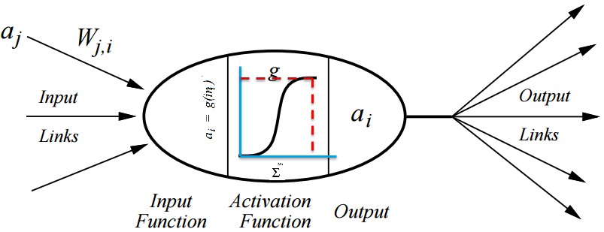
Machine Learning (Artificial Neural Network)
A given node will fire and feed a signal to subsequent nodes in next layer only if the non-linear function it implements reaches a threshold. In ANN use of Sigmoid function is more common than step function
Output ai fired
Threshold input

Slide 16
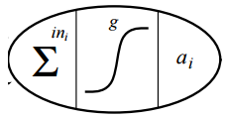
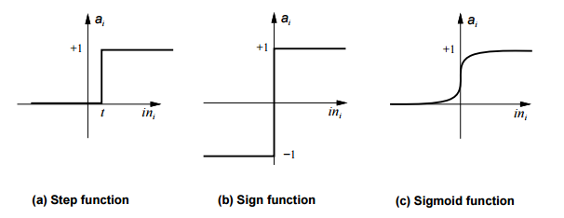
Machine Learning (Artificial Neural Network)
The summation function can be implemented in many ways. It does not have to be mathematical addition of the inputs

Slide 17
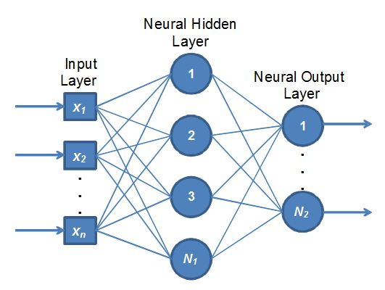
Machine Learning (Artificial Neural Network)
The ANN generic architecture
Neural net consists of multiple layers. It has two layers on the edge, one is input layer and the other is output layer.
In between input and output layer, there can be many other layers. These layers are called hidden layers

Slide 18
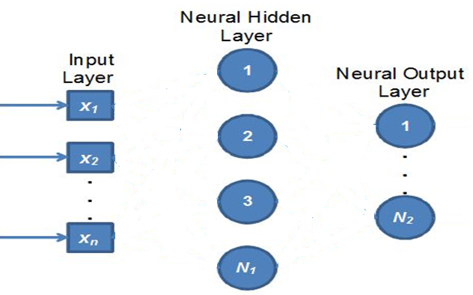
Machine Learning (Artificial Neural Network)
The input layer is passive, does no processing, only holds the input data to supply it to the first hidden layer
Notes:
The input layer is passive, does no processing, only holds the input data to supply it to the first hidden layer
In the hidden layer, each node extracts all the input values from the input layer
While extracting the values from input layer, each hidden node multiply the values with appropriate weights and sum up
The summed value is further processed through a sigmoid function.

Slide 19
Machine Learning (Artificial Neural Network)
Each node in the first hidden layer, takes all input attributes, multiplies with the corresponding weights, adds bias and the output is transformed using non_linear function
The weights for a given hidden node is pre-fixed and all the nodes in the hidden layer have their own weights
The output of each node is fed to output layer nodes or another set of hidden nodes in another hidden layer
X1
Hidden Layer Node 1
W11
W12
W13
X2
ACC = X1*W11 + X2*W12 + X3*W13
X3
N1Output = Sigmoid(ACC)
Notes:
The input layer is passive, does no processing, only holds the input data to supply it to the first hidden layer
In the hidden layer, each node extracts all the input values from the input layer
While extracting the values from input layer, each hidden node multiply the values with appropriate weights and sum up
The summed value is further processed through a sigmoid function.

Slide 20
Machine Learning (Artificial Neural Network)
The output value of each hidden node is sent to each output node in the output layer
Notes:
The input layer is passive, does no processing, only holds the input data to supply it to the first hidden layer
In the hidden layer, each node extracts all the input values from the input layer
While extracting the values from input layer, each hidden node multiply the values with appropriate weights and sum up
The summed value is further processed through a sigmoid function.

Slide 21
Machine Learning (Artificial Neural Network)
Output Node 1
X1
X2
011
O12
O13
O14
X3
ACC = X1*WO11 + X2*WO12 + X3*WO13 + X4*WO14
X4
N1Output = Sigmoid(ACC)

Slide 22
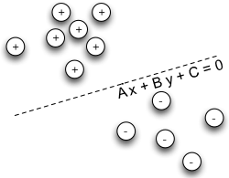
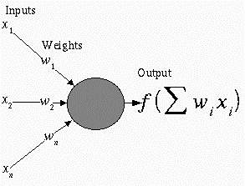
Machine Learning (Artificial Neural Network)
In a binary output ANN, the output node acts like a perceptron classifying the input into one of the two classes
Examples of such ANN applications would be to detect fraudulent transaction, whether a customer will buy a product given the attributes etc.

Slide 23




Machine Learning (Artificial Neural Network)
We can have a ANN with multiple output nodes where a given output node may or may not get triggered given the input and the weights.
We can have a ANN with multiple output nodes where a given output node may or may not get triggered given the input and the weights.

Slide 24
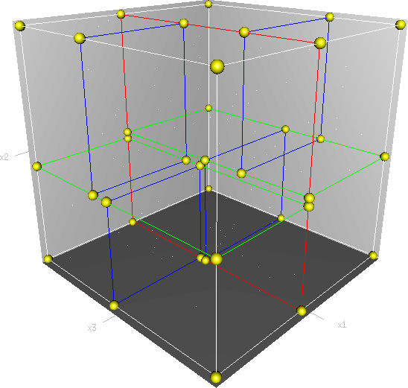
Machine Learning (Artificial Neural Network)
The weights required to make a neural network carry out a particular task are found by a learning algorithm, together with examples of how the system should operate
The examples in vehicle identification could be a large hadoop file of serveral millions sample segments such as bicycle, motorcycle, car, bus etc.
The learning algorithms calculate the appropriate weights for each classification for all nodes at all the levels in the network
If we consider each input as a dimension then ANN labels different regions in the n-dimensional space. In our example one region is cars, other region is bicycle
Car
Bycycle
Image Source: https://en.wikipedia.org/wiki/K-d_tree#/media/File:3dtree.png

Slide 25
Perceptrons

Slide 26
Perceptron
Perceptron Learning Algorithm –
Select random sample from training set as input. Draw the first random line (green) such that blue triangles lie above it and red circles ones below
If classification is correct, do nothing. But first time many blue triangles are on wrong side!
If classification is incorrect, modify the weight vector w and shift the green line
Repeat this procedure until the entire training set is classified correctly
Howsoever times we run this algorithm, it will find a surface which separates the two classes
Run 1
Run n

Slide 27
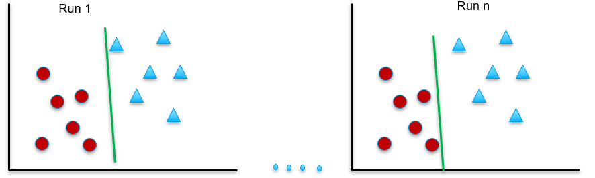
Test
Convergence theorem guarantees that when the classes are linearly separable in the training set, perceptron will find that surface which separates the two classes correctly
The perceptron algorithm does not guarantee it will be able to separate the two classes correctly even when the classes are linearly separable
Why? Because it does not look for an optimal plane. It stops the moment it finds the separator plane (a.k.a dichotomizer).
Since the planes, are passing very close to the data points in the training set, it may not perform well in test set where the distribution of the data will be different

Slide 28
Perceptron Weakness
Perceptrons fail to handle many data distributions such as XOR where it cannot segregate the classes
XOR is an example of distribution of classes not linearly separable in two dimensions but is easily separable in higher 3 dimensional space. Ref: http://www.mind.ilstu.edu/curriculum/artificial_neural_net/xor_problem_and_solution.php
Cover’s theorem – “Formulating classification problem in a space of higher dimensionality (than original problem) increases the probability of the classes becoming linearly separable
Neural networks help implement this theorem in from of neurons in a layer

Slide 29

Origins of Neural Networks
Perceptron were replaced with artificial neuron which not only had a weighted summation operation but also included a non-linearity function.
Multitude of such neurons working together could solve those problems where individual Perceptron failed
Multiple neurons in a single layer is akin to transforming data from lower dimensions to higher dimensions! (Cover’s theorem in action)
Kolmogorov theorem* states that any continuous function f(x1,x2,…,xn) defined on [0,1] with n>2 can be expressed in form of two carefully chosen functions
Looks similar to layer of neurons with non-linear function g acting on summation of weighted inputs ! No wonder neuralnets form basis of complex processing
* https://en.wikipedia.org/wiki/Universal_approximation_theorem (another mathematical theorem)

Slide 30
Components of Neural Networks

Slide 31
Activation Functions
Artificial neuron works in three steps
First it multiplies the input signals with corresponding weights
Second, adds the weighted signals
Third, converts the result to another value using a mathematical transformation function
For the third step, there are multiple mathematical functions available but all together are called the activation function
The purpose of the activation function is to act like a switch for the neuron. Should the neuron fire or not. Also…
The activation function is critical to the overall functioning of the neural network. Without it, the whole neural network will mathematically become equivalent to one single neuron!
Activation function is one of the critical component that gives the neural networks ability to deal with complex problems

Slide 32
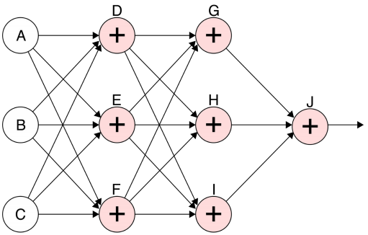
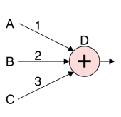
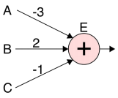
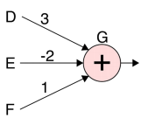
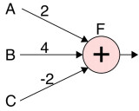
Activation Functions - why?
Let us take a fully connected neural network. Every neuron in every layer takes multiple inputs
The inputs are weighted and summed up at each neuron
The nodes in the second layer are simply scaling up the output of neurons in previous layer
For e.g the neuron G takes as input weight sums from D,E and F, G’s output is scaled version of output of D, E and F
G_Out = 3D -2E + 1F
= 3(1A + 2B + 3C) – 2(-3A + 2B -1C) + 1(2A+4B-2C)
= 8A + 6B + 3C
Thus this part of the network is like a single neuron with weights of 8, 6, 3!!!
Same argument holds for other neurons
Thus the entire neural network collapses to on neuron!
A single neuron is not capable of doing much
G-Out

Slide 33
Activation Functions - What are they?
The activation functions are a mathematical transformations that prevent the network from collapsing to a single neuron
The collapse can happen when the neurons do simple addition and multiplications of the inputs. These are called linear operations. Thus linear operations collapse the network
All activations functions are non-linear transformers for exactly the same reason. This non-linear transformation not only prevents collapse, it also empowers the network to do complex tasks because each neuron does something in the network totality

Slide 34
Activation Functions - Types
Types of non-linear activation functions include –
Piecewise linear functions
Step function
ReLU – Rectified Linear Units
Leaky ReLU
Parametric ReLU
Shifted ReLU
Smooth functions
Smooth ReLU / Exponential ReLU
Sigmoid / Logistic functions
Hyperbolic Tangent (tanh)
Swish (combination of Sigmoid and ReLU)

Slide 35
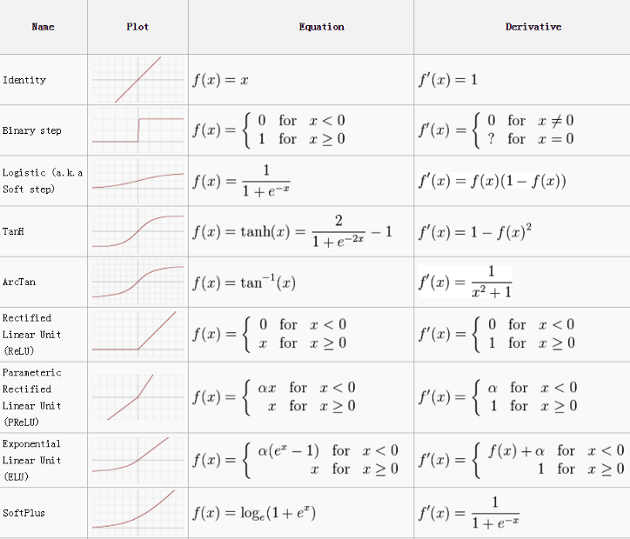
Activation Functions -

Slide 36
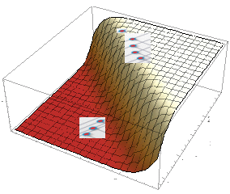
Neurons stretch the features space through non-linear functions and achieve Cover’s theorem
ACC = m1X + C1
N1Output = Sigmoid(ACC)
N1
Neuron1
X
N3
N2
X
Input distribution
Transformed thru sigmoid
ACC = m2X + C2
N2Output = Sigmoid(ACC)
Neuron2
Data points get linearly separable
Transformed thru sigmoid
Input distribution

Slide 37
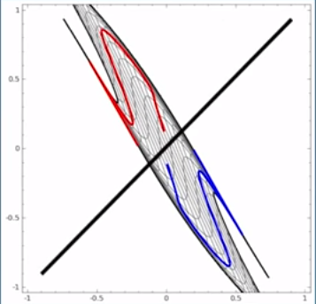
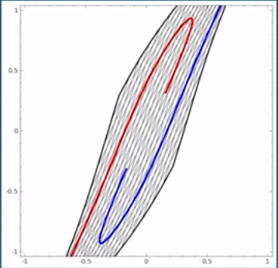
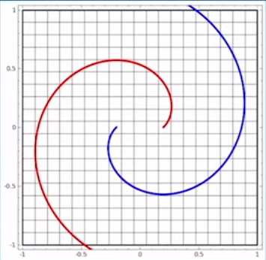
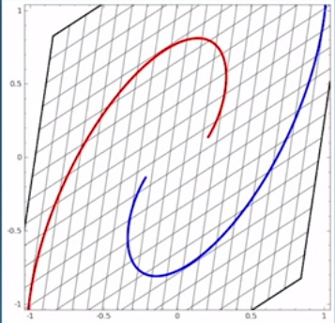
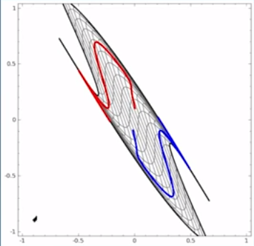
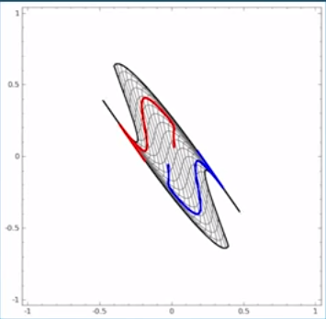
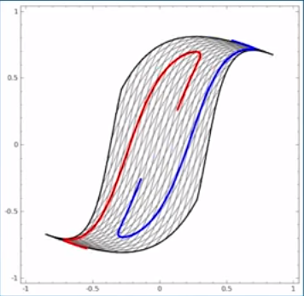
Neurons stretch the features pace through non-linear functions and achieve Cover’s theorem
Image Source: https://colah.github.io/posts/2014-03-NN-Manifolds-Topology/
Ref: https://cs.stanford.edu/people/karpathy/convnetjs//demo/classify2d.html

Slide 38
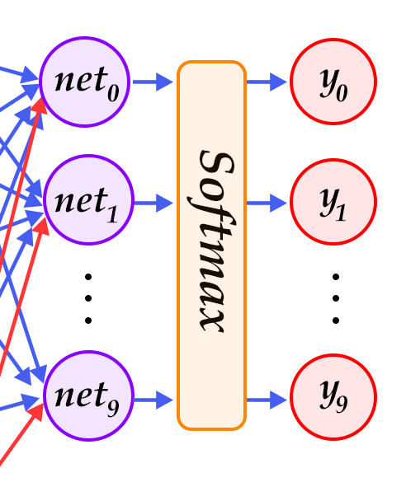

SoftMax Function -
A kind of operation applied at the output neurons of a classifier network
Used only when we have two or more output neurons and is applied simultaneously to all the output neurons
Turns raw numbers coming out of the pen-ultimate layer into probability values in the output layer
Suppose output layer neurons emit (Op1, Op2, Opn). The raw numbers may not make much sense. We convert that into probabilities using Softmax which becomes more meaningful. For e.g. input belongs to cycle is 30 times more likely than sailboat, 13 times more probable than car
Output
Layer
Probability of belonging to
Output
Classes
Entire Network
.07
Op1
0.9
Op2
.03
Opn

Slide 39
Forward Propagation
The directed acyclic path taken by input data from input layer to get transformed using non-linear functions into final network level outputs
Input data is propagated forward from the input layer to hidden layer till it reaches final layer where predictions are emitted
At every layer, data gets transformed non-linearly in every neuron
There may be multiple hidden layers with multiple neurons in each layer
The last layer is the output layer which may have a softmax function (if the network is a multi class classifier)

Slide 40
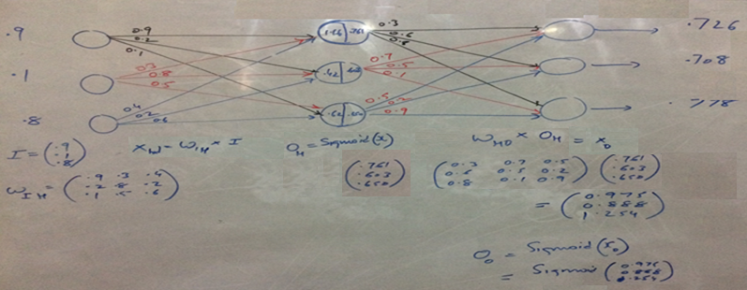
Forward Propagation
Forward prop steps –
Calculate the weighted input to the hidden layer by multiplying 𝑋 by the hidden weight 𝑊ℎ
Apply the activation function and pass the result to the final layer
At output layer, repeat step b replacing 𝑋 by the hidden layer’s output
Input Layer
Hidden Layer
Output Layer

Slide 41
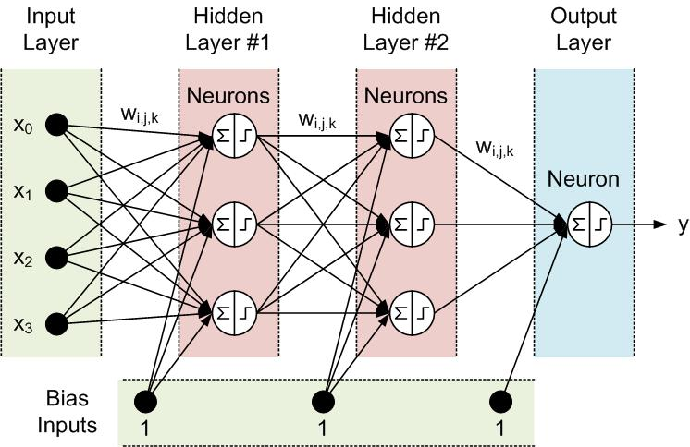
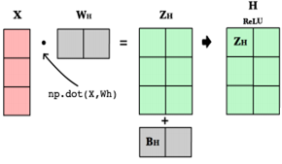
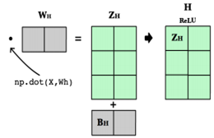
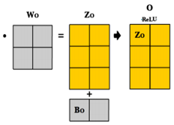
Forward Propagation and Matrix operations
Note: The diagram shows step function instead of ReLU in each neuron
The bias is all set to 1. The bias supplied to a neuron depends on the weight assigned to the connector connecting bias to the neuron

Slide 42
Bias Term
Every neuron in the hidden layers are associated with a bias term. The bias term help us to control the firing threshold in each neuron
It acts like the intercept in a linear equation (y = sum(mx) + c). If sum(mx) is not crossing the threshold but the neuron needs to fire
bias will be adjusted to lower that neuron’s threshold to make it fire! Network learns richer set of patterns using bias
The bias term is also considered as input though it does not come from data

Slide 43



Loss function (Mean Square Loss)
What is an optimization algorithm and what is its use? - Optimization algorithms helps us to minimize (or maximize) an Objective function (another name for Error function) E(x) which is simply a mathematical function dependent on the Model’s internal learnable parameters which are used in computing the target values(Y) from the set of predictors(X) used in the model
C = ½(( wi.xi + b) – y). In this expression Xi and y come from the data and are given. What the ML algorithm learns is the weight wi and bias b. Thus C = f( wi, b)
The optimizer algorithms try to estimate the values of wi and b which when used will give minimum or maximum C. In ML we look for minimum

Slide 44
Relation between error and change in weights
Since part of neuron function is linear equation (before applying the non-linear transformation), the error at each neuron can be expressed in terms of the linear equation.
Y = (w1+ d(w))x + c
Actual y1 given X1
Y = w1x + c
Error e1 in prediction
d(w)
Predicted y1 given X1
e1 = yellow – red
= y_actual - y_pred
= (w1+dm)x + c - (w1x + c)
= w1x + c + dwx – w1x -c
= dwx
Hence dw = e1 / x
w1
The change required in m (dw) is e1/x. However, change required w.r.t another data point may be different. To prevent jumping around with dw, we moderate the change in W by introducing a learning rate l . Hence dw = l( e1/x)

Slide 45
Back Propagation
Back propagation is the process of learning that the neural network employs to re-calibrate the weights and bias at every layer and every node to minimize the error in the output layer
During the first pass of forward propagation, the weights and bias are random number. The random numbers are generated within a small range say 0 – 1
Needless to say, the output of the first iteration is almost always incorrect. The difference between actual value / class and predicted value / class is the error
All the nodes in all the preceding layers have contributed to the error and hence need to get their share of the error and correct their weights
This process of allocating proportion of the error to all the nodes in the previous layer is back propagation
The goal of back propagation is to adjust weights and bias in proportion to the error contribution and in iterative process identify the optimal combination of weights
At each layer, at each node, gradient descent algorithm is applied to adjust the weights

Slide 46
Back Propagation
e1
Error in output node shown as e1, is contributed by node 1 ,2 and 3 of layer 2 through weights w(3,1), w(3,2), w(3,3)
Proportionate error is assigned back to node 1 of hidden layer 2 is (w(3,1) / w(3,1) + w(3,2) + w(3,3)) * e1
The error assigned to node 1 of hidden layer 2 is proportionately sent back to hidden layer 1 neurons
All the nodes in all the layers re-adjust the input weights and bias to address the assigned error (for this they use gradient descent)
The input layer is not neurons, they are like input parameters to a function and hence have no errors

Slide 47
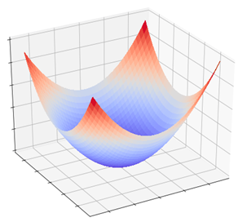
Gradient Descent
The challenge is, all the weights in all the inputs of all the neurons need to be adjusted. It is not manually possible to find the right combination of weights using brute force. Instead, the neural network algorithm uses a learning function called gradient descent
Convex error function
A random combination of bias B1 and input weights W1 (showing only one as more than one is not possible to visualize)
Each combination of W1 and B1 is one particular linear model in a neuron. That model is associated with proportionate error e1 (red dashed line).
Objective is to drive e1 towards 0. For which we need to find the optimal weight (Woptimal) and bias (Boptimal)
The algorithm uses gradient descent algorithm to change bias and weight form starting values of B1 and W1 towards the Boptimal, Woptimal.
Note: in 3D error surface can be visualized as shown but not in more than 3 dimensions
Error
e1
Bias
w1
B1
Weight

Slide 48
Gradient Descent
Actual y1 given X1
Predicted y1 given X1
e1
w1
Happens at every node
Error
e1
Least error E2 is at the global minima of the convex function which only one unique combination of weight (woptimal) and bias (boptimal) will fetch us.
e2
Bias
w1
Boptimal
B1
Woptimal
Weight

Slide 49
Gradient Descent
Let target value for a training example X be y i.e. The data frame used for training has value X,y
Let the model (represented by random m and c) predict the value for the training example X to be yhat
Error in prediction is E = yhat – y. If we sum all the errors across all data points, some will be positive some negative and thus cancel out
To prevent the sum of errors becoming 0, we square the error i.e. E = (y – yhat)^2. Note: in squared expression, y – yhat or yhat – y mean the same
Sum of (y – yhat)^2 across all the X values is called SSE (Sum of Squared Errors)
Using gradient descent (descend towards the global minima). Gradient descent uses partial derivatives i.e how the SSE changes on slightly modifying the model parameters m and c one at a time
d(E) / d(m) = d(sum(yhat – y)^2) / d(m)
d(E) / d(c) = d(sum(yhat – y)^2) / d(c)

Slide 50
Gradient Descent
Gradient descent is a way to minimize an objective function / cost function such as Sum of Squared Errors (SSE) that is dependent on model parameters of weight / slope and bias
The parameters are updated in the direction opposite to the direction of the gradient (direction of maximum increase) of the objective function
In other words we change the values of weight and bias following the direction of the slope of the surface of the error function down the hill until we reach minima
This movement from starting weight and bias to optimal weight and bias may not happen in one shot. It is likely to happen in multiple iterations. The values change in steps
The step size can be influenced using a parameter called Learning Rate. It decides the size of the steps i.e. the amount by which the parameters are updated. Too small learning step will slow down the entire process while too large may lead to an infinite loop
The mathematical expression of gradient descent
learning step
Update Model parameter at e2
Old Model parameter at e1
Gradient descent with learning step

Slide 51
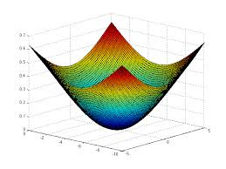
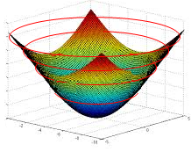

Gradient Descent
Transform our error function (which is a quadratic / convex function) into a contour graph. Gradient is always found on the input model parameters only
Every ring on the error function represents a combination of coefficients (m1 and m2 in the image) which result in same quantum of error i.e. SSE
Let us convert that to a 2d contour plot. In the contour plot, every ring represents one quantum of error.
The innermost ring / bull’s eye is the combination of the coefficients that gives the lease SSE
Bias
weight

Slide 52

Randomly selected starting point
About the contour graph –
Outermost circle is highest error while innermost is the least error circle
A circle represents combination of paramters which result in same error. Moving on a circle will not reduce error.
Objective is to start from anywhere but reach the innermost circle
B1
W1
Bias
weight
Gradient Descent Steps –
First evaluate dy(error)/d(weight) to find the direction of highest increase in error given a unit change in weight (Blue arrow). Partial derivative w.r.t. to weight
Next find dy(error) /d(bias) to find the direction of highest increase in error given a unit change in bias (green arrow). Partial derivative w.r.t. to bias
Partial derivatives give the gradient in the given axis and gradient is a vector
Add the two vectors to get the direction of gradient (black arrow) i.e. direction of max increase in error
We want to decrease error, so find negative of the gradient i.e. opposite to black arrow ( Orange arrow). The arrow tip is new value of bias and weight.
Recalculate the error at this combination an iterate to step 1 till movement in any direction only increases the error
Gradient vector

Slide 53
Thank You

