Slide 1
BOOTSTRAP

Slide 2
WHAT IS RESPONSIVE WEB DESIGN?
Responsive web design is about creating web sites which automatically adjust themselves to look good on all devices, from small phones to large desktops.
Bootstrap is the most popular HTML, CSS, and JavaScript framework for developing responsive, mobile-first web sites.
Bootstrap is completely free to download and use!

Slide 3


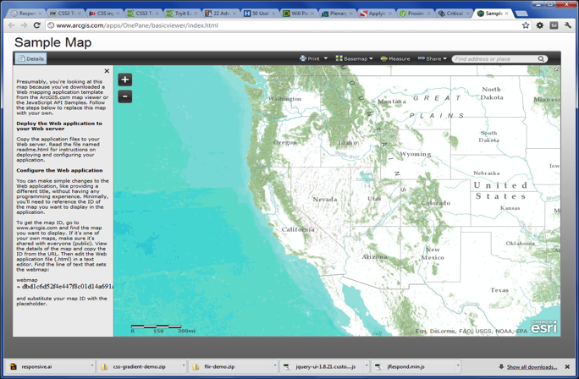
DEFAULT BEHAVIOR

Slide 4
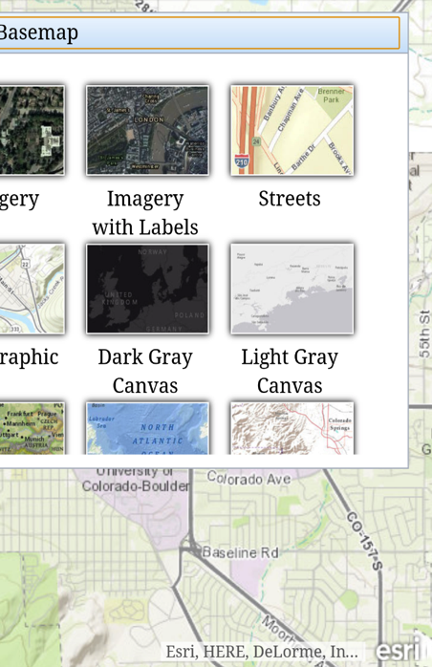
DEFAULT BEHAVIOR

Slide 5

RESPONSIVE DESIGN
Single web app that works well across a variety of devices/screen sizes
Re-use content and software
Considers
  Device limitations
  User’s behavior

Slide 6
RESPONSIVE DESIGN
CSS Media Queries
Fluid Grid System

Slide 7
CSS MEDIA QUERIES
Detect device screen size and orientation
Apply CSS at specific break points
Typical: 480px, 768px, 1024px, 1280px

Slide 8
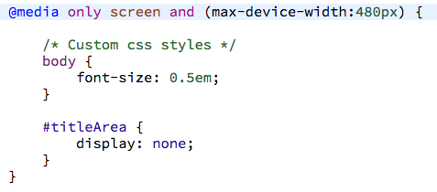
CSS MEDIA QUERIES

Slide 9
FLUID GRID SYSTEM
Layout adapts to different screen sizes
Based on percentages
12 column / 960px

Slide 10
BOOTSTRAP FLUID GRID CSS
<div class="col-xs-12 col-sm-8>
Define Column
Number of
Columns
Device Size

Slide 11
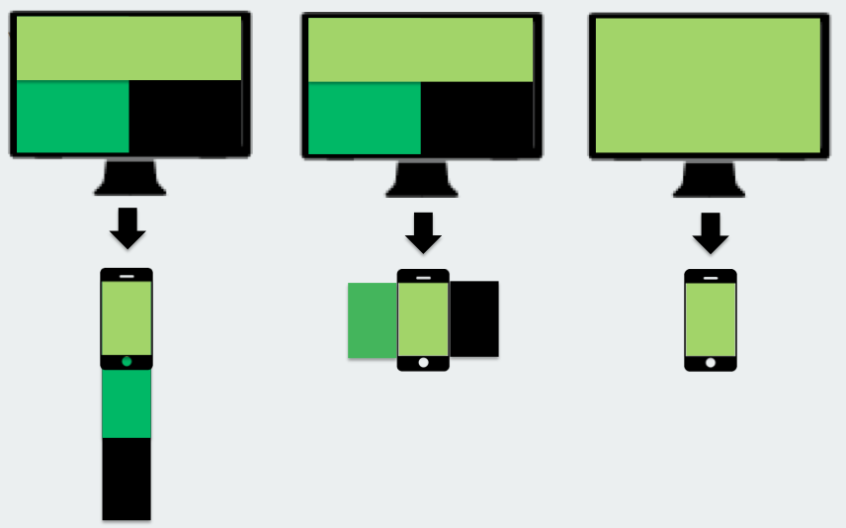
RESPONSIVE GRID LAYOUTS

Slide 12

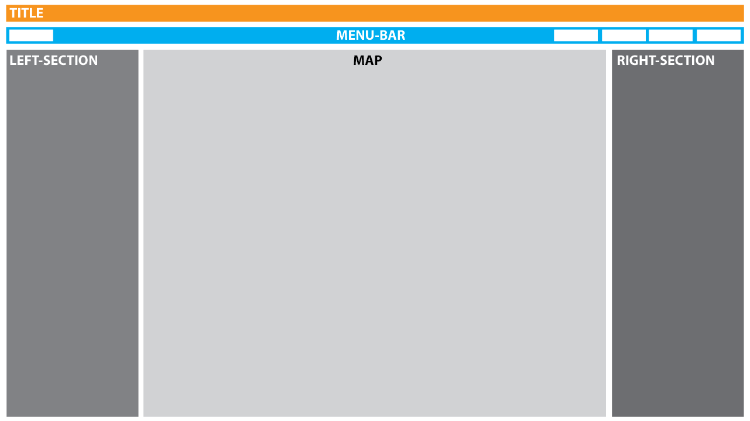
LARGE: 3 ROWS - 3 COLUMNS
>= 1280px

Slide 13
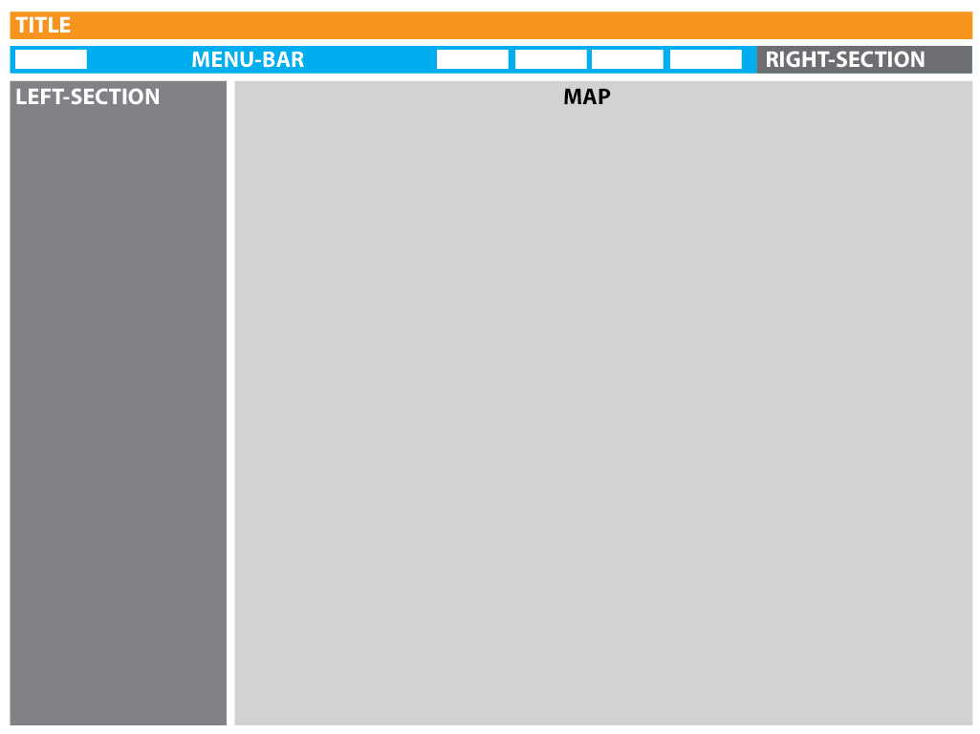
MEDIUM: 2 COLUMNS
1024 - 1280px

Slide 14


SMALL: SINGLE COLUMN
768 - 1024px

Slide 15
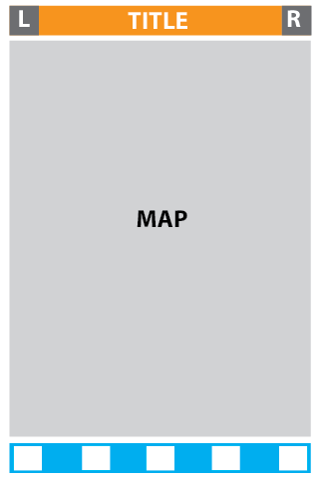
EXTRA SMALL: 1 COLUMN, MINIMIZED
=< 768px

Slide 16
RESPONSIVE APPLICATION

Slide 17
WHAT IS BOOTSTRAP?
Bootstrap is a free front-end framework for faster and easier web development
Bootstrap includes HTML and CSS based design templates for typography, forms, buttons, tables, navigation, modals, image carousels and many other, as well as optional JavaScript plugins
Bootstrap also gives you the ability to easily create responsive designs

Slide 18
BOOTSTRAP HISTORY
Bootstrap was developed by Mark Otto and Jacob Thornton at Twitter, and released as an open source product in August 2011 on GitHub.
Advantages of Bootstrap:
  Easy to use: Anybody with just basic knowledge of HTML and CSS can start using Bootstrap
  Responsive features: Bootstrap's responsive CSS adjusts to phones, tablets, and desktops
  Mobile-first approach: In Bootstrap 3, mobile-first styles are part of the core framework
  Browser compatibility: Bootstrap is compatible with all modern browsers (Chrome, Firefox, Internet Explorer, Safari, and Opera)

Slide 19
WHERE TO GET BOOTSTRAP?
There are two ways to start using Bootstrap on your own web site.
  Download Bootstrap from getbootstrap.com
    If you want to download and host Bootstrap yourself, go to getbootstrap.com, and follow the instructions there.
  Include Bootstrap from a CDN
    If you don't want to download and host Bootstrap yourself, you can include it from a CDN (Content Delivery Network).
    MaxCDN provides CDN support for Bootstrap's CSS and JavaScript. You must also include jQuery.

Slide 20
BOOTSTRAP CDN
You must include the following Bootstrap’s CSS, JavaScript, and jQuery from MaxCDN into your web page.
<!-- Latest compiled and minified Bootstrap CSS -->
<link rel="stylesheet"href="https://maxcdn.bootstrapcdn.com/bootstrap/3.3.7/css/bootstrap.min.css">
<!-- Latest compiled Bootstrap JavaScript -->
<script src="https://maxcdn.bootstrapcdn.com/bootstrap/3.3.7/js/bootstrap.min.js"></script>
<!-- latest jQuery library -->
<script src="https://code.jquery.com/jquery-latest.js"></script>
Advantage of using the Bootstrap CDN:
  Many users already have downloaded Bootstrap from MaxCDN when visiting another site. As a result, it will be loaded from cache when they visit your site, which leads to faster loading time. Also, most CDN's will make sure that once a user requests a file from it, it will be served from the server closest to them, which also leads to faster loading time.

Slide 21
CREATE WEB PAGE WITH BOOTSTRAP
Add the HTML5 doctype
  Bootstrap uses HTML elements and CSS properties that require the HTML5 doctype.
  Always include the HTML5 doctype at the beginning of the page, along with the lang attribute and the correct character set:
  <!DOCTYPE html>
  <html lang="en">
  <head>
  <meta charset="utf-8">
  </head>
  </html>

Slide 22
CREATE WEB PAGE WITH BOOTSTRAP
Bootstrap is mobile-first
  Bootstrap 3 is designed to be responsive to mobile devices. Mobile-first styles are part of the core framework.
  To ensure proper rendering and touch zooming, add the following <meta> tag inside the <head> element:
  <meta name="viewport" content="width=device-width, initial-scale=1">
  The width=device-width part sets the width of the page to follow the screen-width of the device (which will vary depending on the device).
  The initial-scale=1 part sets the initial zoom level when the page is first loaded by the browser.

Slide 23
CREATE WEB PAGE WITH BOOTSTRAP
Containers
  Bootstrap also requires a containing element to wrap site contents.
  There are two container classes to choose from:
    The .container class provides a responsive fixed width container. (See Sample)
    The .container-fluid class provides a full width container, spanning the entire width of the viewport. (See Sample)
Note: Containers are not nestable (you cannot put a container inside another container).

Slide 24
BOOTSTRAP GRIDS
Bootstrap’s grid system allows up to 12 columns across the page.
If you do not want to use all 12 columns individually, you can group the columns together to create wider columns:
<div class="col-md-12">Span 12 columns</div>
<div class="col-md-6">Span 6</div><div class="col-md-6">Span 6</div>
<div class="col-md-4">Span 4</div><div class="col-md-8">Span 8</div>
<div class="col-md-4">Span 4</div><div class="col-md-4">Span 4</div> <div class="col-md-4">Span 4</div>
Bootstrap's grid system is responsive, and the columns will re-arrange automatically depending on the screen size.

Slide 25
GRID CLASSES
The Bootstrap grid system has four classes:
  xs (for phones)
  sm (for tablets)
  md (for desktops)
  lg (for larger desktops)
The classes above can be combined to create more dynamic and flexible layouts.

Slide 26
BASIC STRUCTURE OF A BOOTSTRAP GRID
<div class="row">
<div class="col-*-*"></div>
</div>
<div class="row">
<div class="col-*-*"></div>
<div class="col-*-*"></div>
<div class="col-*-*"></div>
</div>
<div class="row">
...
</div>
First; create a row (<div class="row">). Then, add the desired number of columns (tags with appropriate .col-*-*classes). Note that numbers in .col-*-* should always add up to 12 for each row.

Slide 27
BOOTSTRAP TABLES
A basic Bootstrap table has a light padding and only horizontal dividers.
  The .table class adds basic styling to a table:
Striped Rows
  The .table-striped class adds zebra-stripes to a table:
Bordered Table
  The .table-bordered class adds borders on all sides of the table and cells:
Hover Rows
  The .table-hover class enables a hover state on table rows:
Responsive Tables
  The .table-responsive class creates a responsive table. The table will then scroll horizontally on small devices (under 768px). When viewing on anything larger than 768px wide, there is no difference:

Slide 28
BOOTSTRAP IMAGES
Rounded Corners
  The .img-rounded class adds rounded corners to an image (IE8 does not support rounded corners):
Circle
  The .img-circle class shapes the image to a circle (IE8 does not support rounded corners):
Thumbnail
  The .img-thumbnail class shapes the image to a thumbnail:
Responsive Images
  Images comes in all sizes. So do screens. Responsive images automatically adjust to fit the size of the screen.
  Create responsive images by adding an .img-responsive class to the <img> tag. The image will then scale nicely to the parent element.
  The .img-responsive class applies display: block; and max-width: 100%; and height: auto; to the image:

Slide 29
BOOTSTRAP BUTTONS
Button Styles
  Bootstrap provides seven styles of buttons with the following classes:
.btn-default
.btn-primary
.btn-success
.btn-info
.btn-warning
.btn-danger
.btn-link

Slide 30
BOOTSTRAP BUTTON ELEMENTS
The button classes can be used on the following elements:
  <a>
  <button>
  <input>

Slide 31
BUTTON SIZES
Bootstrap provides four button sizes with the following classes:
.btn-lg
.btn-md
.btn-sm
.btn-xs

Slide 32
BLOCK LEVEL BUTTONS
A block level button spans the entire width of the parent element.
  Add class .btn-block to create a block level button:

Slide 33
ACTIVE/DISABLED BUTTONS
A button can be set to an active (appear pressed) or a disabled (unclickable) state:
  The class .active makes a button appear pressed, and the class .disabled makes a button unclickable:

Slide 34
THANK YOU ☺

