Slide 1


JAVASCRIPT - BASIC CONCEPTS

Slide 2
TABLE OF CONTENT
JavaScript in Nutshell
DOM Structure
Accessing Elements
Embedding JavaScript in HTML
Data Types
ES6 Features
Expressions
Objects & Functions - Defining - Calling
Event Handlers

Slide 3
JAVASCRIPT IN NUTSHELL
  a lightweight programming language ("scripting language")
  used to make web pages interactive
  insert dynamic text into HTML (ex: username)
  react to events (ex: page load user click)
  get information about a user's computer (ex: browser type)
  perform calculations on user's computer (ex: form validation)

Slide 4
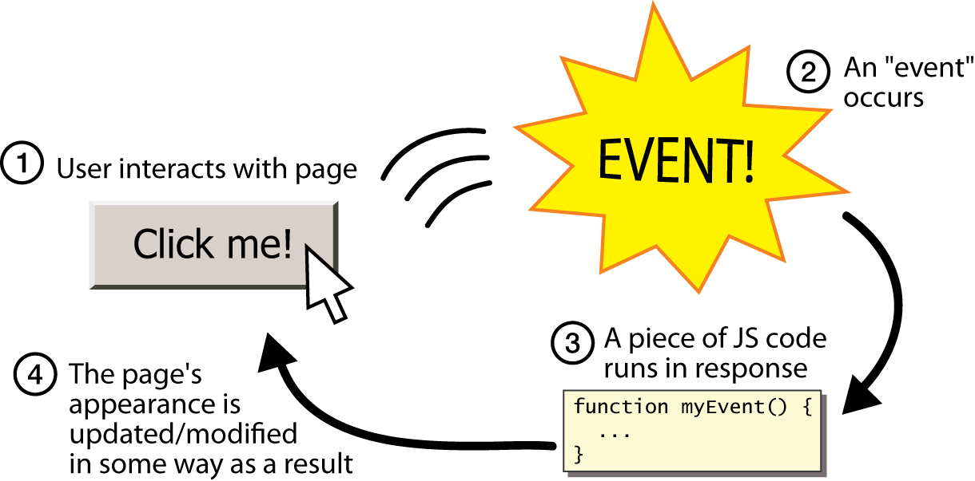
EVENT-DRIVEN PROGRAMMING
split breaks apart a string into an array using a delimiter
  can also be used with regular expressions (seen later)
join merges an array into a single string, placing a delimiter between them

Slide 5
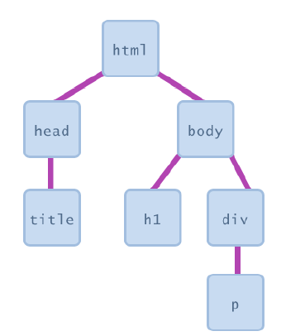
DOCUMENT OBJECT MODEL (DOM)
    JS code manipulates elements on an HTML page
    we can examine elements' state like see whether a box is checked
    Insert some new text into a div
    we can change styles

Slide 6
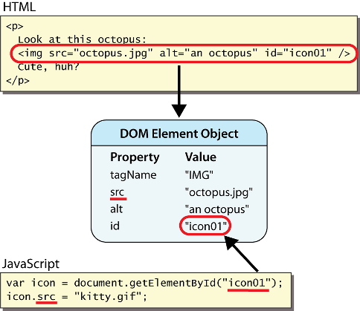
DOM ELEMENT OBJECTS
Notes:
every element on the page has a corresponding DOM object access/modify the attributes of the DOM object with objectName.attributeName

Slide 7
ACCESSING ELEMENTS: DOCUMENT.GETELEMENTBYID
var name = document.getElementById("id");
JS
<button onclick="changeText();">Click me!</button>
<span id="output">replace me</span>
<input id="textbox" type="text" /> HTML
function changeText() {
var span = document.getElementById("output");
var textBox = document.getElementById("textbox");
textbox.style.color = "red";
} JS
Notes:
span.innerHTML = textBox.value;

Slide 8
ACCESSING ELEMENTS: DOCUMENT.GETELEMENTBYID
document.getElementById returns the DOM object for an element with a given id
can change the text inside most elements by setting the innerHTML property
can change the text in form controls by setting the value property

Slide 9
EMBEDDING JAVASCRIPT IN HTML
By using the SCRIPT tag
By specifying a file of JavaScript code
By specifying a JavaScript expression as the value for an HTML attribute
By using event handlers within certain other HTML tags

Slide 10
SCRIPT TAG
The <SCRIPT> tag is an extension to HTML that can enclose any number of JavaScript statements as shown here:
<SCRIPT>
JavaScript statements...
</SCRIPT>
A document can have multiple SCRIPT tags, and each can enclose any number of JavaScript statements.

Slide 11
HIDING SCRIPTS IN COMMENT TAGS
<SCRIPT>
<!-- Begin to hide script contents from old browsers.
JavaScript statements...
// End the hiding here. -->
</SCRIPT>

Slide 12
FAMOUS “HELLO WORLD” PROGRAM
<html>
<body>
<script language="JavaScript">
document.write(“Hello, World!”)
</script>
</body>
</html>

Slide 13
JAVASCRIPT CODE IN A FILE
The SRC attribute of the <SCRIPT> tag lets you specify a file as the JavaScript source (rather than embedding the JavaScript in the HTML).
This attribute is especially useful for sharing functions among many different pages.

Slide 14
EXAMPLE
<HEAD>
<TITLE>My Page</TITLE>
<SCRIPT SRC="common.js">
………….
</SCRIPT>
</HEAD>
<BODY>
………….

Slide 15
DATA TYPES

Slide 16
VARIABLES
var name = expression; JS
var clientName = "Connie Client";
var age = 32;
var weight = 127.4; JS
variables are declared with the var keyword (case sensitive)
types are not specified, but JS does have types ("loosely typed")
  Number, Boolean, String, Array, Object, Function, Null, Undefined
  can find out a variable's type by calling typeof

Slide 17
NUMBER TYPE
var enrollment = 99;
var medianGrade = 2.8;
var credits = 5 + 4 + (2 * 3); JS
integers and real numbers are the same type (no int vs. double)
same operators: + - * / % ++ -- = += -= *= /= %=
similar precedence to Java
many operators auto-convert types: "2" * 3 is 6

Slide 18
COMMENTS
// single-line comment
/* multi-line comment */ JS
identical to Java's comment syntax
recall: 4 comment syntaxes
  HTML: <!-- comment -->
  CSS/JS/PHP: /* comment */

Slide 19
MATH OBJECT
var rand1to10 = Math.floor(Math.random() * 10 + 1);
var three = Math.floor(Math.PI); JS
methods: abs, ceil, cos, floor, log, max, min, pow, random, round, sin, sqrt, tan
properties: E, PI

Slide 20
SPECIAL VALUES: NULL AND UNDEFINED
var ned = null;
var benson = 9;
// at this point in the code,
// ned is null
// benson's 9
// caroline is undefined JS
undefined : has not been declared, does not exist
null : exists, but was specifically assigned an empty or null value
Why does JavaScript have both of these?

Slide 21
LOGICAL OPERATORS
> < >= <= && || ! == != === !==
most logical operators automatically convert types:
  5 < "7" is true
  42 == 42.0 is true
  "5.0" == 5 is true
=== and !== are strict equality tests; checks both type and value
  "5.0" === 5 is false

Slide 22
IF/ELSE STATEMENT
if (condition) {
statements;
} else if (condition) {
statements;
} else {
statements;
}
JS
identical structure to Java's if/else statement
JavaScript allows almost anything as a condition

Slide 23
BOOLEAN TYPE
var iLike190M = true;
var ieIsGood = "IE6" > 0; // false
if ("web devevelopment is great") { /* true */ }
if (0) { /* false */ } JS
any value can be used as a Boolean
  "falsey" values: 0, 0.0, NaN, "", null, and undefined
  "truthy" values: anything else
converting a value into a Boolean explicitly:
  var boolValue = Boolean(otherValue);
  var boolValue = !!(otherValue);

Slide 24
FOR LOOP
var sum = 0;
for (var i = 0; i < 100; i++) {
sum = sum + i;
} JS
var s1 = "hello";
var s2 = "";
for (var i = 0; i < s.length; i++) {
s2 += s1.charAt(i) + s1.charAt(i);
}
// s2 stores "hheelllloo" JS

Slide 25
WHILE LOOPS (SAME AS JAVA)
while (condition) {
statements;
} JS
do {
  statements;
} while (condition); JS
break and continue keywords also behave as in Java

Slide 26
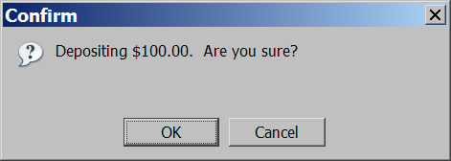
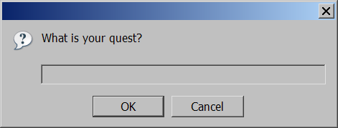
POPUP BOXES
alert("message"); // message
confirm("message"); // returns true or false
prompt("message"); // returns user input string JS

Slide 27
ARRAYS
var name = []; // empty array
var name = [value, value, ..., value]; // pre-filled
name[index] = value; // store element JS
var ducks = ["Huey", "Dewey", "Louie"];
var stooges = []; // stooges.length is 0
stooges[0] = "Larry"; // stooges.length is 1
stooges[1] = "Moe"; // stooges.length is 2
stooges[4] = "Curly"; // stooges.length is 5
stooges[4] = "Shemp"; // stooges.length is 5 JS
Notes:
two ways to initialize an array
length property (grows as needed when elements are added)

Slide 28
ARRAY METHODS
var a = ["Stef", "Jason"]; // Stef, Jason
a.push("Brian"); // Stef, Jason, Brian
a.unshift("Kelly"); // Kelly, Stef, Jason, Brian
a.pop(); // Kelly, Stef, Jason
a.shift(); // Stef, Jason
a.sort(); // Jason, Stef JS
array serves as many data structures: list, queue, stack, ...
methods: concat, join, pop, push, reverse, shift, slice, sort, splice, toString, unshift
  push and pop add / remove from back
  unshift and shift add / remove from front
  shift and pop return the element that is removed

Slide 29
STRING TYPE
var s = "Connie Client";
var fName = s.substring(0, s.indexOf(" ")); // "Connie"
var len = s.length; // 13
var s2 = 'Melvin Merchant'; JS
methods: charAt, charCodeAt, fromCharCode, indexOf, lastIndexOf, replace, split, substring, toLowerCase, toUpperCase
  charAt returns a one-letter String (there is no char type)
length property (not a method as in Java)
Strings can be specified with "" or ''
concatenation with + :
  1 + 1 is 2, but "1" + 1 is "11"

Slide 30
MORE ABOUT STRING
escape sequences behave as in Java: \' \" \& \n \t \\
converting between numbers and Strings:
var count = 10;
var s1 = "" + count; // "10"
var s2 = count + " bananas, ah ah ah!"; // "10 bananas, ah ah ah!"
var n1 = parseInt("42 is the answer"); // 42
var n2 = parseFloat("booyah"); // NaN JS
var firstLetter = s[0]; // fails in IE
var firstLetter = s.charAt(0); // does work in IE
var lastLetter = s.charAt(s.length - 1); JS

Slide 31
SPLITTING STRINGS: SPLIT AND JOIN
var s = "the quick brown fox";
var a = s.split(" "); // ["the", "quick", "brown", "fox"]
a.reverse(); // ["fox", "brown", "quick", "the"]
s = a.join("!"); // "fox!brown!quick!the" JS
split breaks apart a string into an array using a delimiter
  can also be used with regular expressions (seen later)
join merges an array into a single string, placing a delimiter between them

Slide 32
ES6 FEATURES
Default Parameters in ES6
Template Literals in ES6
Multi-line Strings in ES6
De-structuring Assignment in ES6
Arrow Functions in ES6
Promises in ES6
Block-Scoped Constructs Let and Const
Classes in ES6

Slide 33
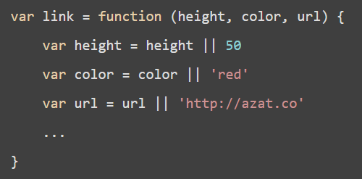
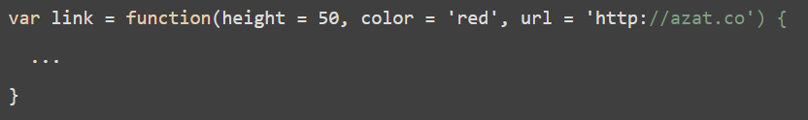
DEFAULT PARAMETERS IN ES6

Slide 34


TEMPLATE LITERALS IN ES6

Slide 35
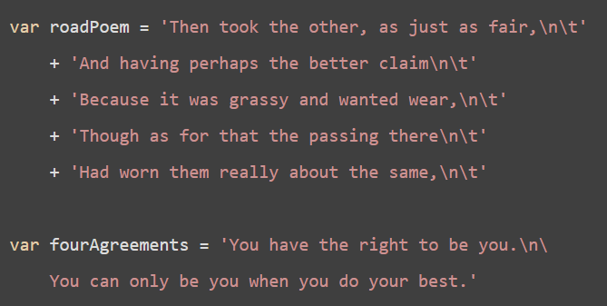
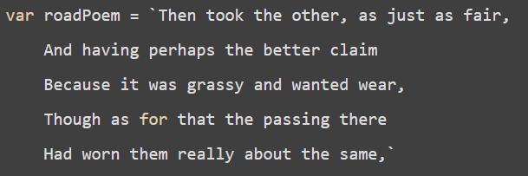
MULTI-LINE STRINGS

Slide 36
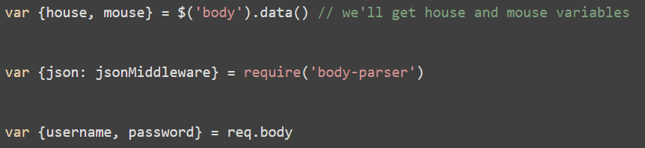
DE-STRUCTURING ASSIGNMENT

Slide 37
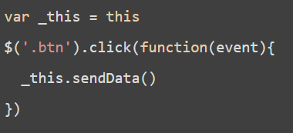
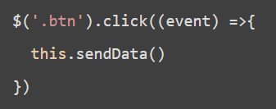
ARROW FUNCTIONS IN ES6

Slide 38
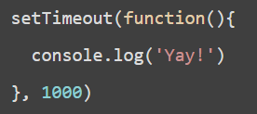
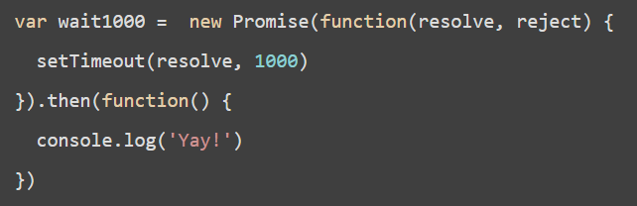
PROMISES IN ES6

Slide 39
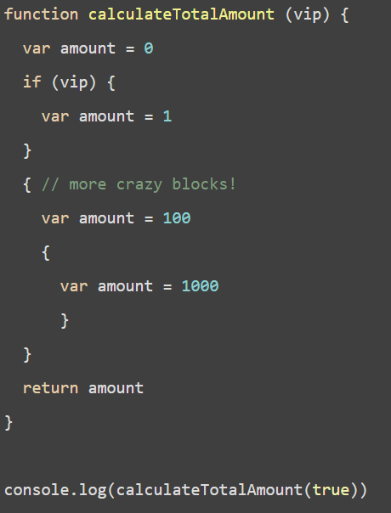
BLOCK-SCOPED CONSTRUCTS LET AND CONST

Slide 40
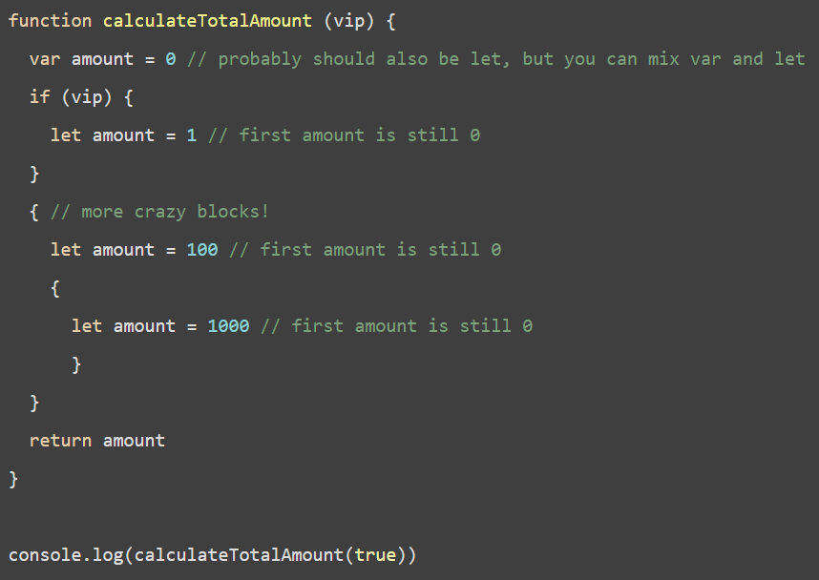
CONTINUE…

Slide 41
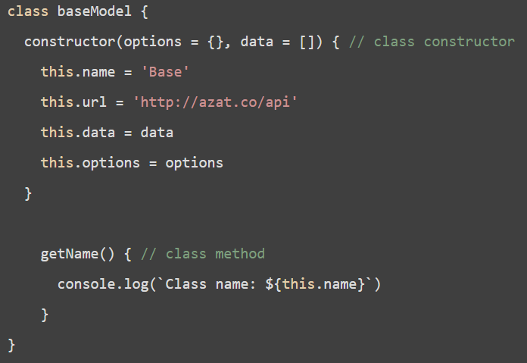
CLASSES IN ES6

Slide 42

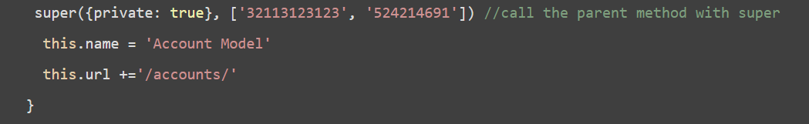
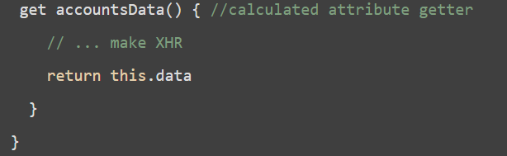
CONTINUE…

Slide 43
EXPRESSIONS
An expression is any valid set of literals, variables, operators, and expressions that evaluates to a single value; the value can be a number, a string, or a logical value.

Slide 44
EXPRESSIONS (CONT’D)
JavaScript has the following types of expressions:
Arithmetic: evaluates to a number, for example 3.14159
String: evaluates to a character string, for example, "Fred" or "234"
Logical: evaluates to true or false

Slide 45
DATATYPE CONVERSION
  JavaScript is a loosely typed language. That means you do not have to specify the data type of a variable when you declare it, and data types are converted automatically as needed during script execution. So, for example, you could define a variable as follows: var answer = 42
  And later, you could assign the same variable a string value, for example, answer = "Thank you"

Slide 46
DATATYPE CONVERSION (CONT’D)
In expressions involving numeric and string values, JavaScript converts the numeric values to strings. For example, consider the following statements:
x = "The answer is " + 42
y = 42 + " is the answer."

Slide 47
DEFINING AND CALLING FUNCTIONS
    Functions are one of the fundamental building blocks in JavaScript. A function is a JavaScript procedure--a set of statements that performs a specific task. A function definition has these basic parts:
    The function keyword.
    A function name.
    A comma-separated list of arguments to the function in parentheses.
    The statements in the function in curly braces.

Slide 48
FUNCTIONS EXAMPLE
      <HEAD>
      <SCRIPT LANGUAGE="JavaScript">
      function square(number) {
      return number * number
      }
      </SCRIPT>
      </HEAD>
      <BODY>
      <SCRIPT>
      document.write("The function returned ", square(5), ".")
      </SCRIPT>
      <P> All done.
      </BODY>

Slide 49
EVENT HANDLERS
  JavaScript applications in the Navigator are largely event-driven. Events are actions that occur usually as a result of something the user does. For example, clicking a button is an event, as is changing a text field or moving the mouse over a hyperlink. You can define event handlers, such as onChange and onClick, to make your script react to events.

Slide 50
EVENT HANDLER (CONT’D)
Here’re a few event handler function
onAbort: user aborts the loading
onClick: user clicks on the link
onChange: user changes value of an element
onFocus: user gives input focus to window
onLoad: user loads page in Navigator

Slide 51
EXAMPLE OF EVENT HANDLER
    <HEAD>
    <SCRIPT>
    function compute(f) {
    if (confirm("Are you sure?"))
    f.result.value = eval(f.expr.value)
    else
    alert("Please come back again.")
    }
    </SCRIPT>
    </HEAD>
    <BODY>
    <FORM>
    Enter an expression:
    <INPUT TYPE="text" NAME="expr" SIZE=15 >
    <INPUT TYPE="button" VALUE="Calculate" onClick="compute(this.form)">
    <BR>
    Result:
    <INPUT TYPE="text" NAME="result" SIZE=15 >
    </FORM>
    </BODY>

Slide 52
Thank You ☺

