Slide 1

NODE Application

Slide 2
Node.js application components
Import required modules
Create server
Read request and return response

Slide 3
Import Required Module
We use the require directive to load the http module and store the returned HTTP instance into an http variable as follows :
Var http = require(“http”);

Slide 4
Create Server
We use the created http instance and call http.createServer() method to create a server instance and then we bind it at port 8081 using the listen method associated with the server instance.

Slide 5
Continue…
http.createServer(function (request, response) {
// Send the HTTP header
// HTTP Status: 200 : OK
// Content Type: text/plain
response.writeHead(200, {'Content-Type': 'text/plain'});
// Send the response body as "Hello World"
response.end('Hello World\n');
}).listen(8081);
// Console will print the message
console.log('Server running at http://127.0.0.1:8081/');

Slide 6
execute the main.js
$ node main.js
'Server running at http://127.0.0.1:8081/

Slide 7
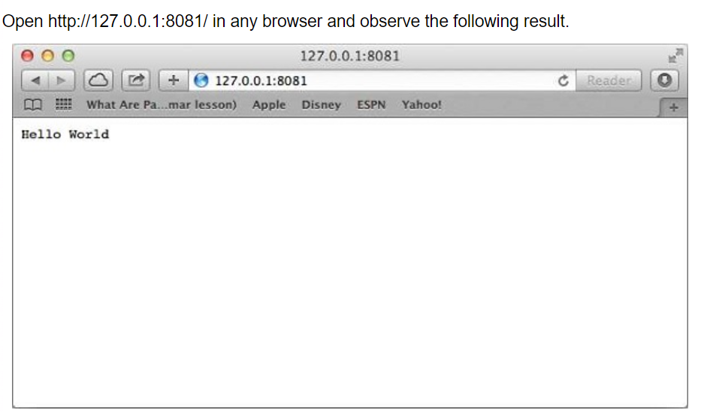
Make a Request to the Node.js Server

Slide 8
Thank you ☺

