Slide 1

Getting Started
What‘s Inside this Course?

Slide 2
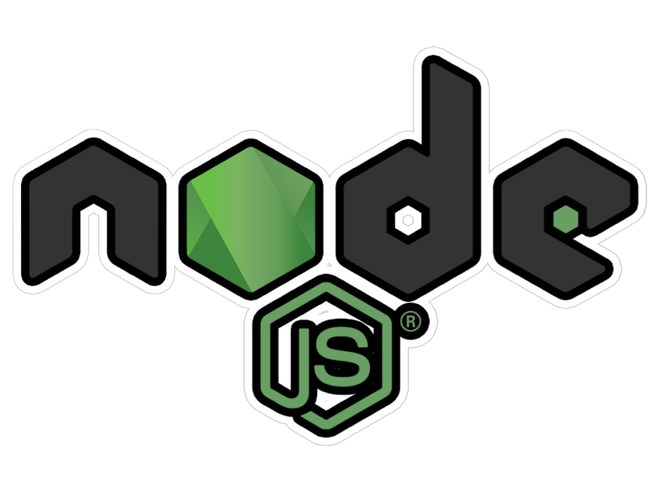
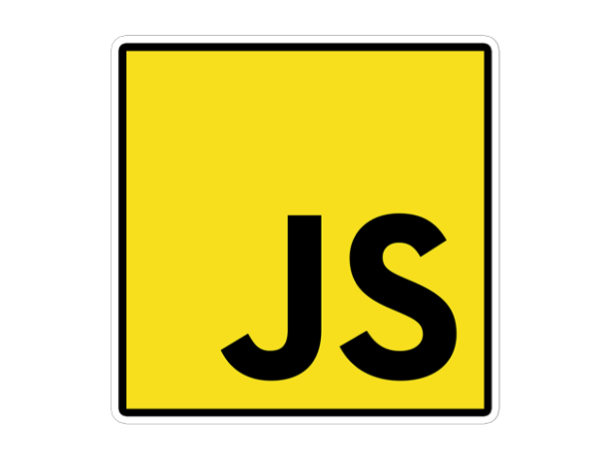
What is Node.js?
A JavaScript Runtime
“JavaScript on the Server”

Slide 3
Continue…
Node.js is a powerful framework developed on Chrome’s V8 JavaScript engine which is one of the fastest JavaScript engine available in the market.
It compiles JavaScript code directly into the native machine code which eventually results in higher efficiency of the applications built with Node.js.
It is a lightweight framework and is heavily used for developing server-side web applications.

Slide 4

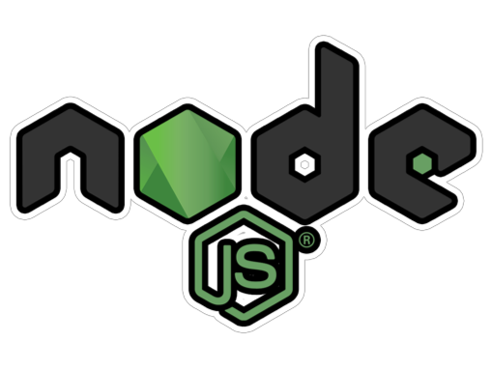




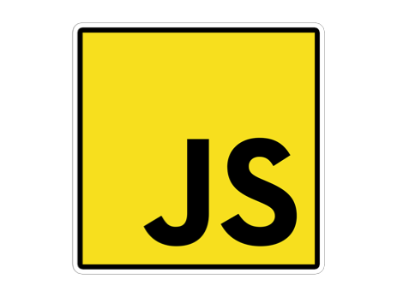
What Does That Mean?
Adds JS Features
uses
Written in
Compiles to
C++
Machine Code
Compiles JavaScript

Slide 5




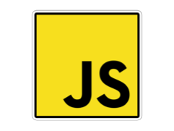

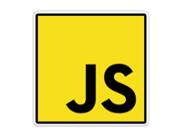


JavaScript on the Server
https://my-page.com
Database
Server
Authentication
Input Validation
Can‘t access server-side Code
Your Business Logic
Request
Response “HTML Page”
Client (Browser)

Slide 6
Features of Node.js
Open Source Node.js is an open source framework MIT license that is supported by a huge community. Its community is pretty much active have contributed to add new capabilities to Node.js applications.
Simple and Fast Since Node.js is built on Google Chrome’s V8 JavaScript Engine, its libraries are capable of fast code execution.
Asynchronous All the libraries of Node.js are asynchronous which means the Node.js based servers never wait for an API to send back the response and move on to the next API.
High Scalability Because of the event mechanism, Node.js is highly scalable and aids the server in a non-blocking response.
Single-Threaded With the help of event looping, Node.js is able to follow the single-threaded model. This lets a single program to handle multiple requests.
No Buffering One of the major functionalities of Node.js applications is that it never buffers any data.
Cross-Platform Node.js can be easily built and deployed on various platforms like Windows, MAC, and Linux.

Slide 7
Node.JS Role - Web Development
Run Server
Create Server & Listen to Incoming Requests
Business Logic
Handle Requests, Validate Input, Connect to Database
Responses
Return Responses (Rendered HTML, JSON, …)

Slide 8
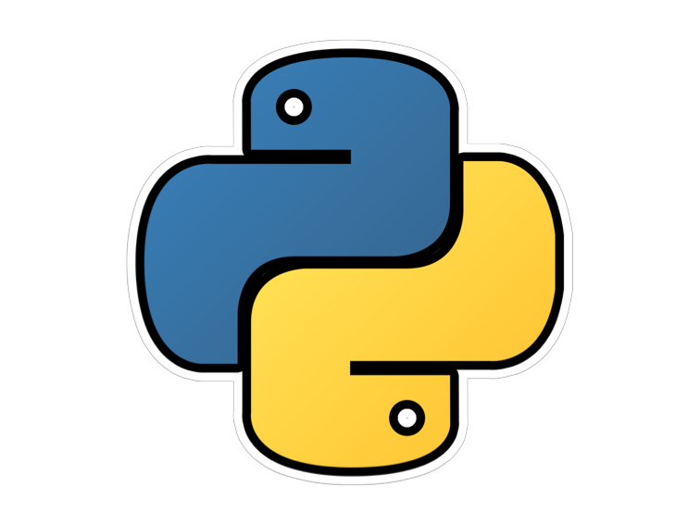


Alternatives
And More (Ruby, ASP.NET, …)
Ultimately, you can build the same web apps with all of them
Choose your preferred syntax, community, ecosystem

Slide 9
Node.js Modules
Core Modules
Local Modules
Third-Party Modules

Slide 10
Core Module
Since Node.js is a very lightweight framework, the core modules bundle the absolute minimum functionalities.
Core Module | Description
http | Contains classes, methods, and events required to create Node.js HTTP server
url | Contains methods for URL resolution and parsing in Node
querystring | Contains methods to deal with a query string of Node
path | Contains methods to deal with file paths
fs | Contains classes, methods, and events to work with file I/O
util | Contains utility functions that can be useful for programmers

Slide 11
Local Modules
var detail = {
name: function (name) {
console.log('Name: ' + name);
},
domain:function (domain) {
console.log('Domain: ' + domain);
}
};
module.exports = detail;

Slide 12
External Modules
You can use the external or 3rd party modules only by downloading them via NPM. These modules are generally developed by other developers and are free to use. Few of the best external modules are express, react, gulp, mongoose, mocha etc.
npm install --g <module_name>

Slide 13
The REPL CONCEPT
R
ead
Read User Input
E
val
Evaluate User Input
P
rint
Print Output (Result)
L
oop
Wait for new Input

Slide 14
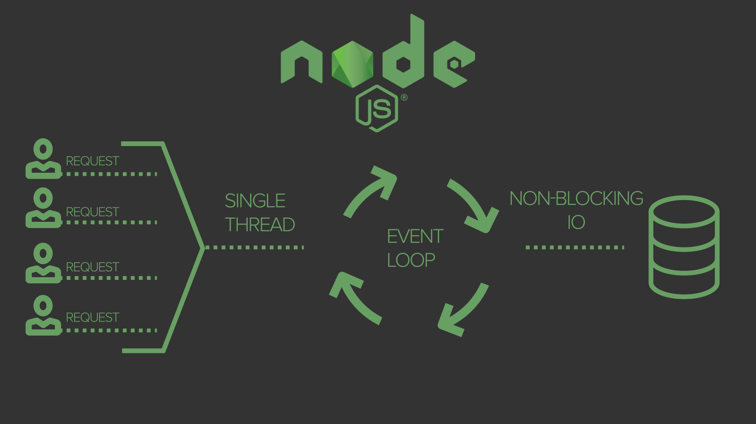

Slide 15
Thank You ☺

