Slide 1

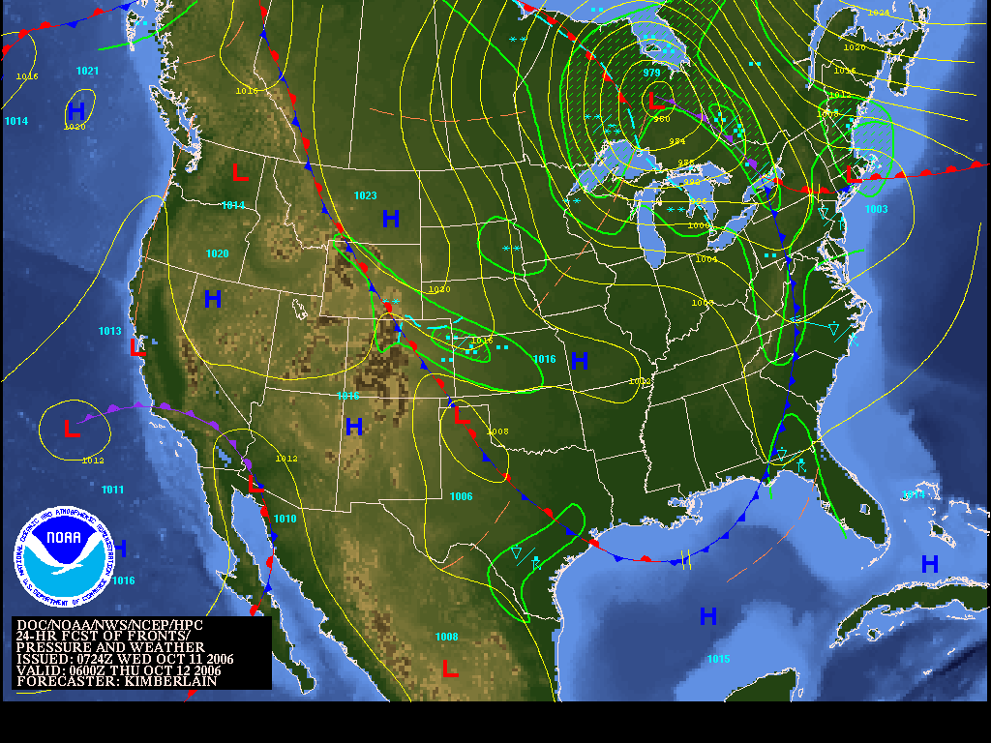
General Meteorology and Their Application Towards Forecasting
National Weather Service Shreveport, LA
www.srh.noaa.gov/shv

Slide 2
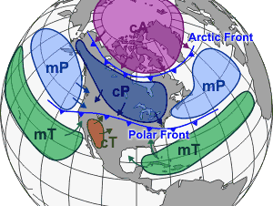
Air Masses
Notes:
An air mass is a large body of air with generally uniform temperature and humidity. The area from which an air mass originates is called a "source region."
Air mass source regions range from extensive snow covered polar areas to deserts to tropical oceans. The United States is not a favorable source region because of the relatively frequent passage of weather disturbances that disrupt any opportunity for an air mass to stagnate and take on the properties of the underlying region. The longer the air mass stays over its source region, the more likely it will acquire the properties of the surface below.
The four principal air mass classifications that influence the continental United States according to their source region are:
1. Polar latitudes - Located poleward of 60° north and south.
2. Continental - Located over large land masses between 25°N/S and 60°N/S.
3. Maritime - Located over the oceans between 25°N/S and 60°N/S
4. Tropical latitudes - Located within about 25° of the equator.
As these air masses move around the earth they can begin to acquire additional attributes. For example, in winter an arctic air mass (very cold and dry air) can move over the ocean, picking up some warmth and moisture from the warmer ocean and becoming a maritime polar air mass (mP) - one that is still fairly cold but contains moisture. If that same polar air mass moves south from Canada into the southern U.S. it will pick up some of the warmth of the ground, but due to lack of moisture it remains very dry. This is called a continental polar air mass (cP).
The Gulf Coast states and the eastern third of the country commonly experience the tropical air mass in the summer. Continental tropical (cT) air is dry air pumped north, off of the Mexican Plateau. If it becomes stagnant over the Midwest, a drought may result. Maritime tropical (mT) air is air from the tropics which has moved north over cooler water.
Air masses can control the weather for a relatively long time period: from a period of days, to months. Most weather occurs along the periphery of these air masses at boundaries called fronts.

Slide 3
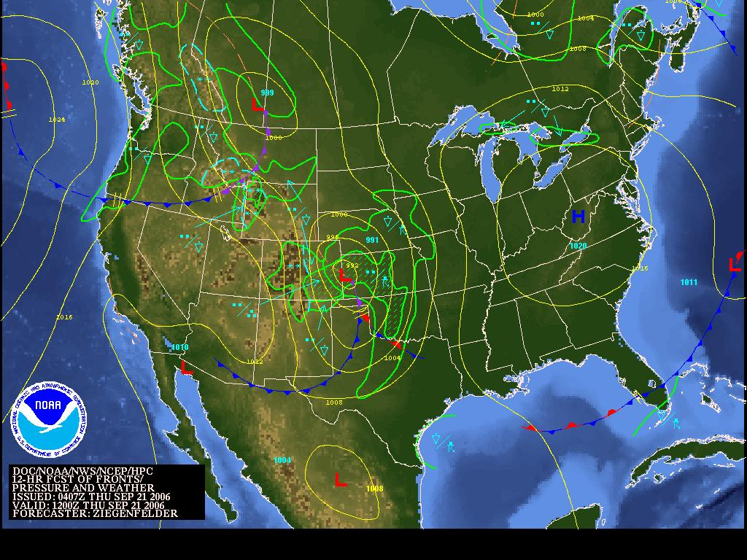
Synoptic Meteorology
Notes:
Synoptic meteorology is primarily concerned with large-scale weather systems, such as extratropical cyclones and their associated fronts and jet streams but not as large as the global scale. We will acquaint the student with the behavior of the atmosphere.
Synoptic means "view together" or "view at a common point". The forecast weather map is for a common point in time, and each of the many different elements that create our weather (e.g. the high and low pressure systems, fronts, and precipitation areas) can be viewed together.
Purpose: While we will not be able to go through the complete meteorology in this class, it is our hope that you will understand some basic fundamentals involved in this topic, and be able to apply them to your life/surroundings.

Slide 4
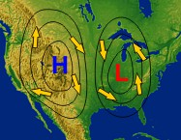
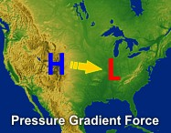
Pressure and Wind
Notes:
High Pressure is depicted by the blue “H” on a weather map, and denotes fair weather over a given location, as the air sinks. This system, or the airflow around it, will rotate clockwise.
Low Pressure is depicted by the red “L” on a weather map, and denotes poor weather over a given location, as the air will rise, giving way to cloud formation, and possibly precipitation. This system, or the airflow around it, will rotate counterclockwise.
We connect these areas or equal pressure with a line. Everywhere along each line is constant pressure. The closer the isobars are packed together the stronger the pressure gradient is. Pressure gradient is the difference in pressure between high and low pressure areas. Wind speed is directly proportional to the pressure gradient. This means the strongest winds are in the areas where the pressure gradient is the greatest.

Slide 5
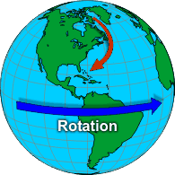
Origin of Wind
Notes:
There are three forces that cause the wind to move as it does. All three forces work together at the same time.
Pressure gradient force (Pgf) is a force that tries to equalize pressure differences. This is the force that causes high pressure to push air toward low pressure. Thus air would flow from high to low pressure if the pressure gradient force was the only force acting on it.
Coriolis force Because of the earth's rotation, there is second force, the Coriolis force that affects the direction of wind flow. This force is what causes objects in the northern hemisphere to turn to the right and objects in the southern hemisphere to turn to the left.
When viewed from space, wind travels in a straight line. However, when view from the Earth, air (as well as other things in flight such as planes and birds) is deflected to the right in the northern hemisphere (red arrow on image). The combination of the two forces would cause the wind to blow parallel to straight isobars with high pressure on the right.
Friction The other force which is the final component to determining the flow of wind. The surface of the earth is rough and it not only slows the wind down but it also causes the diverging winds from highs and converging winds near lows. This is the last of the forces that causes air to spiral out from highs and into lows.

Slide 6
How Do Clouds Form?
In order to understand this process, we must first understand cold/warm air, and their relationship with density.
What is density??? (See experiment)
Notes:
Density represents how molecules behave with one another in a substance or object. If the molecules move slowly, they will become tightly packed, resulting in a higher density. If the molecules move very fast, they will become more and more spaced apart from each other, resulting in a lower density.
Water and air behave very similarly…thus water can be used as a great example of how air parcels, or bubbles of air, can move when heated or cooled. When the air/water is heated, tiny bubbles will form and rise, because they have a lower density that the surrounding air/water. This can be viewed best when performing a “density” experiment.

Slide 7
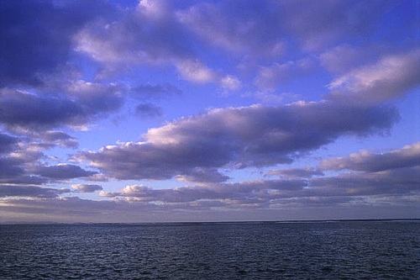
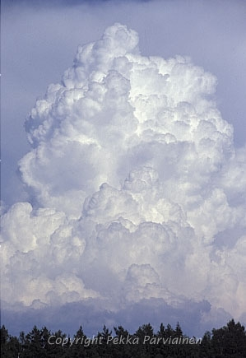
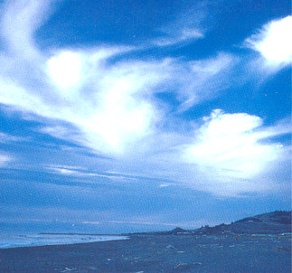
Cloud Formation
Notes:
In order for clouds to form, a lifting mechanism, moisture (water droplets), and condensation nuclei are needed. The density experiment proved that indeed, warm air/water is less dense than cold air/water. Warm air can also serve as a good lifting mechanism needed to produce clouds. As the warm air rises, the air temperature will cool to the dewpoint temperature, the temperature that is needed to reach saturation.
Water droplets form, and will bond onto the condensation nuclei, which will allow other water droplets/condensation nuclei to collide and coalesce. These aerosols consist of suspended solid (dust, smoke, etc) and liquid particles, and provides a surface for the water vapor droplets to adhere to. This collision and coalescence process will make the droplet larger and will eventually form a cloud.
Warm air acts as a good lifting mechanism to aid in the collision/coalescence process, where the condensation nuclei collide with other nuclei, causing the water droplets to grow larger and larger.

Slide 8
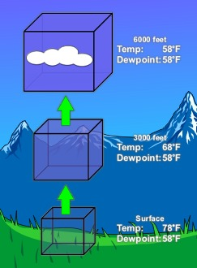
Cloud Formation (Cont’d)
Warm air rises (less dense), and will gradually cool. The air will begin condensing (when the temperature and dewpoint become closer together), and water droplets bond onto condensation nuclei. These nuclei will collide with other nuclei, eventually forming a cloud.
Notes:
Air can reach saturation in a number of ways. The most common way is through lifting. As a bubble or parcel of air rises it moves into an area of lower pressure (pressure decreases with height). As this occurs the parcel expands. This requires energy, or work, which takes heat away from the parcel. So as air rises it cools. This is called an adiabatic process.
Since cold air can hold less water vapor than warm air, some of the vapor will condense onto tiny clay and salt particles called condensation nuclei. The reverse is also true. As a parcel of air sinks it encounters increasing pressure so it is squeezed inward. This adds heat to the parcel so it warms as it sinks. Warm air can hold more water vapor than cold air, so clouds tend to evaporate as air sinks.

Slide 9
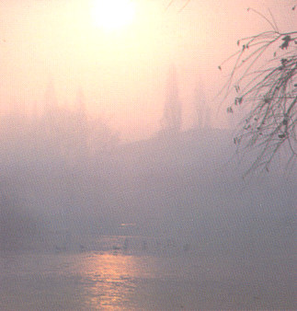
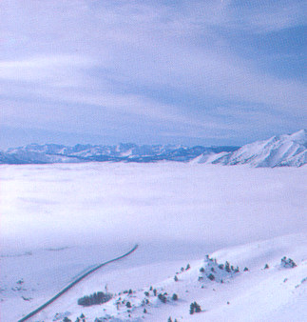
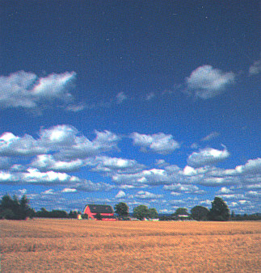
Types of Clouds
Low clouds: Consist of stratoform (flat) clouds, or cumuloform (puffy) clouds, lying on or just above the surface (up to ~10,000 ft).
Stratus: Cumulus:
Notes:
Stratus clouds consist of a feature-less low layer that can cover the entire sky like a blanket, bringing generally gray and dull weather. The cloud bases are usually only a few hundred feet above the ground. Over hills and mountains they can reach ground level when they may be called fog. Also, as fog "lifts" off the ground due to daytime heating, the fog forms a layer of low stratus clouds.
Cumulus clouds are of small vertical development with flat bases and rounded tops. These types of clouds indicate fair weather.

Slide 10
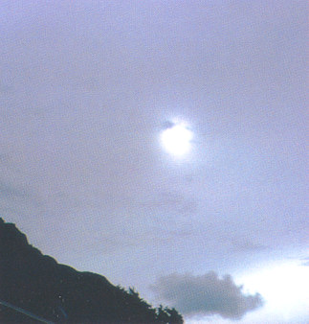
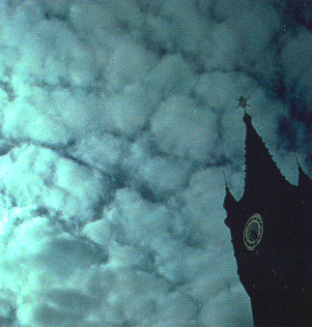
Types of Clouds (Cont’d)
Middle Clouds: Consist of altoform (meaning a middle cloud) type clouds, extending from 10,000 – 20,000 feet above the surface.
Altostratus: Altocumulus:
Notes:
These clouds typically form between 7,000 and 15,000 feet (2,100 to 4,600 m) and bring steady precipitation. As the clouds thicken and precipitation begins to fall, the bases of the clouds tend to lower toward the ground.

Slide 11
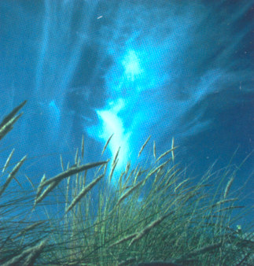

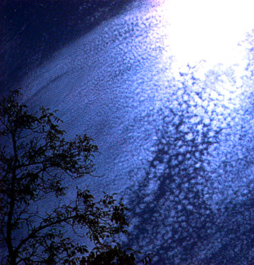
Types of Clouds (Cont’d)
High Clouds: Consists of mainly ice crystals suspended above 20,000 feet from the surface. These clouds are wispy/crisp/featherlike in appearance, and do not produce precipitation.
Cirrus: Cirrostratus: Cirrocumulus:
Notes:
High-level clouds which form above 20,000 feet and are usually composed of ice crystals. High-level clouds are typically thin and white in appearance, but can create an array of colors when the sun is low on the horizon. Cirrus generally occur in fair weather and point in the direction of air movement at their elevation.

Slide 12
How Does Rain Form???
Through the collision/coalescence process, water droplets continue to grow, forming clouds. If enough lift is present in the atmosphere (produced by fronts for example), updrafts are created, which forces the cloud to grow taller. The water droplets continue to grow inside of clouds, until they become too heavy to be suspended by the updraft. It is then that these droplets fall down to the earth as rain.

Slide 13
Types of Fronts
Now that we have learned the concepts of density, we can better understand what fronts are and how they affect the weather.
Cold Front: A transition zone where cold/dry, and stable air, replaces warm/moist, and unstable air. It is depicted by a blue line with triangles pointing towards the direction of movement.
Notes:
Fronts are a dividing line that separates two different air masses. There are three different types of fronts: 1.) cold fronts 2.) warm fronts 3.) stationary fronts.

Slide 14
Cold Front
Colder
Temperatures
27
54
33
Warmer
Temperatures
62
Notes:
Typically, bad weather (thunderstorms) is associated with cold fronts. This threat peaks especially when cold fronts intersect warm fronts near low pressure systems.

Slide 15
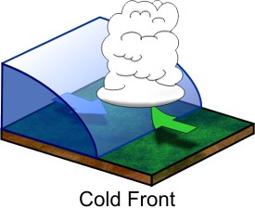
Cold Front (Vertical Profile)
Advancing
Cold air
Rising Warm
air
Notes:
Because cold air is denser than warm air, it can be best referred to as a deep dome of air, capable of easily lifting the warmer, less dense air, forming showers and thunderstorms through the collision and coalescence process.

Slide 16
Warm Front
Colder
Temperatures
45
Warm
Front
38
55
Warmer
Temperatures
62
Notes:
Warm Front: A transition zone where warm, moist air replaces cold, dry air. Typically, warm fronts only travel at half the speed than that of cold fronts (because of the density principle). These fronts are depicted as the red line with semicircles pointing towards the direction of movement.

Slide 17
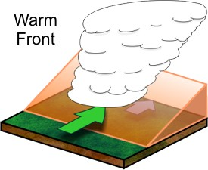
Warm Front (Vertical Profile)
Warm
air
Cold air
Notes:
Since warm air is less dense than cold air, this air mass can be best referred to as a shallow wedge of air, which struggles to lift the heavier/denser cold air. A good analogy can be a weightlifter trying to push a large dump truck…this individual will have trouble pushing the vehicle. Warm fronts do not slope in the vertical as much as cold fronts do. The result will be the warm air gently overriding the cooler, less dense air, thus only light to moderate showers will form at best. The rain/snow will fall ahead of the warm front.
Light to moderate showers and a few thunderstorms will be possible on the north side of the warm front. This is due to the gentleness of the slope of this kind of air mass.

Slide 18
Stationary Front
Cold
Air
Warm
Air
Notes:
Stationary Front: A boundary that has essentially no movement, but separates warm, moist air from cold, dry air. It is depicted by an alternating red and blue line containing blue triangles and red semicircles. The triangles point towards the warmer air, while the semicircles point towards the cooler air.
Here, showers and thunderstorms can be more widespread/numerous on both sides of this front, as this precipitation continues to move parallel to this boundary over the same areas. This scenario can result in extensive flooding given the right conditions.

Slide 19
Mapping Exercise
Draw and analyze a surface weather map for pressure and temperature, and draw the fronts that are indicated by these two variables.
Discuss our results.

Slide 20
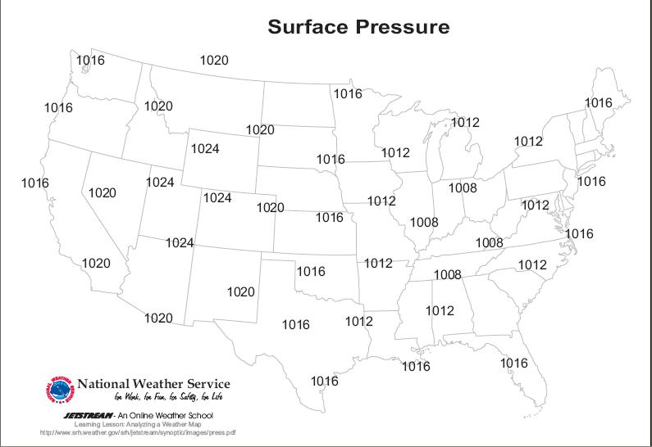

Slide 21
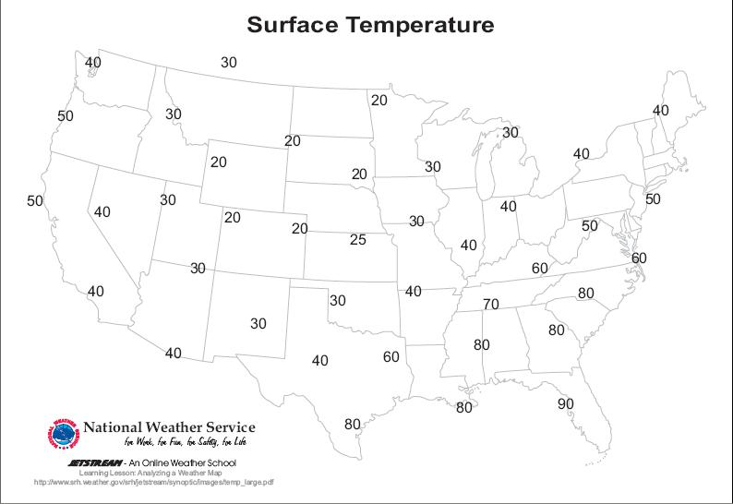

Slide 22
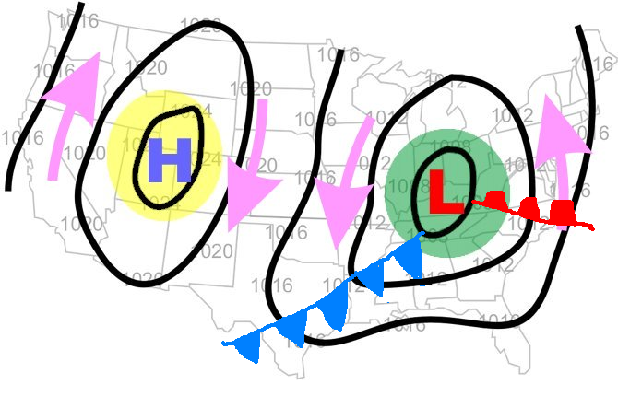
Pressure/Front Map

Slide 23
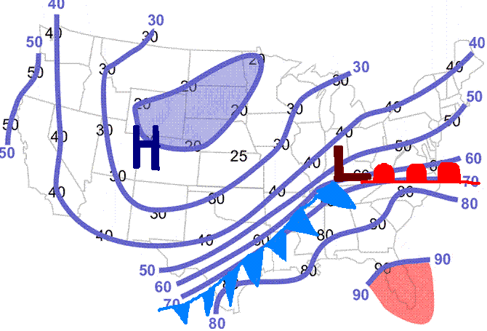
Temperature/Front Map

Slide 24
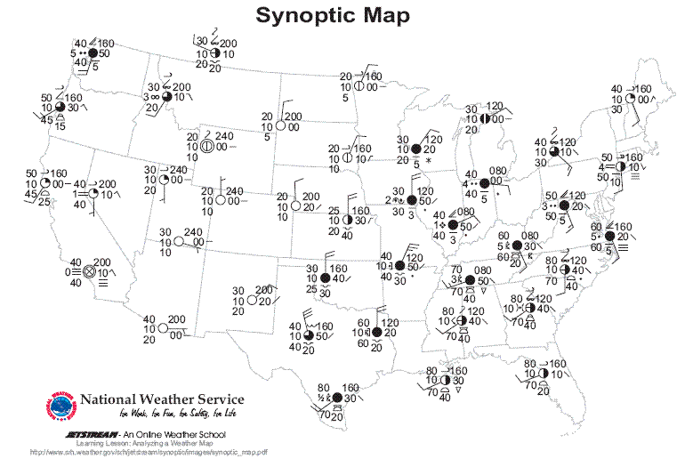

Slide 25
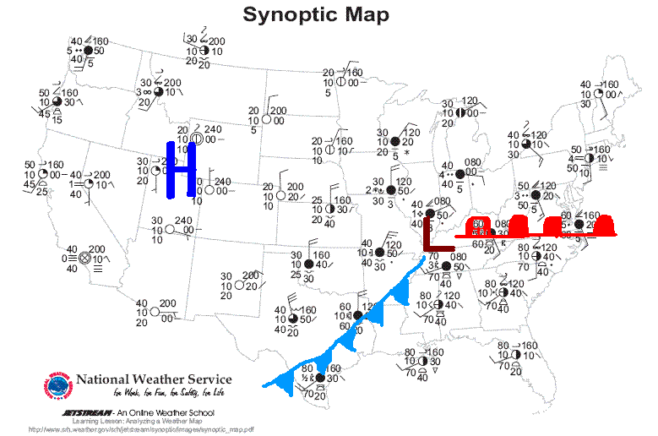

Slide 26
Acknowledgments
Jetstream website – Southern Region Headquarters , National Weather Service
www.srh.noaa.gov/srh/jetstream

