Slide 1
Architecture
Gen AI on AWS

Slide 2
AWS Services & Ecosystem
AWS BedRock
API Gateway
Lambda Function
Cloud Watch
AWS Sagemaker
S3 Bucket
AWS
Sagemaker
(deploy)
S3
NLP Usecases
Chat
Query
summarizer
writer
Finetuning Pipeline
AWS BedRock
Foundation Models
API Gateway
Client
Lambda Function
(pkg)
Other integrations

Slide 3
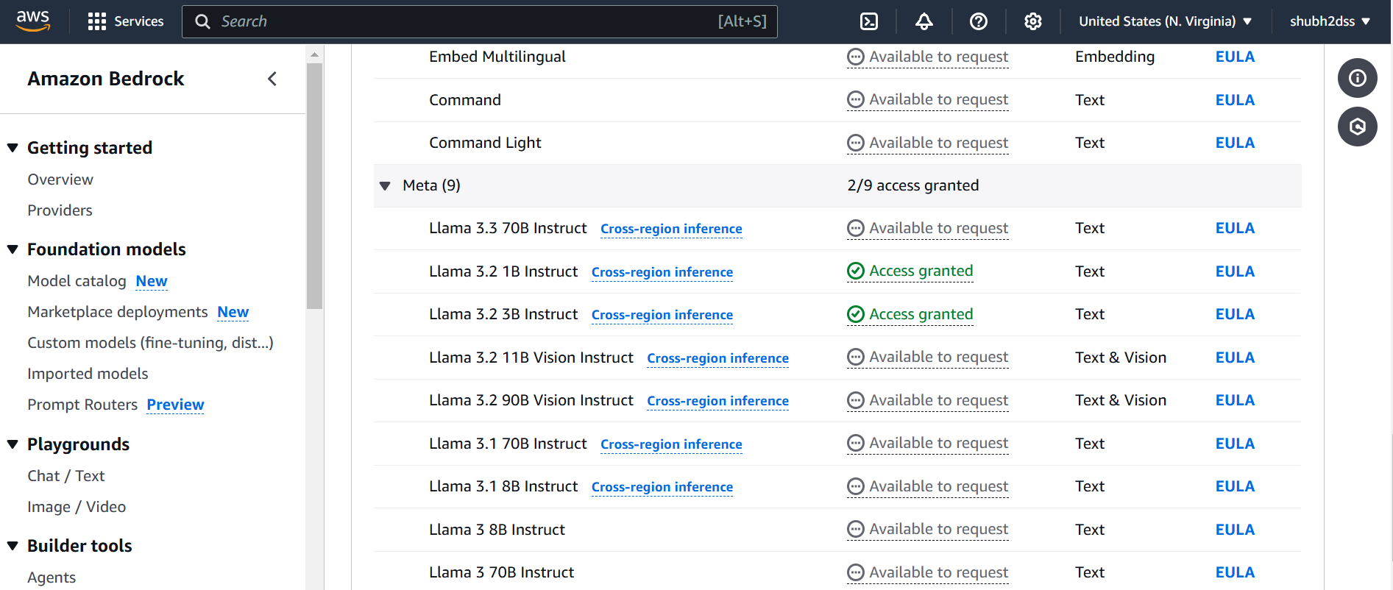
Get Model access
https://us-east-1.console.aws.amazon.com/bedrock/home?region=us-east-1#/model-catalog/serverless/meta.llama3-2-3b-instruct-v1:0

Slide 4
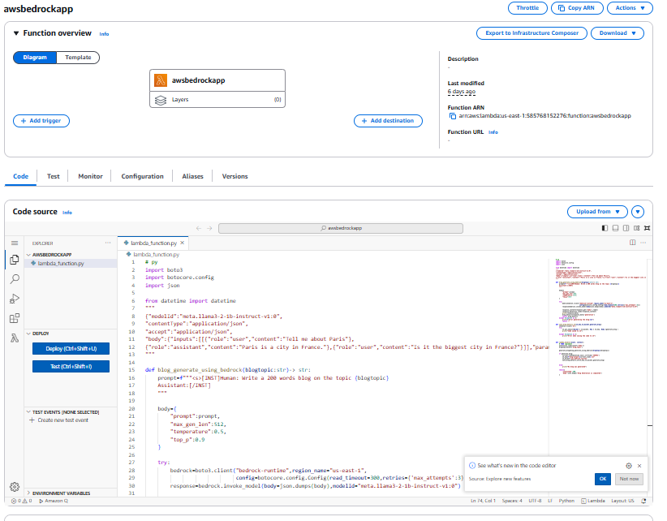
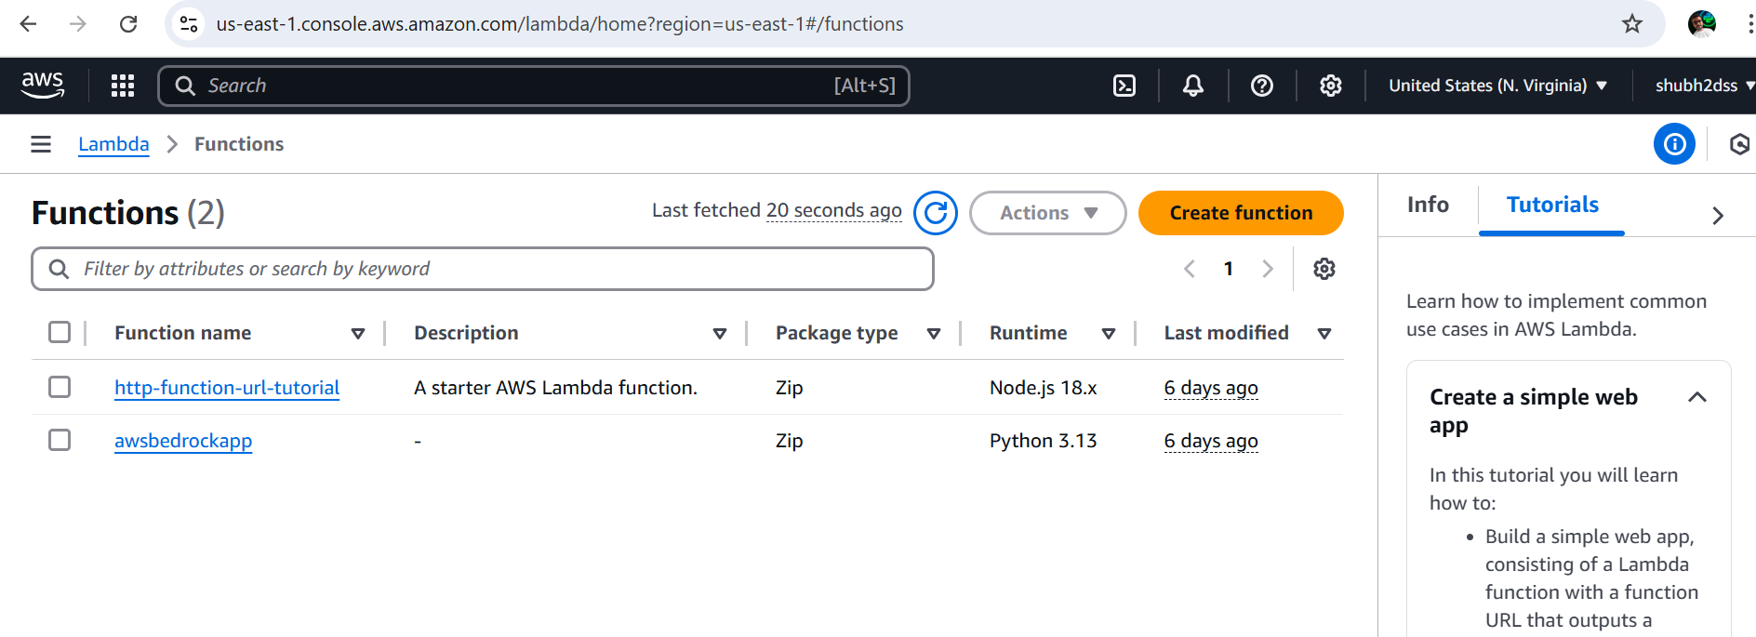
Step1: Create Lambda function.

Slide 5
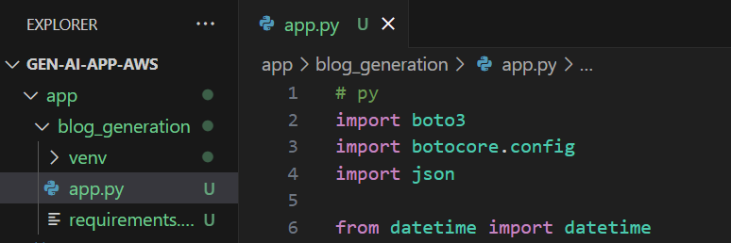
Step2: In VS code create app.py file, venv and install packages using requirements.txt

Slide 6
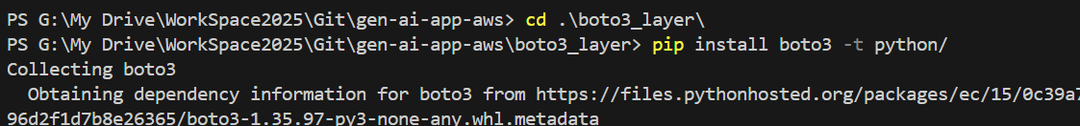
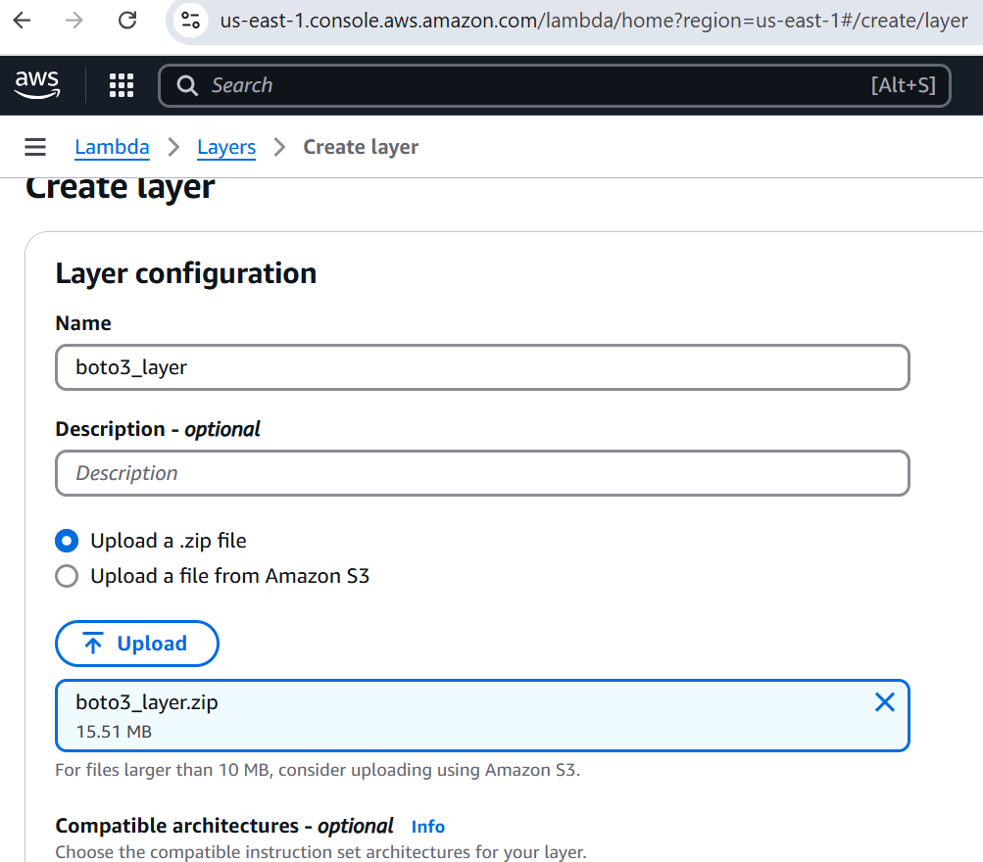
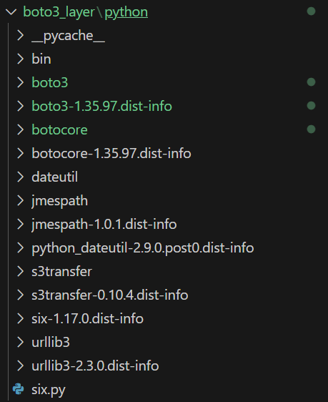
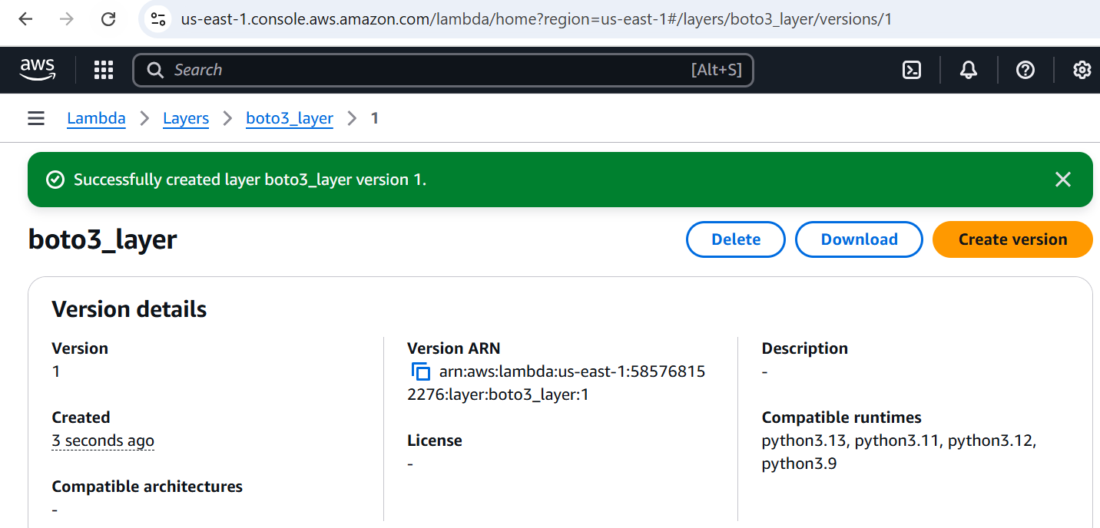
Step3: Paste the code in lambda function code environment. Create boto layer then add from dropdown.

Slide 7
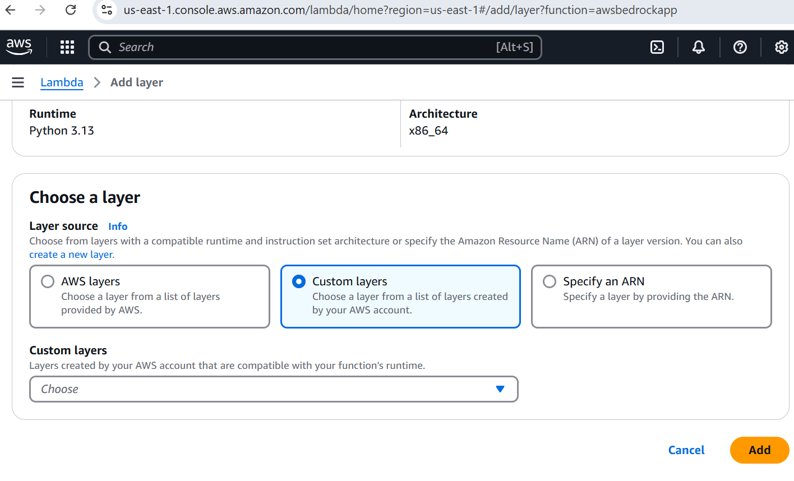
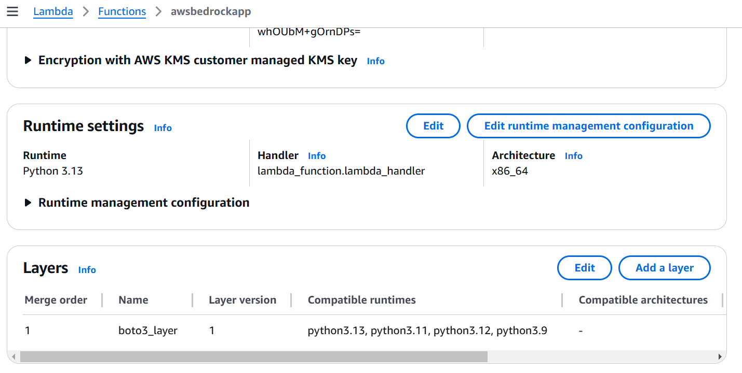
Adding Layers to lambda function.

Slide 9
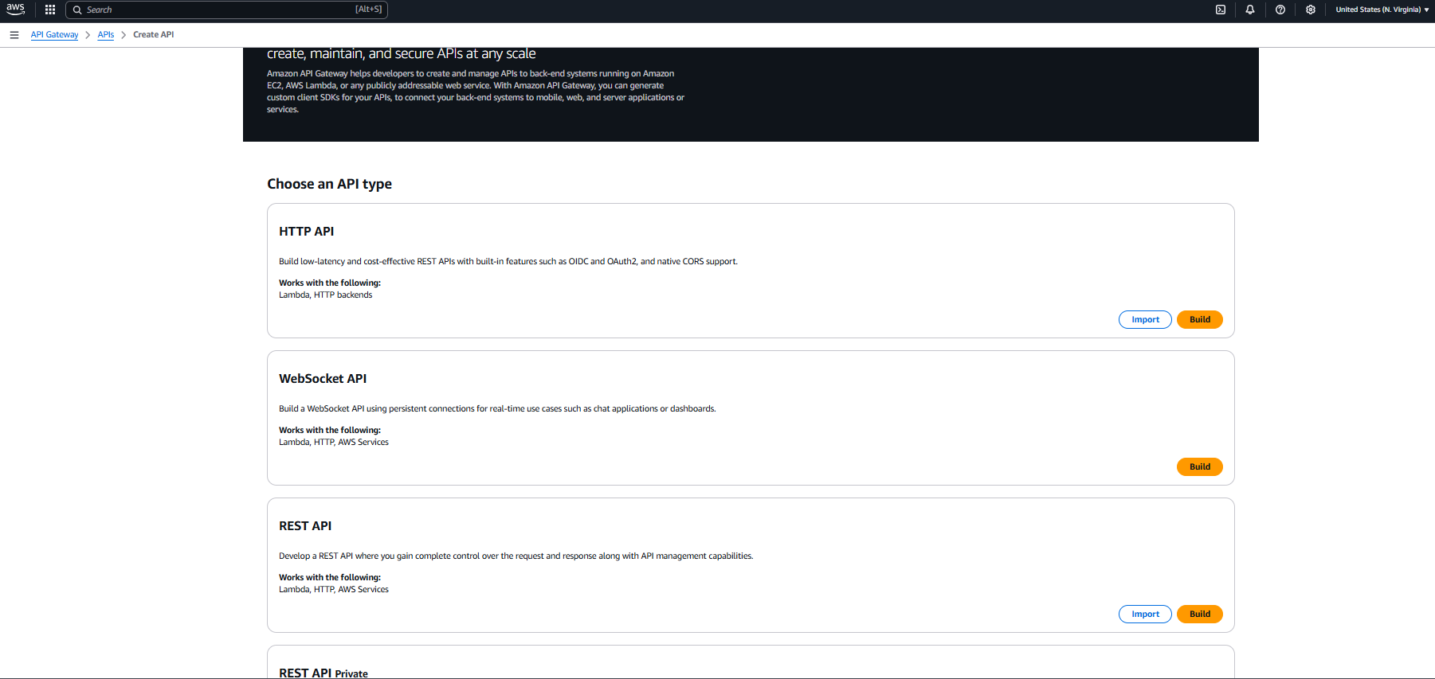
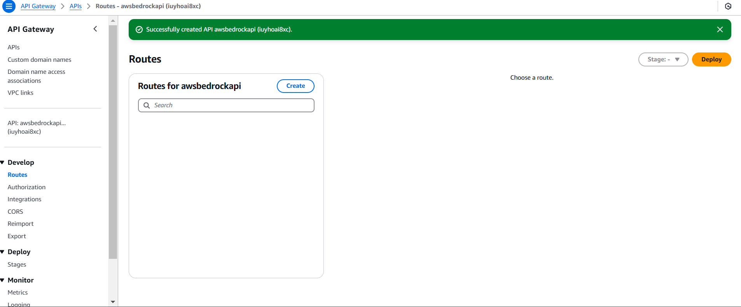
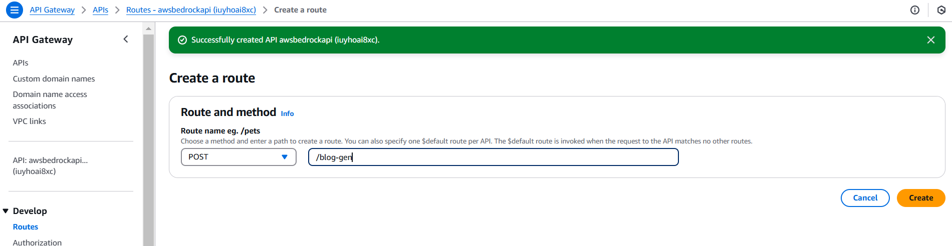
Step4: Create the API gateway and add routes.

Slide 10
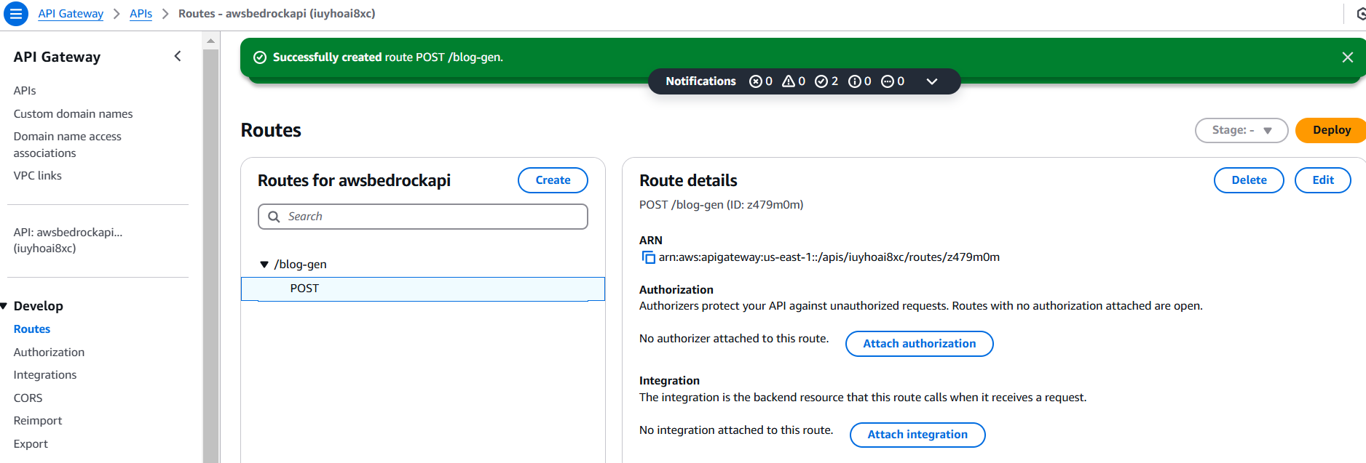

Slide 11
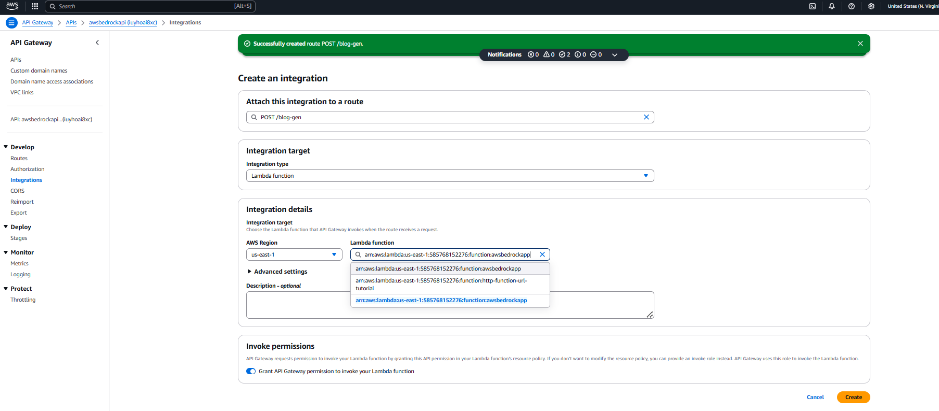
Integrate the API gateway with lambda function - bedrockapp

Slide 12
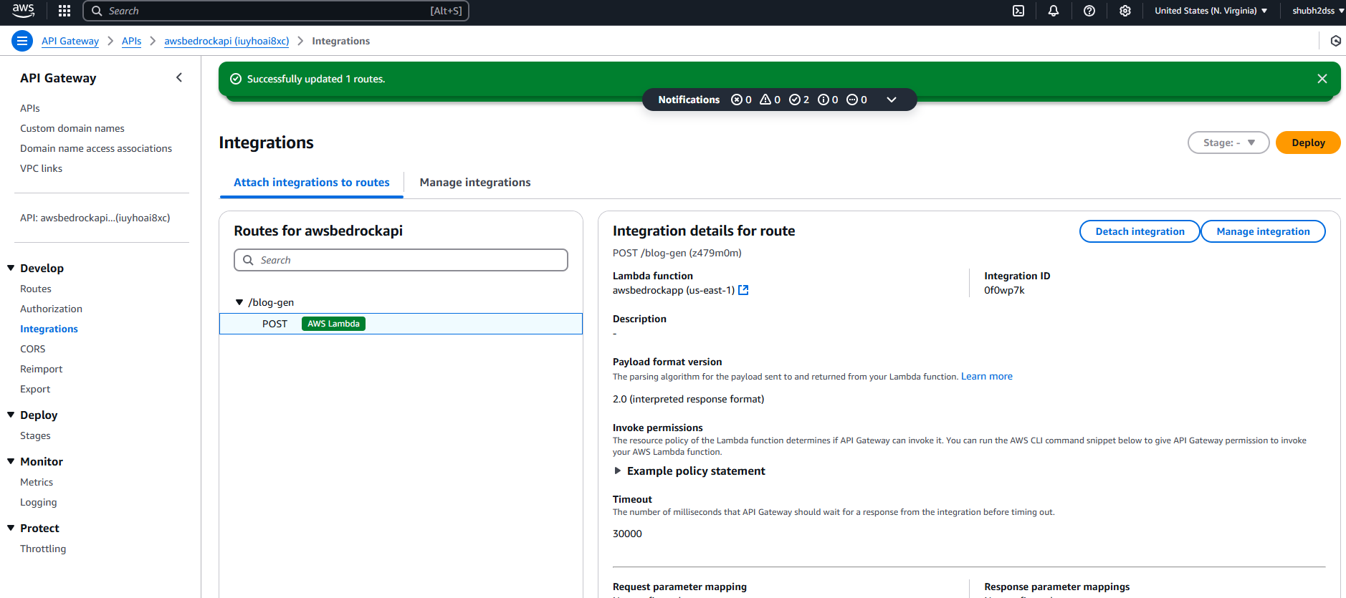

Slide 13
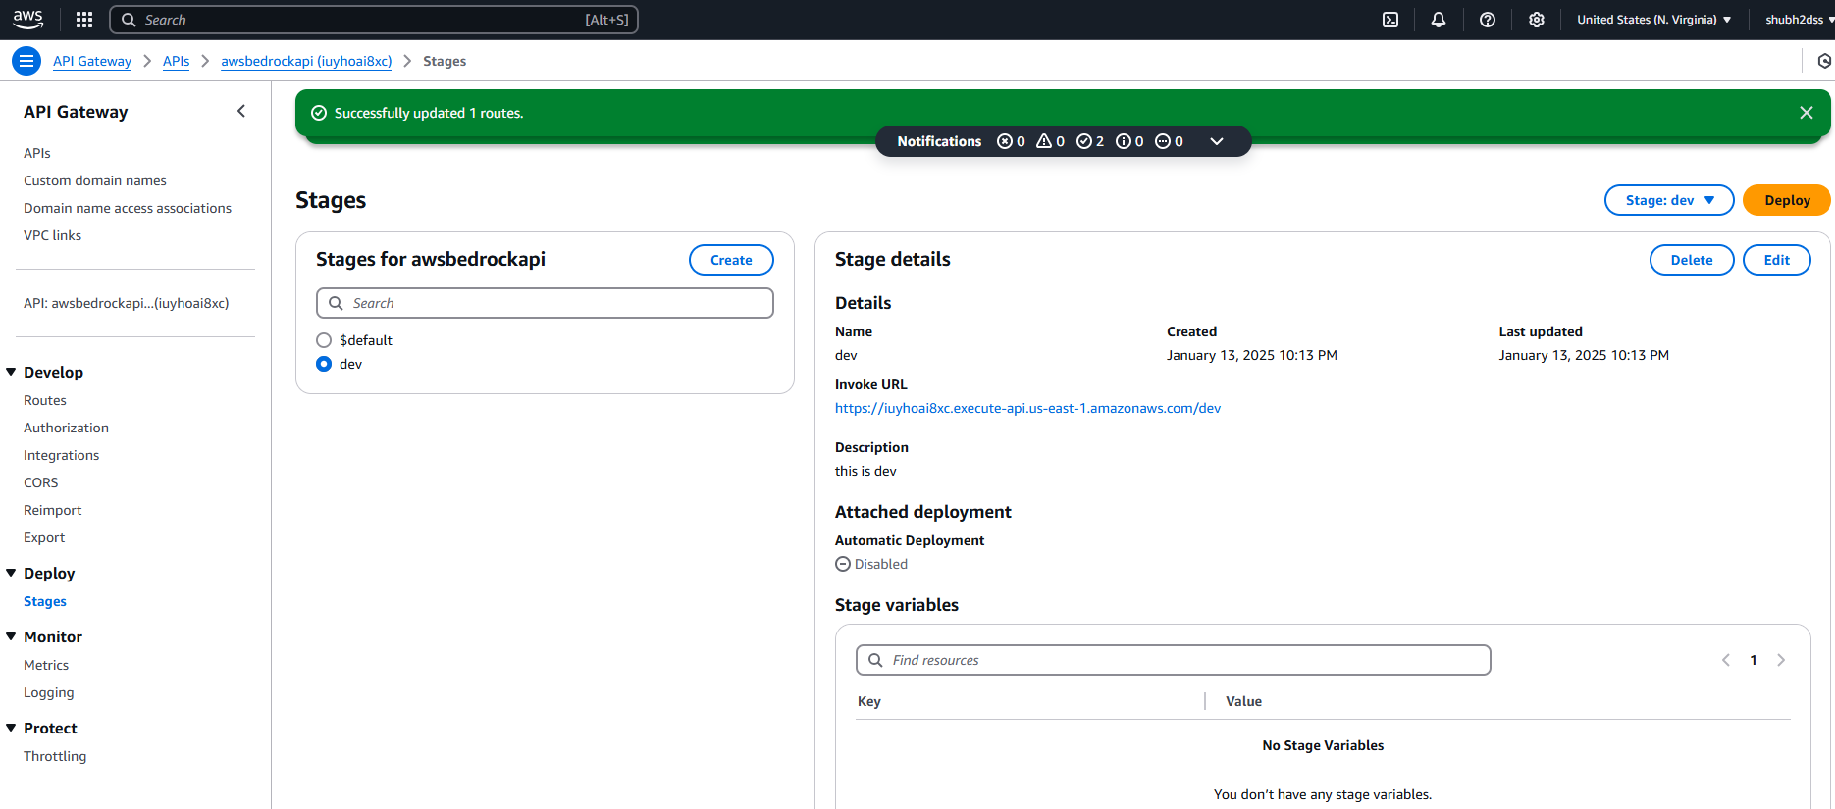
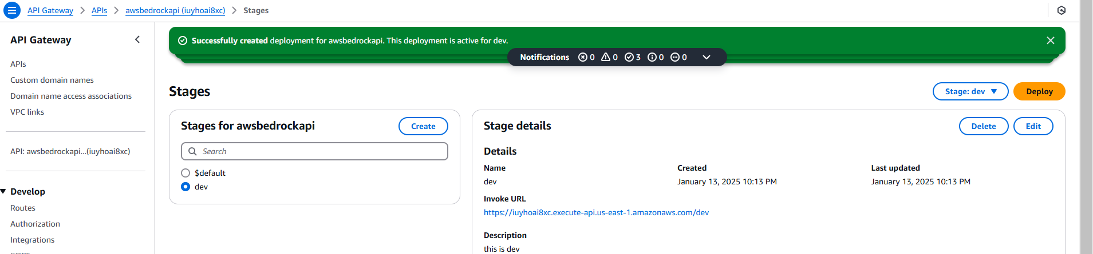
Create DEV env in stage section and deploy

Slide 14
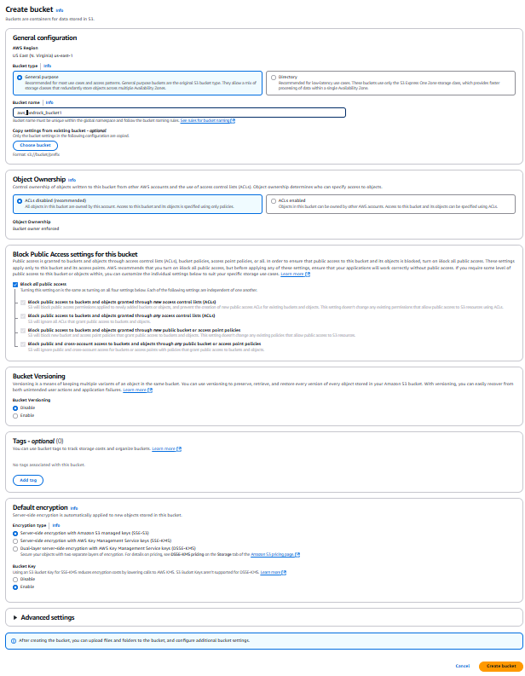
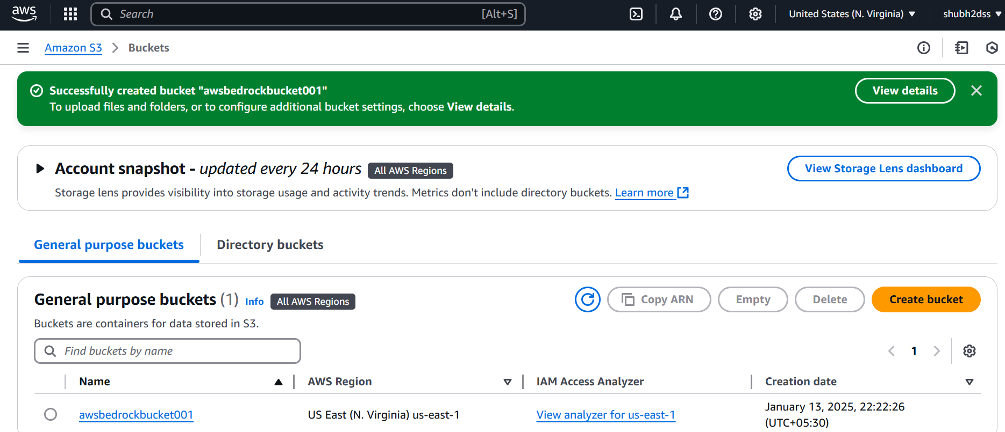
Step4: Create the S3 bucket .

Slide 15
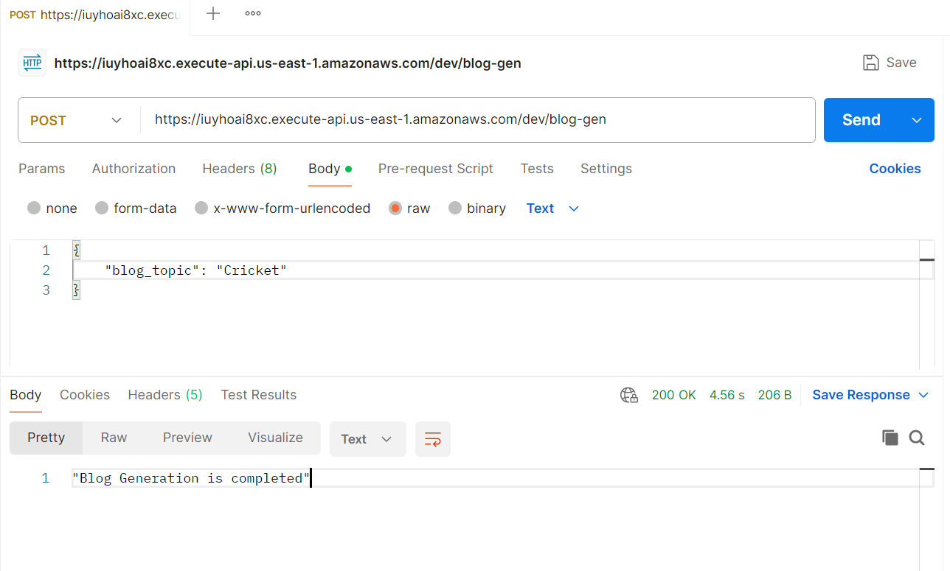
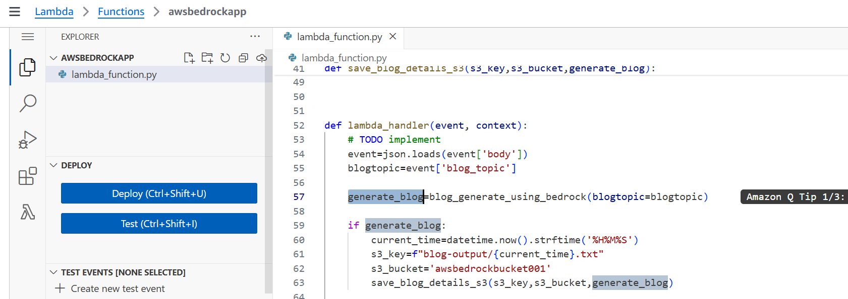
Test the API – API addr from stage section
https://iuyhoai8xc.execute-api.us-east-1.amazonaws.com/dev

Slide 16
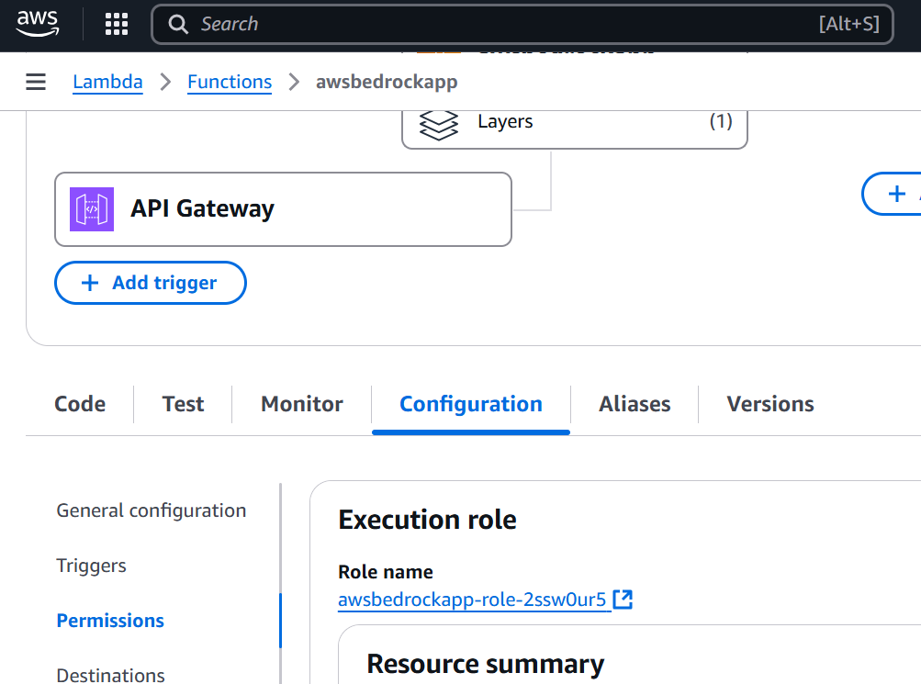
Check the roles and permissions

