Slide 1
Tuples vs. Records
CREAT TABLE MovieStar (
Name CHAR (30),
Address VARCHAR (255),
Gender CHAR (1),
DataOfBirth Date
);
Tuples are similar to records or “structs” in C/C++
The record will occupy (part of) some disk block, and within the record there will be one field for every attribute of the relation.
While this idea appears simple, the “devil is in details.”
In relational terms:
Field = sequence of bytes representing the value of an attribute in a tuple.
Record = sequence of bytes divided into fields, representing a tuple.
File = collection of blocks used to hold a relation = set of tuples/records.
In object­oriented terms (ODL):
Field represents an attribute or relationship.
Record represents an object.
File represents extent of a class.

Slide 2
Representing Data Elements
1. How do we represent fields?
2. How do we represent records?
3. How do we represent collections of records or tuples in blocks of memory?
4. How do we cope with variable record length?
5. How do we cope with the growth of record sizes?
6. How do we represent blobs (Binary Large OBjects)?

Slide 3
How do we represent fields?
Typical attribute can be represented by a fixed length field.
  Integers, reals → 2--8 byte fields.
  CHAR(n) → n bytes.
  VARCHAR(n) → n+1 bytes.
  SQL2 DATE → 10 bytes.
More difficult:
1. Truly varying character string.
2. Many­to-many relationship = set of pointers of arbitrary size.

Slide 4
Importance of data representation - Y2K Problem
Many DBMS had a representation for dates: YYMMDD.
The problem was that applications were taking advantage of the fact that: if date d1 is earlier than d2 then lexicog. d1<d2.
  SELECT name
  FROM MovieStar
  WHERE birthdate < '980603‘
When some children will be born in the new millenium, their birthdates will be lexicographically less than ‘980601’!

Slide 5
Fixed­Length Records
Header = space for information about the record, e.g., record format (pointer to schema), record length, timestamp.
header
gender
We need to know how to access the schema from the record, in case records in the same block belong to different relations.
name
address
birth
to schema
length
timestamp
Space for each field of the record.
  Sometimes, it is more efficient to align fields starting at a multiple of 4.
Aligned
header
gender
header
gender
name
address
birth
name
address
birth
0
30
286
287
297
0
32
288
292
304

Slide 6
Packing Fixed-length Records into Blocks
The simplest form of packing is when:
block holds tuples from one relation,
and tuples have a fixed format.
Blk. Header | Rec1 | Rec2| …|Recn|
E.g. a directory giving the offset of each record in the block.

Slide 7
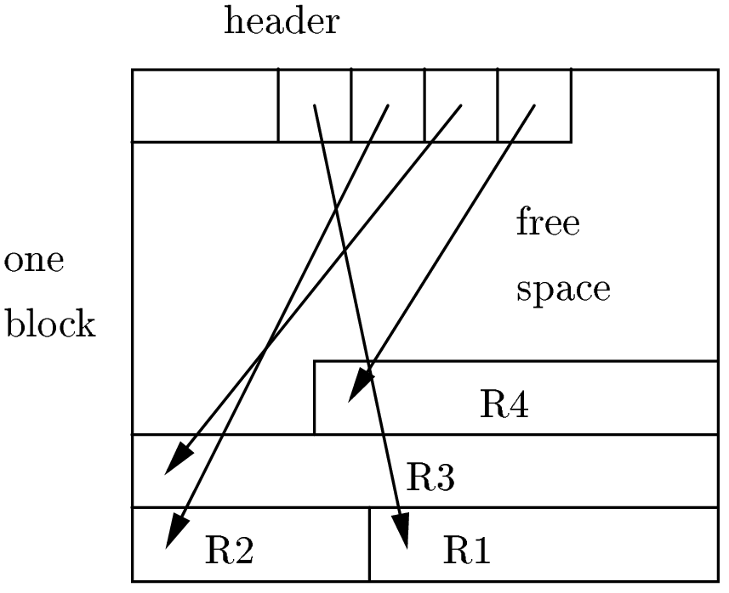
Inside the block
Notice: The offset table grows from the front of the block, while the records are placed starting at the end of the block.
Record address = physical block address + offset of the entry in the block’s offset table.
We have an option, should the record be deleted; we can leave in its offset-table entry a tombstone .
  After a record deletion, following a pointer to this record leads to a tombstone.
  Had we not left the tombstone, the pointer might lead to some new record, with surprising results.
We can move records around within the block, and all we have to do is change the record entry in the offset table.

Slide 8
Representing addresses
We need pointers especially in object oriented databases.
Two kind of addresses:
  Physical (e.g. host, driveID, cylinder,surface,
  sector (block), offset)
  Logical (unique ID).
Physical addresses are very long;
8B is the minimum – (up to 16B in some systems)
Example: A database of objects that is designed to last 100 years.
  If the database grows to encompass 1 million machines and each machine creates 1 object each nanoseconds then we could have 2⁷⁷ objects.
  10 bytes are needed to represent addresses for that many objects.

Slide 9
Representing addresses (Cont.)
We need a map table for flexibility.
The level of indirection gives the flexibility.
For example, many times we move records around, either within a block or from block to block.
What about the programs that are pointing to these records?
  They are going to have dangling pointers, if they work with physical addresses.
We only arrange the map table!
Efficiency?
It is an issue because of indirection.
logical
physical
Logical address
Physical address

Slide 10
Pointer swizzling I
Typical DB structure:
Data maintained by server process, using physical or logical addresses of perhaps 8 bytes.
Application programs are clients with their own (conventional memory) address spaces.
When blocks and records are copied to client's memory, DB addresses must be swizzled = translated to virtual­memory addresses.
  Allows conventional pointer following.
  Especially important in OODBMS, where pointers­as­data are common.
DBMS uses translation table
Db address
memory address

Slide 11
Pointer swizzling II
DBMS uses a translation table
Logical/Physical vs.
DBaddr/Mem-addr map
Logical and Physical address are both representations for the database address.
In contrast, memory addresses in the translation table are for copies of the corresponding object in memory.
All addressable items in the database have entries in the map table, while only those items currently in memory are mentioned in the translation table.
DBaddr
Mem-addr
database address
memory address

Slide 12
Swizzling Example
Disk
Memory
Read into
memory
Swizzled
Block 1
Unswizzled
Block 2

Slide 13
Pointer swizzling III
Swizzling Options:
Never swizzle. Keep a translation table of DB pointers → local pointers; consult map to follow any DB pointer.
  Problem: time to follow pointers.
Automatic swizzling. When a block is copied to memory, replace all its DB pointers by local pointers.
  Problem: requires knowing where every pointer is (use block and record headers for schema info).
  Problem: large investment if not too many pointer­followings occur.
Swizzle on demand. When a block is copied to memory, enter its own address and those of member records into translation table, but do not translate pointers within the block. If we follow a pointer, translate it the first time.
  Problem: requires a bit in pointer fields for DB/local,
  Problem: extra decision at each pointer following.

Slide 14
Pinned records
Pinned record = some swizzled pointer points to it
Pointers to pinned records have to be unswizzled before the pinned record is returned to disk
We need to know where the pointers to it are
Implementation: keep a linked list of all (swizzled) records pointing to a record.
y
x
y
y
Swizzled pointer

Slide 15
Exercise
Suppose that if we swizzle all pointers automatically, we can perform the swizzling in half the time it would take to swizzle each one separately.
If the probability that a pointer in main memory will be followed at least once is p, for what values of p is it more efficient to swizzle automatically than on demand?
Suppose c is the cost of swizzling an individual pointer. This question asks for what values of p is the cost of swizzling fraction p of the pointers at cost c is greater than swizzling them all at cost c/2?
That is, pc > c/2, or p > 1/2.

Slide 16
Variable-Length Data
So far, we assumed fixed format, fixed length, and the schema is a list of fixed-len. fields.
Real life is more complicated;
-- varying size data items (eg,address)
-- repeating fields (star-to-movie relationship)
-- varying format records (SSD)
Sliding Records
Use offset table in a block, pointing to current records.
If a record grows, slide records around the block.
  Not enough space? Create overflow block; offset table must indicate “record moved.”

Slide 17
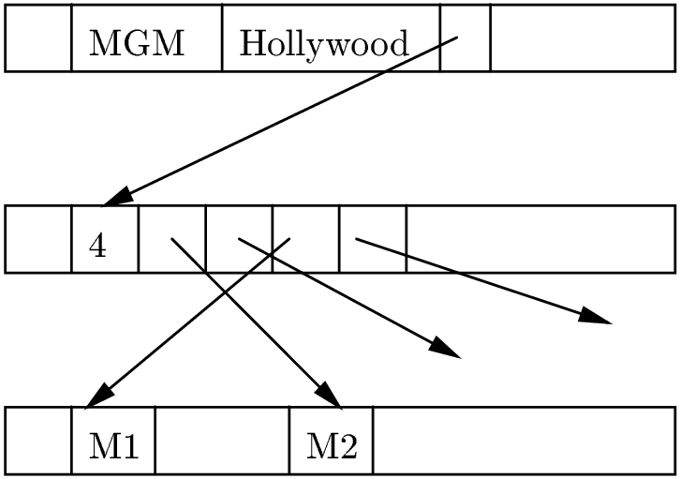
Split Records Into Fixed/Variable Parts
Fixed part has a pointer to space where current value of variable fields can be found.
Example: Studio records = name and address (fixed), plus a set of pointers to movies by that studio.

Slide 18
Varying schema
Varying schema, e.g. XML-data, Information integration, Semi-Structured Data
Records with flexible schema (lots of null-values)
Store “schema with record”

Slide 19
BLOB's
Binary, Large Object = field whose value doesn't fit in a block, e.g., video clip.
Hold in collection of blocks, e.g., several cylinders for fast retrieval.
Allow client to access only part of value, e.g., get first 10 seconds of a video, and supply each 10­second segment within next 10 seconds.

Slide 20
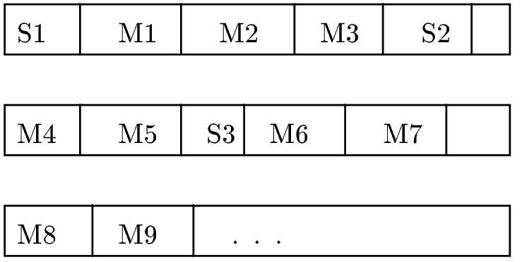
Clustering relations together
Suppose there is a many­one relation from relation R to S. It may make sense to keep tuples of R with their “owner” in S.
Example
  Studios(name, addr)
  Movies(title, year, studio)
Why Cluster?
Supports queries such as:
  SELECT title
  FROM Movies
  WHERE studio = 'Disney';
Few disk I/O's needed to get all Disney movies.
Even supports a query in which only the address of the studio is given and a join is needed.
Notice the importance of type info in record headers.
Problem: When does clustering lose?

Slide 21
Files
File = Collection of blocks. How located?
Linked list of blocks.
Tree­structured access as for UNIX files.
Other index structures --- to be covered in detail.

Slide 22
Sequential Files
Records ordered by search key (may not be “key” in DB sense).
Blocks containing records therefore ordered.
On insert: put record in appropriate block if room.
  Good idea: initialize blocks to be less than full; reorganize periodically if file grows.
If no room in proper block:
  Create new block; insert into proper order if possible (what if blocks are consecutive around a track for efficiency?).
  If not possible, create overflow block, linked from original block.

Slide 23
Deletion/Tombstones
On delete: can we remove record, possibly consolidate blocks, delete overflow blocks?
Danger: pointers to record become dangling.
Solution: tombstone in record header = bit saying deleted/not. Rest of record space can be reused.

