Slide 1

ADVANCED
BIOMOLECULAR ARCHITECTURE
Getting Chem-enabled
Understanding Informatics in Nature
Doing it with Molecules

Slide 2
Some Common Substances
Paper
Hair
Salt and Glass
Water — freezing, boiling and evaporation
Hydrocarbons

Slide 3
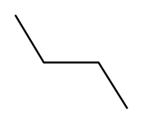
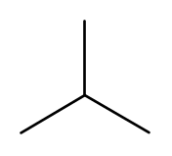




Which has a higher density?
liquefied butane or liquefied 2-methyl propane
0.573 g cm⁻³
0.551 g cm⁻³
Density of hexane is 0.655 g cm⁻³ and that of pentane is 0.621 g cm⁻³
What should be the density of cyclopentane?
0.655 g cm⁻³
0.74 g cm⁻³
The density of liquefied prop?ne is 0.505 g cm⁻³ > prop?ne (0.494 g cm⁻³)
Boiling point of prop?ne is -47.7ºC < prop?ne (-42.1ºC).
The density of liquefied propene is 0.505 g cm⁻³ > propane (0.494 g cm⁻³)
Boiling point of propene is -47.7ºC < propane (-42.1ºC).

Slide 4
TOWARDS HIGHER STRUCTURES
MICELLES
MEMBRANES
MOVIE 1
MOVIE 2

Slide 5
WHERE DO WE BEGIN?

Slide 6

EXPERIMENTS
DETERMINE
DETERMINE
STRUCTURE
PROPERTIES
STRUCTURE
STRUCTURE
PREDICTS
PROPERTIES
atoms
THEORY
atoms
THEORY
VB and MO Theory
molecules
Quantum Mechanics
molecules
Kinetic Molecular Theory
Thermodynamics
substances
substances
EXPLAINS
LAWS
RELATE
RELATE

Slide 7
WHAT DO WE STUDY?
CHEMICAL LOGIC
INFORMATION CONTENT OF ATOMS
ADDED INFORMATION IN MOLECULES
INTERACTION BETWEEN MOLECULES

Slide 8

CHEMICAL PHYSICS
CHEMICAL PHYSICS
+
CHEMICAL LOGIC
Quantum Mechanics
Atomic Structure
Electricity
Magnetism
Electromagnetic Radiations
Thermodynamics
THEORIES
Valence Bond
Molecular Orbital
VSEPR
Acids and Bases
Kinetic Molecular
CHEMICAL PHYSICS
+
CHEMICAL LOGIC
+
CHEMICAL ARITH METIC
CHEMICAL LOGIC
LANGUAGE
APPLICATIONS
Physical Interactions and Phases
Reaction Rates and Equilibria
Reaction Energetics
Symbols
Structures
Nomenclature
Hybridization and Resonance
Structure and Dynamics
Reactivity and Mechanisms
STRUCTURE
Electronic Configuration and
Periodic Law
Electronegativity and
Bond Types
Octet Theory and Valency
Reaction Types
CHEMICAL ARITHMETIC
+
CHEMICAL LOGIC
CHEMICAL ARITHMETIC
Composition and Formulae
Concentration and pH
Equations and Stoichiometry
Relative Masses
Avogadro's Number
Mole Concept

Slide 9

CHEMICAL LOGIC
Constitution of the atom
Chemical versus nuclear reactions
Nuclidic symbols
CHEMICAL ARITHMETIC
The Atom and the Nucleus - Comparing Sizes
Relative Atomic Mass, Mole Concept, Avogadro's Number and amu
. Moles and molar mass
Average Atomic Mass and Isotopic Masses
PROBLEMS---- CHEMICAL PHYSICS
The collapsing atom
Atomic spectroscopy

Slide 10
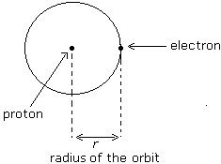





SOLAR MODEL OF THE ATOM
What happens to
KE
PE
TE
When r increases?
WHY?
KE decreases
PE increases
TE increases
KE decreases
PE decreases
TE decreases
Laws of Classical Mechanics and Laws of Electrostatics
=>
KE =
and
Total energy = Kinetic energy + Potential energy =
=
What does this mean?

Slide 11




Balmer and Spectral Lines (1885)
Continuous versus Line Spectra
Planck (1900), Einstein (1905) and Dual Nature of Light
Quantum Effects and the Particle Nature of Light (Photons)
Bohr's Model of the Hydrogen Atom
Consequences of the quantisation of angular momentum
Total Energy

Slide 12





Rydberg’s Constant
Spectral Series
Extension of Bohr's Theory to Hydrogen like Species

Slide 13


Limitations of the Bohr Model
Zeeman and Stark effects - special effects spectroscopy
Many electron atoms and hyperfine structures in
atomic spectra
Quantum Mechanical Principles - Wave Particle Duality
The Uncertainty Principle
Bohr theory must be discarded
BUT WHY DID IT SUCCEED IN THE FIRST PLACE?

Slide 14
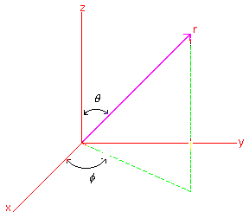
The Wave Function in spherical polar coordinates
( ) = _{total} = _{radial} _{angular} = (r) ( )

Slide 15


In Schrödinger's wave equation, the function Ψ represents all electrons
in an atom.
Schrödinger's wave equation is a second degree differential equation. Its
solutions are also equations.
In order to get definite solution for an electron in three dimensional space, three
quantum conditions namely energy, angular momentum and magnetic moment
must be specified. This gives rise to three quantum numbers.
1. The principal quantum number n.
2. The azimuthal quantum number (or the angular momentum quantum number) l.
3. The magnetic quantum number m_{l} or simply m.
If we specify the values of n, l and m_{l} within a given for an atom, we can specify a
particular orbital of an atom.
H = E
if we write = and specify n, then we specify
all Ψ 's with quantum number n.
To specify a particular orbital we have to specify the quantum number n,l and m_{l} in
4. To locate a particular electron in an orbital, we require a fourth quantum
condition arising because of spin of electron

Slide 16
Each atom- a shoe store?
A summary of rules
Professor Aufbau
Two consequences of charge and spin
Pauli
Hund
The significance of Ψ
The wave description
The probability description

Slide 17
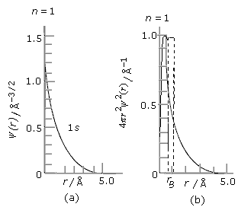
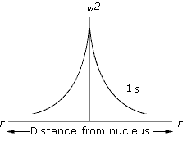

Figure: The plots of radial wave function Ψ (r)(fig. a) and the radial probability distribution function 4π r²Ψ²( r) versus r (fig. b)
Figure: (a) plot of Ψ²( r ) versus r and (b) cloud representation of the probability density distribution 1s electron

Slide 18
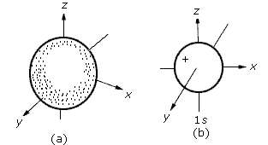
(a) Boundary surface description (probability) of the 1s orbital
(b) Boundary surface for the angular part of the wave function
Ψ (θ , φ ) of the 1s orbital
EXAMPLES
Nodes and stationary waves
The number and types of nodes
Angular nodes and Radial nodes
Consequences of nodes
Penetration of orbitals and radial nodes
Shielding effect of orbitals and angular nodes
Nodes and the combination of orbitals

Slide 19
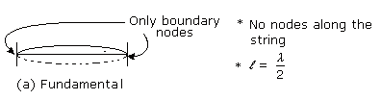
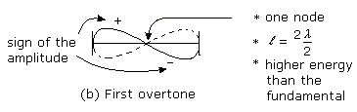
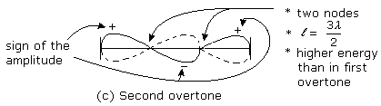
Nodes and stationary waves

Slide 20
The number and types of nodes
Angular nodes and Radial nodes
There are two possible types of nodes as follows:
1. Angular nodes: Angular nodes are encountered if we go around the
nucleus (i.e. vary θ and φ ) at a fixed distance (i.e. fixed r) from the
nucleus. This happens when ψ(θ,φ) = 0. The locus of angular nodes
form a planar surface and are therefore also called planar nodes.
2. Radial nodes:Radial nodes are encountered when we move out
radially along a straight line from the nucleus (i.e. vary r) at a fixed
angle (i.e. fixed θ and φ ). This happens when ψ( r ) = 0. The locus of
radial nodes form a spherical surface and hence are also called spherical
nodes.
We thus have a node when either ψ _{angular} or ψ _{radial} becomes zero,
since
Ψ = ψ _{radial} x ψ _{angular}
The angular part of the wave function or ψ(θ,φ) as we have already
seen depends only on the value of l (and not on n). The number of
angular nodes is also always equal to the value of l independently of
n.

Slide 21
Consequences of nodes
Penetration of orbitals and radial nodes
Shielding effect of orbitals and angular nodes

Slide 22
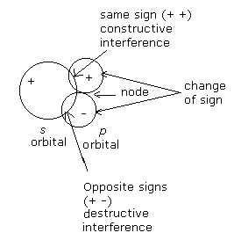
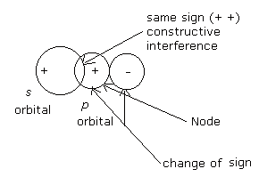
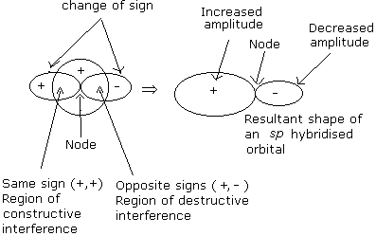
Nodes and the combination of orbitals

Slide 23
NEXT
THE CONSEQUENCES
ELECTRONIC CONFIGURATION
OF ATOMS

Slide 24

Number of electrons in
The valence shell
The Table
Stability due to
configuration
Oxidation State
Number of electrons in
Inner shells
G
R
O
U
P
N
U
M
B
E
R
Size
Division
Into s and p
blocks
Principal quantum number of
The valence shell
Covalency
Shielding
Number of Inner shells
Division
Into d and f
blocks
Coordination
number
Modifying factor
Derived from
Electronic
configuration
Types of inner subshells
A
T
O
M
I
C
N
U
M
B
E
R
Direct Information
Derived Information
PERIOD
NUMBER
Direct
Information
Electronic
Configuration
Periodic Variation
Organization of
The Periodic Table
Nuclear
Charge
Derived
Information
Monotonic Variation
Direct Information
Correlation
Experimental
Information
For Free Atom
Linking
Concepts
Physical and
Chemical Properties
Of Elements
Derived
Information
Explanation
Electronegativity
Reactivity
Ionization energy
Charge density =
Effective nuclear charge
r²
Polarizability
And
Polarizing power
Metallic and non
Metallic character
Electron affinity
Charge and size of ion
Nature of bonds
Metallic and covalent radii
Bond length and strength

Slide 25

Periodic Properties
From here

Slide 26
From Electronic Configuration to the Periodic Table
configuration
1s
2s
2p
3s
3p
4s
3d
4p
5s
4d
5p
6s
4f
5d
6p
7s
5f
6d
7p
Period
I
II
III
IV
V
VI
VII
Elements
2
8
2
8
18
18
32
??
C
O
U
N
T
10
18
36
54
86
?

Slide 27
Electronic Configuration
Number of unpaired Electrons
Higher (n+l) or Higher (n)? Neutral Atoms and Ions
The First 36
Different Conventions
2.8.5
1s² 2s² 2p⁶ 3s² 3p³
Show p_{x}, p_{y}, p_{z}
Boxes and excited states
[Ne] 3s² 3p³
1s² 2s¹ to 1s² 2p¹ approx 1.5 eV
What is the energy difference between 2s and 2p orbitals in Li²⁺
How Many angular nodes are there in a g orbital?

Slide 28
e
e
e
r
v
E
+
2+
3+
e
e
e
e
e
2+
3+
1s
2s

Slide 29
Direct Correlations
Value of n in Outermost Shell
Number of Electrons in the nth Shell
Number of Electrons in the (n-1)th and (n-2)th Shell
Stability of Completed Shell
‘Valency’ and ‘Possible Number of Bonds’
‘Number’ and ‘Nature of Bonds’

Slide 30
Ionic
Covalent
Polar Covalent
Coordinate Covalent
Three Numbers
Oxidation State
Covalency
Coordination Number
Minimum and Maximum Values for Oxidation State
for p Block NH₃ to N₂O₅
For d block Cr, Mn, Zn
The Periodic Variations of the Numbers
Within Periods
Within Groups

Slide 31

The Indirect Consequences of the Electronic Configurations
Direct Information
PROPERTIES OF SUBTANCES
Direct
Information
A
T
O
M
I
C
N
U
M
B
E
R
Derived Information
Electronic
Configuration
Organization of
The Periodic Table
Derived
Information
PROPERTIES OF MOLECULES
Periodic Variation
Nuclear
Charge
Modifying factor
Derived from
Electronic
configuration
Correlation
Direct Information
Monotonic Variation
NUMBER AND NATURE OF BONDS
Explanation
Derived
Information
Experimental
Information
For Free Atom
Physical and
Chemical Properties
Of Elements
PROPERTIES OF ATOMS
Linking
Concepts

Slide 32

General Trend in Electrostatic Attraction
Between Valence Shell Electrons and the Nucleus
INCREASE
D
E
C
R
E
A
S
E
ANOMALIES IN THE GENERAL TRENDS
Inner Shell Shielding
d subshell electrons
f subshell electrons
Filled and Half-filled Subshells
Electron-Electron Repulsion and Size of the Atom

Slide 33
PERIODICITY OF PROPERTIES OF THE FREE ATOM
IONIZATION ENERGY

Slide 34
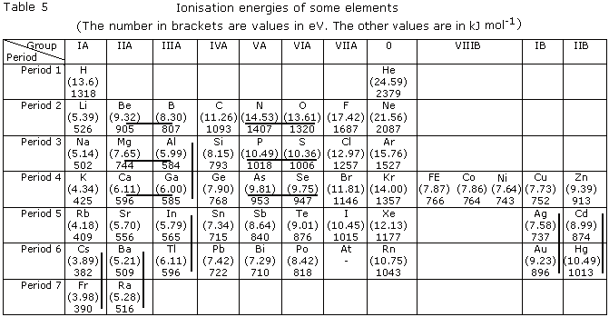
IONIZATION ENERGY
PERIODIC TABLE

Slide 35
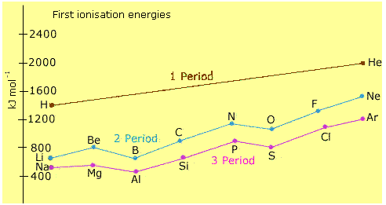
IONIZATION ENERGY
PERIODIC TABLE

Slide 36
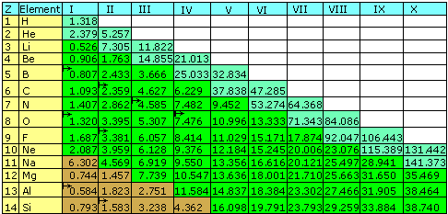
IONIZATION ENERGY
PERIODIC TABLE

Slide 37
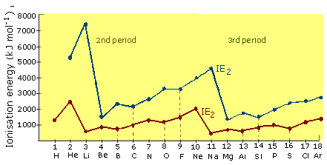
IONIZATION ENERGY
PERIODIC TABLE
IE₁

Slide 38
PERIODICITY OF PROPERTIES OF THE FREE ATOM
ELECTRON AFFINITY

Slide 39
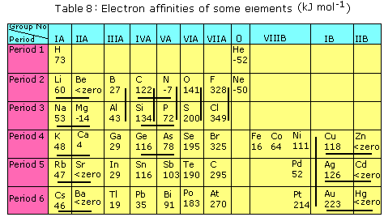
ELECTRON AFFINITY
PERIODIC TABLE

Slide 40
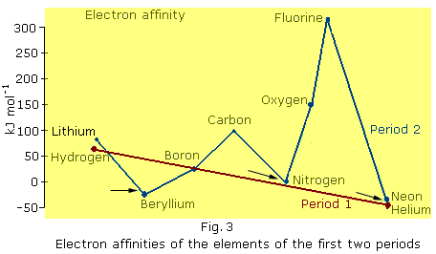
ELECTRON AFFINITY
PERIODIC TABLE

Slide 41
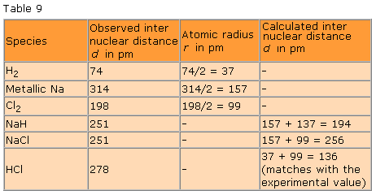
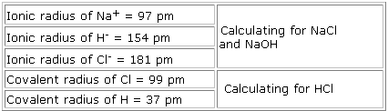
The Size of the Atom and the State of Bonding
COVALENT, METALLIC, IONIC AND VAN DER WAALS RADII OF ATOMS
37
?
278
?
136
NaH

Slide 42
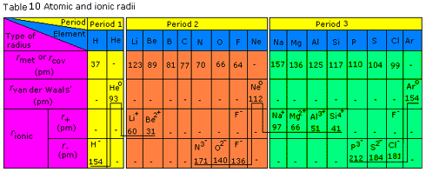
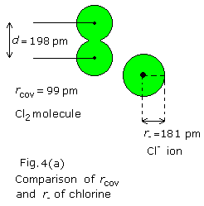
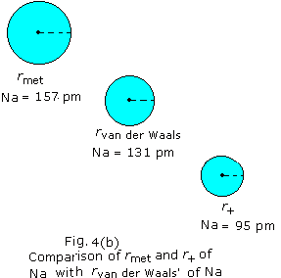
The Size of the Atom and the State of Bonding
COVALENT, METALLIC, IONIC AND VAN DER WAALS RADII OF ATOMS

Slide 43
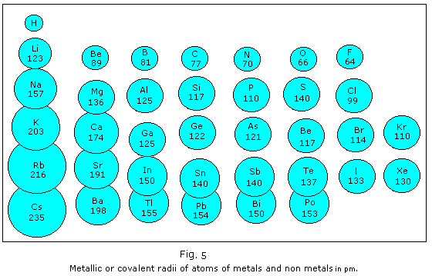
The Size of the Atom and the State of Bonding
COVALENT, METALLIC, IONIC AND VAN DER WAALS RADII OF ATOMS

Slide 44
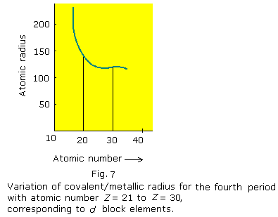
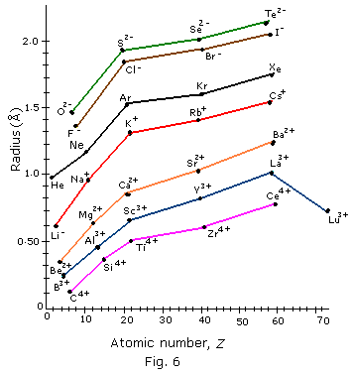
The Size of the Atom and the State of Bonding
COVALENT, METALLIC, IONIC AND VAN DER WAALS RADII OF ATOMS

Slide 45
PERIODICITY OF PROPERTIES OF THE BONDED ATOM
ELECTRONEGATIVITY
The Link between
the
Properties of the Free Atom
and
Properties of Substances

Slide 46
PERIODICITY OF PROPERTIES OF THE BONDED ATOM
ELECTRONEGATIVITY
average quantitative expression of the qualitative nature
of an atom participating in bond formation
DEFINITION
ELECTRON AFFINITY
Vs
ELECTRONEGATIVITY
PROBLEMS
DIRECT EXPERIMENTS
SPECIFIC CHEMICAL ENVIRONMENT

Slide 47



PERIODICITY OF PROPERTIES OF THE BONDED ATOM
ELECTRONEGATIVITY
ELECTRONEGATIVITY SCALES
The Mulliken Scale (1934)
The Allred Rochow scale
Surface Density of the Charge
The Pauling scale
Ionic Character, Bond Energy and Δ EN

Slide 48
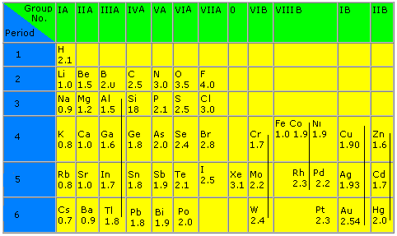
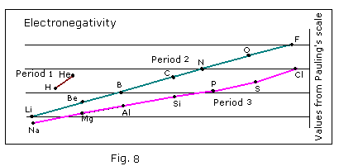
PERIODICITY OF PROPERTIES OF THE BONDED ATOM
ELECTRONEGATIVITY
= D _{A - B(actual)} – D _{A - B(cov)}
D _{A - B(cov)} =
relative electronegativity scale

Slide 49
PERIODICITY OF PROPERTIES OF THE BONDED ATOM
ELECTRONEGATIVITY
SAME ELEMENT WITH DIFFERENT ELECTRONEGATIVITY VALUES
different sources quote slightly different values
effective electronegativity values and oxidation states
CO
CO₂
Cr₂O₃
CrO₃
PERIODIC BEHAVIOUR OF ELECTRONEGATIVITY VALUES
INCREASES
CH₄ < NH₃ < C₂H₂
NON
METALS
?
Electronegativity ++
D
E
C
R
E
A
S
E
S
SIMILAR
Electronegativity - -
METALS

Slide 50
PERIODICITY OF PROPERTIES OF THE BONDED ATOM
ELECTRONEGATIVITY
Which of the following has a higher electronegativity?
i) Z = 16 or Z = 20
iv) Z = 4 or Z = 9
Metallic and Non- metallic Characteristics and their Relation with Electronegativity
Gold (2.54) !!!
boron (2.0)
hydrogen (2.1)
Electronegativity and reactivity of metals and non-metals
which are more metallic
(for metals) and more
non-metallic
(for non-metals)?
Br, I
Mg, Al
Transition metals
Lithium
Fluorine
Acid or Base Strength of Oxides ?
Random Examples
Potassium and Copper

Slide 51
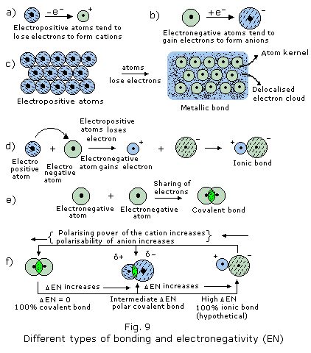
PERIODICITY OF PROPERTIES OF THE BONDED ATOM
ELECTRONEGATIVITY
Can there be a 100% ionic bond?
CsF
EN = (4 - 0.7)
= 3.3
% ionic Character
Calculated
Around 90
Experimental
72%

Slide 52
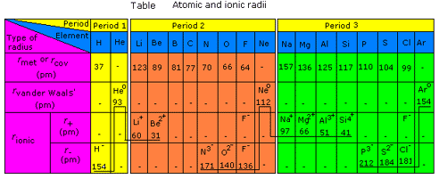
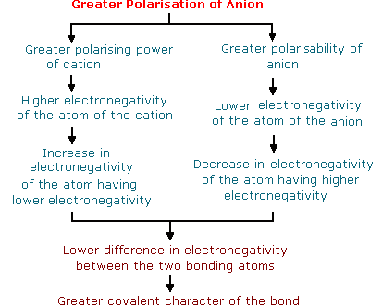
PERIODICITY OF PROPERTIES OF THE BONDED ATOM
ELECTRONEGATIVITY
CORRELATING ELECTRONEGATIVITY,
POLARISING POWER
AND
POLARISABILITY OF IONS
FAJAN’S RULE
Covalency is favoured by the following:
a) Small cation (high polarising power)
b) Large anion (high polarisability)
c) Large charge on either (or both) ions
(increased polarisation) and
d) Cations with non inert gas configuration
(less shielding or higher effective nuclear
charge and hence,
higher polarising power)

Slide 53
USING THE PERIODIC TABLE
PROPERTIES OF ELEMENTS
Density of Metals
Reducing Power of Metals and Oxidizing Power of Non-metals
Thermal and Electrical Conductivity

Slide 54
USING THE PERIODIC TABLE
PROPERTIES OF IONS
Solvation Energy
Stability
Magnetic Properties and Colour
Ability to Form Complexes

Slide 55
USING THE PERIODIC TABLE
PROPERTIES OF IONIC COMPOUNDS
Lattice Energy
Melting Point
Hydration Energy and Stability
Stabilities of Salts of Oxyacids

Slide 56
USING THE PERIODIC TABLE
PROPERTIES OF COVALENT COMPOUNDS
Lattice Energy
Melting Point
Hydration Energy and Solubility
Stabilities of Salts of Oxyacids

Slide 57
Number of electrons in
The valence shell
The Table
Stability due to
configuration
Oxidation State
Number of electrons in
Inner shells
G
R
O
U
P
N
U
M
B
E
R
Size
Division
Into s and p
blocks
Principal quantum number of
The valence shell
Covalency
Shielding
Number of Inner shells
Division
Into d and f
blocks
Coordination
number
Modifying factor
Derived from
Electronic
configuration
Types of inner subshells
A
T
O
M
I
C
N
U
M
B
E
R
Direct Information
Derived Information
PERIOD
NUMBER
Direct
Information
Electronic
Configuration
Periodic Variation
Organization of
The Periodic Table
Nuclear
Charge
Derived
Information
Monotonic Variation
Direct Information
Correlation
Experimental
Information
For Free Atom
Linking
Concepts
Physical and
Chemical Properties
Of Elements
Derived
Information
Explanation
Electronegativity
Reactivity
Ionization energy
Charge density =
Effective nuclear charge
r²
Polarizability
And
Polarizing power
Metallic and non
Metallic character
Electron affinity
Charge and size of ion
Nature of bonds
Metallic and covalent radii
Bond length and strength

Slide 58
BONDING

Slide 59
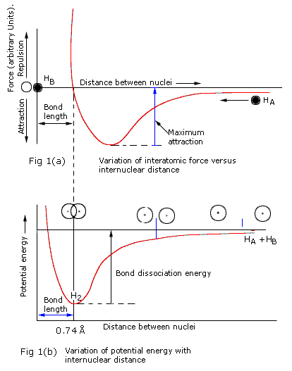
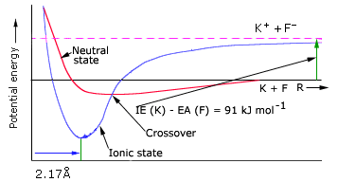
Theoretical Considerations of the
Energetics of Bond Formation
The Covalent bond
The Ionic Bond

Slide 60
Two Theories of Bonding
Valence Bond Theory
Molecular Orbital Theory
Capitalist Philosophy
Socialist Philosophy
resonance
delocalised molecular orbitals
hybridization
hybridization
lone pair and bond pair
orbital box diagrams
Bonding and nonbonding orbitals
number of bonds
bond order
descriptions of σ and π bonds
σ and π molecular orbitals

Slide 61
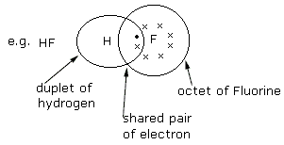
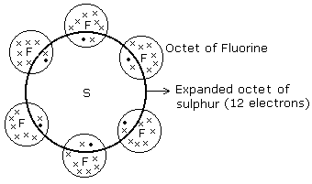
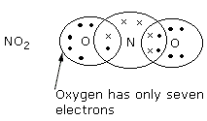
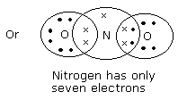
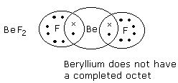
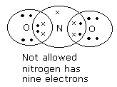
The Lewis Octet Rule and its Violations
Duplet instead of octet
Expanded octet
Incomplete octets
Odd electron molecules

Slide 62
The Lewis dot structure and the information it conveys
Connectivity
Formal charges
Number of bonding and nonbonding electron pairs
Number of bonds

Slide 63









Writing the Lewis Structures of Molecules
Deciding on Connectivity
or
H-H-O ?
H-
-C-O-O-H
?
Using Curved Arrows
:
(right)
(wrong)
Half Arrows

Slide 64









Writing the Lewis Structures of Molecules
..
..
..
Electron Book Keeping
-
+
+
-
+
-
..
..
..
Identifying Coordinate Covalent Bonds

Slide 65
Writing the Lewis Structures of Molecules
 | Lone pairs | Bond pairs
for neutral carbon for neutral nitrogen for neutral oxygen | none (or 1) 1 (or 2) 2 | 4 (or 2) 3 (or 1) 2
for C⁺ for N⁺ for O⁺ | none none 1 | 3 4 3
for C⁻ for N⁻ for O⁻ | 1 2 3 | 3 2 1
Thumb Rules

Slide 66

Writing the Lewis Structures of Molecules
To write a complete Lewis structure, these five steps are followed:
Carbon monoxide
1. Write down the connectivity.
C - O
2. Give each atom its due share of electrons.
3. Pair up all the electrons.
4. Check and correct octets.
5. Assign formal charges.

Slide 67



Writing the Lewis Structures of Molecules
Ozone
1. Write down the connectivity.
O - O - O
2. Give each atom its due share of electrons.
3. Pair up all the electrons.
4. Check and correct octets.
5. Assign formal charges.
..
+
-

Slide 68
Writing the Lewis Structures of Molecules
What about Sulfur dioxide?

Slide 69


Writing the Lewis Structures of Molecules
Nitronium ion
1. Write down the connectivity.
O - N - O (not N - O – O)
2. Give each atom its due share of electrons.
3. Pair up all the electrons.
4. Check and correct octets.
5. Assign formal charges.

Slide 70





Writing the Lewis Structures of Molecules
hydrogen deficiency index (HDI)
CxHy
HDI =
= (number of π
bonds) + (number of rings)
C₆H₆
HDI =
= (three π
bonds) + (one ring)
Structural formula
Molecular formula
Formula after removal
of hetero atom
C₂H₄
C₂H₅N
C₂H₄
C₂H₄O
C₂H₄
C₂H₃Cl

Slide 71

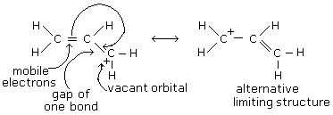
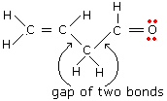
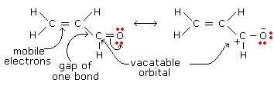



Resonance and Conjugation
Identifying conjugated electrons in a molecule

Slide 72
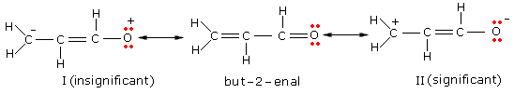




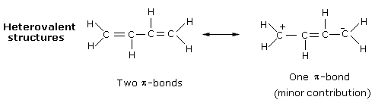

Resonance and Conjugation
How significant is a resonance structure?
Disallowed and unfavoured structures

Slide 73

Resonance and Conjugation
How significant is a resonance structure? Charge separation
But-2-ene
But-2-enal
Butanedione

Slide 74


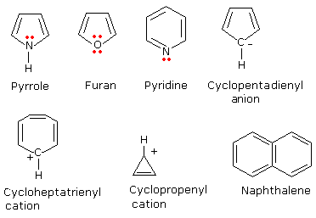
Resonance and Conjugation
Resonance energy, equivalent structures and aromaticity
HUCKEL RULE

Slide 75





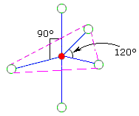
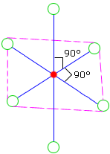

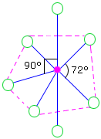

Prediction of Shapes and Bond Angles
The VSEPR Theory
Steric number
2
3
4
5
6
7

Slide 76
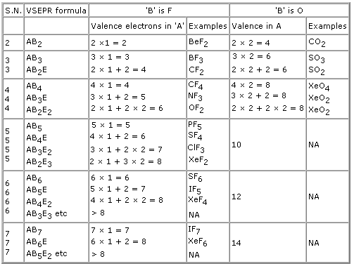
Prediction of Shapes and Bond Angles
The VSEPR Theory
(i) AB₂, AB₂E, AB₂E₂, AB₂E₃
(ii) AB₃, AB₃E, AB₃E₂
(iii) AB₄, AB₄E, AB₄E₂
(iv)AB₅, AB₅E and
(v) AB₆, AB₆E
will show variation of shapes
within each set.
Step 1. Find out the steric number from the lewis structure
Step 2. Write down the VSEPR formula for the given molecule as ABmEn
Step 3. Determine the shapes of the molecule

Slide 77














Prediction of Shapes and Bond Angles
The VSEPR Theory
How do we know where to put the lone pairs
NO₂⁺
SO₂,
XeO₂
HgCl₂
, NO₂⁻
ICl₂⁻
CO₂
OF₂
XeF₂
SCl₂
OCS
H₂O
I₃⁻
N₂O
BrF₃
XeO₃
PCl₃
BF₃
SO₃²⁻
H₃O⁺
CO₃²⁻
ClF₃
NO₃⁻
NH₃
SO₃
CHCl₃
PCl₄⁺
IO₂F₂⁻
SO₄²⁻
BH₄⁻
CH₄
SF₄
XeF₄
NH₄⁺
PF₃Cl₂
XeOF₄
PCl₅
BrF₅
SF₆
XeF₆
PF₆⁻

Slide 78
Prediction of Shapes and Bond Angles
The VSEPR Theory
Let us play a game
NO₂⁺
XeF₆
BF₃
NH₄⁺
CO₂
BrF₅
NO₃⁻
SF₄
OCS
PCl₅
SO₄²⁻
CHCl₃
XeO₃
PF₆⁻
ICl₄⁻
HgCl₂
H₃O⁺
SCl₂
CH₄
OF₂
PF₃Cl₂
ClF₃
ICl₂⁻
SF₆
BH₄⁻
SO₃
I₃⁻
XeO₂
BrF₃
SO₂,
IO₂F₂⁻
NO₂⁻
PCl₃
XeF₄
SO₃²⁻
XeOF₄
XeF₂
CO₃²⁻
NH₃
H₂O
PCl₄⁺
N₂O

Slide 79
Prediction of Shapes and Bond Angles
The VSEPR Theory
Let us visualize
NO₂⁻
NH₃
NH₂⁻
SF₄
ICl₃
I₃⁻
IF₅
ICl₄⁻
BeCl₂
BF₃
NH₄⁺
PF₅
IF₆⁺

