Slide 1

Digital Image Processing (CSE/ECE 478)
Lecture-8: Image Enhancement in Frequency Domain – FT of sampled functions, DFT
27.08.2018
Ravi Kiran
Rajvi Shah
Center for Visual Information Technology (CVIT), IIIT Hyderabad

Slide 2
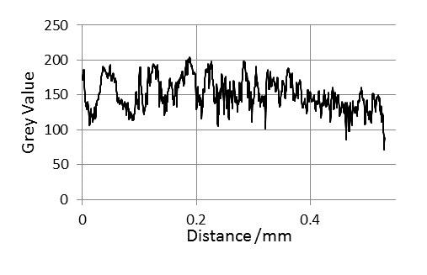
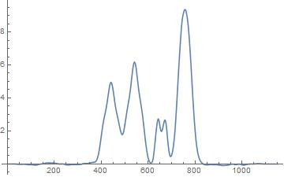
x(t) can be non-periodic
… and/or have limited support
https://i.stack.imgur.com/fKznF.jpg

Slide 3
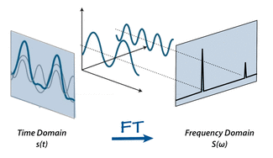
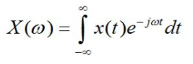
Fourier Transform
For non-periodic fn

Slide 4
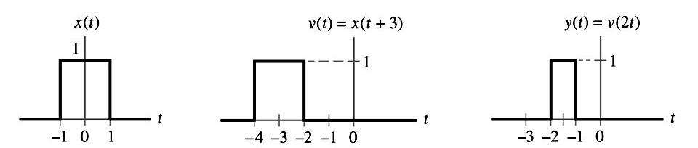
Signal – shift and scale

Slide 5
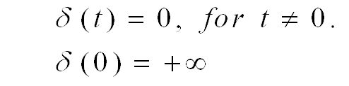
Impulse Function
1
http://lpsa.swarthmore.edu/BackGround/ImpulseFunc/ImpFunc.html

Slide 6
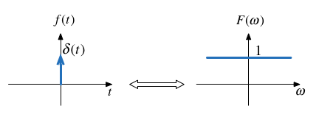
FT of impulse function

Slide 7

Time-shifted Impulse
Time-shifted impulse
Sifting Property
http://lpsa.swarthmore.edu/BackGround/ImpulseFunc/ImpFunc.html

Slide 8

FT of time-shifted impulse

Slide 9
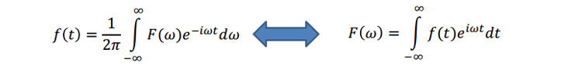
FT of complex exponential

Slide 10
FT of impulse function (intuition)

Slide 11
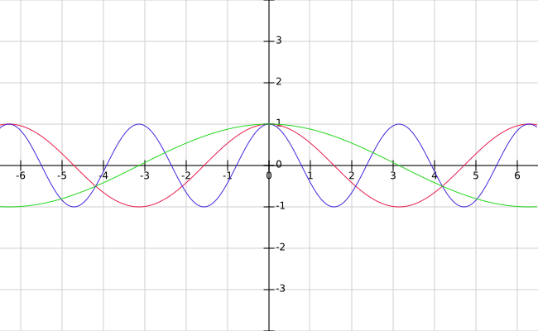
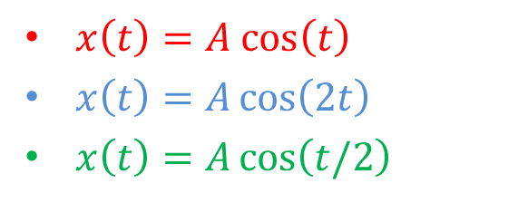
FT of time-shifted impulse
$x\left(t\right)=A cos\left(t\right)$
$x\left(t\right)=A\cos\left(2t\right)$
$x\left(t\right)=A\cos\left(t/2\right)$

Slide 12
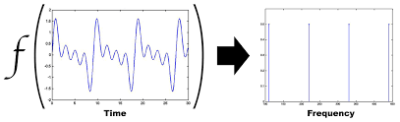


FT of a periodic function
$$F$$
http://lpsa.swarthmore.edu/Fourier/Xforms/FXPeriodic.html
http://devonbryant.github.io/blog/2013/03/02/fourier-transforms/

Slide 13
FT of impulse train

Slide 14
FT of impulse train

Slide 15
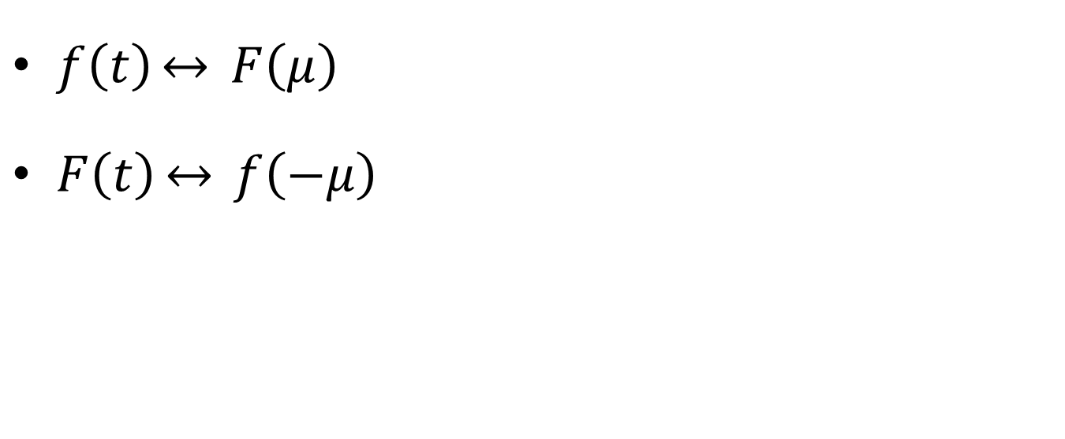
Symmetry property of FT
$f\left(t\right)\underset{↔}{} F\left(μ\right)$
$F\left(t\right)\underset{↔}{} f\left(−μ\right)$

Slide 16
Convolution

Slide 17
Convolution Theorem

Slide 18
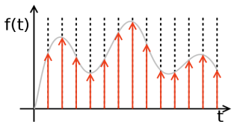
Sampling

Slide 19
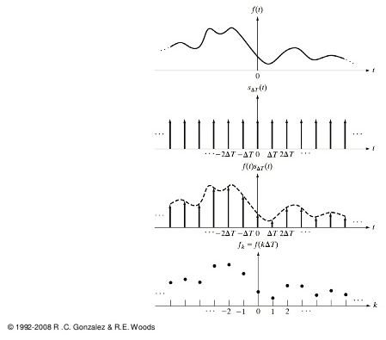
Sampling = f(t) x Impulse Train

Slide 20
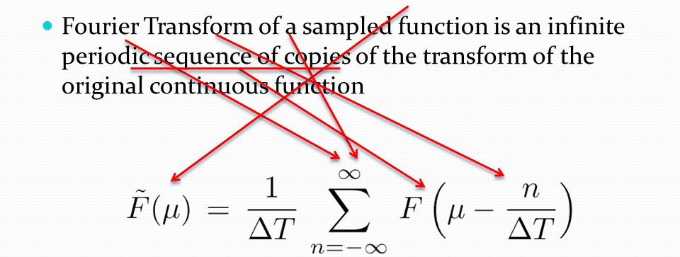
FT of sampled function

Slide 21
FT of sampled function
Continuous
Periodic (copies of f(t)’s FT)
NOTE: FT is continuous

Slide 22
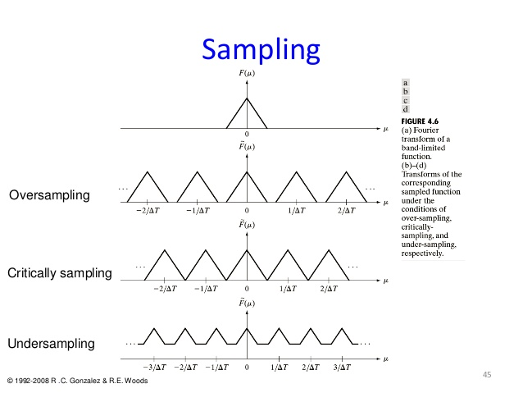

Slide 23
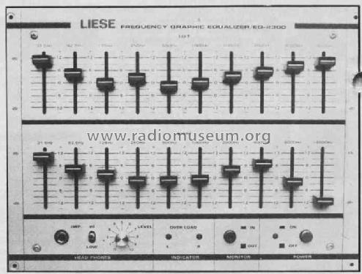
Digital processing of frequencies
Need discrete frequency samples, but FT of sampled function is

Slide 24
Observation
Characterizing one period is enough
How do we actually get the frequency ‘samples’ ?

Slide 25
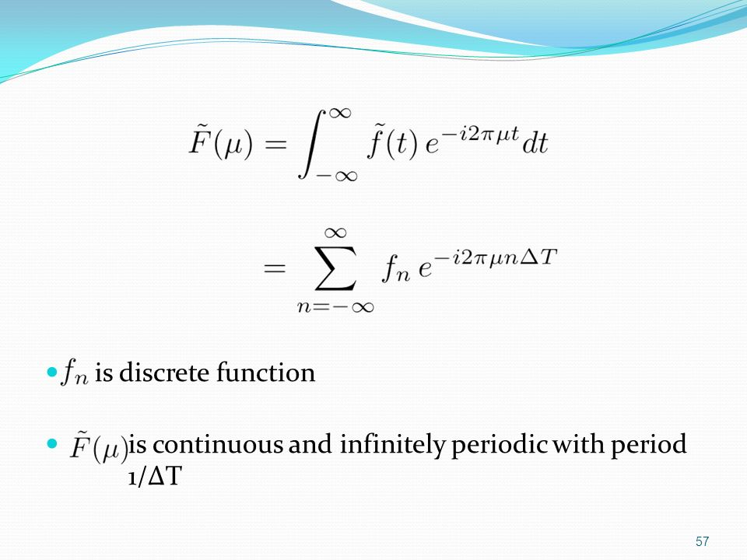
Discrete Fourier Transform
FT of sampled function .. In terms of sampled function
https://slideplayer.com/slide/10719747/

Slide 26
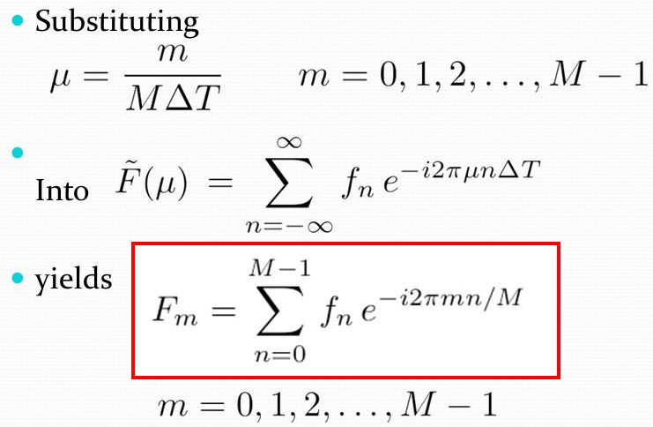
https://slideplayer.com/slide/10719747/

Slide 27
DFT and IDFT

Slide 28
Relationship between Sampling and Frequency Intervals

Slide 29
References & Fun Reading/Viewing
GW DIP textbook, 3rd Ed., (4.2.4, 4.2.5,4.3.1,4.3.2, 4.4.1)
http://www.thefouriertransform.com/
A visual introduction to Fourier Transform: https://www.youtube.com/watch?v=spUNpyF58BY
Fourier Transform, Fourier Series and Frequency Spectrum: https://www.youtube.com/watch?v=r18Gi8lSkfM

Slide 30
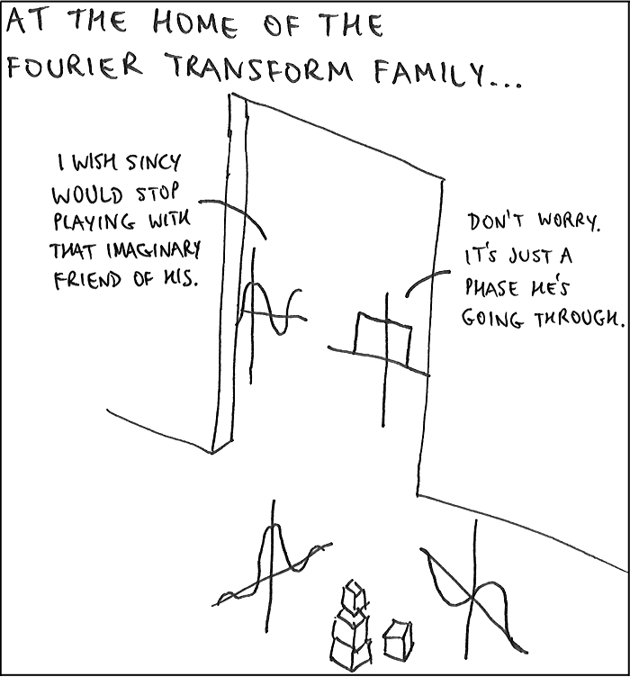
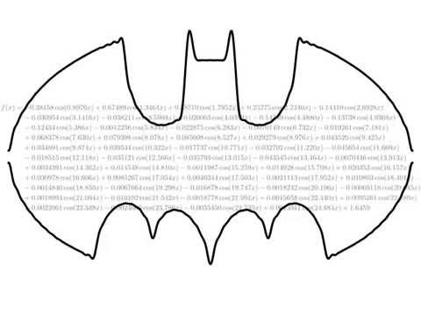
sinc(ax) = sin(ax)/ax
https://www.youtube.com/watch?v=IhAiINH7pBU
https://i.stack.imgur.com/wKrSc.png

