Slide 1
File System
Objectives
  Function of file systems
  Describe the interfaces to file systems
  Discuss design trade-offs
  Explore file system protection

Slide 2
File Concept
Contiguous logical address space
File is an abstraction by OS.
These are mapped to physical devices
Types:
  Data
    numeric
    character
    binary
  Program

Slide 3
File Structure
None - sequence of words, bytes
Simple record structure
  Lines
  Fixed length
  Variable length
Complex Structures
  Formatted document
  Relocatable load file
Can simulate last two with first method by inserting appropriate control characters
Who decides:
  Operating system
  Program

Slide 4
Common terms related to files
Common terms
  Field is the basic element of data
  A record is collection of related fields
  A file is a collection of similar records
  A database is a collection of related data/files
Typical operations to be supported
  Retrieve_all: Retrieve all the records in the file
  Retrieve_one: Retrieve one record
  Retrieve_next: Retrieve next
  Retrieve_previous: Retrieve previous
  Insert_One
  Delelete_One
  Update_one
  Retrieve_few

Slide 5
File Management Systems (FMS)
A file management system is the set of system software that provides services and applications in the use of files. Users can access files only through FMS.
This relieves the programmer of necessity of developing special-purpose software for each application.
Objectives of FMS
  To meet the data management needs and requirements of the user: storage of data and ability to perform operations
  Optimize the performance regarding throughput and response time
  To provide I/O support for variety of storage devices
  To prevent the potential lost of destroyed data
  To provide I/O support for multiple users.

Slide 6
Minimal et of requirements of FMS
Each user should be able to create, delete, read, change files
Each user may have controlled access to other user’s files
Each user should control access to his/her files
Each user should be able to restructure the files
Each user should be able to move data between files.
Each user should be able to backup and recover the user’s files in case of damage
Each user should be able to access the files using symbolic names.

Slide 7
File Attributes
Name – only information kept in human-readable form
Type – needed for systems that support different types
Location – pointer to file location on device
Size – current file size
Protection – controls who can do reading, writing, executing
Time, date, and user identification – data for protection, security, and usage monitoring
Information about files are kept in the directory structure, which is maintained on the disk

Slide 8
File Operations
A file is a abstract data type.
File operations are as follows
  Create
  Write : File position pointer
  Read
  file seek – reposition the pointer within file
  Delete: Search a directory
  Truncate: Keep the attributes and delete the content.
  Open(F_{i}) – search the directory structure on disk for entry F_{i}, and move the content of entry to memory
  Close (F_{i}) – move the content of entry F_{i} in memory to directory structure on disk

Slide 9
Open Files
The OS keeps a small table “Open-file table” containing information about all open files
The open() system call returns a pointer to the entry in Open-file table.
OS maintains two kinds of internal tables
  A per-process table: tracks all the files the process has open
    Current pointer is found here.
  A system-wide table: An entry in per-process tables points to a system-wide open-file table.
    The system-wide table contains process-independent information
      Location of file, access dates and file size.
Several pieces of data are needed to manage open files:
  File pointer: pointer to last read/write location, per process that has the file open
  File-open count: counter of number of times a file is open – to allow removal of data from open-file table when last processes closes it
  Disk location of the file: cache of data access information
  Access rights: per-process access mode information

Slide 10

In-Memory File System Structures
(a) File open (b) File read

Slide 11
Open File Locking
Provided by some operating systems and file systems
Mediates access to a file
Similar to reader-writer locks
A shared lock is similar to reader lock
An exclusive lock is similar to writer lock.
Programmers should be careful in holding exclusive locks for a longer times.
Mandatory or advisory:
  Mandatory – access is denied depending on locks held and requested
  Advisory – processes can find status of locks and decide what to do

Slide 12
File Locking Example – Java API
import java.io.*;
import java.nio.channels.*;
public class LockingExample {
public static final boolean EXCLUSIVE = false;
public static final boolean SHARED = true;
public static void main(String arsg[]) throws IOException {
FileLock sharedLock = null;
FileLock exclusiveLock = null;
try {
RandomAccessFile raf = new RandomAccessFile("file.txt", "rw");
// get the channel for the file
FileChannel ch = raf.getChannel();
// this locks the first half of the file - exclusive
exclusiveLock = ch.lock(0, raf.length()/2, EXCLUSIVE);
/** Now modify the data . . . */
// release the lock
exclusiveLock.release();

Slide 13
File Locking Example – Java API (cont)
// this locks the second half of the file - shared
sharedLock = ch.lock(raf.length()/2+1, raf.length(), SHARED);
/** Now read the data . . . */
// release the lock
exclusiveLock.release();
} catch (java.io.IOException ioe) {
System.err.println(ioe);
}finally {
if (exclusiveLock != null)
exclusiveLock.release();
if (sharedLock != null)
sharedLock.release();
}
}
}

Slide 14

File Types – Name, Extension

Slide 15
File structures
How many file structures should be supported by OS ?
  More file structures implies more complexity
Suppose if OS supports five file structures, code should be provided for all.
UNIX considers file as a sequence of 8-bit bytes.

Slide 16
Access Methods
Sequential Access
read next
write next
reset
no read after last write
(rewrite)
Direct Access
read n
write n
position to n
read next
write next
rewrite n
n = relative block number

Slide 17

Sequential-access File

Slide 18

Simulation of Sequential Access on a Direct-access File

Slide 19

Example of Index and Relative Files

Slide 20
Directory Structure
A collection of nodes containing information about all files
Directory
Files
F 1
F 2
F 3
F 4
F n
Both the directory structure and the files reside on disk
Backups of these two structures are kept on tapes

Slide 21

A Typical File-system Organization

Slide 22
Information in a Device Directory
Name
Type
Address
Current length
Maximum length
Date last accessed (for archival)
Date last updated (for dump)
Owner ID
Protection information (discuss later)

Slide 23
Operations Performed on Directory
Search for a file
Create a file
Delete a file
List a directory
Rename a file
Traverse the file system

Slide 24
Organize the Directory (Logically) to Obtain
Efficiency – locating a file quickly
Naming – convenient to users
  Two users can have same name for different files
  The same file can have several different names
Grouping – logical grouping of files by properties, (e.g., all Java programs, all games, …)

Slide 25

Single-Level Directory
A single directory for all users
Naming problem
Grouping problem

Slide 26

Two-Level Directory
Separate directory for each user
Path name
Can have the same file name for different user
Efficient searching
No grouping capability

Slide 27

Tree-Structured Directories

Slide 28
Tree-Structured Directories (Cont)
Efficient searching
Grouping Capability
Current directory (working directory)
  cd /spell/mail/prog
  type list

Slide 29
Tree-Structured Directories (Cont)
Absolute or relative path name
Creating a new file is done in current directory
Delete a file
rm <file-name>
Creating a new subdirectory is done in current directory
  mkdir <dir-name>
Example: if in current directory /mail
mkdir count
mail
prog
copy
prt
exp
count
Deleting “mail” ⇒ deleting the entire subtree rooted by “mail”

Slide 30

Acyclic-Graph Directories
Have shared subdirectories and files

Slide 31
Acyclic-Graph Directories (Cont.)
Two different names (aliasing)
If dict deletes list ⇒ dangling pointer
Solutions:
  Backpointers, so we can delete all pointers
  Variable size records a problem
  Backpointers using a daisy chain organization
  Entry-hold-count solution

Slide 32

General Graph Directory

Slide 33
General Graph Directory (Cont.)
How do we guarantee no cycles?
  Allow only links to file not subdirectories
  Garbage collection
  Every time a new link is added use a cycle detection
  algorithm to determine whether it is OK

Slide 34
File System Mounting
A file system must be mounted before it can be accessed
A unmounted file system (i.e. Fig. 11-11(b)) is mounted at a mount point

Slide 35
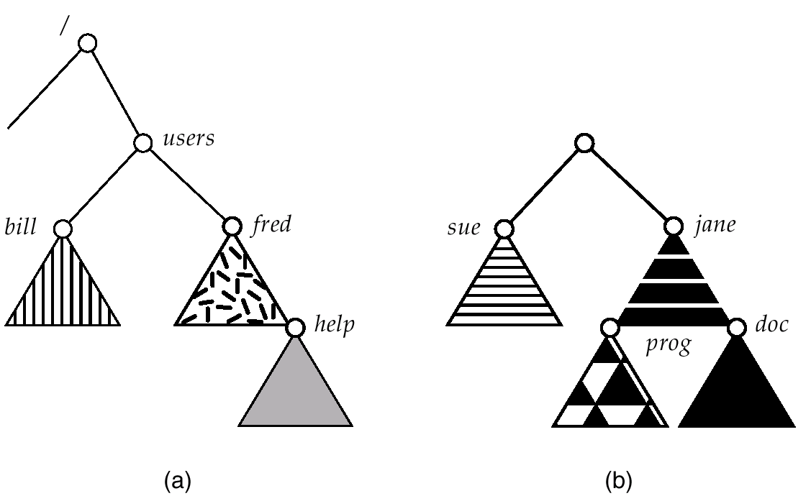
(a) Existing. (b) Unmounted Partition

Slide 36
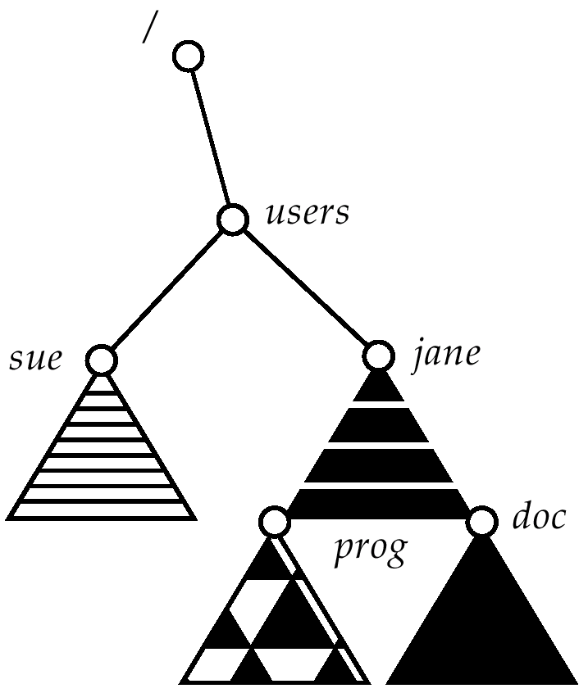
Mount Point

Slide 37
File Sharing
Sharing of files on multi-user systems is desirable
Sharing may be done through a protection scheme
On distributed systems, files may be shared across a network
Network File System (NFS) is a common distributed file-sharing method

Slide 38
File Sharing – Multiple Users
User IDs identify users, allowing permissions and protections to be per-user
Group IDs allow users to be in groups, permitting group access rights

Slide 39
File Sharing – Remote File Systems
Uses networking to allow file system access between systems
  Manually via programs like FTP
  Automatically, seamlessly using distributed file systems
  Semi automatically via the world wide web
Client-server model allows clients to mount remote file systems from servers
  Server can serve multiple clients
  Client and user-on-client identification is insecure or complicated
  NFS is standard UNIX client-server file sharing protocol
  CIFS is standard Windows protocol
  Standard operating system file calls are translated into remote calls
Distributed Information Systems (distributed naming services) such as LDAP, DNS, NIS implement unified access to information needed for remote computing

Slide 40
File Sharing – Failure Modes
Remote file systems add new failure modes, due to network failure, server failure
Recovery from failure can involve state information about status of each remote request
Stateless protocols such as NFS include all information in each request, allowing easy recovery but less security

Slide 41
File Sharing – Consistency Semantics
Consistency semantics specify how multiple users are to access a shared file simultaneously
  Similar to process synchronization algorithms
    Tend to be less complex due to disk I/O and network latency (for remote file systems
  Andrew File System (AFS) implemented complex remote file sharing semantics
  Unix file system (UFS) implements:
    Writes to an open file visible immediately to other users of the same open file
    Sharing file pointer to allow multiple users to read and write concurrently
  AFS has session semantics
    Writes to an open file by a user are not visible immediately to oher users that have the same file open.
    Writes only visible to sessions starting after the file is closed

Slide 42
Protection
File owner/creator should be able to control:
  what can be done
  by whom
Types of access
  Read
  Write
  Execute
  Append
  Delete
  List

Slide 43
Access Lists and Groups
Mode of access: read, write, execute
Three classes of users
RWX
a) owner access 7 ⇒ 1 1 1
RWX
b) group access 6 ⇒ 1 1 0
RWX
c) public access 1 ⇒ 0 0 1
Ask manager to create a group (unique name), say G, and add some users to the group.
For a particular file (say game) or subdirectory, define an appropriate access.
owner
group
public
chmod
761
game
Attach a group to a file
chgrp G game

