Slide 1
Chapter 24: Single-Source Shortest Paths
Given: A single source vertex in a weighted, directed graph.
Want to compute a shortest path for each possible destination.
  Similar to BFS.
We will assume either
  no negative-weight edges, or
  no reachable negative-weight cycles.
Algorithm will compute a shortest-path tree.
  Similar to BFS tree.
Comp 122, Fall 2003
Single-source SPs - <number>

Slide 2
Outline
General Lemmas and Theorems.
  CLRS now does this last. We’ll still do it first.
Bellman-Ford algorithm.
DAG algorithm.
Dijkstra’s algorithm.
We will skip Section 24.4.
Comp 122, Fall 2003
Single-source SPs - <number>

Slide 3
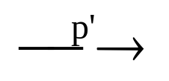
General Results (Relaxation)
Lemma 24.1: Let p = ‹v₁, v₂, …, v_{k}› be a SP from v₁ to v_{k}. Then,
p_{ij} = ‹v_{i}, v_{i+1}, …, v_{j}› is a SP from v_{i} to v_{j}, where 1 ≤ i ≤ j ≤ k.
So, we have the optimal-substructure property.
Bellman-Ford’s algorithm uses dynamic programming.
Dijkstra’s algorithm uses the greedy approach.
Let δ(u, v) = weight of SP from u to v.
Corollary: Let p = SP from s to v, where p = s u →v. Then,
δ(s, v) = δ(s, u) + w(u, v).
Lemma 24.10: Let s ∈ V. For all edges (u,v) ∈ E, we have
δ(s, v) ≤ δ(s, u) + w(u,v).
Comp 122, Fall 2003
Single-source SPs - <number>

Slide 4
Lemma 24.1 holds because one edge gives the shortest path, so the other edges must give sums that are at least as large.
Comp 122, Fall 2003
Single-source SPs - <number>

Slide 5
Relaxation
Algorithms keep track of d[v], π[v]. Initialized as follows:
Initialize(G, s)
for each v ∈ V[G] do
d[v] := ∞;
π[v] := NIL
od;
d[s] := 0
These values are changed when an edge (u, v) is relaxed:
Relax(u, v, w)
if d[v] > d[u] + w(u, v) then
d[v] := d[u] + w(u, v);
π[v] := u
fi
Comp 122, Fall 2003
Single-source SPs - <number>

Slide 6
Properties of Relaxation
d[v], if not ∞, is the length of some path from s to v.
d[v] either stays the same or decreases with time
Therefore, if d[v] = δ(s, v) at any time, this holds thereafter
Note that d[v] ≥ δ(s, v) always
After i iterations of relaxing on all (u,v), if the shortest path to v has i edges, then d[v] = δ(s, v).
Comp 122, Fall 2003
Single-source SPs - <number>

Slide 7
Properties of Relaxation
Consider any algorithm in which d[v], and π[v] are first initialized
by calling Initialize(G, s) [s is the source], and are only changed by
calling Relax. We have:
Lemma 24.11: (∀ v:: d[v] ≥ δ(s, v)) is an invariant.
Implies d[v] doesn’t change once d[v] = δ(s, v).
Proof:
Initialize(G, s) establishes invariant. If call to Relax(u, v, w)
changes d[v], then it establishes:
  d[v] = d[u] + w(u, v)
  ≥ δ(s, u) + w(u, v) , invariant holds before call.
  ≥ δ(s, v) , by Lemma 24.10.
Corollary 24.12: If there is no path from s to v, then
d[v] = δ(s, v) = ∞ is an invariant.
Comp 122, Fall 2003
Single-source SPs - <number>

Slide 8
For lemma 24.11, note that initialization makes the invariant true at the beginning.
Comp 122, Fall 2003
Single-source SPs - <number>

Slide 9
More Properties
Lemma 24.13: Immediately after relaxing edge (u, v) by calling
Relax(u, v, w), we have d[v] ≤ d[u] + w(u, v).
Lemma 24.14: Let p = SP from s to v, where p = s u →v.
If d[u] = δ(s, u) holds at any time prior to calling Relax(u, v, w),
then d[v] = δ(s, v) holds at all times after the call.
Proof:
After the call we have:
  d[v] ≤ d[u] + w(u, v) , by Lemma 24.13.
  = δ(s, u) + w(u, v) , d[u] = δ(s, u) holds.
  = δ(s, v) , by corollary to Lemma 24.1.
By Lemma 24.11, d[v] ≥ δ(s, v), so d[v] = δ(s, v).
Comp 122, Fall 2003
Single-source SPs - <number>

Slide 10
Lemma 24.13 follows simply from the structure of Relax.
Lemma 24.14 shows that the shortest path will be found one vertex at a time, if not faster. Thus after a number of iterations of Relax equal to V(G) - 1, all shortest paths will be found.
Comp 122, Fall 2003
Single-source SPs - <number>

Slide 11
Bellman-Ford returns a compact representation of the set of shortest paths from s to all other vertices in the graph reachable from s. This is contained in the predecessor subgraph.
Comp 122, Fall 2003
Single-source SPs - <number>

Slide 12
Predecessor Subgraph
Lemma 24.16: Assume given graph G has no negative-weight cycles
reachable from s. Let G_{π} = predecessor subgraph. G_{π} is always a
tree with root s (i.e., this property is an invariant).
Proof:
Two proof obligations:
  (1) G_{π} is acyclic.
  (2) There exists a unique path from source s to each vertex in V_{π}.
Proof of (1):
Suppose there exists a cycle c = ‹v₀, v₁, …, v_{k}›, where v₀ = v_{k}.
We have π[v_{i}] = v_{i-1} for i = 1, 2, …, k.
Assume relaxation of (v_{k-1}, v_{k}) created the cycle.
We show cycle has a negative weight.
Note: Cycle must be reachable from s. (Why?)
Comp 122, Fall 2003
Single-source SPs - <number>

Slide 13
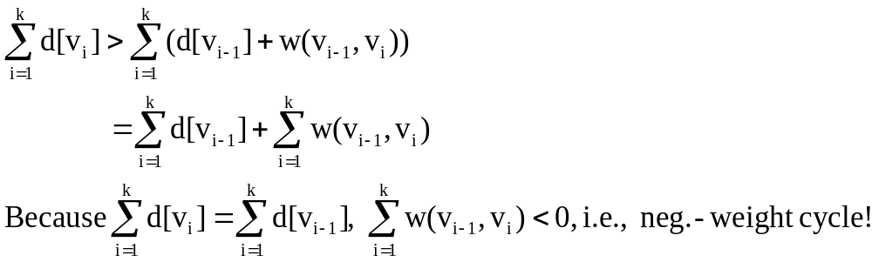
Proof of (1) (Continued)
Before call to Relax(v_{k-1}, v_{k}, w):
  π[v_{i}] = v_{i-1} for i = 1, …, k–1.
  Implies d[v_{i}] was last updated by “d[v_{i}] := d[v_{i-1}] + w(v_{i-1}, v_{i})”
  for i = 1, …, k–1. [Because Relax updates π.]
  Implies d[v_{i}] ≥ d[v_{i-1}] + w(v_{i-1}, v_{i}) for i = 1, …, k–1. [Lemma 24.13]
Because π[v_{k}] is changed by call, d[v_{k}] > d[v_{k-1}] + w(v_{k-1}, v_{k}). Thus,
Comp 122, Fall 2003
Single-source SPs - <number>

Slide 14
Comment on Proof
d[v_{i}] ≥ d[v_{i-1}] + w(v_{i-1}, v_{i}) for i = 1, …, k–1 because when Relax(v_{i-1} , v_{i} , w) was called, there was an equality, and d[v_{i-1}] may have gotten smaller by further calls to Relax.
d[v_{k}] > d[v_{k-1}] + w(v_{k-1}, v_{k}) before the last call to Relax because that last call changed d[v_{k}].
Comp 122, Fall 2003
Single-source SPs - <number>

Slide 15
Proof of (2)
Proof of (2):
(∀ v: v ∈ V_{π}:: (∃ path from s to v)) is an invariant.
So, for any v in V_{π}, ∃ at least 1 path from s to v.
Show ≤ 1 path.
Assume 2 paths.
x
s
u
z
v
y
impossible!
Comp 122, Fall 2003
Single-source SPs - <number>

Slide 16
Lemma 24.17
Lemma 24.17: Same conditions as before. Call Initialize & repeatedly
call Relax until d[v] = δ(s, v) for all v in V. Then, G_{π} is a shortest-path
tree rooted at s.
Proof:
Key Proof Obligation: For all v in V_{π}, the unique simple path p from
s to v in G_{π} (path exists by Lemma 24.16) is a shortest path from s to v
in G.
Let p = ‹v₀, v₁, …, v_{k}›, where v₀ = s and v_{k} = v.
We have d[v_{i}] = δ(s, v_{i})
d[v_{i}] ≥ d[v_{i-1}] + w(v_{i-1}, v_{i}) (reasoning as before)
Implies w(v_{i-1}, v_{i}) ≤ δ(s, v_{i}) – δ(s, v_{i-1}).
Comp 122, Fall 2003
Single-source SPs - <number>

Slide 17
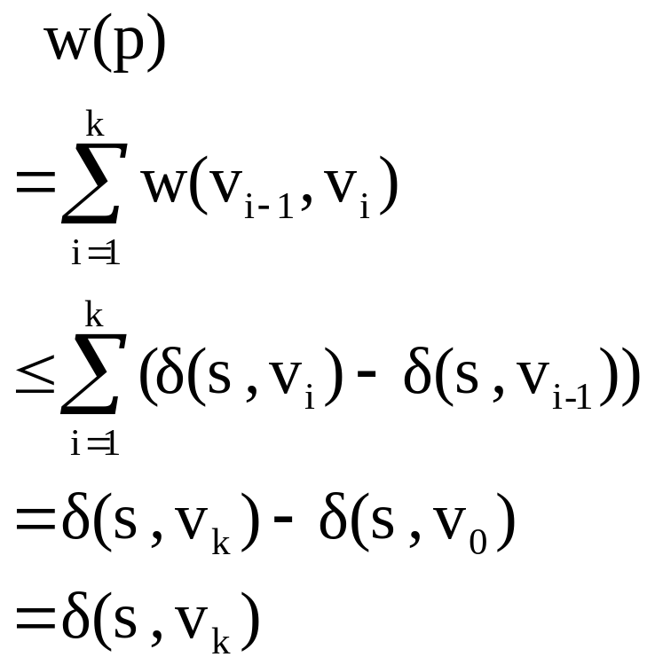
Proof (Continued)
So, equality holds and p is a shortest path.
Comp 122, Fall 2003
Single-source SPs - <number>

Slide 18
And note that this shortest path tree will be found after V(G) - 1 iterations of Relax.
Comp 122, Fall 2003
Single-source SPs - <number>

Slide 19
Bellman-Ford Algorithm
Can have negative-weight edges. Will “detect” reachable negative-weight
cycles.
Initialize(G, s);
for i := 1 to |V[G]| –1 do
for each (u, v) in E[G] do
Relax(u, v, w)
od
od;
for each (u, v) in E[G] do
if d[v] > d[u] + w(u, v) then
return false
fi
od;
return true
Time
Complexity
is O(VE).
Comp 122, Fall 2003
Single-source SPs - <number>

Slide 20
So if Bellman-Ford has not converged after V(G) - 1 iterations, then there cannot be a shortest path tree, so there must be a negative weight cycle.
Comp 122, Fall 2003
Single-source SPs - <number>

Slide 21
Example
u
v
5
∞
∞
–2
6
–3
8
z
0
7
–4
7
2
∞
∞
9
x
y
Comp 122, Fall 2003
Single-source SPs - <number>

Slide 22
Example
u
v
5
6
∞
–2
6
–3
8
z
0
7
–4
7
2
7
∞
9
x
y
Comp 122, Fall 2003
Single-source SPs - <number>

Slide 23
Example
u
v
5
6
4
–2
6
–3
8
z
0
7
–4
7
2
7
2
9
x
y
Comp 122, Fall 2003
Single-source SPs - <number>

Slide 24
Example
u
v
5
2
4
–2
6
–3
8
z
0
7
–4
7
2
7
2
9
x
y
Comp 122, Fall 2003
Single-source SPs - <number>

Slide 25
Example
u
v
5
2
4
–2
6
–3
8
z
0
7
–4
7
2
7
-2
9
x
y
Comp 122, Fall 2003
Single-source SPs - <number>

Slide 26
Another Look
Note: This is essentially dynamic programming.
Let d(i, j) = cost of the shortest path from s to i that is at most j hops.
d(i, j) =
0 if i = s ∧ j = 0
∞ if i ≠ s ∧ j = 0
min({d(k, j–1) + w(k, i): i ∈ Adj(k)}
∪ {d(i, j–1)}) if j > 0
i
z u v x y
1 2 3 4 5
0 0 ∞ ∞ ∞ ∞
1 0 6 ∞ 7 ∞
2 0 6 4 7 2
3 0 2 4 7 2
4 0 2 4 7 –2
j
Comp 122, Fall 2003
Single-source SPs - <number>

Slide 27
Lemma 24.2
Lemma 24.2: Assuming no negative-weight cycles reachable from
s, d[v] = δ(s, v) holds upon termination for all vertices v reachable
from s.
Proof:
Consider a SP p, where p = ‹v₀, v₁, …, v_{k}›, where v₀ = s and v_{k} = v.
Assume k ≤ |V| – 1, otherwise p has a cycle.
Claim: d[v_{i}] = δ(s, v_{i}) holds after the i^{th} pass over edges.
  Proof follows by induction on i.
By Lemma 24.11, once d[v_{i}] = δ(s, v_{i}) holds, it continues to hold.
Comp 122, Fall 2003
Single-source SPs - <number>

Slide 28
Correctness
Claim: Algorithm returns the correct value.
(Part of Theorem 24.4. Other parts of the theorem follow easily from earlier results.)
Case 1: There is no reachable negative-weight cycle.
Upon termination, we have for all (u, v):
  d[v] = δ(s, v) , by lemma 24.2 (last slide) if v is reachable;
  d[v] = δ(s, v) = ∞ otherwise.
  ≤ δ(s, u) + w(u, v) , by Lemma 24.10.
  = d[u] + w(u, v)
So, algorithm returns true.
Comp 122, Fall 2003
Single-source SPs - <number>

Slide 29
Case 2
Case 2: There exists a reachable negative-weight cycle
c = ‹v₀, v₁, …, v_{k}›, where v₀ = v_{k}.
We have Σ_{i = 1, …, k} w(v_{i-1}, v_{i}) < 0. (*)
Suppose algorithm returns true. Then, d[v_{i}] ≤ d[v_{i-1}] + w(v_{i-1}, v_{i}) for
i = 1, …, k. (because Relax didn’t change any d[v_{i}] ). Thus,
  Σ_{i = 1, …, k} d[v_{i}] ≤ Σ_{i = 1, …, k} d[v_{i-1}] + Σ_{i = 1, …, k} w(v_{i-1}, v_{i})
But, Σ_{i = 1, …, k} d[v_{i}] = Σ_{i = 1, …, k} d[v_{i-1}].
Can show no d[v_{i}] is infinite. Hence, 0 ≤ Σ_{i = 1, …, k} w(v_{i-1}, v_{i}).
Contradicts (*). Thus, algorithm returns false.
Comp 122, Fall 2003
Single-source SPs - <number>

Slide 30
Shortest Paths in DAGs
Topologically sort vertices in G;
Initialize(G, s);
for each u in V[G] (in order) do
for each v in Adj[u] do
Relax(u, v, w)
od
od
Comp 122, Fall 2003
Single-source SPs - <number>

Slide 31
Example
6
1
r
s
t
u
v
w
∞
5
0
2
∞
7
∞
–1
∞
–2
∞
4
3
2
Comp 122, Fall 2003
Single-source SPs - <number>

Slide 32
Example
6
1
r
s
t
u
v
w
∞
5
0
2
∞
7
∞
–1
∞
–2
∞
4
3
2
Comp 122, Fall 2003
Single-source SPs - <number>

Slide 33
Example
6
1
r
s
t
u
v
w
∞
5
0
2
2
7
6
–1
∞
–2
∞
4
3
2
Comp 122, Fall 2003
Single-source SPs - <number>

Slide 34
Example
6
1
r
s
t
u
v
w
∞
5
0
2
2
7
6
–1
6
–2
4
4
3
2
Comp 122, Fall 2003
Single-source SPs - <number>

Slide 35
Example
6
1
r
s
t
u
v
w
∞
5
0
2
2
7
6
–1
5
–2
4
4
3
2
Comp 122, Fall 2003
Single-source SPs - <number>

Slide 36
Example
6
1
r
s
t
u
v
w
∞
5
0
2
2
7
6
–1
5
–2
3
4
3
2
Comp 122, Fall 2003
Single-source SPs - <number>

Slide 37
Example
6
1
r
s
t
u
v
w
∞
5
0
2
2
7
6
–1
5
–2
3
4
3
2
Comp 122, Fall 2003
Single-source SPs - <number>

Slide 38
Dijkstra’s Algorithm
Assumes no negative-weight edges.
Maintains a set S of vertices whose SP from s has been determined.
Repeatedly selects u in V–S with minimum SP estimate (greedy choice).
Store V–S in priority queue Q.
Initialize(G, s);
S := ∅;
Q := V[G];
while Q ≠ ∅ do
u := Extract-Min(Q);
S := S ∪ {u};
for each v ∈ Adj[u] do
Relax(u, v, w)
od
od
Comp 122, Fall 2003
Single-source SPs - <number>

Slide 39
Example
u
v
∞
1
∞
10
9
2
3
s
0
4
6
5
7
∞
∞
2
x
y
Comp 122, Fall 2003
Single-source SPs - <number>

Slide 40
Example
u
v
10
1
∞
10
9
2
3
s
0
4
6
5
7
5
∞
2
x
y
Comp 122, Fall 2003
Single-source SPs - <number>

Slide 41
Example
u
v
8
1
14
10
9
2
3
s
0
4
6
5
7
5
7
2
x
y
Comp 122, Fall 2003
Single-source SPs - <number>

Slide 42
Example
u
v
8
1
13
10
9
2
3
s
0
4
6
5
7
5
7
2
x
y
Comp 122, Fall 2003
Single-source SPs - <number>

Slide 43
Example
u
v
8
1
9
10
9
2
3
s
0
4
6
5
7
5
7
2
x
y
Comp 122, Fall 2003
Single-source SPs - <number>

Slide 44
Example
u
v
8
1
9
10
9
2
3
s
0
4
6
5
7
5
7
2
x
y
Comp 122, Fall 2003
Single-source SPs - <number>

Slide 45
Correctness
Theorem 24.6: Upon termination, d[u] = δ(s, u) for all u in V
(assuming non-negative weights).
Proof:
By Lemma 24.11, once d[u] = δ(s, u) holds, it continues to hold.
We prove: For each u in V, d[u] = δ(s, u) when u is inserted in S.
Suppose not. Let u be the first vertex such that d[u] ≠ δ(s, u) when
inserted in S.
Note that d[s] = δ(s, s) = 0 when s is inserted, so u ≠ s.
⇒ S ≠ ∅ just before u is inserted (in fact, s ∈ S).
Comp 122, Fall 2003
Single-source SPs - <number>

Slide 46
Proof (Continued)
Note that there exists a path from s to u, for otherwise
d[u] = δ(s, u) = ∞ by Corollary 24.12.
⇒ there exists a SP from s to u. SP looks like this:
p₂
u
s
p₁
x
y
S
Comp 122, Fall 2003
Single-source SPs - <number>

Slide 47
Proof (Continued)
Claim: d[y] = δ(s, y) when u is inserted into S.
  We had d[x] = δ(s, x) when x was inserted into S.
  Edge (x, y) was relaxed at that time.
  By Lemma 24.14, this implies the claim.
Now, we have: d[y] = δ(s, y) , by Claim.
≤ δ(s, u) , nonnegative edge weights.
≤ d[u] , by Lemma 24.11.
Because u was added to S before y, d[u] ≤ d[y].
Thus, d[y] = δ(s, y) = δ(s, u) = d[u].
Contradiction.
Comp 122, Fall 2003
Single-source SPs - <number>

Slide 48
Complexity
Running time is
  O(V²) using linear array for priority queue.
  O((V + E) lg V) using binary heap.
  O(V lg V + E) using Fibonacci heap.
(See book.)
Comp 122, Fall 2003
Single-source SPs - <number>

