Slide 1
The Lowest Common Ancestor
In a rooted tree T, a node u is an ancestor of a node v if u is on the unique path from the root to v.
In a rooted tree T, the Lowest Common Ancestor (LCA) of two nodes u and v is the deepest node in T that is the ancestor of both u and v.

Slide 2
For example…
1
2
3
4
5
6
Node 3 is the LCA of nodes 4 and 6.
Node 1 is the LCA of node 2 and 5.

Slide 3
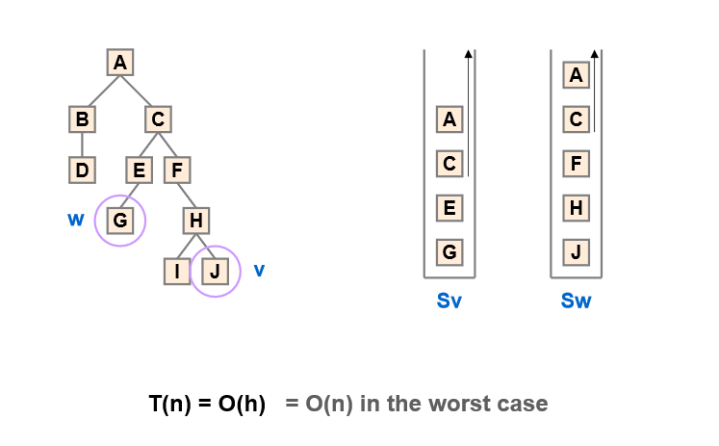
LCA for BT(1)

Slide 4
LCA for BT(2)
struct Node *findLCA(struct Node* root, int n1, int n2)
{
if (root == NULL) return NULL;
if (root->key == n1 || root->key == n2) // one is ancestor of other
return root;
Node *left_lca = findLCA(root->left, n1, n2);
Node *right_lca = findLCA(root->right, n1, n2);
if (left_lca && right_lca) return root; //both found on either sides of root so root is the LCA
return (left_lca != NULL)? left_lca: right_lca; //both found on same side of root so continue search on the single side.
}

Slide 5
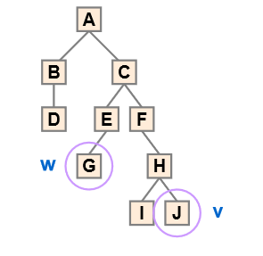
LCA using inorder and post order in BT(3)
Inorder: . B D A G E C F I H J
PostOrder: D B G E I J H F CA
Inorder: B D A G E C F I H J
Position in PostOrder: 2 1 10 3 4 9 8 5 7 6
Max in range is the LCA

Slide 6
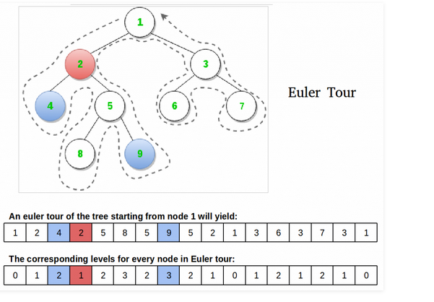

LCA for BT(4): Euler path
http://www.geeksforgeeks.org/find-lca-in-binary-tree-using-rmq/
ooooo
Tour
Level
First
Occurrence

Slide 7
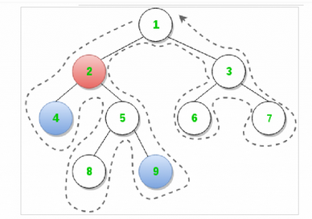
LCA for BT(4): Euler path
http://www.geeksforgeeks.org/find-lca-in-binary-tree-using-rmq/
---LCA has the minimum level among elements between first occurrence of two input elements
--- Look at LevelArray. Element 2 has min level among elements between first occurrence of 4 and 9.
ooooo
Algorithm LCA(u,v)
{
a=FirstOccurrence(u)
b=FirstOccurrence(v)
Let min_index be the index of the minium element in the array Level[] in the range (a,b).
Tour[min_index] gives the LCA(u,v)
}

Slide 8
LCA for BST
struct node *lca(struct node* root, int n1, int n2)
{
if (root == NULL) return NULL;
// If both n1 and n2 are smaller than root, then LCA lies in left
if (root->data > n1 && root->data > n2)
return lca(root->left, n1, n2);
// If both n1 and n2 are greater than root, then LCA lies in right
if (root->data < n1 && root->data < n2)
return lca(root->right, n1, n2);
return root;
}

