Slide 1
Complex Variables

Slide 2
Preview
For real variables, theorems are typically stated for functions defined on intervals (open, closed)
We will introduce the corresponding concepts in the complex plane
Mostly the same as defined in R² (MAT 3238?)

Slide 3
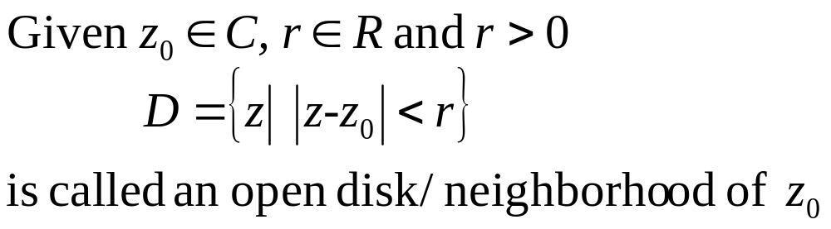


Definition 1 Open Disk/ (Circular) Neighborhood

Slide 4
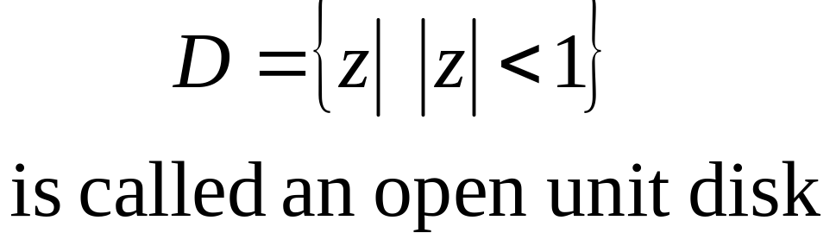
Example 1

Slide 5
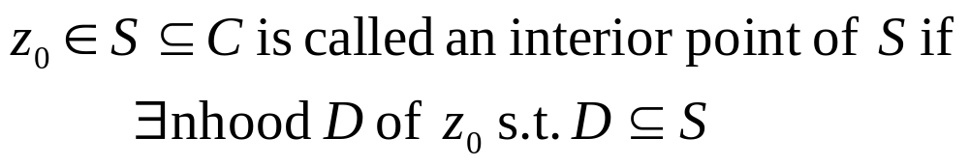

Definition 2 Interior Points

Slide 6
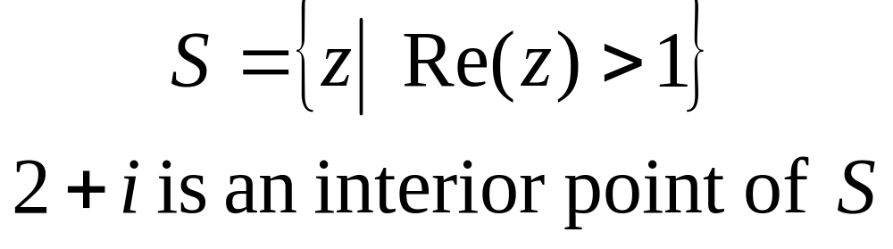
Example 2

Slide 7

Definition 3 Open Sets

Slide 8
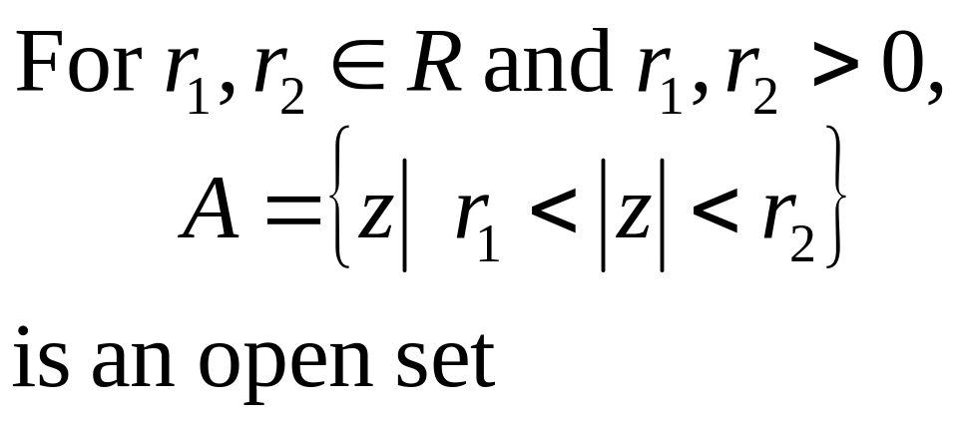
Example 3

Slide 9
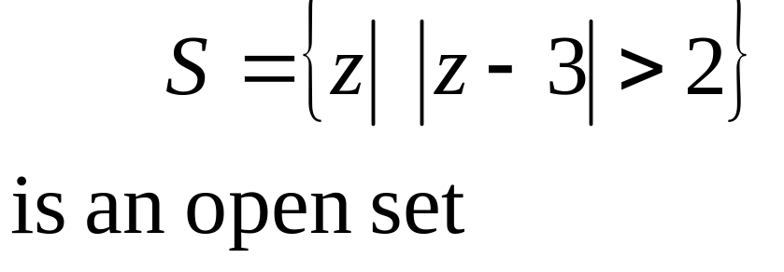
Example 4

Slide 10
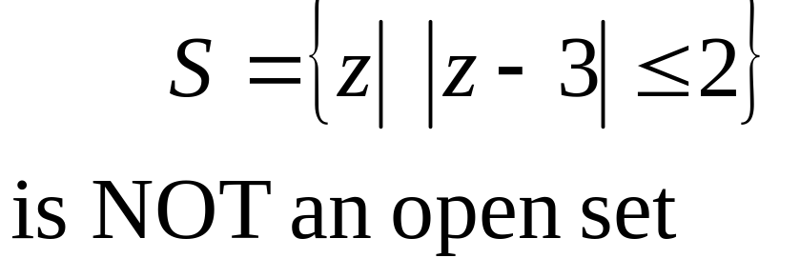
Example 5

Slide 11
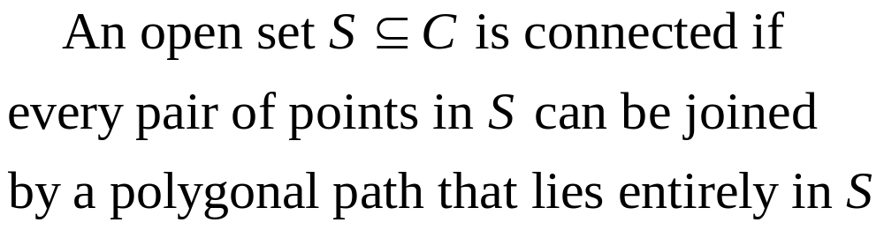
Definition 4
Connected Open Sets

Slide 12
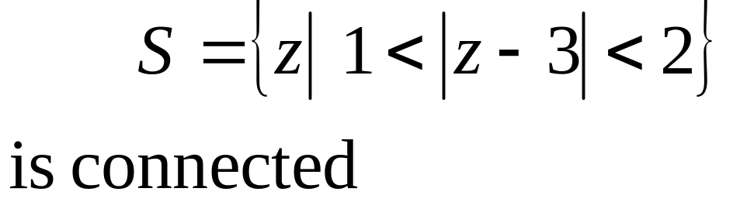
Example 6

Slide 13
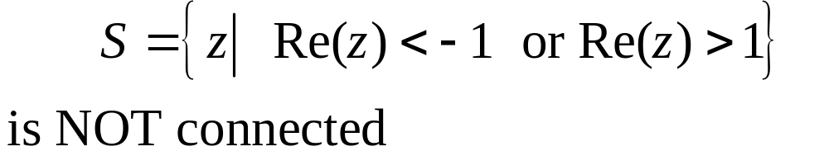
Example 7

Slide 14
Definition 5 Domain

Slide 15
Domain
Many results in real and complex analysis are true only in domains. Below is an example in calculus (real analysis). We will take a look at why the connectedness is important.

Slide 16
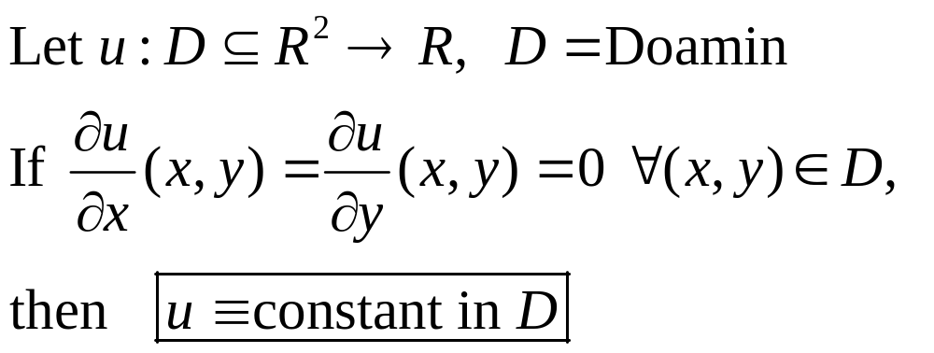
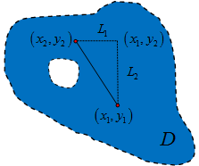
Theorem
Idea

Slide 17
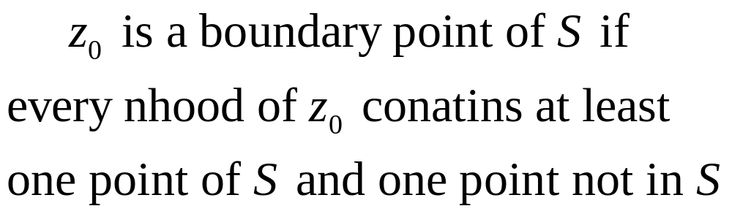
Definition 6 Boundary Points

Slide 18
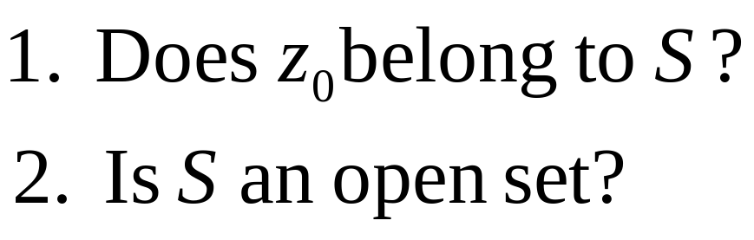
Observations

Slide 19
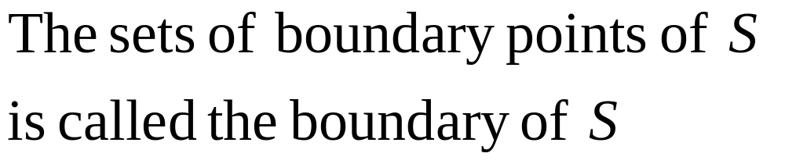
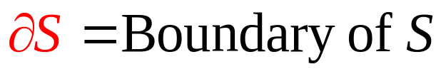
Definition 7 Boundary

Slide 20
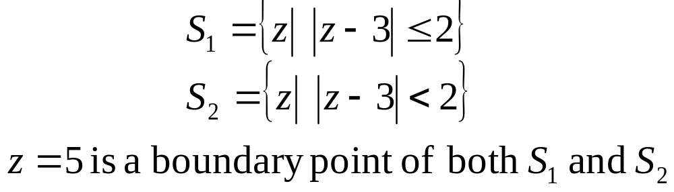
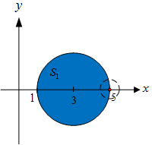

Example 8

Slide 21
Example 8

Slide 22
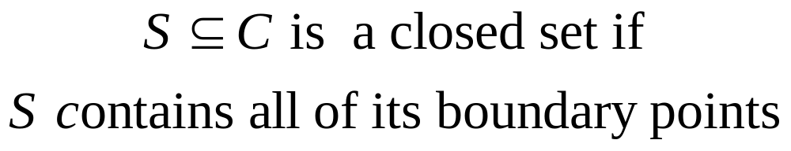
Definition 8 Closed Sets

Slide 23
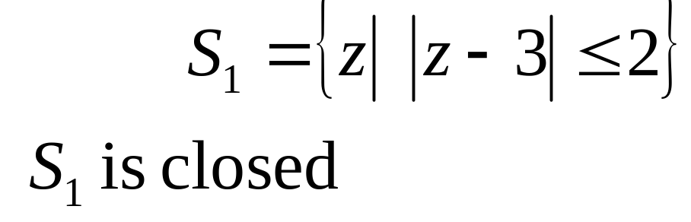
Example 9

Slide 24
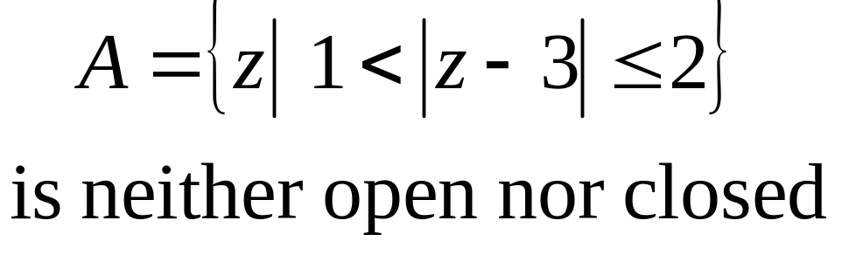
Example 10

Slide 25
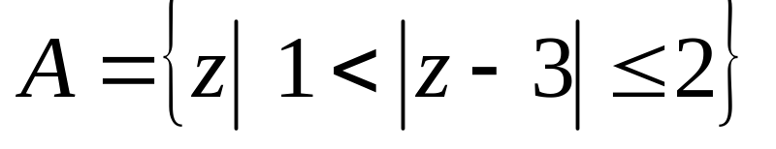




Example 10

Slide 26
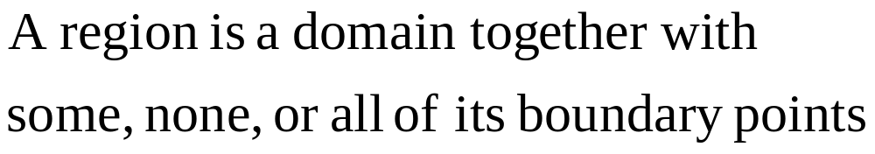
Definition 9 Region

Slide 27
Definition 9 Region
T or F: If D is a domain, then it is a region.

Slide 28
Definition 9 Region
T or F: If D is a domain, then it is a region.
T or F: If D is a region, then it is a domain.

Slide 29
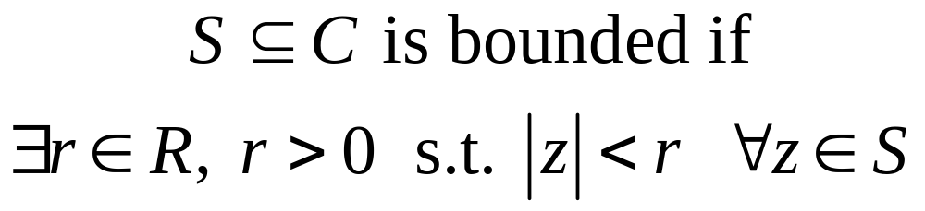

Definition 10 Bounded Sets

Slide 30
Limit of a Function
We say that the complex number w₀ is the limit of the function f(z) as z approaches z₀ if f(z) stays close to w₀ whenever z is sufficiently near z₀ . Formally, we state:

Slide 31

Definition. Limit of a Complex Sequence. Let f(z) be a function defined in some neighborhood of z₀ except with the possible exception of the point z₀ is the number w₀ if for any real number ε > 0 there exists a positive real number δ > 0 such that |f(z) – w₀|< ε whenever 0<|z - z₀|< δ.

Slide 32
Limits: Interpretation
We can interpret this to mean that if we observe points z within a radius δ of z₀, we can find a corresponding disk about w₀ such that all the points in the disk about z₀ are mapped into it. That is, any neighborhood of w₀ contains all the values assumed by f in some full neighborhood of z₀, except possibly f(z₀).
v
y
w = f(z)
ε
δ
w₀
z₀
x
u
z-plane
w-plane

Slide 33
Properties of Limits
If as z → z₀, lim f(z) → A and lim g(z) → B, then
lim [ f(z) ± g(z) ] = A ± B
lim f(z)g(z) = AB, and
lim f(z)/g(z) = A/B. if B ≠ 0.

Slide 34
Continuity
Definition. Let f(z) be a function such that f: C C. We call f(z) continuous at z₀ iff:
  F is defined in a neighborhood of z₀,
  The limit exists, and
A function f is said to be continuous on a set S if it is continuous at each point of S. If a function is not continuous at a point, then it is said to be singular at the point.

Slide 35
Note on Continuity
One can show that f(z) approaches a limit precisely when its real and imaginary parts approach limits, and the continuity of f(z) is equivalent to the continuity of its real and imaginary parts.

Slide 36
Properties of Continuous Functions
If f(z) and g(z) are continuous at z₀, then so are f(z) ± g(z) and f(z)g(z). The quotient f(z)/g(z) is also continuous at z₀ provided that
g(z₀) ≠ 0.
Also, continuous functions map compact sets into compact sets.

Slide 37
Derivatives
Differentiation of complex-valued functions is completely analogous to the real case:
Definition. Derivative. Let f(z) be a complex-valued function defined in a neighborhood of z₀. Then the derivative of f(z) at z₀ is given by
Provided this limit exists. F(z) is said to be differentiable at z₀.

Slide 38
Properties of Derivatives

