Slide 1

Stack Overflow Survey Data Analysis
Shubha Pandey
11 June 2025

Slide 2



OUTLINE
Executive Summary
Introduction
Methodology
Results
Visualization – Charts
Dashboard
Discussion
Findings & Implications
Conclusion
Appendix

Slide 3

EXECUTIVE SUMMARY
The dashboard summarizes insights from the Stack Overflow Developer Survey.
Covers current and future tech usage along with demographics.
Helps identify industry patterns and developer preferences.
Current Technology Usage
Languages: JavaScript, Python, SQL are top-used.
Databases: MySQL, PostgreSQL, SQLite most common.
Platforms: Windows, Linux, macOS preferred environments.
Web Frameworks: React.js, Node.js, Angular widely used.
Future Technology Trends
Desired Languages: Python, Go, TypeScript in demand.
Desired Databases: PostgreSQL, MongoDB, Redis popular choices.
Preferred Platforms: Developers prefer modern, cross-platform systems.
Future Frameworks: React.js, Vue.js, Next.js trending.
Demographics
Countries: Majority from the US, India, Germany.
Age Groups: Most respondents are aged 25–34.
Education: Majority hold Bachelor's or Master's degrees.
Employment: Most work full-time in development roles.
The insights help employers, educators, and product teams align strategies with developer needs and trends.

Slide 4

INTRODUCTION
Purpose of the Report
Analyze developer trends from Stack Overflow's survey data.
Visualize current and future technology preferences.
Understand developer demographics.
Target Audience
Tech companies and hiring managers
Educators and curriculum designers
Career advisors and policy makers
Developers interested in industry trends
Value of the Report
Guides recruitment and training strategies.
Supports curriculum planning for tech education.
Helps product teams align tools and platforms with user needs.
Offers developers data-backed career direction.

Slide 5

METHODOLOGY
Data Source
Stack Overflow Developer Survey dataset
Publicly available, structured, and self-reported by developers worldwide
Data Collection
Conducted via online survey
Includes responses on tools, platforms, roles, preferences, and demographics
Data Wrangling and Preprocessing
Handled multi-select columns
Removed null or irrelevant responses
Grouped and aggregated categorical data (e.g., age ranges, education)
Extracted top values using value counts and frequency ranking
Converted some categorical values to numeric for plotting

Slide 6
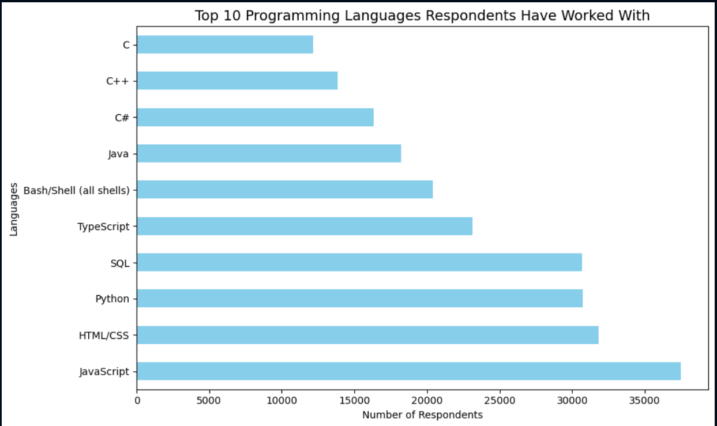
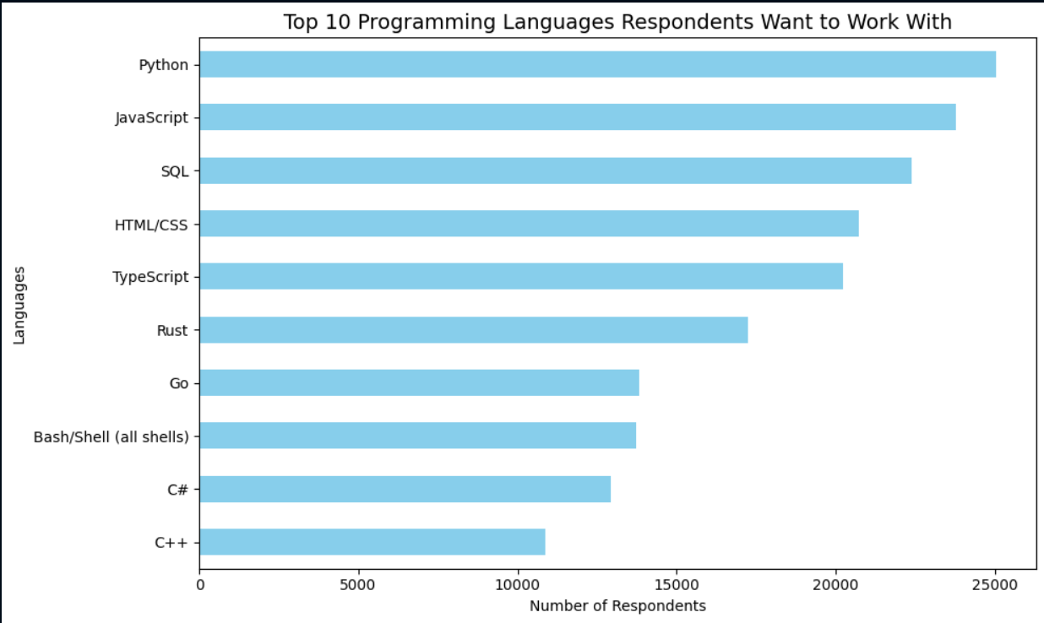
PROGRAMMING LANGUAGE TRENDS
Current Year
Next Year
<Bar chart of top 10 programming languages for the current year goes here.>
< Bar chart of top 10 programming languages for the next year goes here.>

Slide 7
PROGRAMMING LANGUAGE TRENDS - FINDINGS & IMPLICATIONS
Findings
JavaScript and Python are Dominant
HTML/CSS & SQL Remain Core
TypeScript Gaining Ground
C, C++, Java, C# are Still Strong in Legacy/Enterprise
Rust, Go, and Kotlin are Emerging
Implications
Python is a Must-Learn
TypeScript is the Future of Front-End
Full-Stack Developers Need Versatility
Modern Systems Programmers Should Learn Rust/Go
Language Ecosystem is Diverse

Slide 8
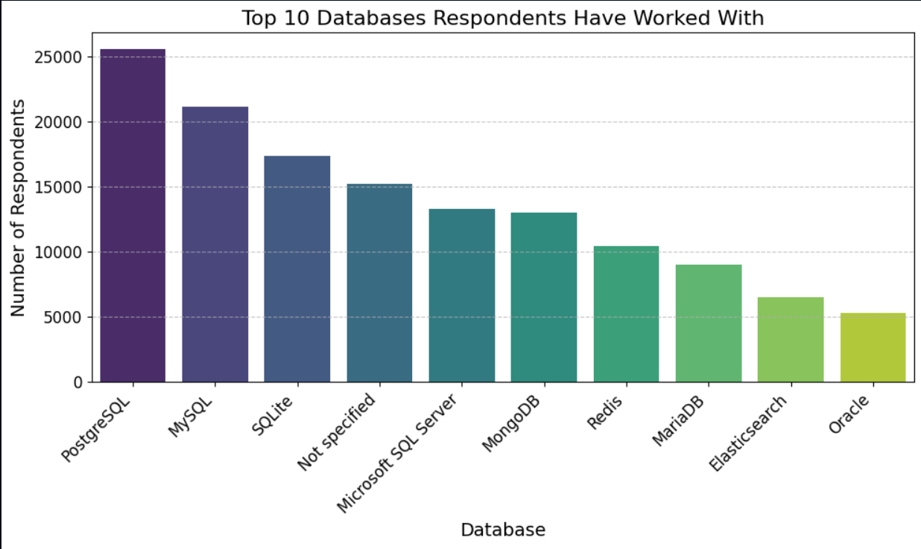
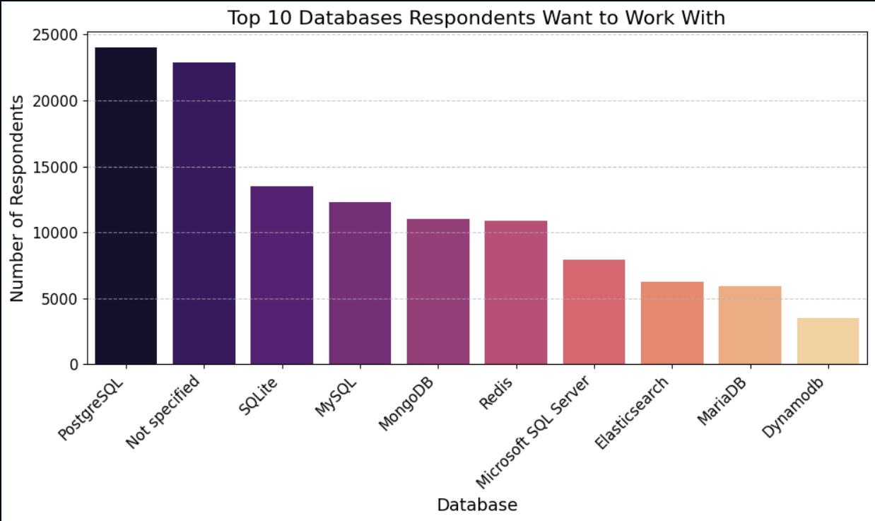
DATABASE TRENDS
Current Year
Next Year
< Bar chart of top 10 databases for the current year goes here >
< Bar chart of top 10 databases for the next year goes here.>

Slide 9
DATABASE TRENDS - FINDINGS & IMPLICATIONS
Findings
MySQL and PostgreSQL are the most widely used.
Oracle and Microsoft SQL Server still retain enterprise usage.
MongoDB leads NoSQL demand.
Firebase and Redis remain in top demand
Implications
Adoption of real-time and cloud-native databases is rising.
Enterprise demand for Oracle/SQL Server is decreasing among newer talent.
Developers are diversifying across RDBMS and NoSQL depending on use case.
Upskilling in PostgreSQL, MongoDB, and Firebase will align with market trends.

Slide 10

DASHBOARD
Top 10 Programming Languages In Current and Next Year
Top 10 Databases In Current and Next Year
Current technology
Future Technology
Demographics

Slide 11
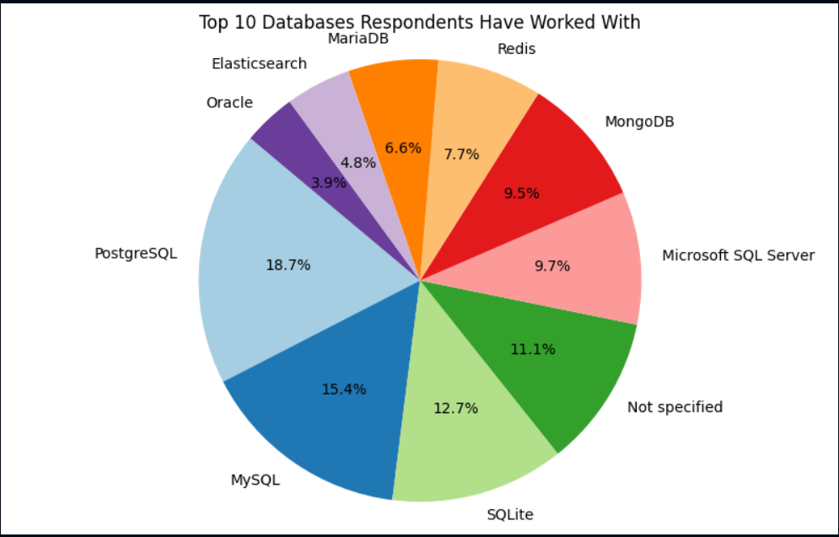
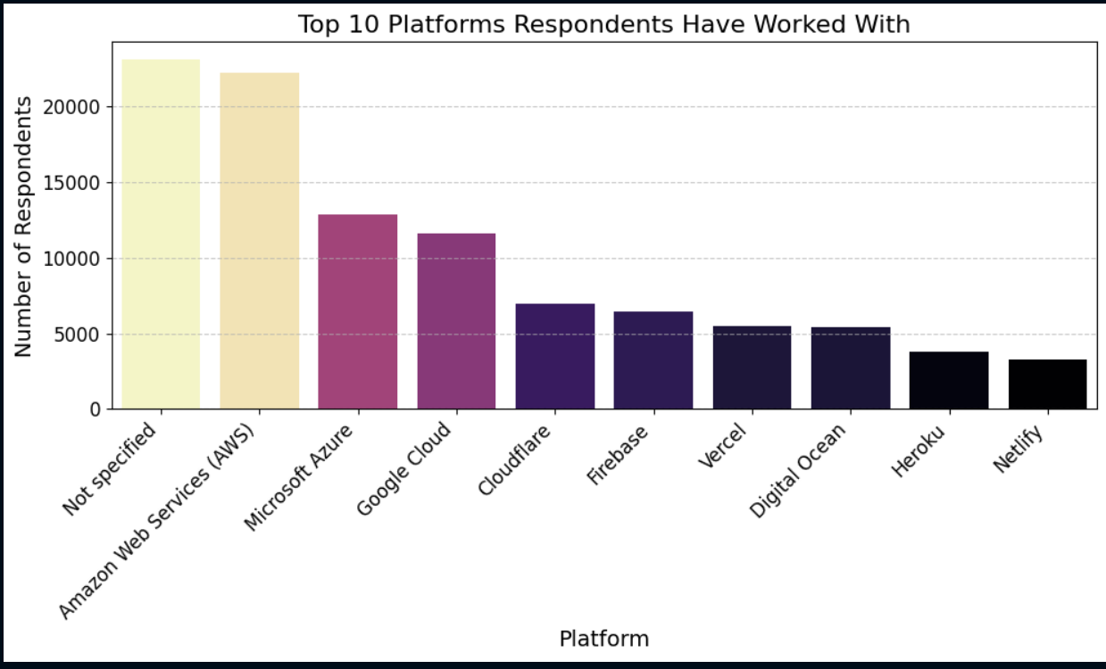
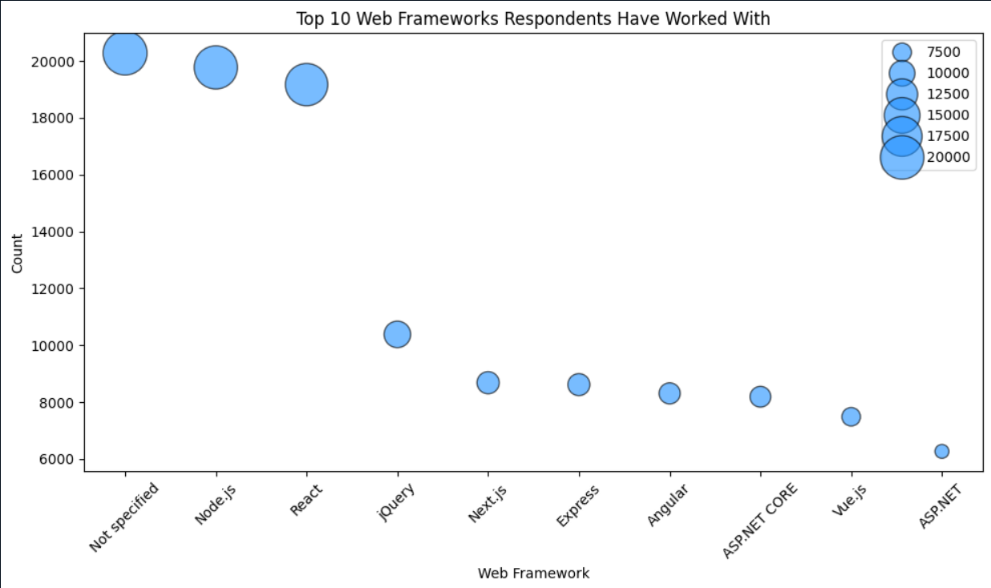
DASHBOARD TAB 1

Slide 12
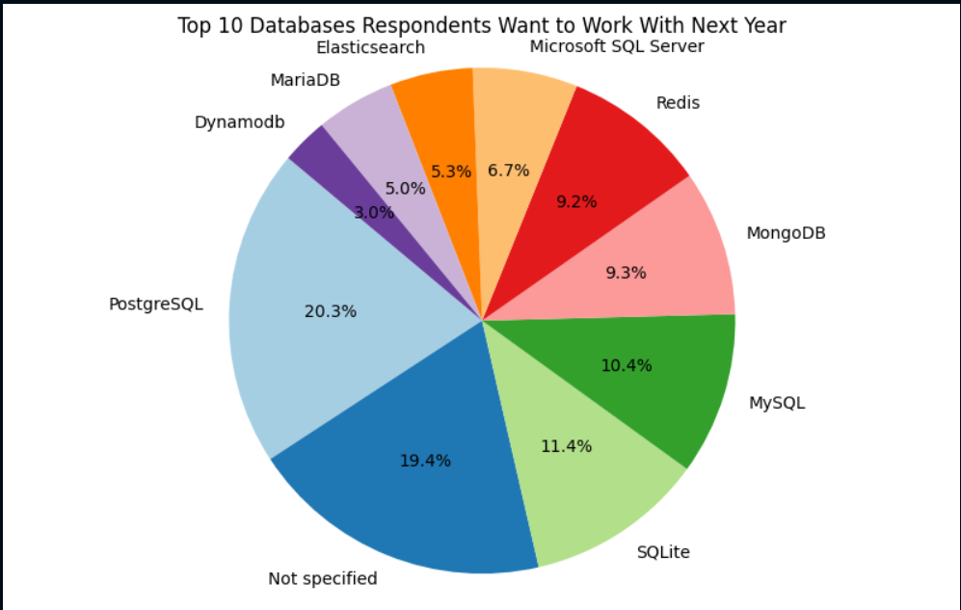
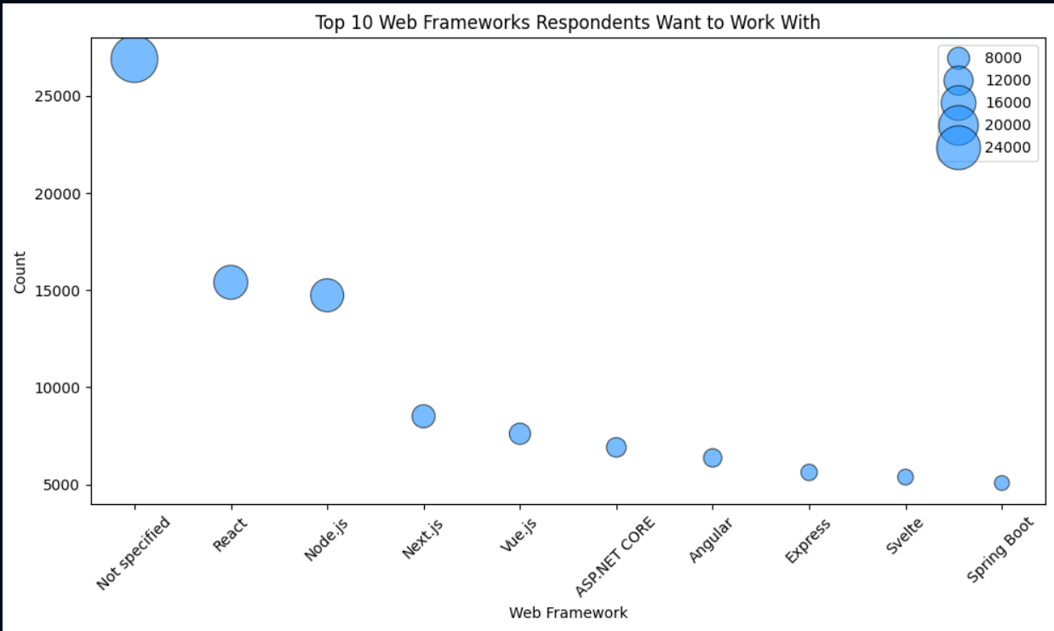
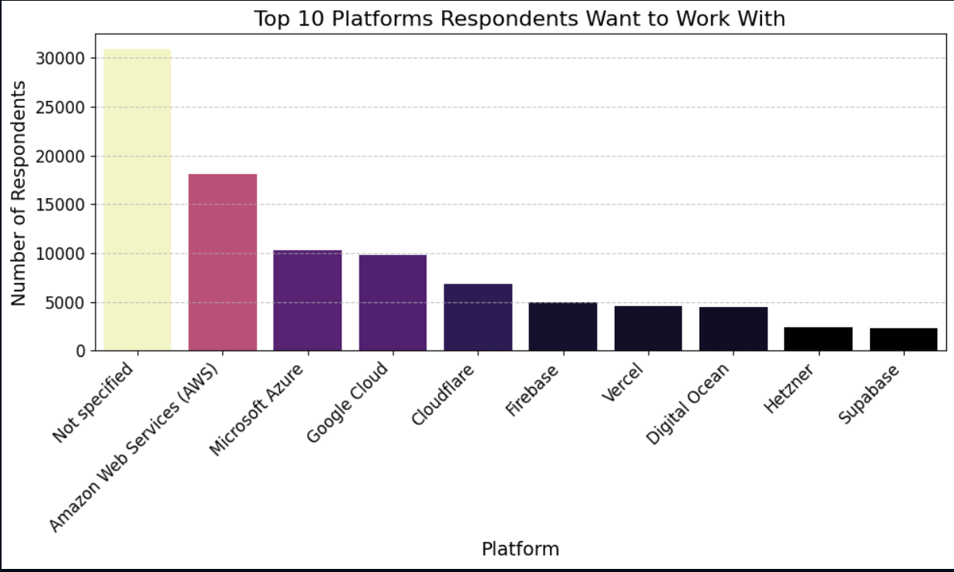
DASHBOARD TAB 2

Slide 13
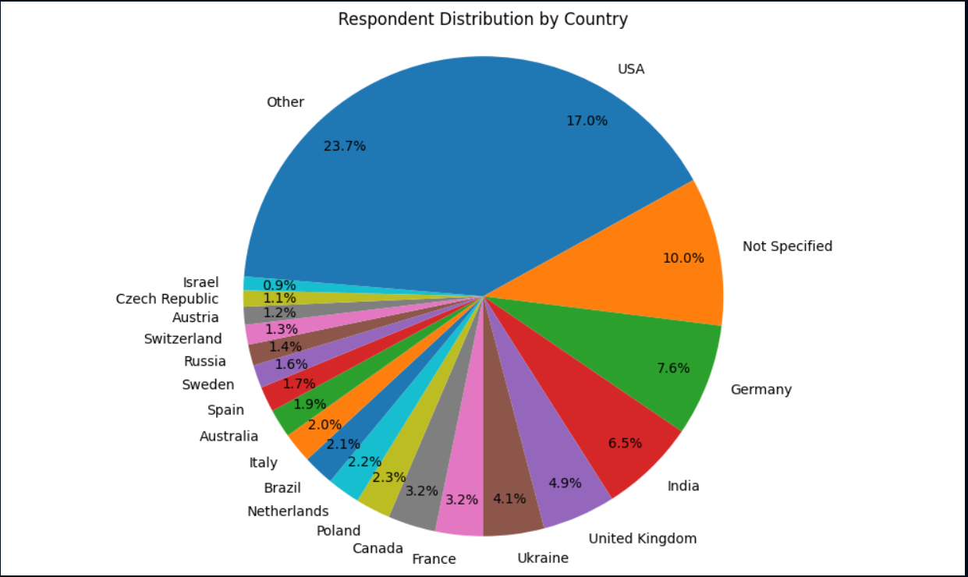
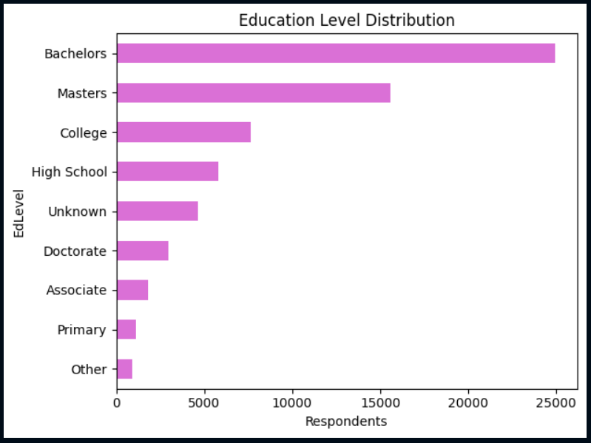
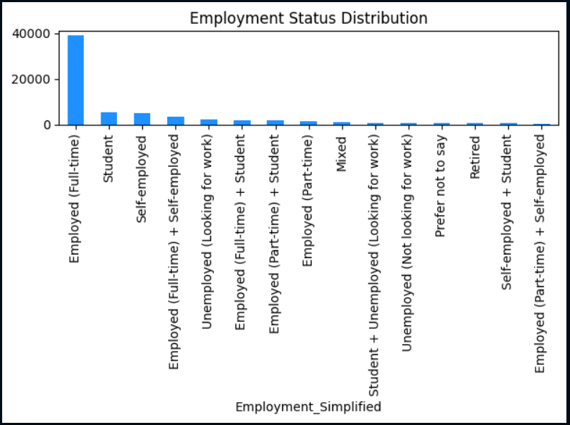
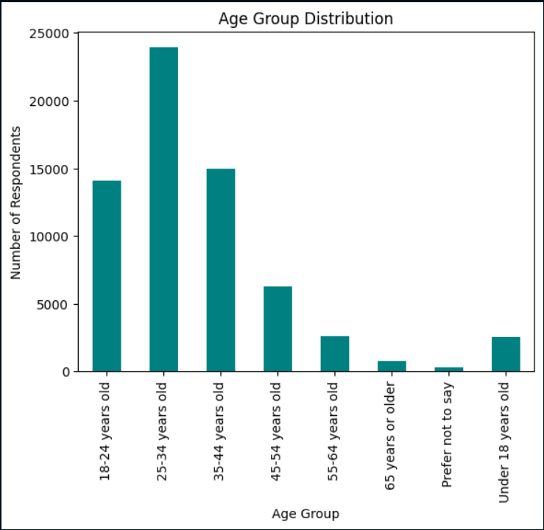
DASHBOARD TAB 3

Slide 14
DISCUSSION
📌 Current Usage
Python, SQL, and JavaScript dominate language usage.
MySQL and PostgreSQL are the most used databases.
Windows and Linux are dominant platforms.
📌 Future Demand
High intent to learn Go, Rust, TypeScript, and PostgreSQL.
Increasing interest in MongoDB, Firebase, and modern platforms like AWS/GCP.
📌 Demographics
Most respondents are aged 18–34, with Bachelor’s degree.
Highest participation from countries like India, USA, Germany.
Majority are students or early-career developers focused on web/mobile development.

Slide 15
OVERALL FINDINGS & IMPLICATIONS
Open-source tools (Python, PostgreSQL, Linux) dominate both current use and future demand.
NoSQL and real-time databases (MongoDB, Firebase) gaining traction.
Younger developers are shaping future tech trends.
Cloud-native and cross-platform tools are becoming essential.
Focused learning paths should prioritize modern web frameworks, data platforms, and cloud ecosystems.

Slide 16

CONCLUSION
PostgreSQL and MongoDB are strategic skills to learn.
Languages like Python, JavaScript, and SQL remain foundational.
Strong preference for open-source, cross-platform, and cloud-compatible tools.
Developers should align skill development with industry demand and emerging technologies.
Real-time analytics, cloud computing, and scalable data platforms will define future-ready professionals.

Slide 17

APPENDIX

Slide 18
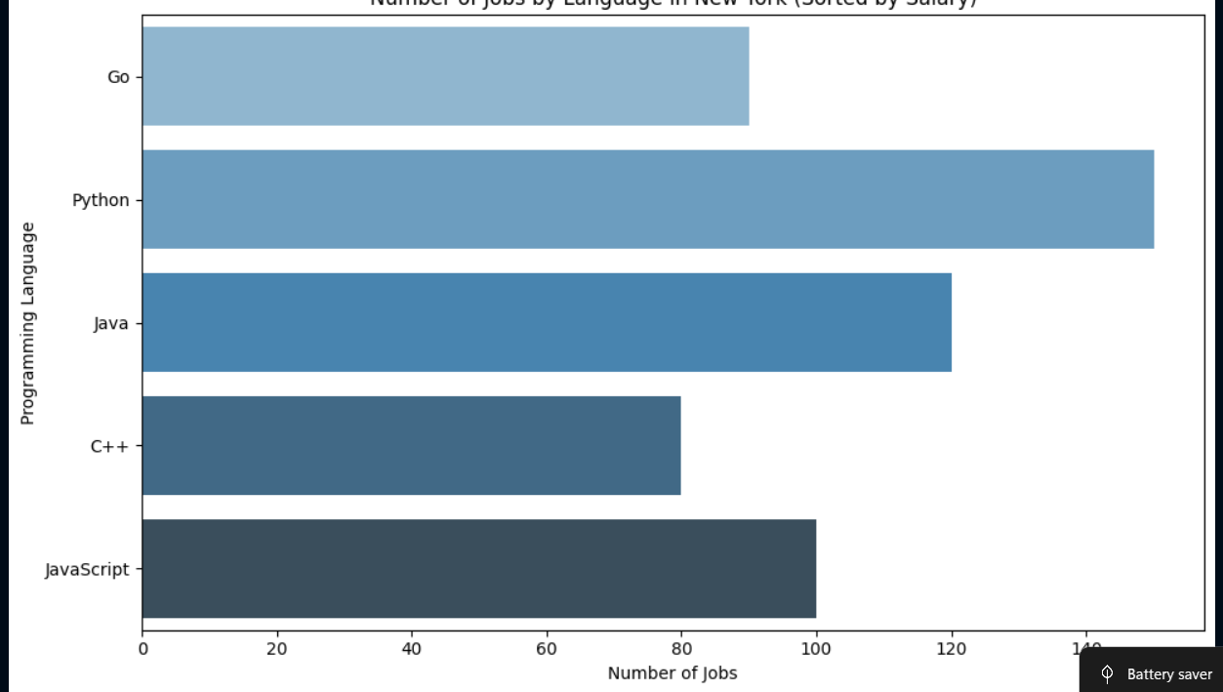
JOB POSTINGS
In Module 1 you have collected the job posting data using Job API in a file named “job-postings.xlsx”. Present that data using a bar chart here. Order the bar chart in the descending order of the number of job postings.

Slide 19
POPULAR LANGUAGES
In Module 1 you have collected the job postings data using web scraping in a file named “popular-languages.csv”. Present that data using a bar chart here. Order the bar chart in the descending order of salary.

