Slide 1
Project 2 Graduate section
Shubhabrata Mukherjee
Id: 16201097

Slide 2
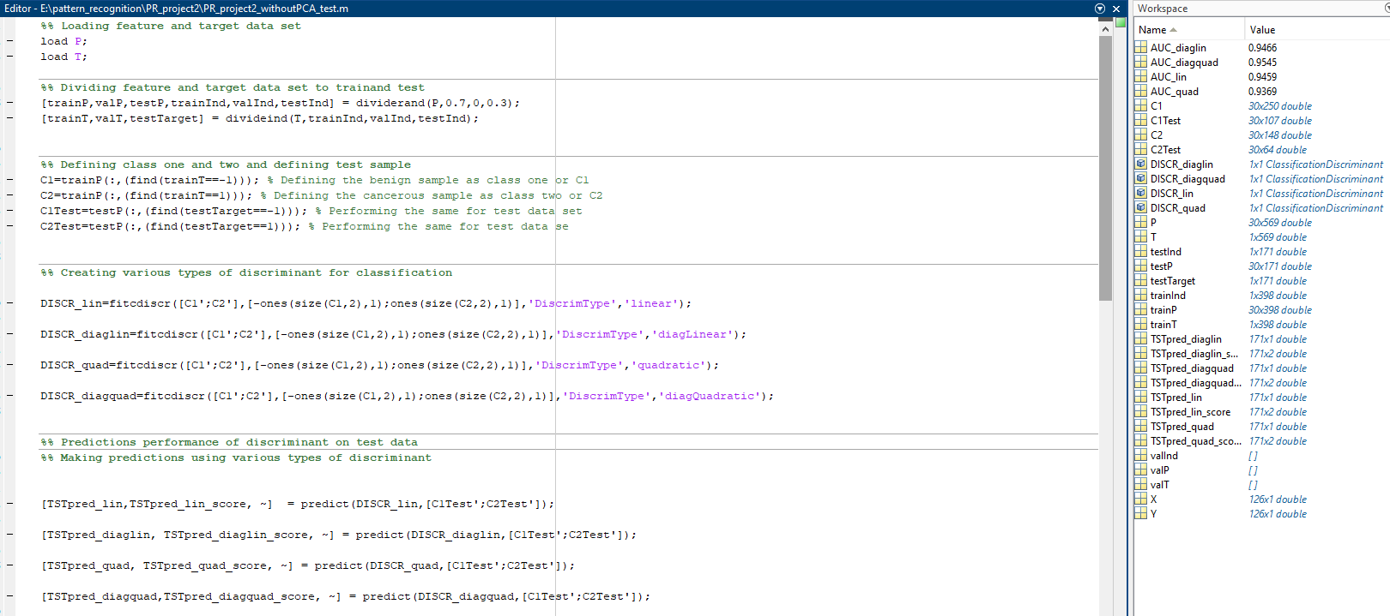
MATLAB code snippet for various discriminants

Slide 3
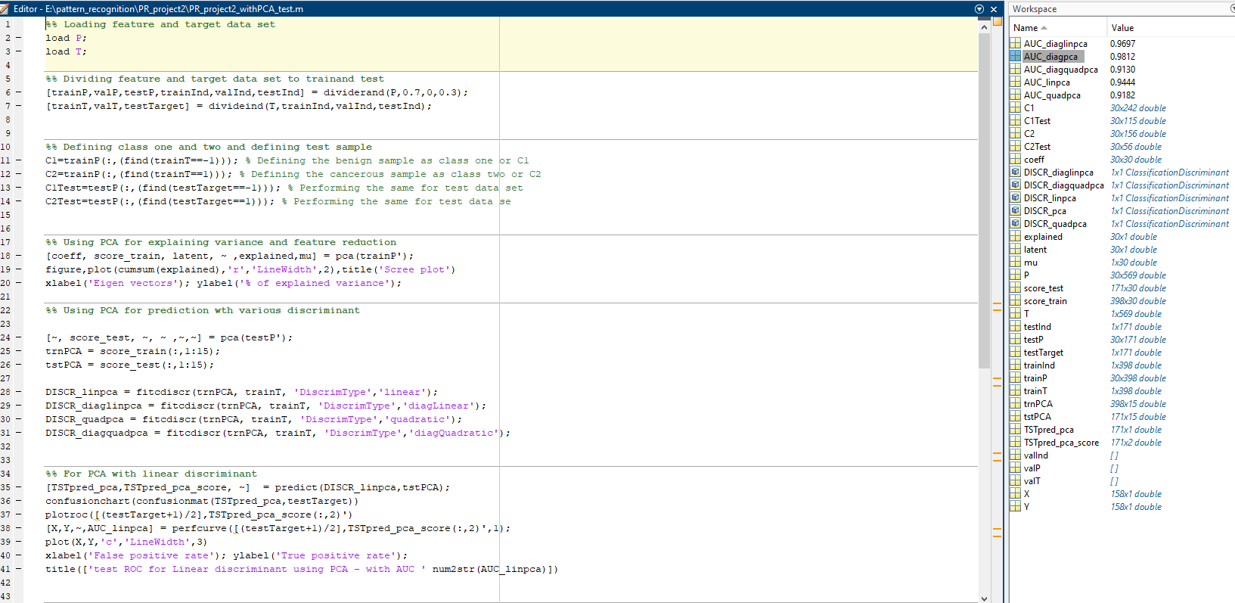
MATLAB code snippet for discriminants with PCA

Slide 4
Confusion matrix for test data using linear discriminant
As seen from generated confusion matrix:
TP or True Positive = 106
TN or True Negative = 58
FP or False Positive = 1
FN or False Negative = 6
Total (N) = 171,
Accuracy = TP + TN / N = 95.91 %

Slide 5
Confusion matrix for test data using diaglinear discriminant
As seen from generated confusion matrix:
TP or True Positive = 105
TN or True Negative = 58
FP or False Positive = 2
FN or False Negative = 6
Total (N) = 171,
Accuracy = TP + TN / N = 95.32 %

Slide 6
Confusion matrix for test data using quadratic discriminant
As seen from generated confusion matrix:
TP or True Positive = 103
TN or True Negative = 62
FP or False Positive = 4
FN or False Negative = 2
Total (N) = 171,
Accuracy = TP + TN / N = 96.49 %

Slide 7
Confusion matrix for test data using diagquadratic discriminant
As seen from generated confusion matrix:
TP or True Positive = 102
TN or True Negative = 59
FP or False Positive = 5
FN or False Negative = 5
Total (N) = 171,
Accuracy = TP + TN / N = 94.15 %

Slide 8
ROC using linear discriminant

Slide 9
ROC using diaglinear discriminant

Slide 10
ROC using quadratic discriminant

Slide 11
ROC using diagquadratic discriminant

Slide 12
ROC comparison of various types of discriminants

Slide 13
Scree plot for percentage of explained variance
As seen from the Scree plot:
Maximum variance is explained just using first 3 Eigen Vectors.
Reducing dimensionality to about half of its original length, reduces dimensionality to 30 to 15, which can explain almost 100% of total variance.
Hence, we can deduce this is a highly skewed data set, with maximum variance concentrated on just first few Eigen vectors.

Slide 14
Confusion matrix for test data with linear discriminant using PCA
As seen from generated confusion matrix:
TP or True Positive = 104
TN or True Negative = 59
FP or False Positive = 1
FN or False Negative = 7
Total (N) = 171,
Accuracy = TP + TN / N = 95.32 %

Slide 15
ROC with linear discriminant using PCA

Slide 16
ROC with diaglinear discriminant using PCA

Slide 17
ROC with quadratic discriminant using PCA

Slide 18
ROC with diagquadratic discriminant using PCA

Slide 19
Conclusion and Discussion: Without PCA
For linear discriminant we got 95.91 % accuracy, for testing data
For diaglinear discriminant we got 95.32 % accuracy, for testing data
For quadratic discriminant we got 96.49 % accuracy, for testing data
For diagquadratic discriminant we got 94.15 % accuracy, for testing data
ROC performance is best for diagquadratic discriminant with an AUC of .95449.

Slide 20
Conclusion and Discussion: With PCA
Using PCA with linear discriminant we got 95.32 % accuracy, for testing data
For linear discriminant we got ROC as .94441 for testing data
For diaglinear discriminant we got ROC as .96972 for testing data
For quadratic discriminant we got ROC as .91817 for testing data
For diagquadratic discriminant we got ROC as .91304 for testing data
Scree plot shows maximum variance is explained just using first 3 Eigen Vectors.
ROC performance is best for diaglinear discriminant using PCA with an AUC of .96972.

Slide 21
Submitted file list
PR_project2_withoutPCA_test.m
PR_project2_withPCA_test.m
Project2_Shubhabrata.ppt: This presentation.

