Slide 1
Mini project 4: Transfer learning
Shubhabrata Mukherjee
Graduate section

Slide 2
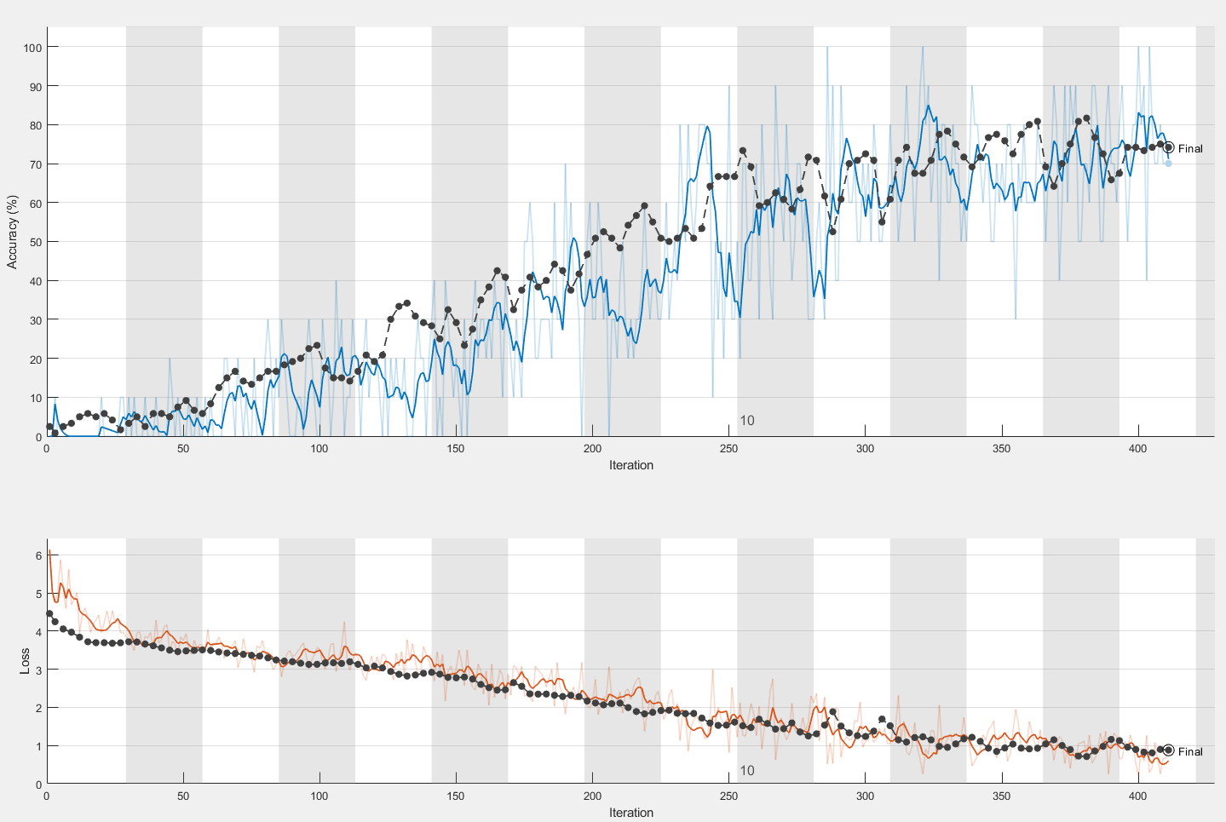
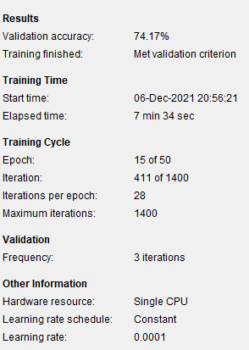
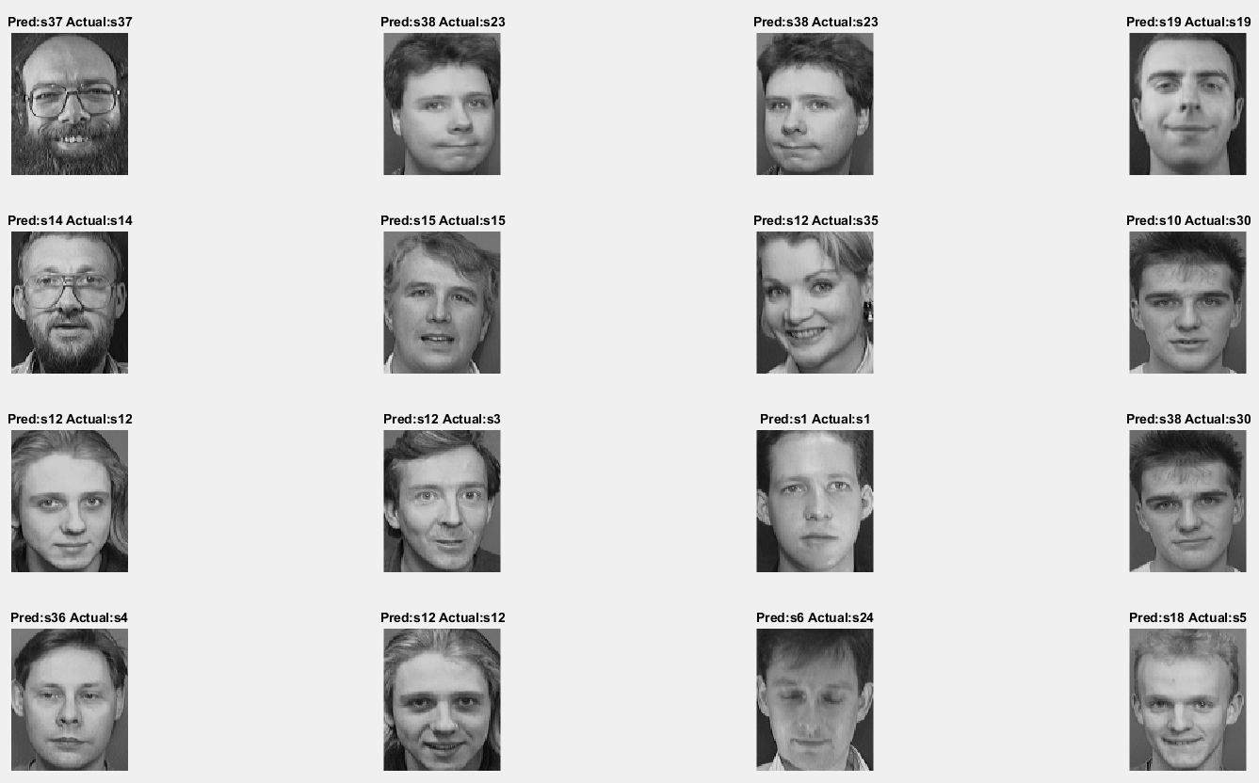
Alexnet training procedure: part 1
Alexnet primary training performance:
Validation Accuracy : 74.17%
Validation Loss = 0.8793
Transfer learning was used on legacy AlexNet model and trained for total 15 epochs and 411 iterations in 7 minutes 34 seconds.

Slide 3
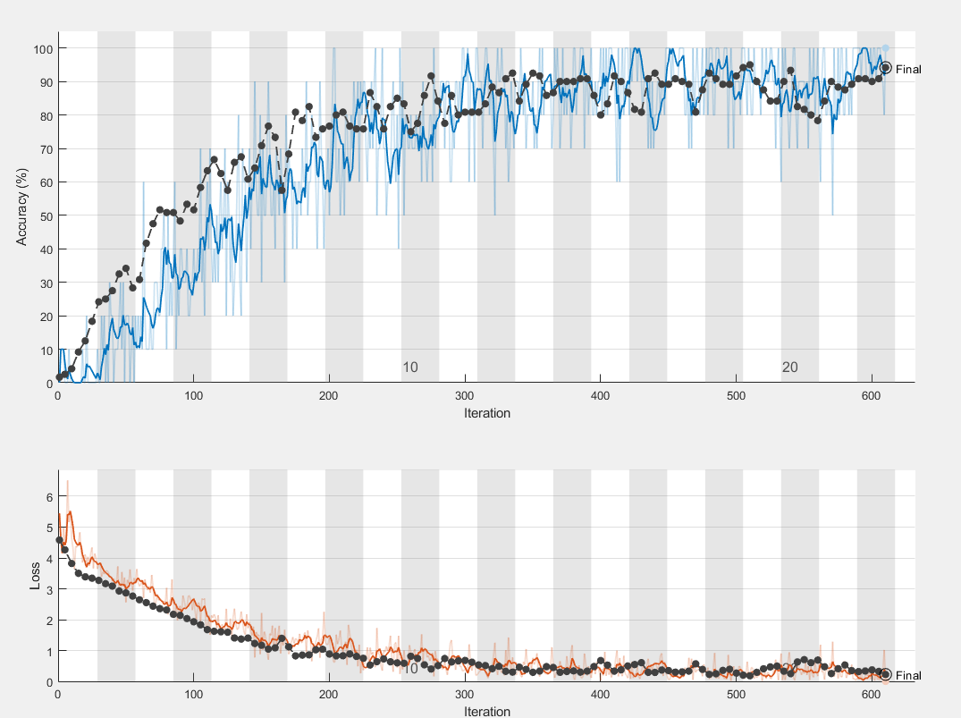
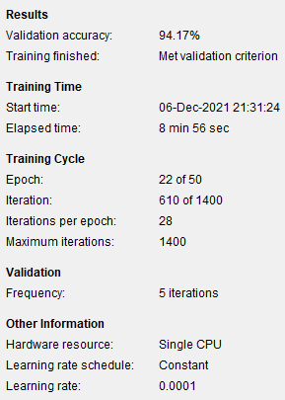
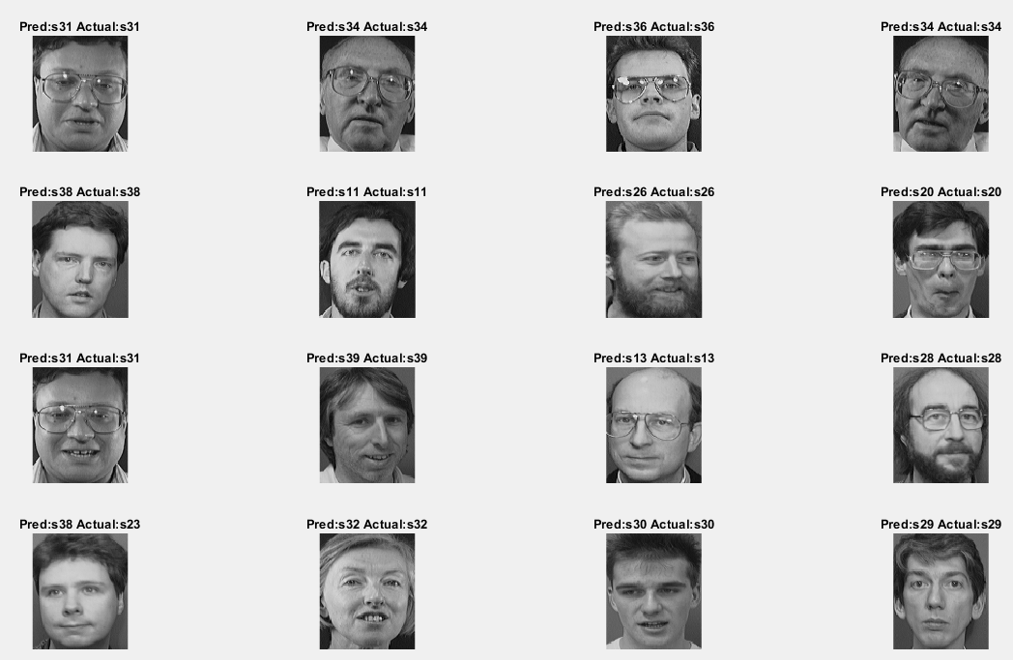
Alexnet training procedure: part 2
Alexnet final training performance:
Validation Accuracy : 94.17%
Validation Loss = 0.2266
Transfer learning was used on primarily trained model (name alexnet_primary) mentioned in previous slide and trained for total 22 epochs and 610 iterations in 8 minutes 56 seconds.

Slide 4
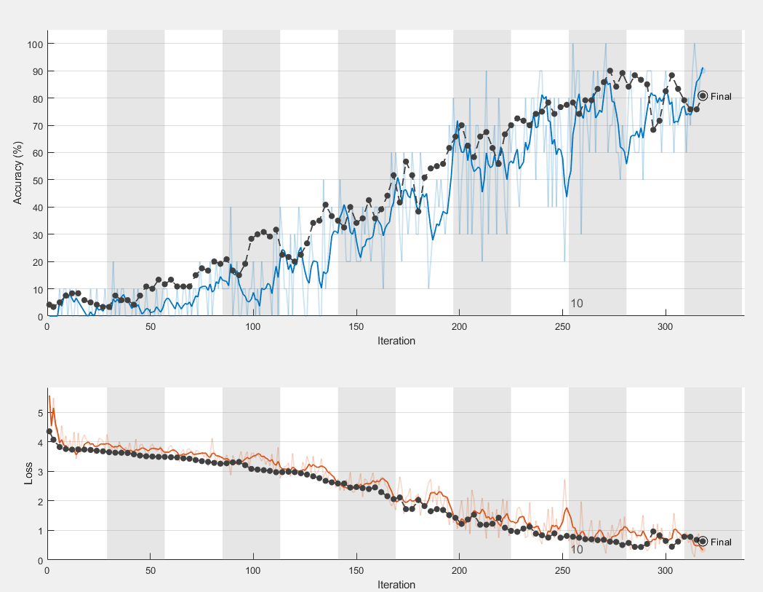
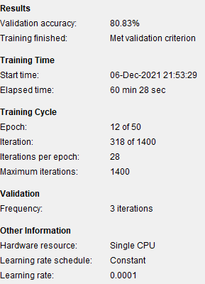
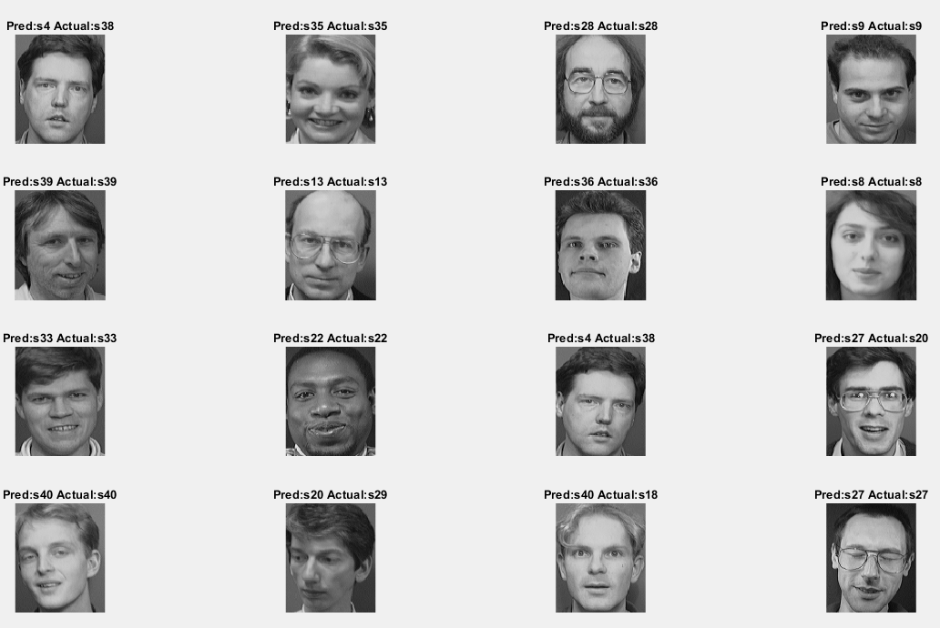
vgg19 training procedure: part1
vgg19 primary training performance:
Validation Accuracy : 80.83%
Validation Loss = .6321
Transfer learning was used on legacy vgg19 model (name alexnet_primary) mentioned in previous slide and trained for total 22 epochs and 610 iterations in 60 minutes 28 seconds.

Slide 5
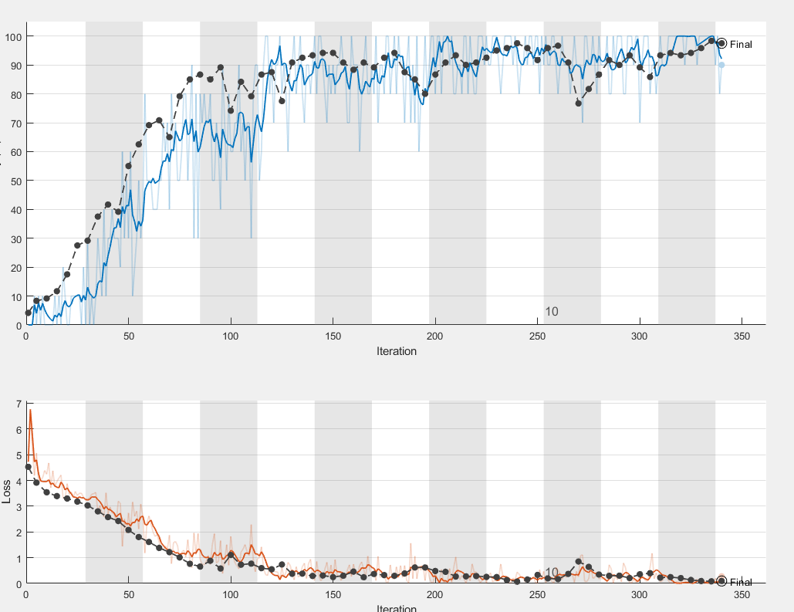
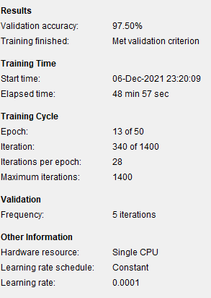
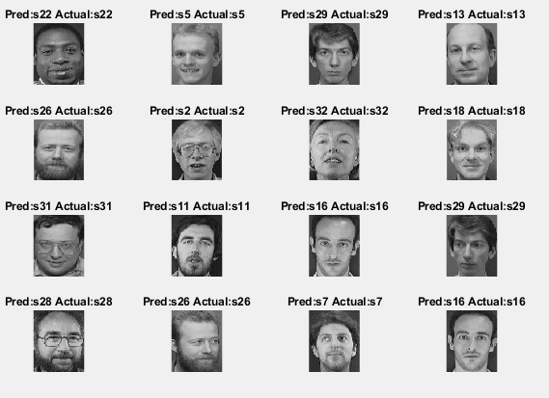
vgg19 training procedure: part2
vgg19 final training performance:
Validation Accuracy : 97.5%
Validation Loss = .0952
Transfer learning was used on primarily trained model (name vgg19_primary) mentioned in previous slide and trained for total 13 epochs and 340 iterations in 48 minutes 57 seconds.

Slide 6
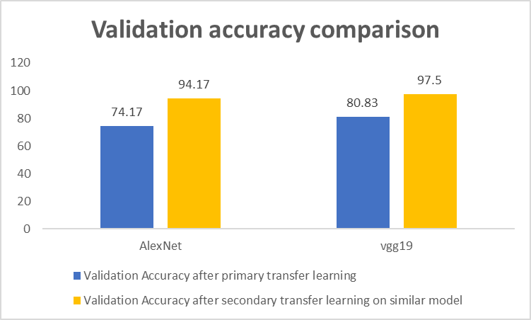
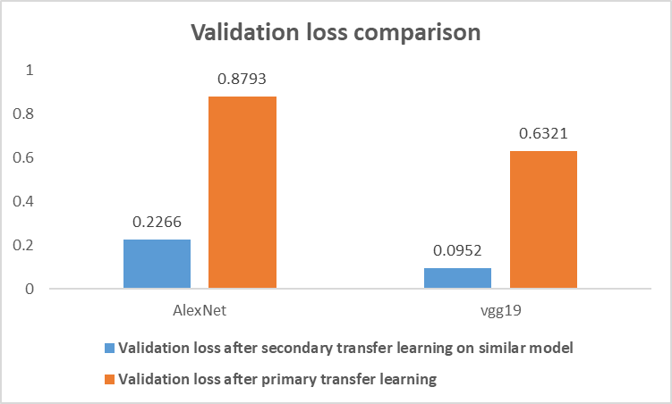
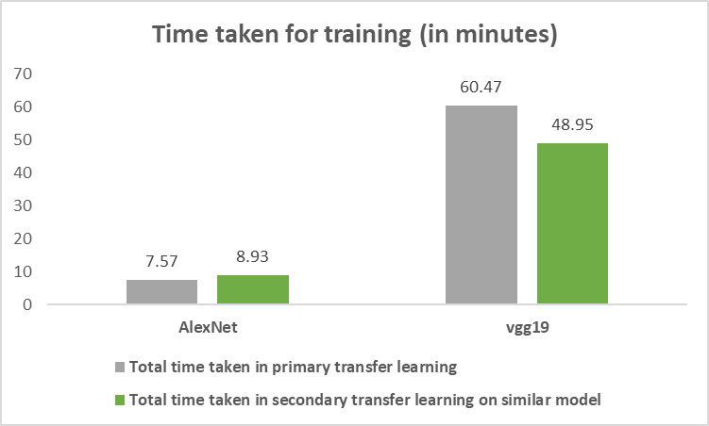
Discussion and conclusion
As seen from the above comparison, vgg19 performed better than alexnet, however vgg19 had a much longer training time compared to alexnet.

