Slide 1
Project 3 Graduate section
Shubhabrata Mukherjee
Id: 16201097

Slide 2
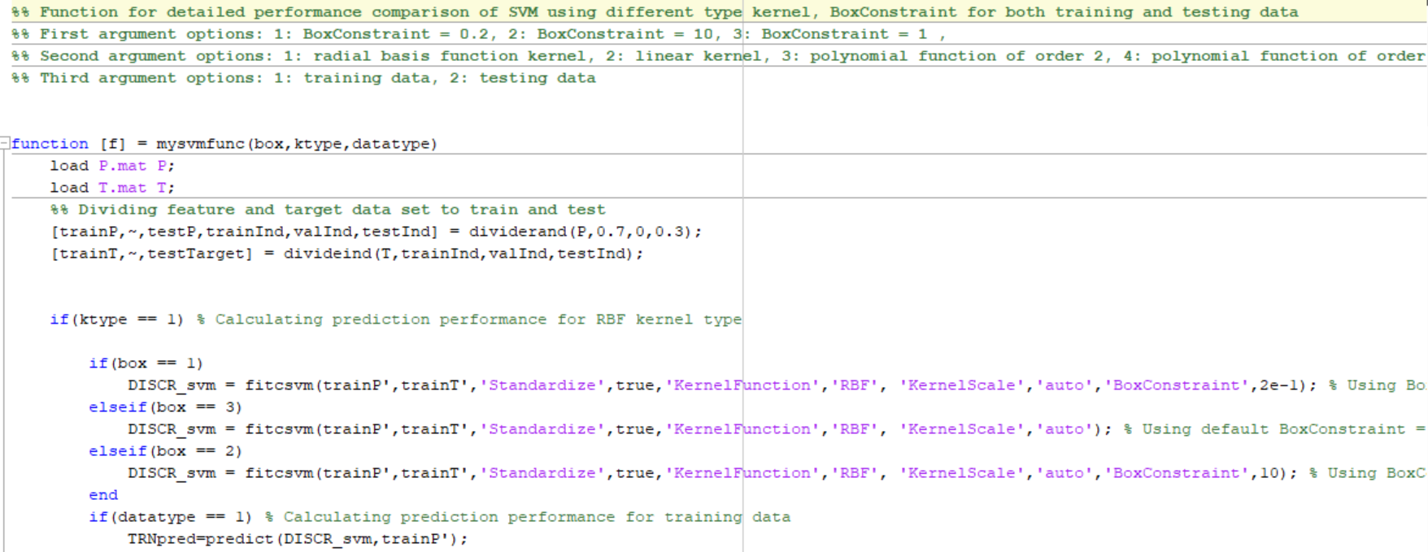
MATLAB code snippet for main function file

Slide 3
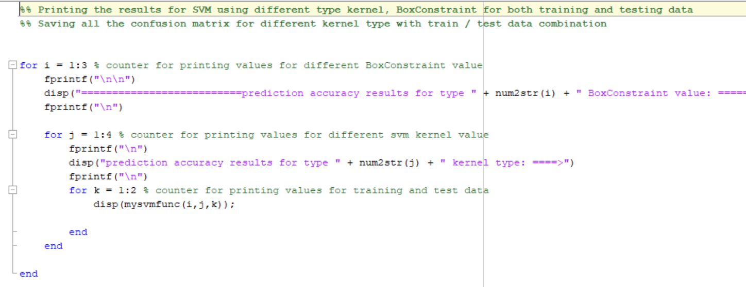
MATLAB code snippet for assisting script

Slide 4
SVM Experiments with different kernel types
Q1:
besides RBF, use linear and polynomial kernels of orders 2 and 3 and report the confusion matrices for training and testing datasets. Which one has a better generalization capability and why?

Slide 5
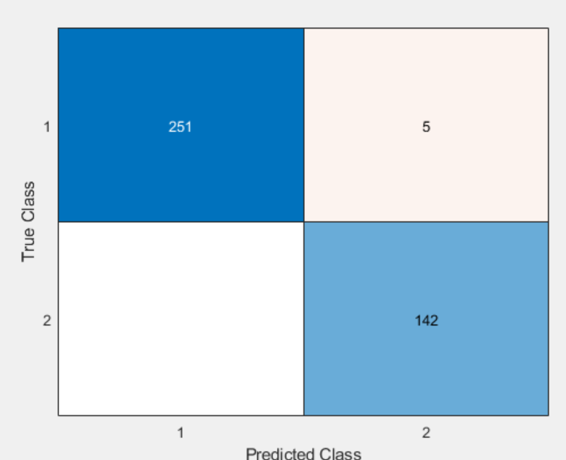
SVM using RBF kernel for train data
The accuracy of SVM using the RBF kernel is 98.7437, for a default BoxConstraint is used, which us 1 , when train data is used for Prediction.

Slide 6
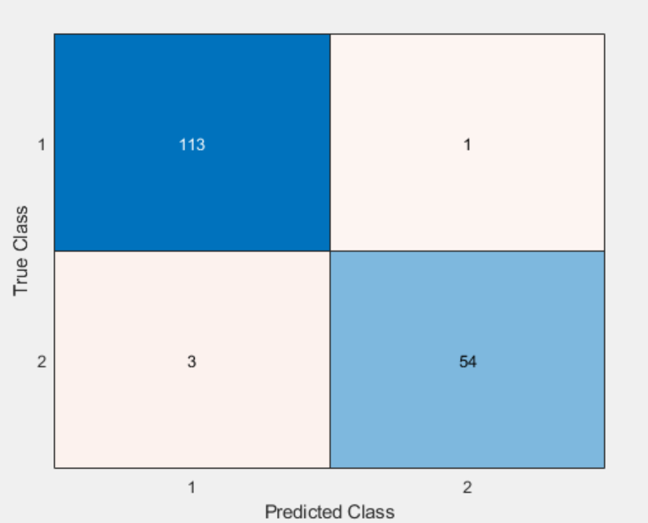
SVM using RBF kernel for test data
The accuracy of SVM using the RBF kernel is 97.6608, for a default BoxConstraint is used, which us 1 , when test data is used for Prediction.

Slide 7
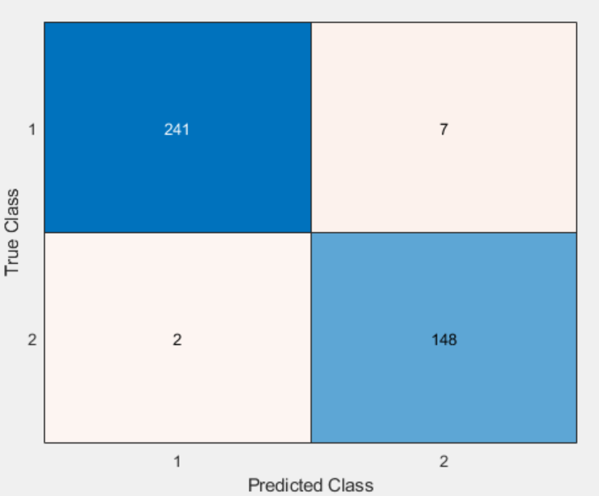
SVM using linear kernel for train data
The accuracy of SVM using the linear kernel is 97.7387, for a default BoxConstraint is used, which us 1 , when train data is used for Prediction.

Slide 8
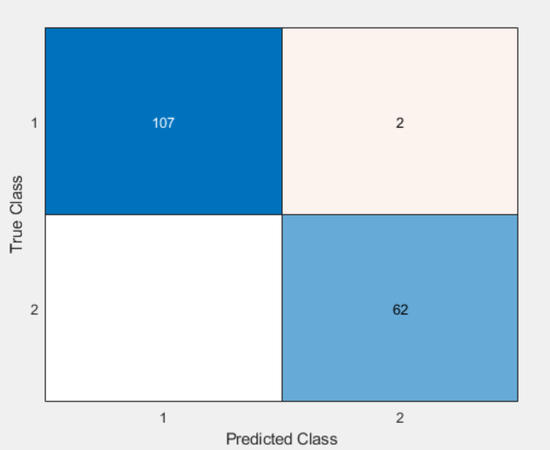
SVM using linear kernel for test data
The accuracy of SVM using the linear kernel is 98.8304, for a default BoxConstraint is used, which us 1 , when test data is used for Prediction.

Slide 9
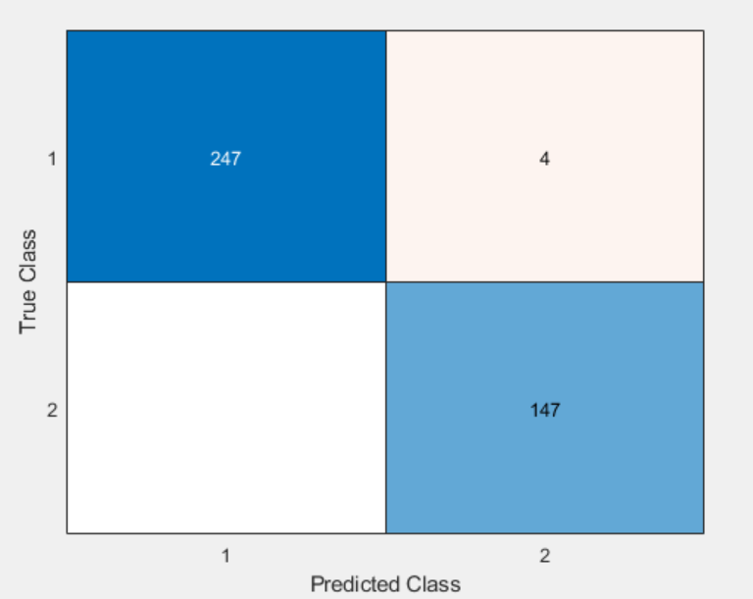
SVM using second order polynomial kernel for train data
The accuracy of SVM using the second order polynomial kernel is 98.995, for a default BoxConstraint is used, which us 1 , when train data is used for Prediction.

Slide 10
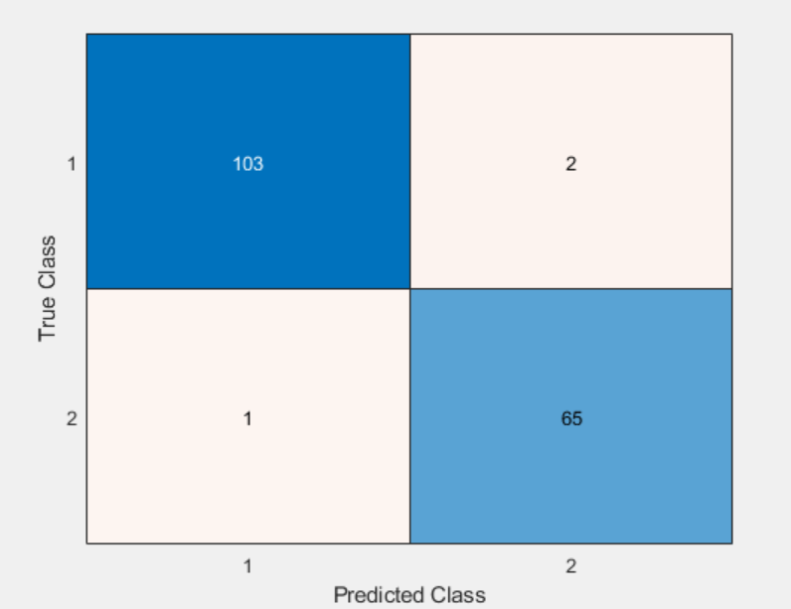
SVM using second order polynomial kernel for test data
The accuracy of SVM using the second order polynomial kernel is 98.2456, for a default BoxConstraint is used, which us 1 , when test data is used for Prediction.

Slide 11

SVM using third order polynomial kernel for train data
The accuracy of SVM using the third order polynomial kernel is 98.995, for a default BoxConstraint is used, which us 1 , when train data is used for Prediction.

Slide 12
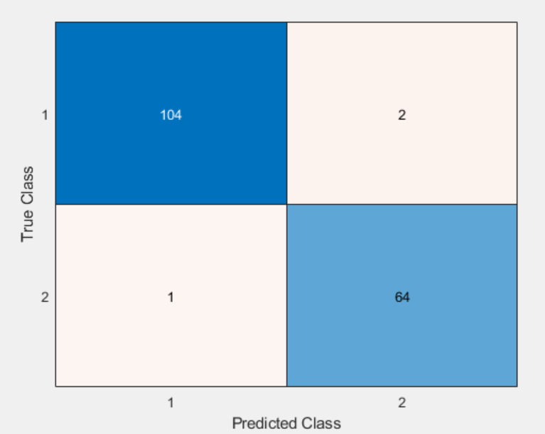
SVM using third order polynomial kernel for test data
The accuracy of SVM using the third order polynomial kernel is 98.2456, for a default BoxConstraint is used, which us 1 , when test data is used for Prediction.

Slide 13
SVM Experiments with different BoxConstraint value
Q2:
Change box constraint and try to get better testing results. Show the results for at least 3 different settings for this parameter for each of the kernels in task 1

Slide 14
Results for BoxConstraint value 0.2
Prediction accuracy results for RBF kernel type: ====>
The Training accuracy % of SVM using RBF kernel is: 96.4824
The Testing accuracy % of SVM using RBF kernel is: 95.3216
Prediction accuracy results for linear kernel type: ====>
The Training accuracy % of SVM using linear kernel is: 97.7387
The Testing accuracy % of SVM using linear kernel is: 95.3216
Prediction accuracy results for second order polynomial kernel type: ====>
The Training accuracy % of SVM using second order polynomial kernel is: 97.2362
The Testing accuracy % of SVM using second order polynomial kernel is: 95.9064
Prediction accuracy results for third order kernel kernel type: ====>
The Training accuracy % of SVM using third order polynomial kernel is: 98.2412
The Testing accuracy % of SVM using third order polynomial kernel is: 95.3216

Slide 15
Results for BoxConstraint value 1
Prediction accuracy results for RBF kernel type: ====>
The Training accuracy % of SVM using RBF kernel is: 98.7437
The Testing accuracy % of SVM using RBF kernel is: 97.6608
Prediction accuracy results for linear kernel type: ====>
The Training accuracy % of SVM using linear kernel is: 97.7387
The Testing accuracy % of SVM using linear kernel is: 98.8304
Prediction accuracy results for second order polynomial kernel type: ====>
The Training accuracy % of SVM using second order polynomial kernel is: 98.995
The Testing accuracy % of SVM using second order polynomial kernel is: 98.2456
Prediction accuracy results for third order polynomial kernel type: ====>
The Training accuracy % of SVM using third order polynomial kernel is: 98.995
The Testing accuracy % of SVM using third order polynomial kernel is: 98.2456

Slide 16
Results for BoxConstraint value 10
Prediction accuracy results for RBF kernel type: ====>
The Training accuracy % of SVM using RBF kernel is: 99.4975
The Testing accuracy % of SVM using RBF kernel is: 97.6608
Prediction accuracy results for linear kernel type: ====>
The Training accuracy % of SVM using linear kernel is: 98.2412
The Testing accuracy % of SVM using linear kernel is: 98.2456
Prediction accuracy results for second order polynomial kernel type: ====>
The Training accuracy % of SVM using second order polynomial kernel is: 99.7487
The Testing accuracy % of SVM using second order polynomial kernel is: 97.6608
Prediction accuracy results for third order polynomial kernel type: ====>
The Training accuracy % of SVM using third order polynomial kernel is: 99.7487
The Testing accuracy % of SVM using third order polynomial kernel is: 98.2456

Slide 17
Discussions and conclusion: part 1
From the result of SVM Experiments with different kernel types, using default BoxConstraint =1 we observed that, polynomial kernel performed best among all the kernel type. Both the second order and third order polynomial performed equally well in current observation.
Because the difference between training and test accuracy is least for polynomial kernel, so, the polynomial kernel has best better generalization capability.

Slide 18
Discussions and conclusion: part 2
From the result of SVM Experiments with different BoxConstraint value, with different Kernel, we observed that, BoxConstraint = 1 has best overall performance.
Using BoxConstraint = 1 with linear kernel we got 98.8304 % testing Prediction performance, which is best test data performance.
We also observed, for BoxConstraint = .2 , both training and testing data performance is worse among all three BoxConstraint value due to high bias.
On the other hand, BoxConstraint = 10 produced better training accuracy, but due to overfitting / more variance, we had a lower performance than BoxConstraint = 1.

Slide 19
Submitted file list
mysvmfunc.m : Main function file for Prediction using different kernel type, box constraints, train or test value.
PR3_main.m: The file for Calling mysvmfunction to print various prédiction results.
Project3_Shubhabrata.ppt: This presentation.
script_output.pdf: output sample of script
5. output_figures_confusion_matrix: confusion matrix matlab figures.
Reference:
Project descriptions document as provided.
Matlab help commands.
https://www.mathworks.com/matlabcentral/answers/index

