Slide 1
Final Project Graduate section
Shubhabrata Mukherjee

Slide 2
Combining classifiers: Goal of the project
Create various combination of classifiers using classifiers used in previous projects.
The primary goal is to combine low bias, high variance classifiers for lower testing error.
Then to Use feature selection to create further diversity in the classifier pool.
Also, consider variations mentioned previously and fusion them and build more diverse arrays of classifiers to get higher accuracy even with using lesser number of features.

Slide 3
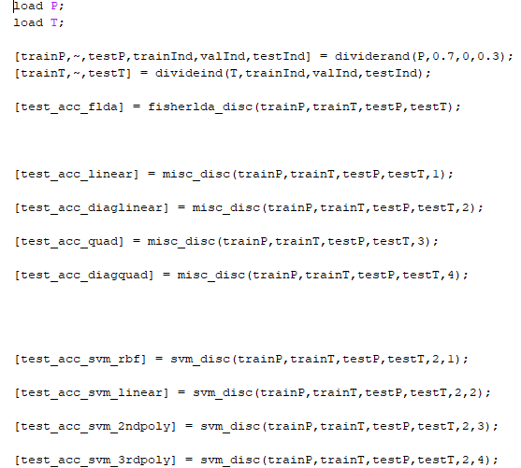
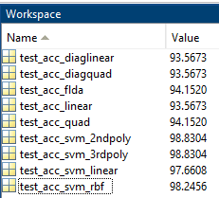
Choosing few best “base-classifier” from existing one’s
Left shown the test accuracy performance of all the classifier we have built in previous projects.
We choose the top 4 classifier having highest accuracy and higher variance.
They are:
SVM with RBF kernel
SVM with linear kernel
SVM with second order polynomial kernel
SVM with third order polynomial kernel
Developed code:
fisherlda_disc.m: function for fisher discriminant.
misc_disc.m: function for different discriminant like linear, quadratic, diaglinear, diagquadratic etc.
svm_disc.m: function for different svm based discriminant.
PRfinal_disc_comparison.m: code for comparing test accuracy performance of different base classifier
LDA3.m: Fisher discriminant base function (supplied by instructor)

Slide 4
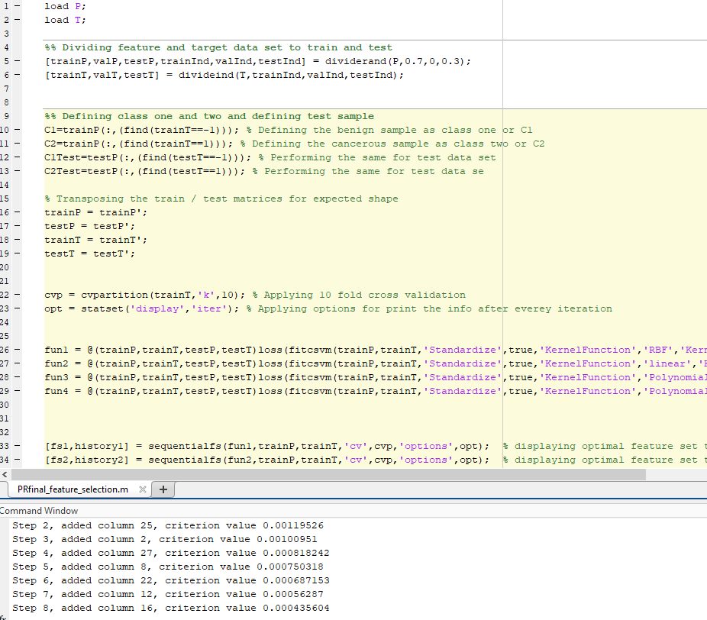
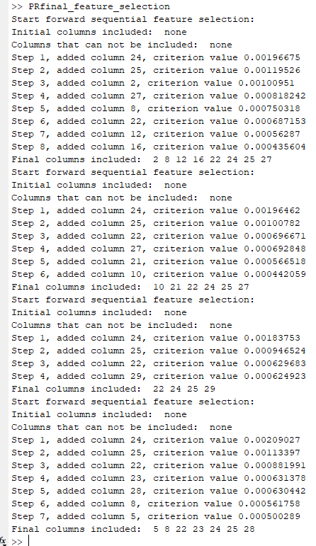
Sequential feature selection
forward sequential feature selection[1] function sequentialfs have been applied for this purpose.
Four different accuracy / loss criterion function has been used:
Using SVM with RBF kernel
Using SVM with linear kernel
Using SVM with second order polynomial kernel
Using SVM with third order polynomial kernel
As shown in left, other than the default (all features), 4 more variation of feature set has been calculated by sequentialfs.
Each of this 4 case, it starts from no feature and keep adding features till the error keep reducing.
Developed code:
PRfinal_feature_selection.m: Code for computing various sub-set of features using sequentialfs function.

Slide 5
Combining classifier: ensemble – Various ROC

Slide 6
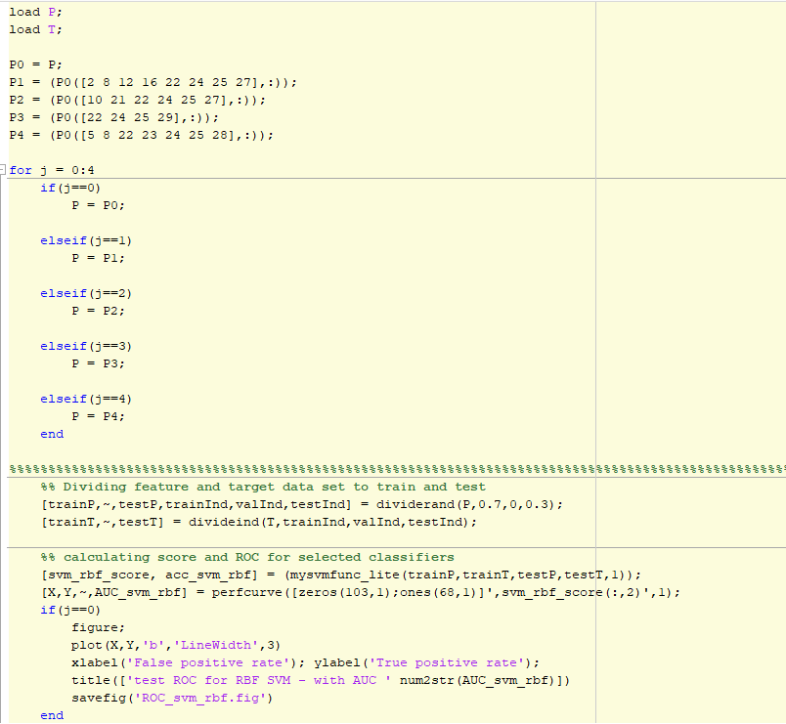
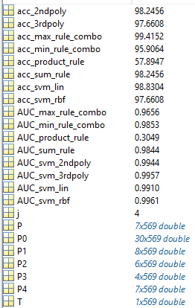
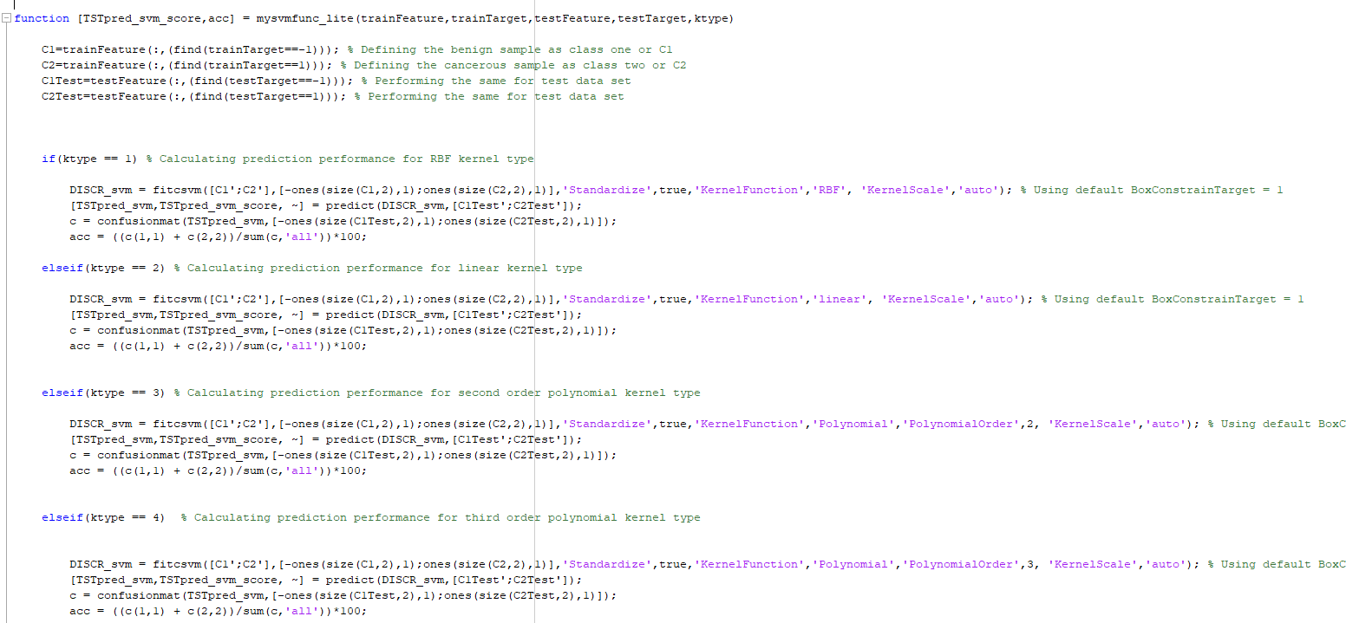
Accuracy Performance of different ensemble
Developed code:
mysvmfunc_lite.m : Function for generating score and accuracy with different variety of SVM kernel.
PRfinal_ensemble.m: Script for building different ensemble classifiers, also making further variations using different feature selection, and finally create the accuracy and ROC metrics.
From chose 4 base classifiers, different ensemble can be made using sum (average)rule, max rule, min rule, product rule etc. [2]
We have chosen 4 such combinations and made ensemble classifiers.
In some cases, the ensemble gave better accuracy than base classifiers.
Only product rule classifier performed poorly with a poor AUC and poor accuracy performance.

Slide 7
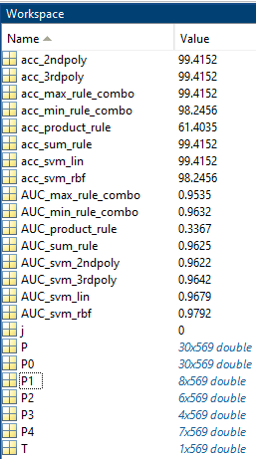
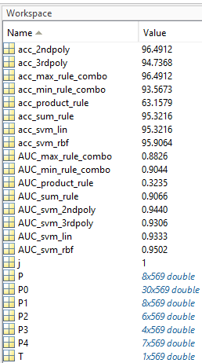
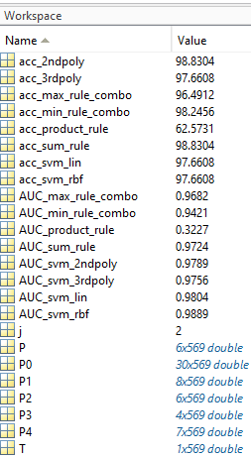
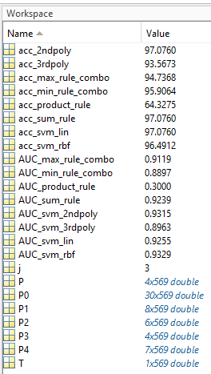
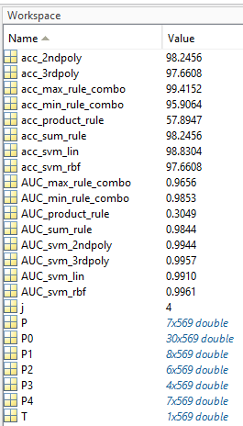
Accuracy Performance of various ensemble with combinations of various feature selection
Default:
for all features
For Columns:
2,8 12,16,22,24,25,27
For Columns: 10,21,22 24,25,27
For Columns:
22 24,25,29
For Columns:
5,8,22,23,24,25,28

Slide 8
Conclusions and Discussions
As per the ROC curve seen in slide 4, after combining the base classifiers, the variation in data increased and bias decreased.
As per the accuracy metrics in slide 5 and 6, we have below observation:
The ensemble classifier built using max rule has 99.4152% accuracy, which is the highest test prediction accuracy among all discussed classifiers and ensembles.
Looking at other ensemble combinations we saw overall the combinations works as good or better than the original / base classifiers.
From the performance of different ensembles with different feature combination we saw that, with just columns (features) 5,8,22,23,24,25,28 we could achieve 99.4152% with max rule ensemble.
Looking at other ensemble with different feature combination we saw overall the combinations works as good or better than the original / base classifiers, even with just a subset of features.
Particularly the product rule classifier suffers with the accuracy, as it covers a little AUC, one probable reason might be, initially up to the 70% true positive, it has equally more false positive, which reduces the overall accuracy.

Slide 9
References and attachments:
[1] Introduction to Machine Learning by Ethem Alpaydin, MIT press, 4th edition, chapter 6, section 6.2 - Subset selection: Forward selection and backward selection: p- 118-119
[2] Introduction to Machine Learning by Ethem Alpaydin, MIT press, 4th edition, chapter 18, section 18.4 – Classifier combination rules: Table 18.1 and Table 18.2:
p- 539
[3] Introduction to Machine Learning by Ethem Alpaydin, MIT press, 4th edition, chapter 18, section 18.9 - Stacked Generalization p- 550-551
[4] https://www.mathworks.com/help/stats/stacked-ensemble-stacking-example.html
Attached folders /files / scripts / results:
A. selection_of_base_discriminants_code (Folder):
MATLAB Codes for selecting top classifiers from the base classifiers from previous projects.
B. Feature_selection_code_result(Folder):
MATLAB code and results for feature selection.
C. classifier_ensembles(Folder):
MATLAB code and results for ensemble building and creating more fusion with various subset of data.
D. PR_final_Shubhabrata.ppt(Presentation): This presentation

