Slide 1
College-admission-agent
CAPSTONE PROJECT
Presented By:
1. Shubharaksha-Mangalore Institute Of Technology & Engineering-Computer Science and Engineering

Slide 2
OUTLINE
Problem Statement (Should not include solution)
Proposed System/Solution
System Development Approach (Technology Used)
Algorithm & Deployment
Result (Output Image)
Conclusion
Future Scope
References

Slide 3
Problem Statement
In the current digital landscape, students face challenges navigating college admission processes, including unclear eligibility criteria, varying fee structures, inconsistent deadlines, and fragmented information across websites. These issues lead to confusion, misinformation, and missed opportunities. There is a strong need for a centralized, intelligent system that simplifies and streamlines the admission experience.

Slide 4
Proposed Solution
The proposed system is a College Admission Agent, powered by Retrieval-Augmented Generation (RAG), which:
Understands student queries in natural language.
Retrieves and summarizes admission policies, eligibility, course details, and fee structures from trusted sources.
Offers accurate, real-time responses about deadlines, required documents, and procedures.
Reduces manual inquiries and enhances applicant experience.

Slide 5
System Approach
Platform: IBM Cloud Lite
AI Model: IBM Granite Foundation Model
Frameworks: LangChain / Haystack for RAG pipeline
Storage: Vector DB (e.g., Pinecone / Chroma) for document retrieval

Slide 6
Algorithm & Deployment
RAG-based Architecture: Combines document retrieval with generative model output.
Steps:
Upload knowledge documents (PDFs, scraped HTML).
Index data into a vector database.
User inputs a query (e.g., “What is the fee for B.Tech at XYZ College?”).
Retriever fetches relevant chunks.
Generator (IBM Granite) provides context-aware, natural language response.
Deployment: Hosted on IBM Cloud or locally with Docker.

Slide 7
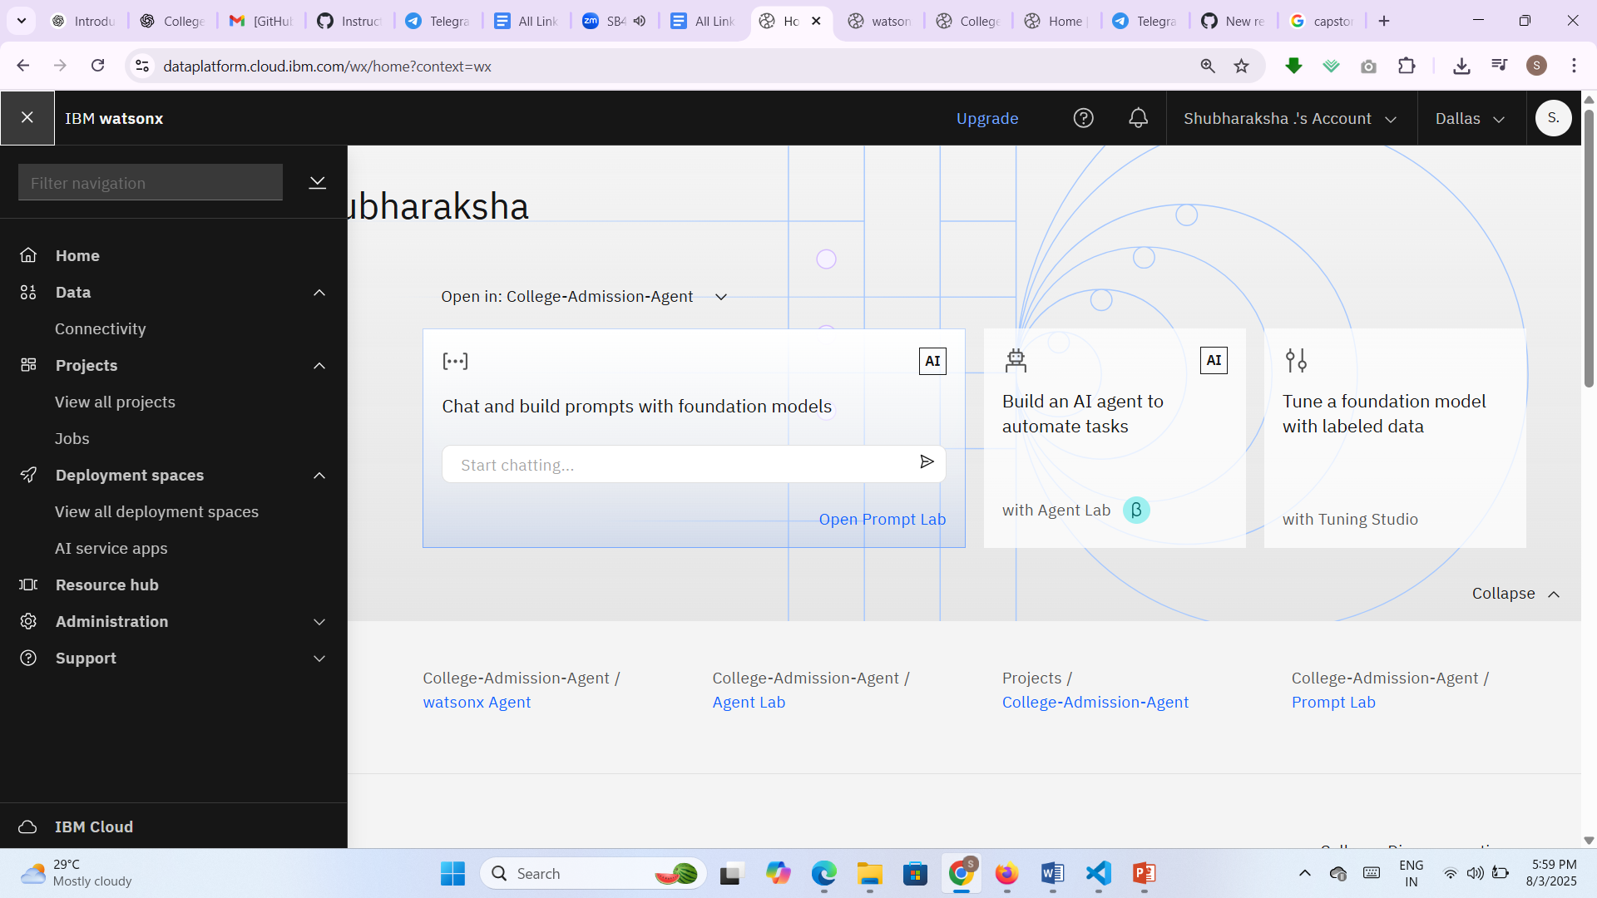
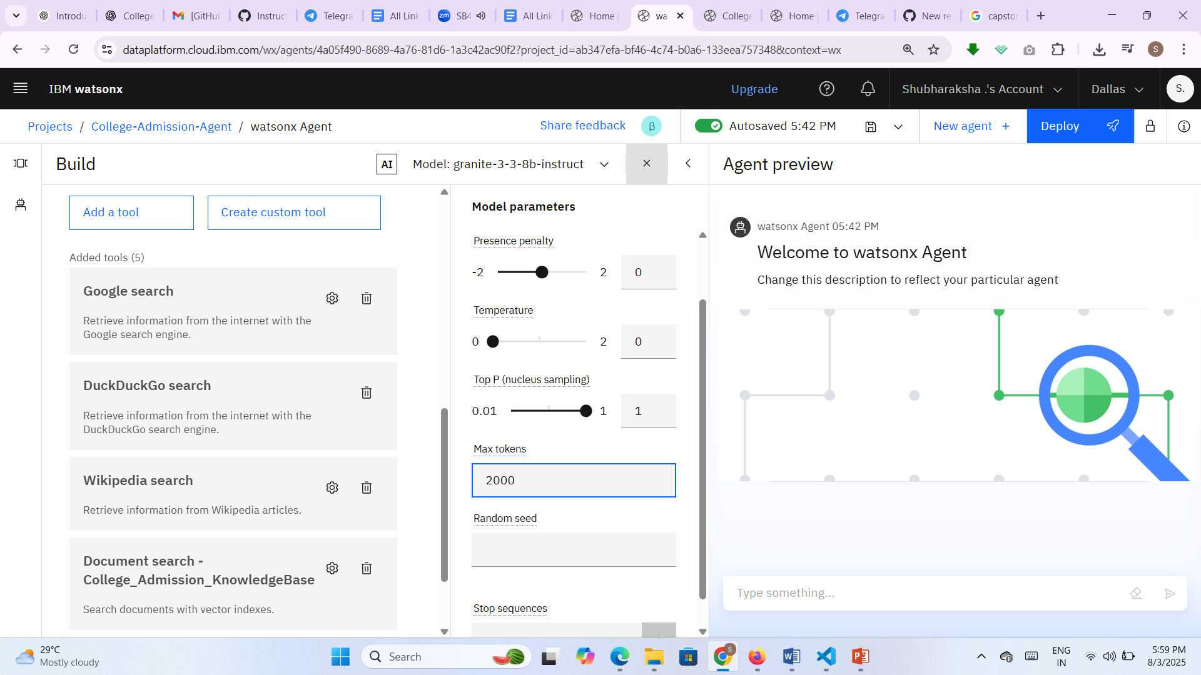
Result

Slide 8
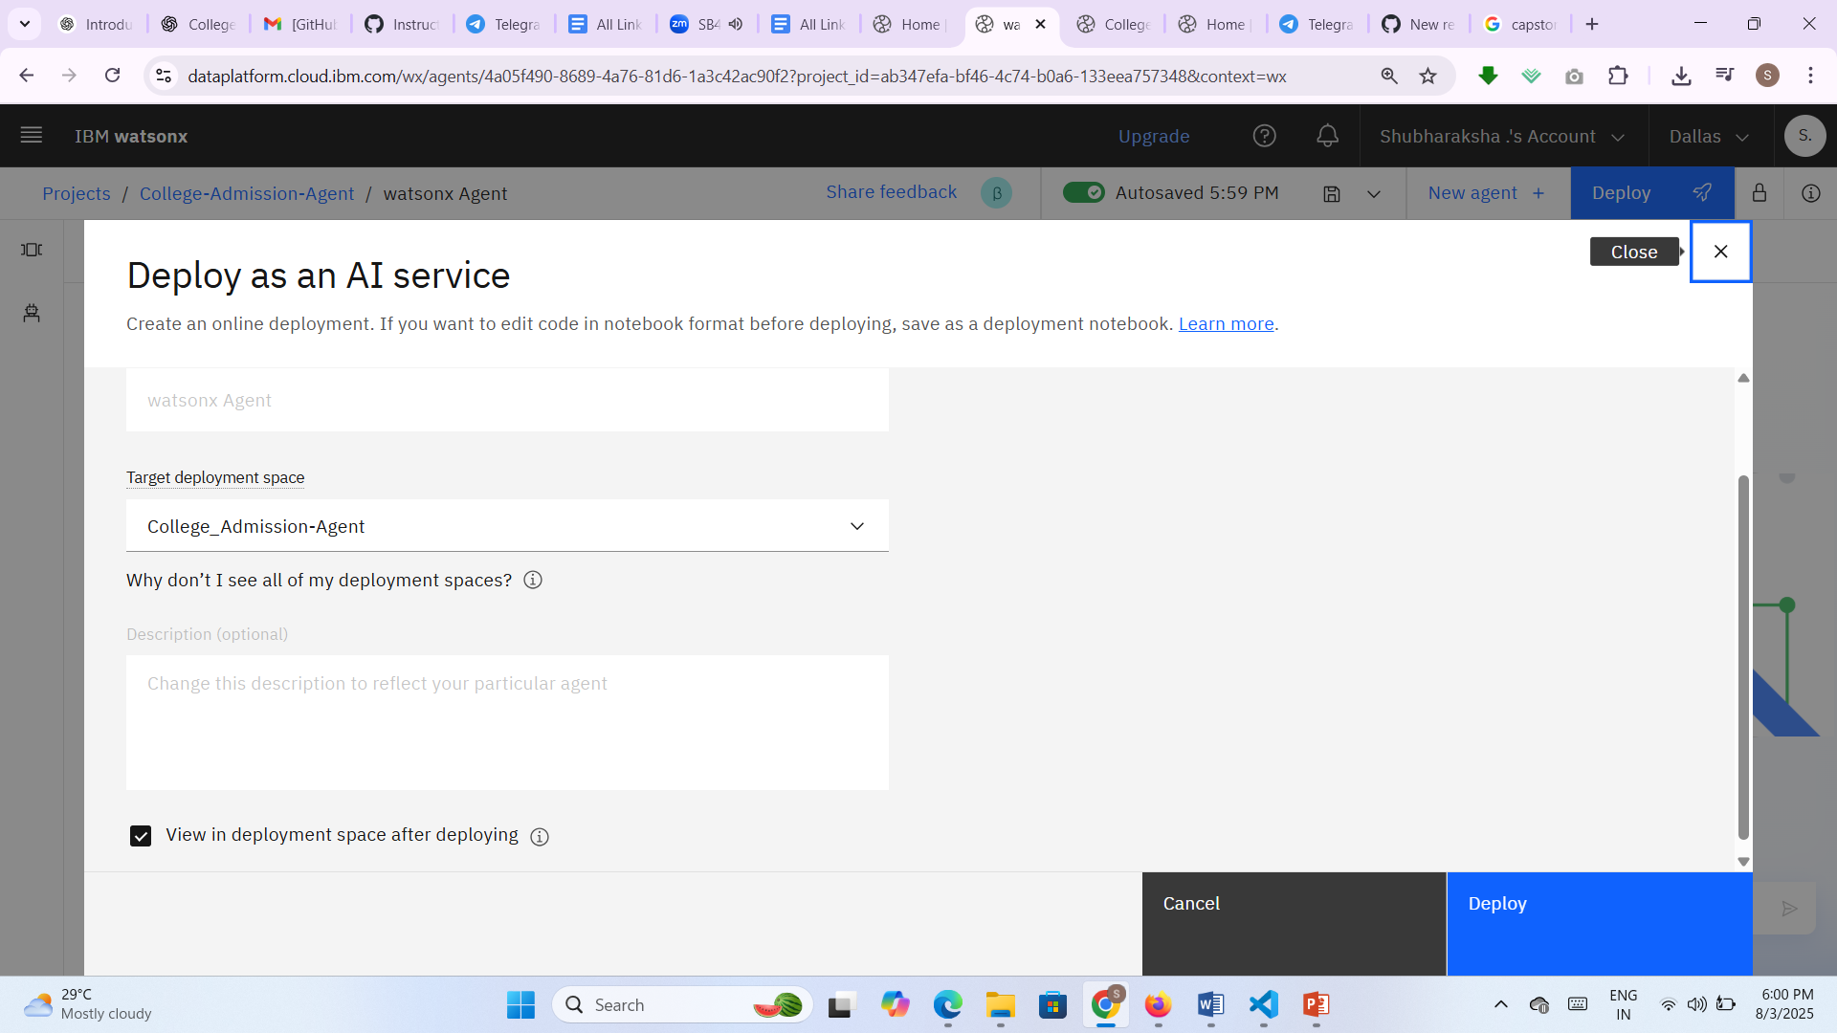
RESULTS

Slide 9
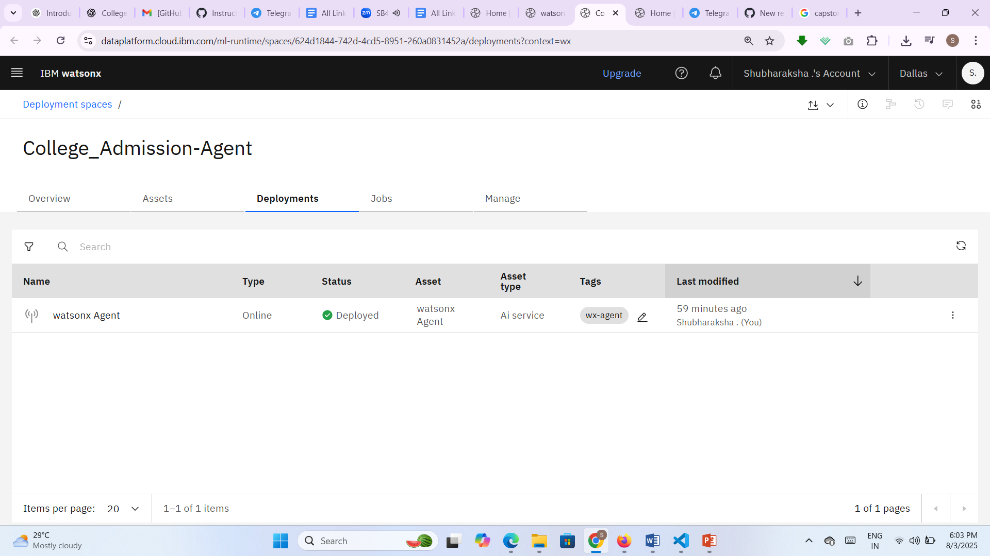
Results

Slide 10
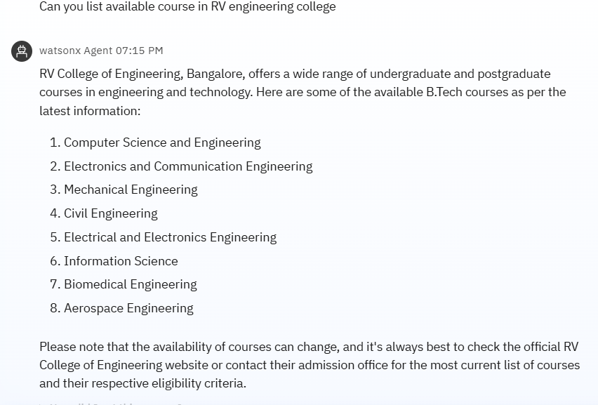
RESULTS

Slide 11
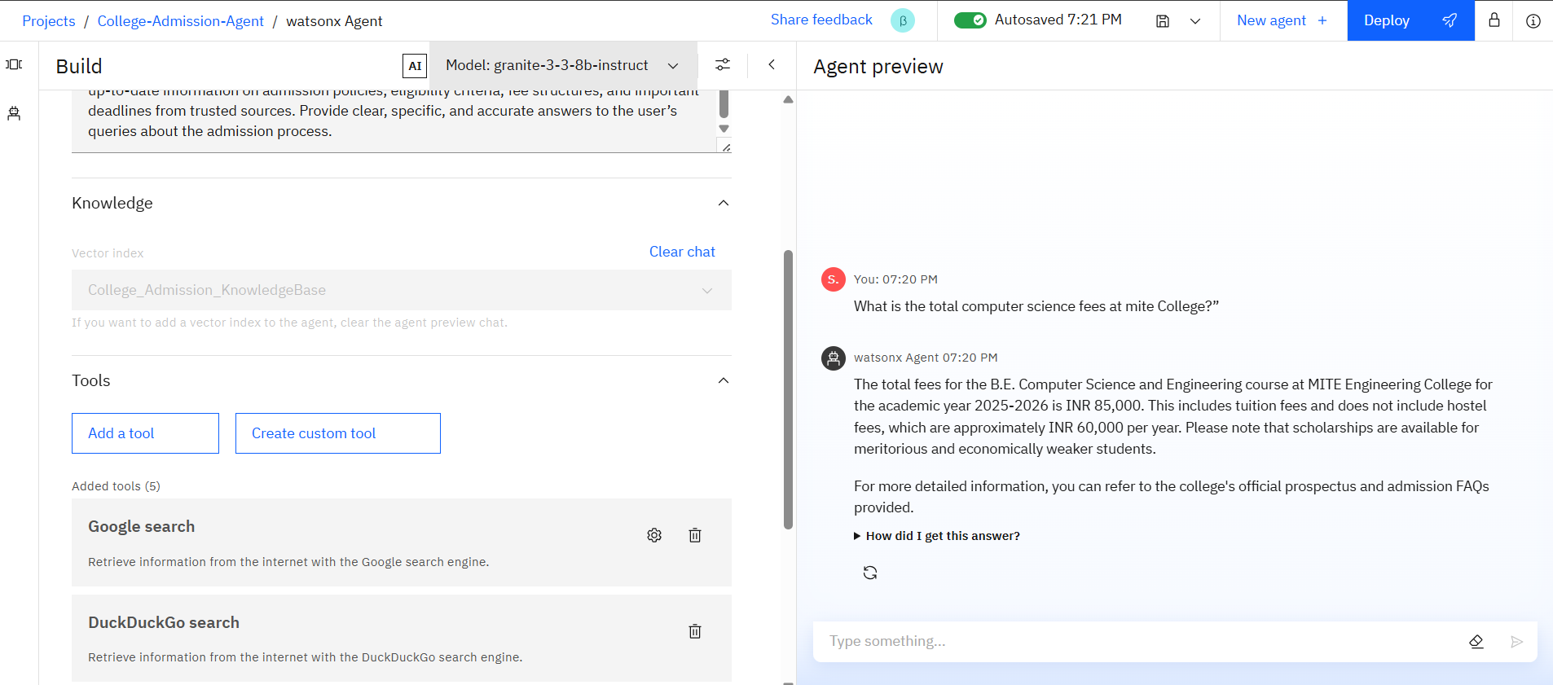
OUTPUTS

Slide 12
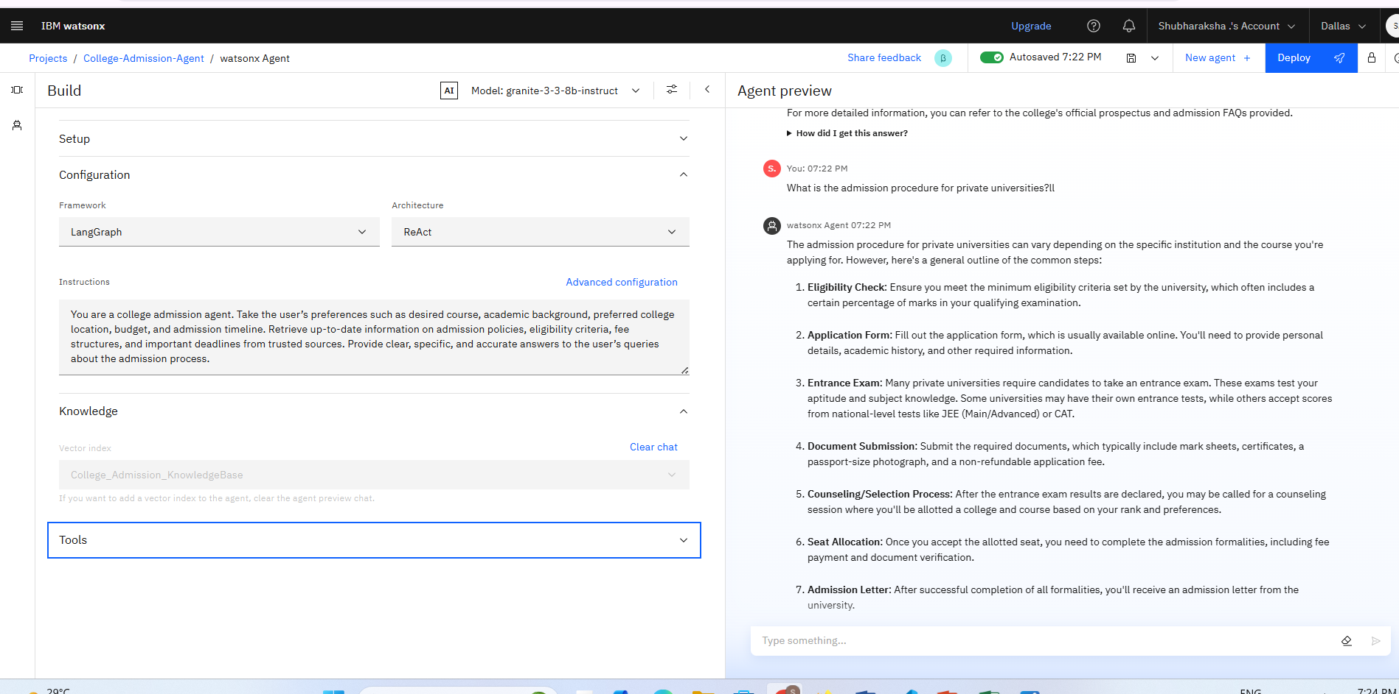
OUTPUTS
ll

Slide 13
Conclusion
The College Admission Agent successfully reduces friction in the application process, empowers students with accurate information, and ensures transparency. It minimizes the workload for admission offices and improves outreach to students from diverse backgrounds.

Slide 14
Future scope
Add multilingual support (Hindi, Tamil, etc.)
Connect with real-time APIs for live updates from universities
Integrate chatbot into college websites
Expand to include scholarship and hostel queries

Slide 15
References
IBM SkillsBuild Labs & Granite documentation
Government college admission portals
Research on RAG and Agentic AI architecture
Github link:https://github.com/shubha39/IBM_Cloud-Project

Slide 16
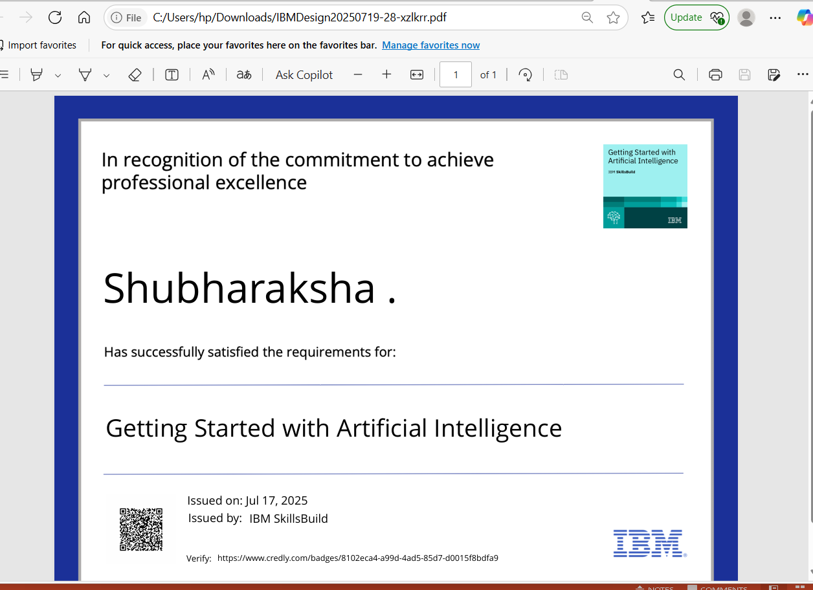
IBM Certifications

Slide 17
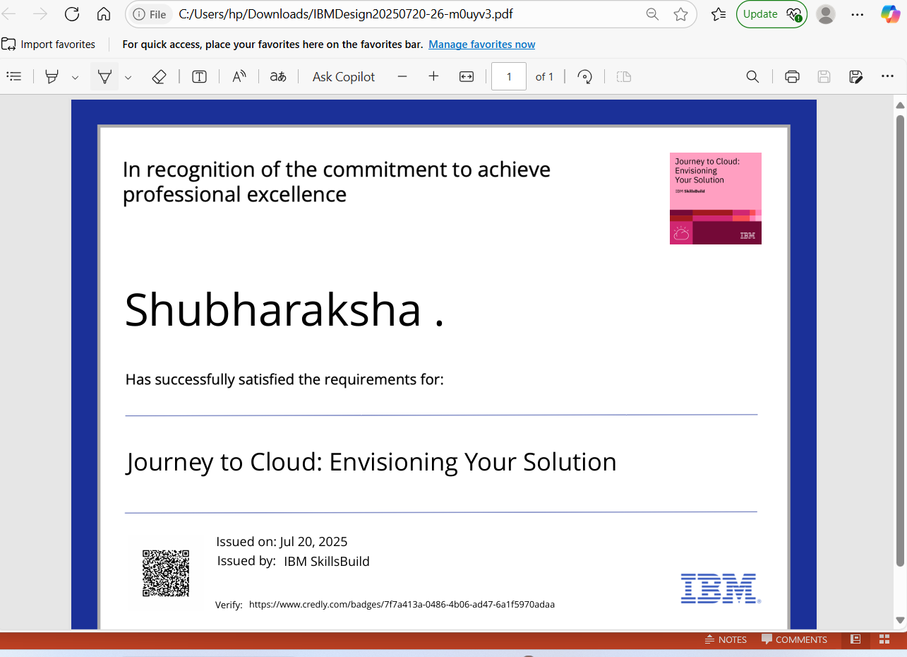
IBM Certifications

Slide 18
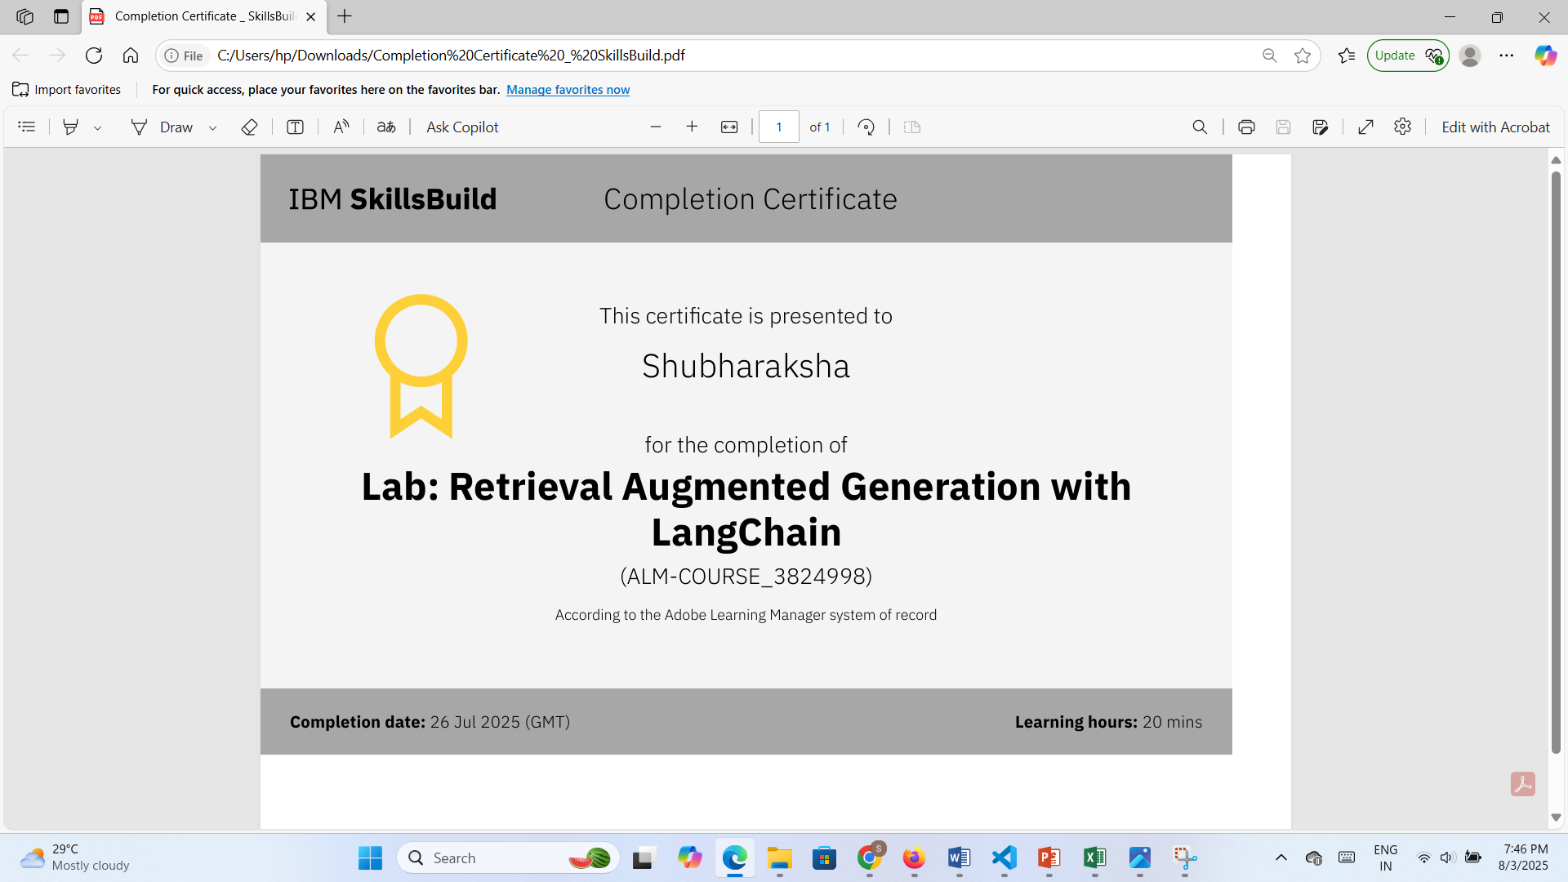
IBM Certifications

Slide 19
THANK YOU

