Slide 1

MANAGEMENT

Slide 2
Meaning
Management is the process of designing and maintaining an environment in which individuals, working together in groups, efficiently accomplish selected goals.
The attainment of organizational goals (sales, profit maximization, productivity, employee and customer satisfaction) in an efficient and effective manner through planning, organizing, leading and controlling organizational resources.

Slide 3
Organizational Resources :
Management
Manpower
Materials
Methods
Money
Machinery
Market

Slide 4
Definitions of Management
Koontz, “Management is the art of getting things done through and with the people in formally organized groups.”
Louis E Boone & David L Kurtz, Management is use of people and other resources to accomplish objectives.
Mary Parker Follet, the act of getting things done through people.
Frederick Taylor, Management is the art of knowing what you want to do in the best and cheapest way.

Slide 5
Features of Management
Organized activities- without organize activities two groups of people can not be involve in the performance of activities. E.g., Iron Steel Company, NGO’s.
Existence of objectives- an objective or set of objectives should exist towards which the organized group, activities are directed without objective, it is difficult to defines the direction.
Relationship among resources- organize activities man to achieve common goals to establish certain relationship among their available resources, which includes man, money, material and machine.
Working with and through people- a sizeable proportions of management principles relates to how human being can be put for better efforts in the organization.

Slide 6
Intangible- it can’t be seen but can be felt by the results of its efforts in the form of production, sales and profits.
Goal-oriented- goals may be economic or non-economic. E.g., in a business organization, the primary goal is to produce and distribute goods to earn profit.
Universal- it is an all-pervasive activity. It is needed in all type of organization, e.g., university, club, army, government, business.

Slide 7
Social process- because it deals with people.
System of authority- management may be understood as the rule-making and rule-enforcing body in an organization. According to Drucker, “ management is a multi-purpose organ that manages a business, manages managers and manages workers and work.”
Decision making- management process involves decision making at various levels for getting things done by others. Decision making basically involves selecting the most appropriate opportunity out of the several.

Slide 8
Importance of Management
Effective utilization resources
Development of resources
Stability in the society (management changing and modifies their resources in accordance with the changing environment of the society)
Management improve the quality of life through the development of resources.
To incorporate Innovation, changes need to be incorporated to keep the organization alive and efficient.

Slide 9
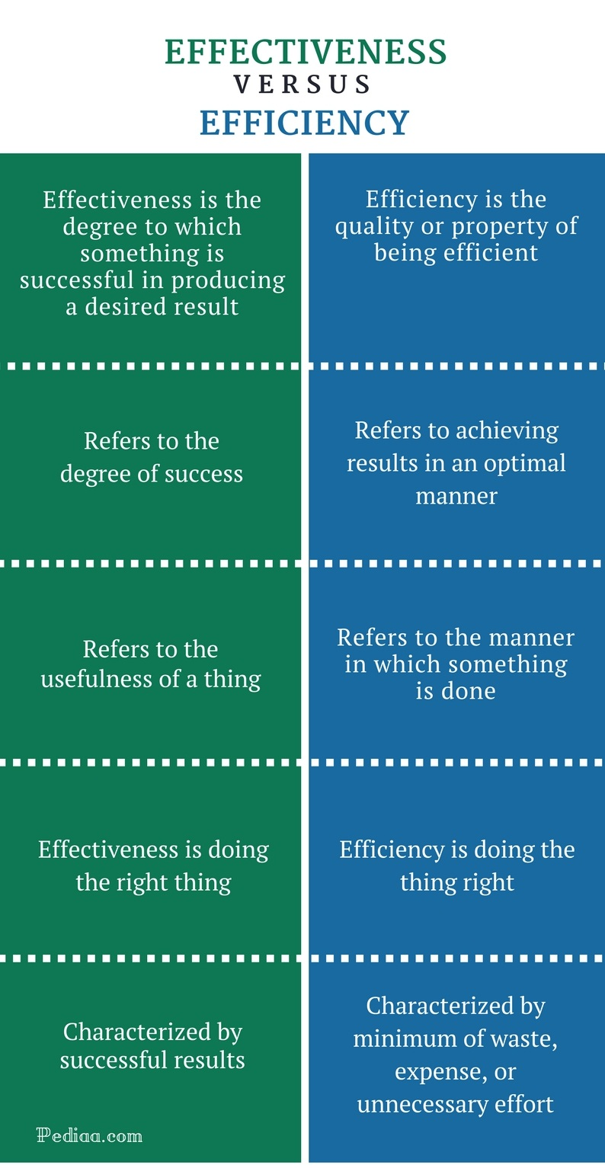

Slide 10
Management is Art, Science and Profession
Management is a Art as it is concerned with the application of knowledge and skills (personal qualities like music, painting etc.) to achieve results.
Management is a Science as it has a systematized body of knowledge, concepts and principles (like the motion-studies, morale, motivation, leadership)
Management is not a full fledged Profession because (a) there is no university organized degree to become a manager, (b) there is no all india body to regulate the practices of managements, (c) there is no widely expected code of conduct.

Slide 11
Science | Art | Profession
An organized or systematized body of knowledge pertaining to a specific field of enquiry. | It is the application of knowledge and personal skills to achieve results. | It is an (a) occupation for which specialized knowledge, skills and training are required, (b) these skills are used for larger interest of the society, (c) the success of these skills is not measured in monetary terms always.

Slide 12
Science Vs Art
Science | Art
Advances by knowledge Proves Predicts Defines Measures Impresses | Advances by practice Feels Guesses Describes Opines Expresses

Slide 13
Levels Of Management
The term ‘levels of management refers to a line of separation between different positions held by different persons in an organization.
Level of management depends upon the nature, size and functions of an organization.
Levels of management also expand with the expansion of organization.
There is a limit to the number of subordinates a person can supervise.

Slide 14
Levels of management are increased so as to achieve effective supervision.
The levels of management of an organization may be broadly be divided in to three parts namely, top management, middle management and lower level or first line management.

Slide 15
Levels of Management –
Top management
Middle management
First-line/supervisory management

Slide 16
Top Management
Executives-CEO, MD, BOD, Presidents, Vice Presidents
Manage the entire organization or major parts
Develop the purpose, the goals, strategies, long-term plans
Report to board of directors or other executives
Top management is the ultimate source of authority and it establishes goals and policies for the enterprise. It devotes more time for planning and co-ordination functions.

Slide 17
Middle Management
Managers and department heads
Implement top manager’s strategies by developing short-term plans
Report to executives
Supervise first-line managers

Slide 18
First-Line Management
Supervisors, crew leaders, office managers
Implement middle manager’s plans
Report to middle managers
Supervise operative employees

Slide 19
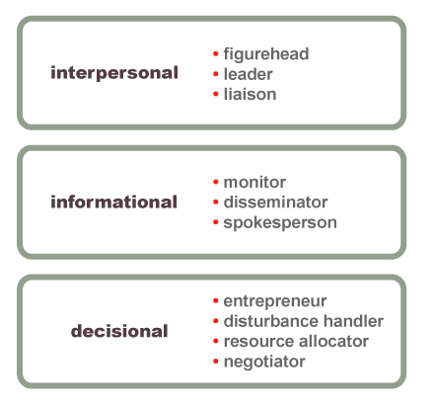
Mintzberg’s Managerial Roles

Slide 20
Interpersonal Roles
Roles that managers assume to provide direction and supervision to both employees and the organization as a whole.
Figurehead—symbolizing the organization’s mission by solving the personal problems of employees in the organization.
Leader—training, counseling, and mentoring to obtain high employee performance.
Liaison—linking and coordinating the activities of people and groups both inside and outside the organization.

Slide 21
Informational Roles
Roles associated with the tasks needed to obtain and transmit information in the process of managing the organization.
Monitor—analyzing information from both the internal and external environment and also keeps check on the activities of employees.
Disseminator—transmitting information from top level to lower level to influence the attitudes and behavior of employees.
Spokesperson—person who speaks on behave of a group and using information to positively influence the way people in and out of the organization respond to it.

Slide 22
Decisional Roles
Roles associated with methods managers use in planning strategy and utilizing resources.
Entrepreneur—deciding which new projects or programs to initiate and to invest resources in.
Disturbance handler—managing inter personal conflicts inside the organization and also unexpected events or crisis.
Resource allocator—assigning resources between functions and divisions, setting the budgets of lower managers.
Negotiator—reaching agreements between other managers, unions, customers, or shareholders.

Slide 23
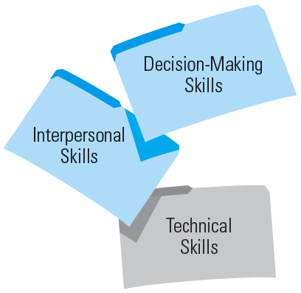
Skills of Manager

Slide 24
Decision-making Skills
Select alternatives to solve problems
Take advantage of opportunities
Be able to conceptualize, diagnose and analyze
Use math skills
Manage time

Slide 25
Interpersonal Skills
“People skills”
Your relationships with all individuals and groups
Understanding
Communicating
Motivating
Resolving conflict
Working as a team member
“It’s not what you know, it’s who you know.”
Ethics

Slide 26
Technical Skills
“Business skills”
Using methods and techniques to perform a task
Keeping up with the latest technology in your job

Slide 27
Coordination
Meaning:
Coordination is a managerial function in which different activities of the business are properly adjusted and interlinked.
Co-ordination is the process which ensures smooth interplay of the functions of management. Common objectives are achieved without much wastage of time, efforts and money with the help of co-ordination.
‘‘Coordination is balancing and keeping together the team by ensuring suitable allocation of tasks to the various members and seeing that the tasks are performed with harmony among the members themselves.’’ - E.F.L. Brech

Slide 28
Features Of Coordination
Continuous activity
Integrates group efforts
Ensures unity of action
A deliberate effort
Part of management
Managerial responsibility
Creativity
System concept

Slide 29
Importance Of Management
Coordination encourages team spirit.
Coordination gives proper direction.
Coordination facilitates motivation.
Coordination makes optimum utilization of resources.
Coordination helps to achieve objectives quickly.
Coordination improves relations in the organization.
Coordination leads to higher efficiency.
Coordination improves goodwill of the organization.
Coordination harmonize conflicts
Coordination accomplish tasks completely.
Coordination promotes stability, growth and prosperity of the organization

Slide 30
Business Ethics/Ethics in Management
Ethics is a set of rules that define right and wrong conduct. Business Ethics (also known as Corporate Ethics) can be defined as written and unwritten codes of principles and values that govern decisions and actions within a company.
In the business world, the organization’s culture sets standards for determining the difference between good and bad decision making and behavior.

Slide 31
Ethical Issues in Business
Adulteration in edible items
Product Safety/ Unequal Standards
Product storage and logistics irresponsibility
Finished accountability after selling the product.
Less expenditure on social causes/wellbeing
Environmental issues

Slide 32
Importance of Organizational/Business Ethics
Ethics influence and contribute to:
Employee commitment.
Investor and customer loyalty and confidence.
Legal problems and penalties.
Customer satisfaction.
The ability to build relationships with stakeholders.
Cost control.
Performance, revenue, and profits.
Reputation and image.

Slide 33
Social Responsibility of Managers
Social responsibility of business refers to its obligation to take those decision and perform those actions which are desirable in terms of the objectives and values of our society.
Social responsibility refers to the obligations and duties of the business towards the society.
The aim of business is no longer only profit maximization but also to be socially responsible.

Slide 34
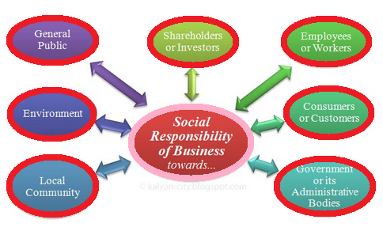
Social Responsibilities of business towards different sectors

Slide 35
A. Towards Investors/Shareholders
Fair Dividend
Efficient Business
Optimum Use of Resources
Planned Growth
Effective Communication
B. Towards Employees :
Meaningful Work
Job Satisfaction
Fair Salaries & Benefits
Best Quality of Work life
Succession Planning and Development

Slide 36
C. Towards customers:
Fair Price
Superior Service
Superior Product Design
Quick and complete Information
D. Towards Government:
Payment of Taxes, Custom Duties etc.
Abide by the Laws
Observe the Policies
Maintain Law & Security

Slide 37
E. Towards Society /General Public:
Employment
Welfare Services
Maintaining Pollution Free Environment
F. Towards Local Community/Compititors :
Fair Competition
Cooperation for Sharing of Scarce Resources and Facilities
Collaboration for Maximization of Business Efficiency

Slide 38
Functions of Management
Planning
Organizing
Controlling
Directing
Coordinating
Staffing

Slide 39
Planning
According to Koontz & O’Donell, “Planning is deciding in advance what to do, how to do and who is to do it. Planning bridges the gap between where we are to, where we want to go. It makes possible things to occur which would not otherwise occur”
According to Abraham Lincoln “We must plan for the future, because people who stay in the present will remain in the past.”

Slide 40
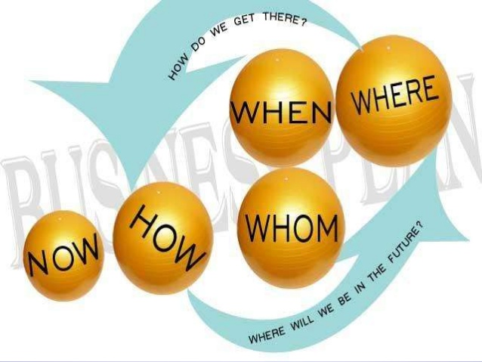

Slide 41
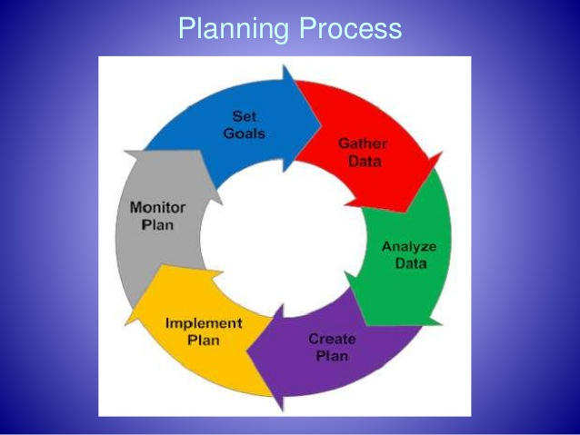
Planning Process

Slide 42
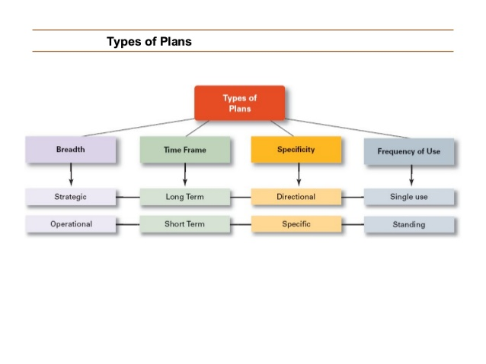
Types Of Plans

Slide 43
Types of Plans
Strategic Plans
Apply to the entire organization.
Establish the organization’s overall goals.
Seek to position the organization in terms of its environment.
Operational Plans
Specify the details of how the overall goals are to be achieved.
Cover short time period.

Slide 44
Long-Term Plans
Plans with time frames extending beyond three years
Short-Term Plans
Plans with time frames on one year or less
Specific Plans
Plans that are clearly defined and leave no room for interpretation
Directional Plans
Flexible plans that set out general guidelines, provide focus, yet allow discretion in implementation.

Slide 45
Single-Use Plan
A one-time plan specifically designed to meet the need of a unique situation.
Standing Plans
Ongoing plans that provide guidance for activities performed repeatedly.

Slide 46
FORECASTING
Forecasting is the attempt to predict future outcomes based on past events and management insight.
Forecasting is a decision-making tool used by many businesses to help in budgeting, planning, and estimating future growth.
Forecasting is the technique of estimating the relevant future events and problems on the basis of past and present behavior or happenings.

Slide 47
Techniques of Forecasting
Techniques of Forecasting
Qualitative
Method
Quantitative Method
Grass Roots
Time Series
Market Research
Causal Relationship
Panel Consensus
Simulation
Historical Analogy
Delphi Method

Slide 48
Qualitative Methods
Grass Roots: deriving future demand by asking the person closest to the customer.
Market Research: trying to identify customer habits; new product ideas.
Panel Consensus: bringing the internal members or experts from all level in the company together, and have a open discussion about a product deriving future estimations from the panel of experts in the area.
Historical Analogy: identifying another similar market.
Delphi Method: based on the results of several rounds of questionnaires sent to a panel of experts. Several rounds of questionnaires are sent out, and the different responses are aggregated and shared with the group after each round.

Slide 49
Quantitative Methods
Time Series: models that predict future demand based on past history trends
Causal Relationship: models that use statistical techniques to establish relationships between a dependent variable and one or more independent variables
Simulation: technique where several forecast methods are compared to each other. The method which most closely reflects the actual outcome is then selected to use when calculating the base forecast for the next period. This selection is made each time forecasting is done.

Slide 50
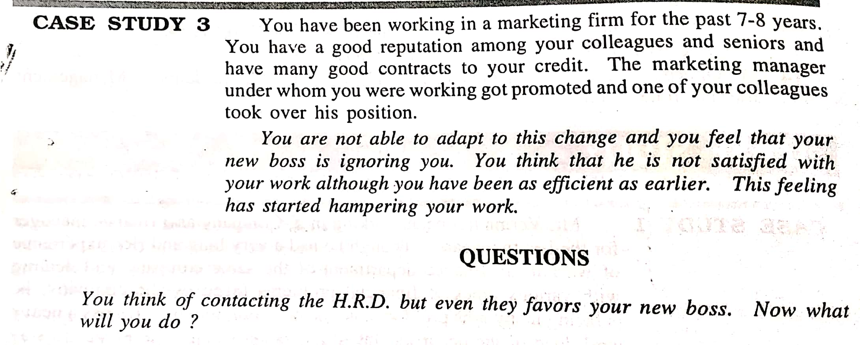
CASE STUDY

Slide 51
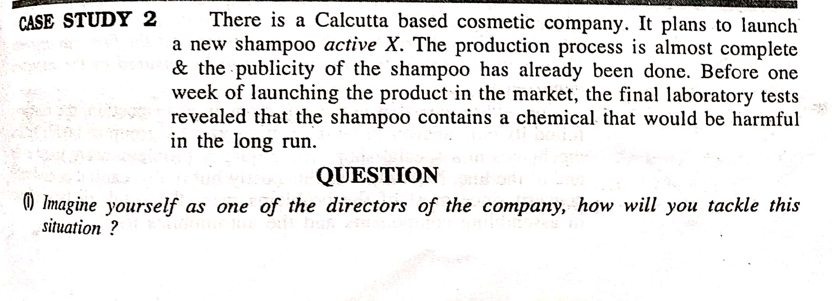
CASE STUDY

Slide 52
ORGANISING
The word ‘organize’ means placement of ideas, objects or people in a correct order so that they are easily available whenever required.
In management, it represents all those activities that result in the formal assigning of tasks, authority & responsibility to groups and individuals.
Organization involves two or more people with ideas and resources, working together in a structured, formal environment to achieve common goals.
It is a social and managerial system with a clearly defined boundary, which pursues collective goals through planning, hiring the human resources, directing their effort and controlling the performance.

Slide 53
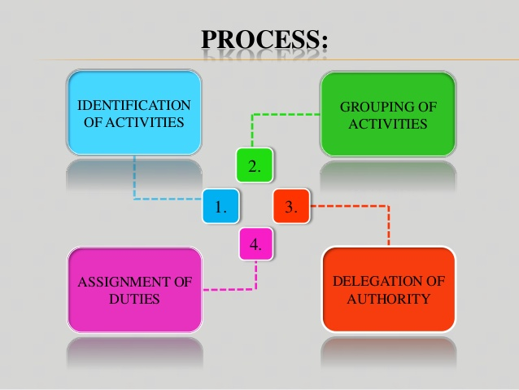
PROCESS OF ORGANIZING

Slide 54
PROCESS OF ORGANIZING
Identification of Activities: First step is to determine the tasks that must be performed to achieve the established objectives. Activities and jobs are building blocks of any organization. The activities to be performed depends upon the objectives, nature and size of the enterprise.
Grouping of Activities: The various activities are the grouped into departments or divisions according to similarity and common purpose. Such grouping is necessary for the purpose of specialization, coordination and control. It may be grouped on various basis i.e. functions products, territories, customers etc depending on requirements.

Slide 55
Assignment of Duties: Groups of activities or departments are then allotted to different positions. Every position is occupied by an individual best suited for it. The assignments of activities creates responsibility and ensures certainty of work performance. The process should be carried down to the lowest levels. It is basically done to avoid duplication of work and over-lapping efforts.
Delegation of Authority: Every individual is given the authority required to carry out the responsibility assigned to him. A chain of command is created through successive delegation of authority. Different positions are linked vertically and horizontally by establishing formal authority. Every individual must know to whom he is accountable and who are his subordinates.

Slide 56
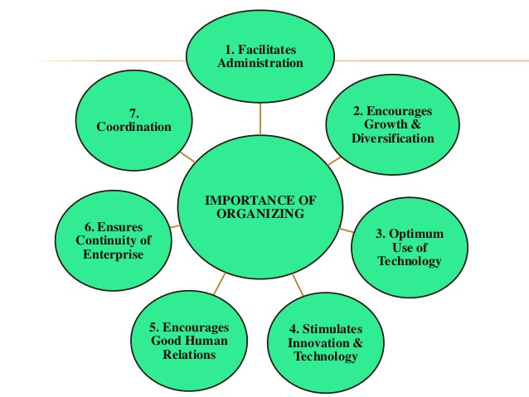
IMPORTANCE OF ORGANIZING

Slide 57
IMPORTANCE OF ORGANIZING
Facilitates Administration: Achievement of the objectives of an enterprise by providing a framework of coordination and control. It provides a system of authority and network for effective communication. Individual goals can be coordinated towards group goals. A properly balanced organization facilitated both management and operation of the enterprise.
Encourages Growth & Diversification: It has enabled organizations to grow and expand to giant sizes. Systematic division of work and consistent delegation of authority facilitate taking up of new activities and meeting new demands. It provides flexibility for growth without losing control over various activities.

Slide 58
Optimum Use of New Technology: It is made through a sound structure manned with competent employees. In addition, Optimum use of technology permits optimum utilization of human resources. Sound organization ensures that every individual is placed on the job for which one is best suited.
Stimulates Innovation & Creativity: It stimulates creative thinking and initiative on the part of employees. It provides for effective management of change and responds favorably to changes in environment. It provides recognition for the professional and the specialist in terms of their achievement.

Slide 59
Encourages Good Human Relations: The assignment of right jobs to right person improves job satisfaction and inter-personal relations. Well-defined jobs and clear lines of authority and responsibility ensure good human relations.
Ensures Continuity of Enterprise: It provides scope for the training and development of future management. It provides avenues for development and promotions through delegation and decentralization.
Coordination: It facilitates order and cohesiveness in the enterprise. Division of labor, better utility of technology and human talent helps to improve the efficiency and quality of work. Clear channels of communication among the members of the organization leads to coordination.

Slide 60
Type of Organization
Line Organization
Line and Staff Organization
Functional Organization
Project Organization
Matrix Organization
Formal Informal

Slide 61
Theories of Management
Classical
Bureaucratic Theory (Max Weber)
Scientific Theory
(FW Taylor)
Administrative Theory (Henry Fayol)
Neo
Human Relations (Elton Mayo)
Human Relations
(Mary Parker)
Behavioral Theory a) Mc Gregor (X & Y Theory) b) Maslow Theory (Need Hierarchy)
Modern
Quantitative Approach
System Approach
Contigency Approach

Slide 62
CLASSICAL THEORY

Slide 63
Bureaucratic Management Theory
Bureaucratic Theory was developed by a German Sociologist and political economist Max Weber (1864-1920).
Bureaucracy is the exercise of control based on knowledge, expertise, and/or experience.
He proposed that organizations must adopt policies which are fair and opposed to favoritism-based and recorded in writing.

Slide 64
Principles of Bureaucratic Theory
Qualification-based hiring – Hire employees based on their educational qualification or technical training.
Merit-based promotion – Managers decide on promotions and base their decisions on experience or achievement.
Chain of command – Organizations must have a structure wherein each position reports and is accountable to a higher position. Also, create a complaints process to protect the rights of workers in lower positions.

Slide 65
Division of labor – Responsibilities, tasks, and authority is equally divided and clearly defined.
Impartiality – Regardless of the position or status of an employee, all rules and regulations must apply to all members of the organization.
Recording in writing – Record every single administrative act, decision, rule or procedure in writing.
Owners are not managers – The owners of a company should not manage it.

Slide 66
Scientific Management Theory
F W Taylor, the father of scientific management aimed at improving economic efficiency, especially labor productivity.
Taylor had a simple view about what motivated people at work - money.
He felt that by organizing work in the most efficient way, the organization's productivity would be increased, allowing it to reward employees with additional remuneration, which Taylor argued was employee's only motivation.

Slide 67
Principles of Scientific Management Theory
Develop a science for each aspect of work. Also, study and analyze it to find the single best way to do the work.
Ensure that the selection of workers is based on a scientific methodology and not on nepotism and favoritism. Also, train, teach and develop the workforce allowing them to reach the optimum potential.
Your employees are not your enemies. Therefore, create an environment of cooperation with them to ensure the implementation of scientific principles.
Divide all work and responsibility equally between the workers and the management.

Slide 68
Administrative Theory
The first expert of Administrative Management Theory was Henri Fayol (1841-1925). Fayol is called the "Father of Administrative Management".
According to the Administrative Management Theory / School, management is the process of getting things done through people. Here importance is given to groups and not to individuals.

Slide 69
HENRY FAYOL’S 14 Principles of Management
1. DIVISION OF WORK:
Work should be divided among individuals and groups to ensure that effort and attention are focused on special portions of the task. Fayol presented work specialization as the best way to use the human resources of the organization.
2. AUTHORITY:
The concepts of Authority and responsibility are closely related. Authority was defined by Fayol as the right to give orders and the power to exact obedience. Responsibility involves being accountable, and is therefore naturally associated with authority. Whoever assumes authority also assumes responsibility.

Slide 70
3. DISCIPLINE:
A successful organization requires the common effort of workers. Penalties should be applied judiciously to encourage this common effort.
4. UNITY OF COMMAND
Workers should receive orders from only one manager.
5. UNITY OF DIRECTION:
The entire organization should be moving towards a common objective in a common direction.
6. SUBORDINATION OF INDIVIDUAL INTERESTS TO THE GENERAL INTERESTS:
The interests of one person should not take priority over the interests of the organization as a whole.

Slide 71
7. REMUNERATION:
Many variables, such as cost of living, supply of qualified personnel, general business conditions, and success of the business, should be considered in determining a worker’s rate of pay.
8. CENTRALIZATION:
Fayol defined centralization as lowering the importance of the subordinate role. Decentralization is increasing the importance. The degree to which centralization or decentralization should be adopted depends on the specific organization in which the manager is working.

Slide 72
9. SCALAR CHAIN:
Managers in hierarchies are part of a chain like authority scale. Each manager, from the first line supervisor to the president, possess certain amounts of authority. The President possesses the most authority; the first line supervisor the least. Lower level managers should always keep upper level managers informed of their work activities. The existence of a scalar chain and adherence to it are necessary if the organization is to be successful.
10. ORDER:
For the sake of efficiency and coordination, all materials and people related to a specific kind of work should be treated as equally as possible.

Slide 73
11. EQUITY:
All employees should be treated as equally as possible.
12. STABILITY OF TENURE OF PERSONNEL:
Retaining productive employees should always be a high priority of management. Recruitment and Selection Costs, as well as increased product-reject rates are usually associated with hiring new workers.
13. INITIATIVE:
Management should take steps to encourage worker initiative, which is defined as new or additional work activity undertaken through self direction.
14. ESPIRIT DE CORPS:
Management should encourage harmony and general good feelings among employees.

Slide 74
NEO CLASSICAL THEORIES

Slide 75
A) Human Relation Theory
Contributors of this theory are Elton Mayo and Mary Parker.
The human relations management theory is a researched belief that people desire to be part of a supportive team that facilitates development and growth.
Therefore, if employees receive special attention and are encouraged to participate, they perceive their work has significance, and they are motivated to be more productive, resulting in high quality work.

Slide 76
B) Behavioral Theory:
Behavioral science movement is regarded as a further refinement of human relations movement.
It covered wider aspects in inter-personal roles and responsibilities. It laid emphasis on the application of the methods and findings of general and social psychology and sociology for understanding the organizational behavior.

Slide 77
Contributors of Behavioral Theory
A) Abraham Maslow: Need Hierarchy Theory
He is an eminent U.S. psychologist, gave a general theory of motivation known as Need Hierarchy Theory in his paper published in 1943.
According to him people have a wide range of needs which motivate them to work

Slide 78
The classification of human needs:
(i) Physiological needs:
These needs arc related to the survival and maintenance of life. These include food, clothing, shelter etc.
(ii) Safety needs:
These consist of physical safety against murder, fire, accident, security against unemployment, etc.
(iii) Social needs:
These are also called affiliation needs and include need for love, affection, belonging or association with family, friends and other social groups.

Slide 79
(iv) Ego or esteem needs:
These are the needs derived from recognition, status, achievement, power, prestige etc.
(v) Self-fulfillment or self-actuation needs:
It is the need to fulfill what a person considers to be his real mission in life. It helps an individual to realize one’s potentialities to the maximum. Maslow is of the opinion that these needs have a hierarchy and are satisfied one by one. When first needs are satisfied then the person moves to the second and when this is satisfied, he moves to the third and so on.

Slide 80
B) Douglas-McGregor (1906-1964):
McGregor was a social psychologist.
McGregor is known for the development of a theory on Motivation.
He named it as Theory X and Theory Y.

Slide 81
Theory X
Theory X represents the traditional and narrow view of human nature.
Theory X assumes that the average worker is lazy and dislikes work.
He is unambitious, avoids responsibility and prefers to be led.
He does not bother about the organizational objectives so he should be directed to achieve these goals.
This theory explains many of the observable features of human behavior.

Slide 82
Theory Y
As per this theory people are not lazy by nature as theory X supposes them to be but the treatment in the organization makes them so.
The work to people is as normal as play and rest.
They will exercise self- control and self-direction.
People are ready to accept responsibility under proper conditions.
This represents a modern and dynamic nature of workers.
An organization designed on the basis of Theory Y will assume decentralization, participation of leadership and two-way communication.

Slide 83
MODERN THEORIES

Slide 84
Quantitative or Mathematical Approach or Management Science Approach:
Mathematics has been universally recognized as an important tool of analysis and a language for precise expression of concept and relationship.
the Mathematical School gives a quantitative basis for decision-making and considers management as a system of mathematical models and processes.
Different mathematical and quantitative techniques or tools, such as linear programming, simulation and queuing, are being increasingly used in almost all the areas of management for studying a wide range of problems.

Slide 85
System Approach
This approach came in 1960. Its early contributors include Ludwing Von Bertalanffy, Lawrence J. Henderson, W.G. Scott, Deniel Katz, Robert L. Kahn, W. Buckley and J.D. Thompson.
They viewed organization as an organic and open system, which is composed of interacting and interdependent parts, called subsystems. The system approach is to look upon management as a system or as “an organised whole” made up of sub­systems integrated into a unity or orderly totality.
System approach is based on the generalization that everything is inter-related and inter-dependent.

Slide 86
The Contingency Approach
It is the latest approach to the existing management approaches. During the 1970’s, contingency theory was developed by J.W. Lorsch and P.R. Lawrence,
Management problems are different under different situations and require to be tackled as per the situation.
The contingency view seeks to understand the inter-relationships within and among sub-systems as well as between the organization and its environment and to define patterns of relationships or configurations of variables contingency views are ultimately directed toward suggesting organization designs and managerial actions most appropriate for specific situations. mand of the situation.

