Slide 1
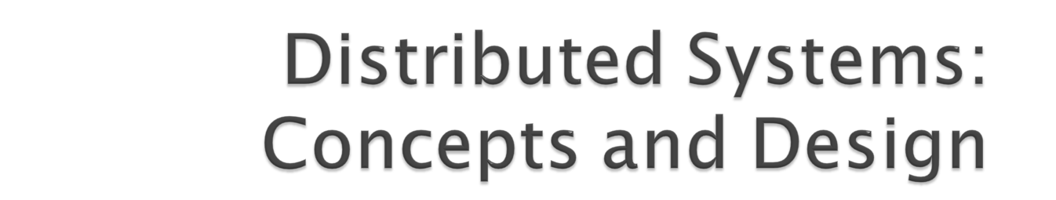
Sandeep Saxena

Slide 2

A distributed system is one in which components located at networked computers communicate and coordinate their actions only by passing messages.
Three Examples
  The internet
  An intranet which is a portion of the internet managed by an organization
  Mobile and ubiquitous computing

Slide 3

The Internet is a very large distributed system.
The implementation of the internet and the services that it suports has entailed the development of practical solutions to many distributed system issues.

Slide 4

An intranet is a portion of the Internet that is separately administered and has a boundary that can be configured to enforce local security policies
The main issues arising in the design of components for use in intranets are: file services, firewalls, cost.

Slide 5
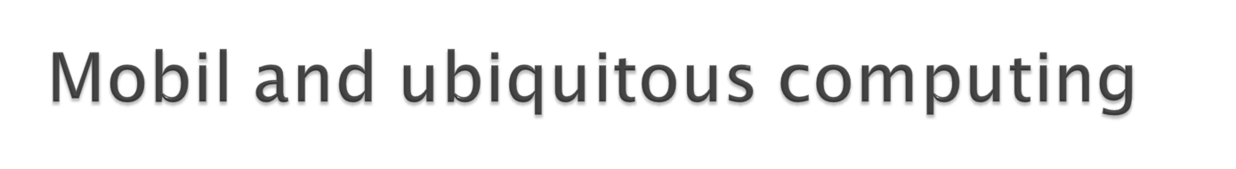
The portability of the devices, such as laptop computers, PDA, mobile phone, refrigerators, togather with their ability to connect conveniently to networks in different places, makes mobile computing possible.
Ubiquitous computing is the harnessing of many small cheap computational devices that are present in users’ physical environments, including the home, office and elsewhere.

Slide 6
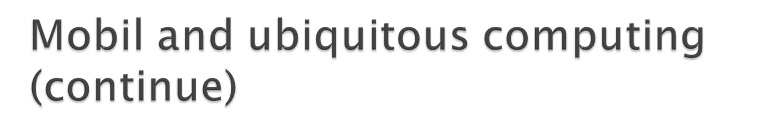
Mobile and ubiquitous computing raise significant system issues presents an architecture for mobile compuing and outlines the issues that arise from it,
  how to support the discovery of resources in a host environment;
  eliminating the need for users to reconfigure their mobile devices as they move around;
  helping users to cope with limited connectivity as they travel;
  and providing privacy and other security guarantees to users and the environments that the visit.

Slide 7
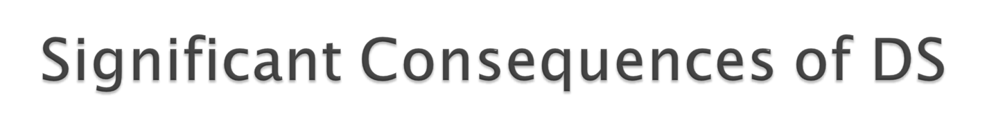
Concurrency
  The capacity of the system to handle shared resources can be increased by adding more resources to the network.
No global clock
  The only communication is by sending messages through a network.
Independent failures
  The programs may not be able to detect whether the network has failed or has become unusually slow.

Slide 8

The term ”resource” is a rather abstract one, but it best characterizes the range of things that can usefully be shared in a networked computer system. It extends from
  hardware components such as disks and printers
  Software defined entities such as files, databases and data objects of all kinds.

Slide 9

Services
  A distinct part of a computer system that manages a collection of related resources and presents their functionality to users and applications.
  http, telnet, pop3...
Server
  A running program (a process) on a networked computer that accepts requests from programs running on other computers to perform a service, and responds apppropriately.
  IIS, Apache...
Client
  The requesting processes.

Slide 10

The WWW is an evolving system for publishing and accessing resources and services across the Internet.
The Web is an open system:
  Its operation is based on communication standards and document standards that are freely published and widely implemented.
  The Web is one with respect to the types of ’resource’ that can be published and shared on.

Slide 11
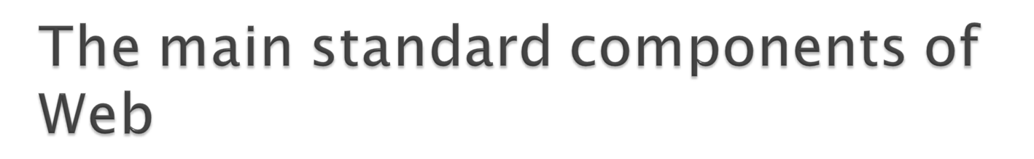
HyperText Markup Language (HTML)
Uniform Resource Laocators (URLs)
HyperText Transfer Protocol (HTTP)
  HTTP is a ’request-reply’ protocol.

Slide 12

Dynamic pages
  CGI
  Javascript
  ASP, PHP...
Discussion
  Hypertext model is lacking in some respects.
  HTML is limited in exchanging structured data, one solution is XML.
  A Web page is not always a satisfactory user interface.

Slide 13

Heterogeneity
Openness
Security
Scalability
Failure handling
Concurrency
Transparency

Slide 14

Heterogeneity applies to-
  Different networks, hardware, operating systems, programming languages, developers.
We set up protocols to solve these heterogeneities.
Middleware: a software layer that provides a programming abstraction as well as masking the heterogeneity.
Mobile code: code that can be sent from one computer to another and run at the destination.
  Example: java applets
  Virtual machine approach

Slide 15

The openness of DS is determined primarily by the degree to which new resource-sharing services can be added and be made available for use by a variety of client programs.
Open systems are characterized by the fact that their key interfaces are published.
Open DS are based on the provision of a uniform communication mechanism and published interfaces for access to shared resources.
Open DS can be constrcted from heterogeneous hardware and software.

Slide 16

Security for information resources has three components:
  Confidentiality: protection against disclosure to unauthorized individuals.
  Integrity: protection against alteration or corruption.
  Availability: protection against interference with the means to access the resources.
Two new security challenges:
  Denial of service attacks (DoS).
  Security of mobile code.

Slide 17

A system is described as scalable if it remains effective when there is a significant increase in the number of resources and the number of users.
Challenges:
  Controlling the cost of resources or money (example:-Internet)
  Controlling the performance loss.
  Preventing software resources from running out
  (Example IP address 32 to 128)
  Avoiding preformance bottlenecks.

Slide 18

When faults occur in hardware or software, programs may produce incorrect results or they may stop before they have completed the intended computation.
Failure in DS is partial.
Techniques for dealing with failures:
  Detecting failures( Checksum)
  Masking failures( Hidden, Exam:- Retransmission)
  Tolerating failures(web browser can’t contact to server)
  Recovering form failures(roll back)
  Redundancy :-services can be made to tolerate by the use of redundancy( two routes, replication)

Slide 19

There is a possibility that several clients will attempt to access a shared resource at the same time.
Any object that represents a shared resource in a distributed system must be responsible for ensuring that operates correctly in a concurrent environment.
For an object to be safe in a concurrent environment, its operations must be synchronized in such a way that the data remains consistent

Slide 20

Transparency is defined as the concealment from the user and the application programmer of the separation of components in a distributed system, so that the system is perceived as a whole rather than as a collection of independent components.
Eight forms of transparency:
  Access transparency **
  Location transparency **
  Concurrency transparency
  Replication transparency
  Failure transparency
  Mobility transparency
  Performance transparency
  Scaling transparency

Slide 21
Access transparency
  Enables local and remote resources to be accessed using identical operations.
Location transparency
  Access without knowledge of their physical location
Concurrency transparency
  Operate concurrent using shared resources without interference between them
Replication transparency
  Multiple instances of resources to be used without knowledge of replica

Slide 22
Failure transparency
  Allowing users and applications to complete their tasks despite the failure of hardware or software
Mobility transparency
  Movement of resources and clients without affecting the operations of the users
Performance transparency
  Allows the system to reconfigured to improve performance as load vary
Scaling transparency
  Allows to expand in scale without change to the system structure .

Slide 23

Distributed systems are everywhere
  Internet, intranet, wireless networks.
Resource sharing is the main motivating factor for constructing distribute systems.
The constrcution of distributed systems produces many challenges.

Slide 24
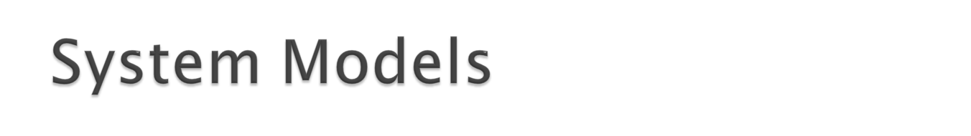
Introduction
Architectural models
Fundamental models
summary

Slide 25

The common properties and design issues for distributed systems in the form of descriptive modes are discussed.
Three fundamental models are introduced that help to reveal key problems for the designers of the distributed system.
The purpose of these models is to specify the design issues, difficulties and threats that must be resolved to develop distributed system.

Slide 26
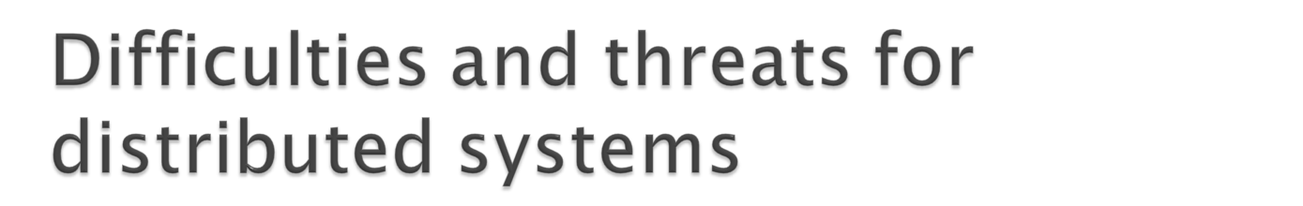
Widely varying modes of use.
Wide range of system environments
Internal problems:
  non-synchronized clocks,
  conflicting data updates,
  many modes of hardware and software failure involving the individual components of a system.

Slide 27

An architectural model defines
  the way in which the components of systems interact with one another and
  the way in which they are maped onto an underlying network of computers
The fundamental model provides
  Abstract view of just those characteristics of the distributed system that affect their dependability characteristics

Slide 28

An architectural model of a distributed system first simplifies and abstracts the functions of the individual components of a DS and then it considers:
  The placement of the components across a network of computers
  The interrelationships between the components.

Slide 29

Software layers
System architectures
Variations on the client-server model
Interfaces and objects
Design requirements for distributed architectures

Slide 30

Referred to the structuring of software as layers or modules in a single computer
Services offered and requested between processes located in the same or different computers
This process and service view can be expressed in terms of service layers.

Slide 31
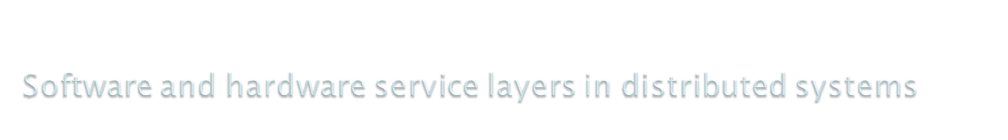
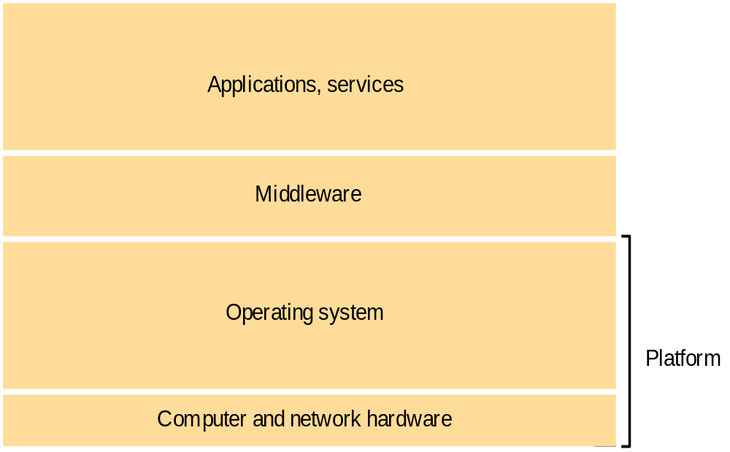

Slide 32
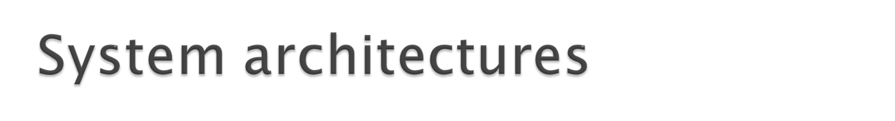
The principal architectural models on which the distribution responsibilities are based
Client-server model
Services provided by multiple servers
Proxy servers and caches
Peer processes

Slide 33

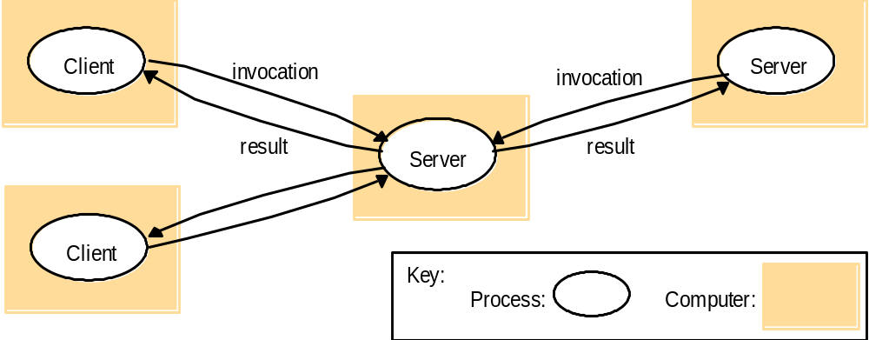

Slide 34
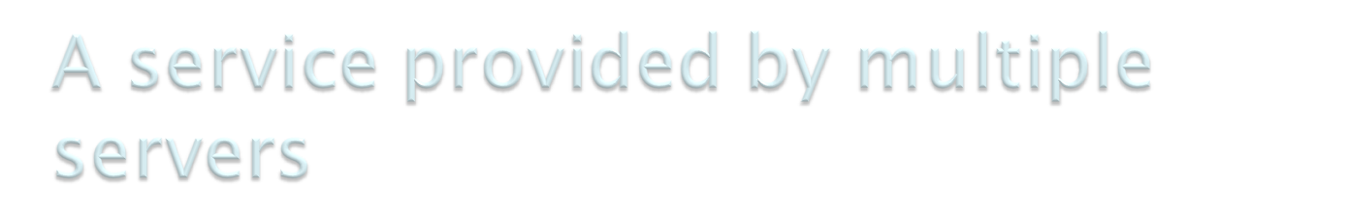
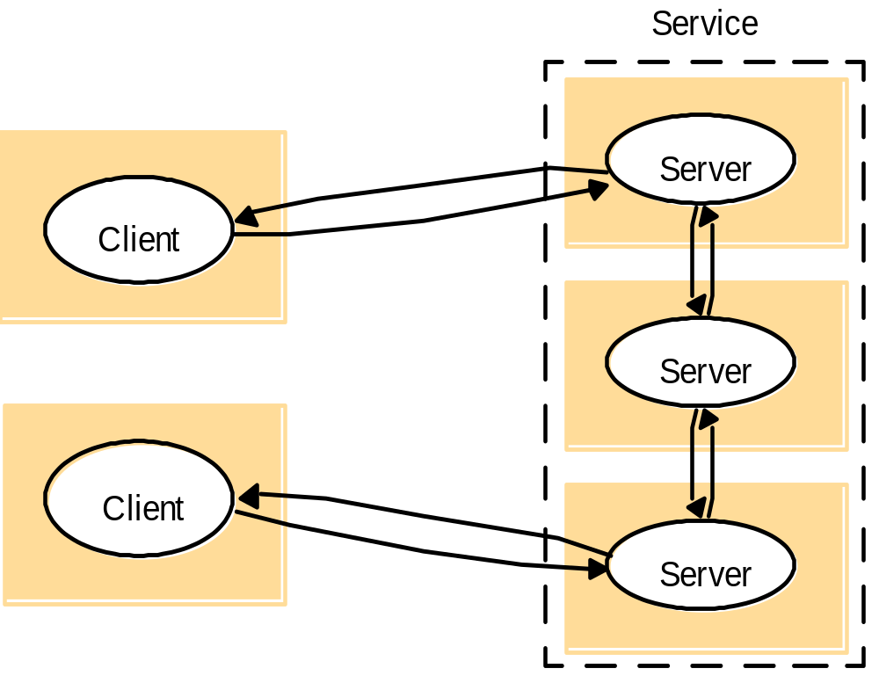

Slide 35

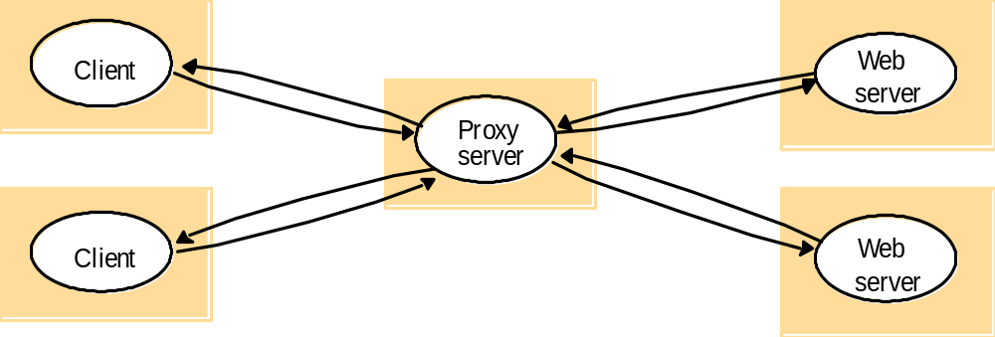

Slide 36

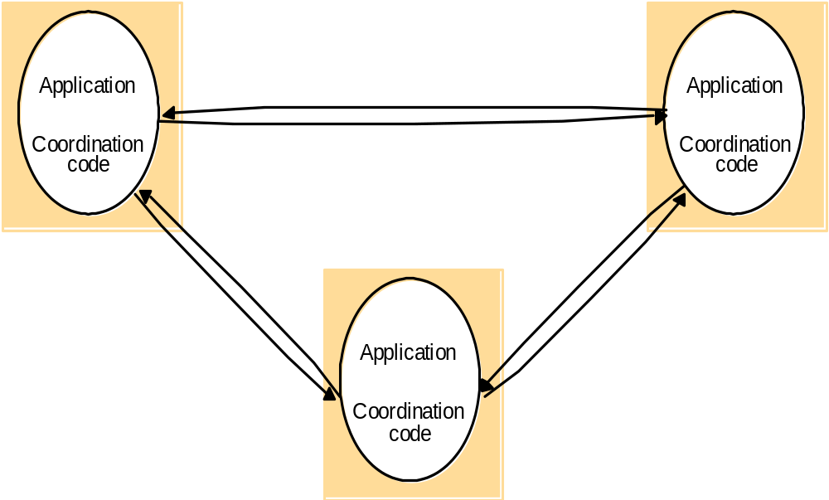
Instructor’s Guide for Coulouris, Dollimore and Kindberg Distributed Systems: Concepts and Design Edn. 3
© Addison-Wesley Publishers 2000

Slide 37
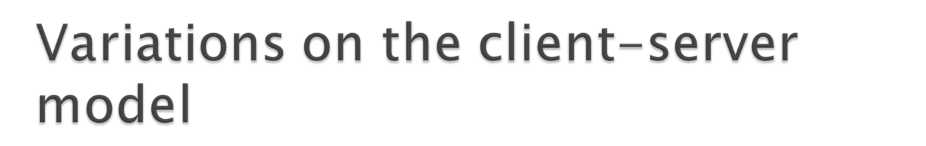
Mobile code
Mobile agents
Network computers
Thin client
Mobile devices and spontaneous networking
The X-11 window system

Slide 38

Applets are well known and widely used examples of mobile code
The user running a browser selects a link to an applet whose code is stored on a web server
The code is downloaded and runs
Running the downloaded code locally give a advantage that no delay
Consider an application that requires that user should be kept update with changes as they occur at the server
This is achieved only by initiated by the client called push model
Example stock broker, cricket update

Slide 39

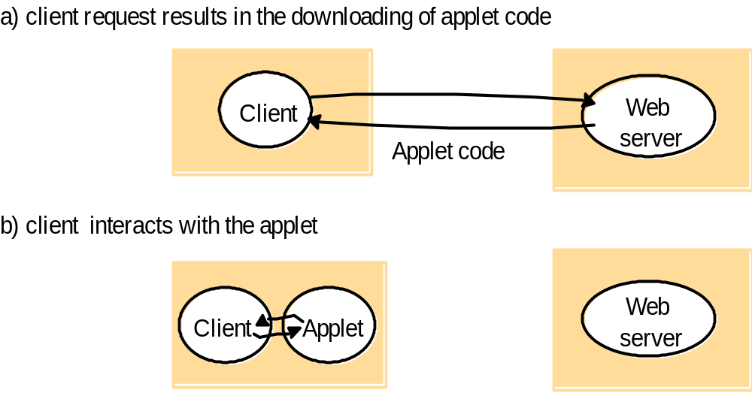
Instructor’s Guide for Coulouris, Dollimore and Kindberg Distributed Systems: Concepts and Design Edn. 3
© Addison-Wesley Publishers 2000

Slide 40

A mobile agents is a running program (code + data) that travels from one computer to another, carrying out a task on someone’s behalf for:
  Collecting the information
  Returning with a result
mobile agents might be used
  to install and maintain software
  To compare the prices of products
  Performs a series of database operations

Slide 41

The network computer downloads its operating system and any application software needed by the user from a remote file server
Applications runs locally but the files are maintained by the remote file server
All the data and code is stored on a remote that’s why user may migrate from one network computer to another

Slide 42

The thin client refers to a software layer that support a window based user interface on a computer that is local to the user while executing application program on remote

Slide 43

Compute server
Network computer or PC
Thin
network
Application
Client
Process
Instructor’s Guide for Coulouris, Dollimore and Kindberg Distributed Systems: Concepts and Design Edn. 3
© Addison-Wesley Publishers 2000

Slide 44

Hardware component moves between different location
Carrying software component with them
Service discovery
Location management

Slide 45

The set of functions available for invocation in a process is specified by one or more interface definition
With C++ and java distributed objects are created
Objects can be encapsulated in server processes and references to them are passed to other processes so that their methods can be accessed by remote invocation
  CORBA by RMI

Slide 46
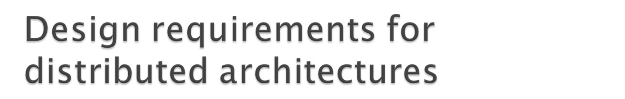
Performance issues
Use of caching and replication
Dependability issues

Slide 47

Responsiveness
  Users of interactive application require a fast and consistent response to interaction.
  When a remote service is invoked, the speed of the response is depond not only on the load and performance of the server but the network delay
  To achieve good response time
    The system must composed of few layers
    The data quantity should be small
  Example:
    Locally cached pages
    Less graphics

Slide 48
Throughput
  The rate at which computational work is done.
  Effected by:
    Processing speed of client and server
    Data transfer rate
Balancing computer loads
  In some case load balancing may involve moving partially-completed work as the loads on hosts changes.
  Example java applets

Slide 49
Quality of services
  The ability to meet the deadlines of users need.
The main non-functional properties of system that affect the quality of service:
  Reliability
  Security
  Performance
    Responsiveness
    Throughput
    Redefined by timeliness guarantees

Slide 50
Use of caching and replication
  The design of systems that overcome them by the use of data replication and caching
  How cached copies of the resources are kept update
  Web caching protocol
    Both web browser and proxy server cache responses to client request
  Cache consistency protocol

Slide 51

The dependability of computer systems as correctness, security and fault tolerance.
Fault tolerance: reliability is achieved through redundancy- the provision of multiple resources
Security: the architectural impact of the requirement for security concerns the need to locate sensitive data and other resources only in computers that can be effectively secured against attack.

