Slide 1



Slide 2
Azure fundamentals
RBAC
Three different types of roles: Reader, Contributor, and Owner.
Using Azure RBAC, you can segregate duties within your team and grant only the amount of access to users that they need to perform their jobs.

Slide 3
Azure SQL dtabase on-premises
Part of the Azure SQL family, Azure SQL Database is an intelligent, scalable, relational database service built for the cloud.
With serverless compute and Hyperscale storage options that automatically scale resources on demand, you're free to focus on building new applications without worrying about storage size or resource management.

Slide 4
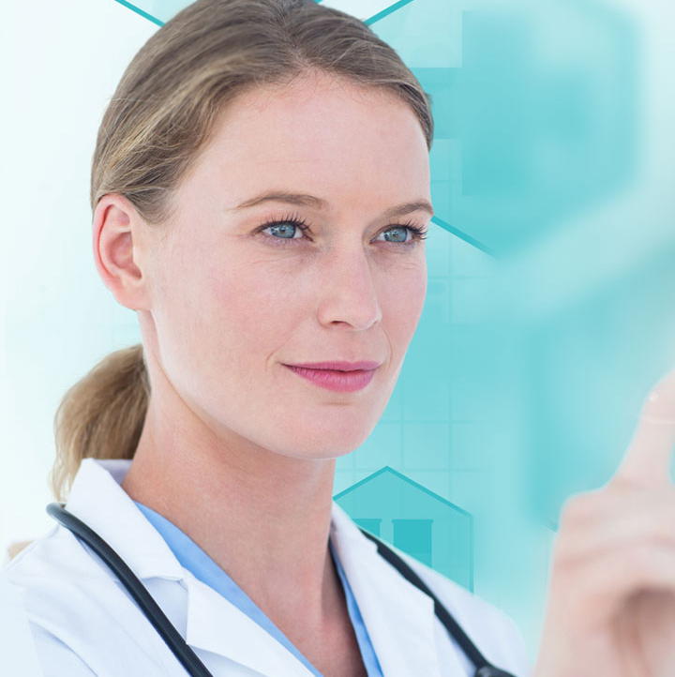
IoT various purposes in healthcare-azure
IoT for Patients - Devices in the form of wearables like fitness bands and other wirelessly connected devices like blood pressure and heart rate monitoring cuffs, glucometer etc. give patients access to personalized attention. These devices can be tuned to remind calorie count, exercise check, appointments, blood pressure variations and much more.
IoT for Physicians - By using wearables and other home monitoring equipment embedded with IoT, physicians can keep track of patients’ health more effectively. They can track patients’ adherence to treatment plans or any need for immediate medical attention. IoT enables healthcare professionals to be more watchful and connect with the patients proactively. Data collected from IoT devices can help physicians identify the best treatment process for patients and reach the expected outcomes.
There are several other purposes too in healthcare. ☺

Slide 5
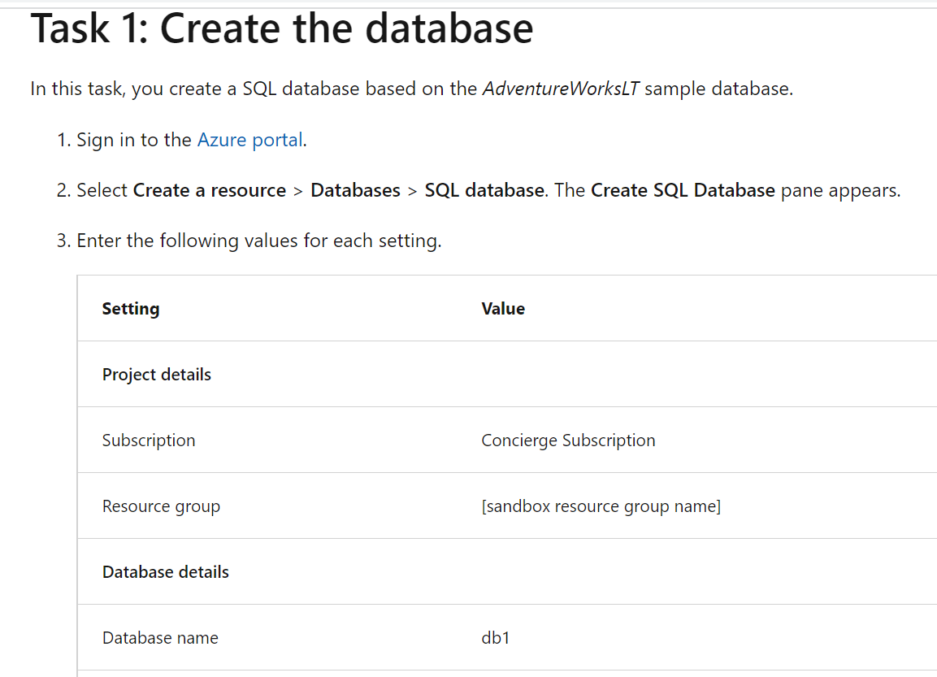
Snippets to create database query in AZURE

Slide 6
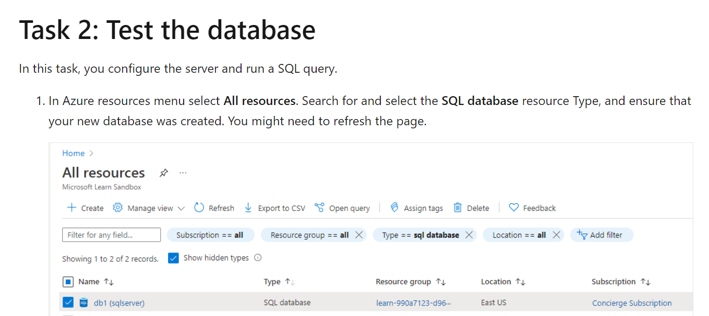

Slide 7
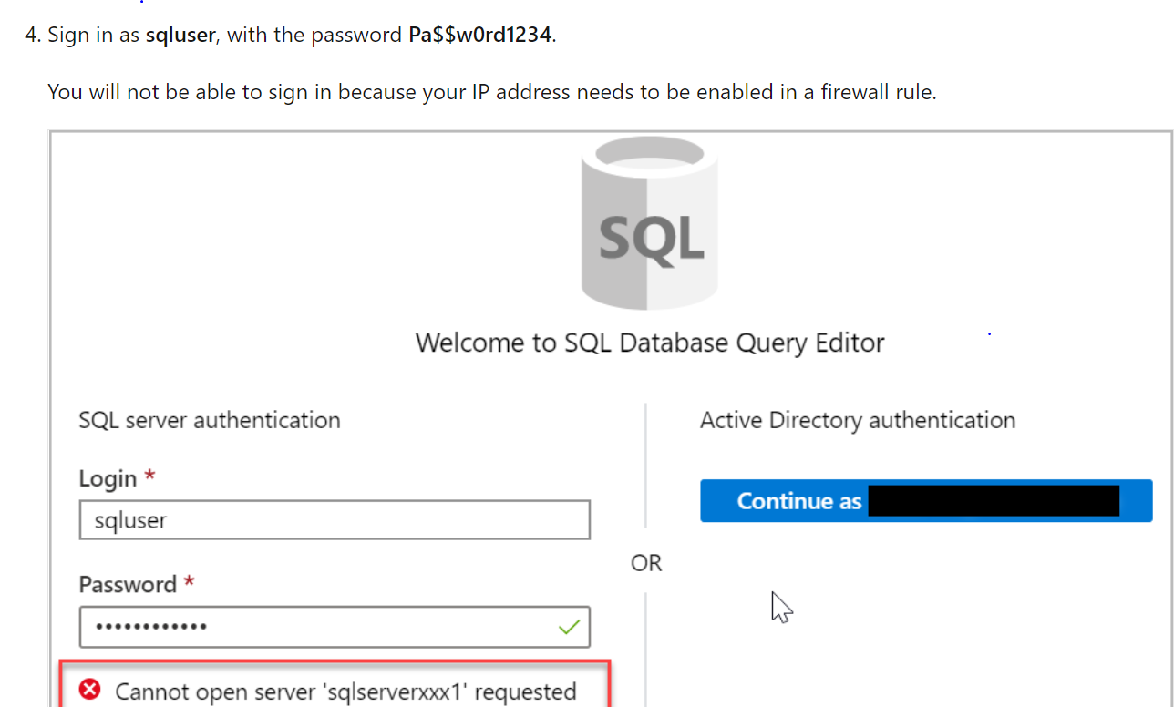

Slide 8
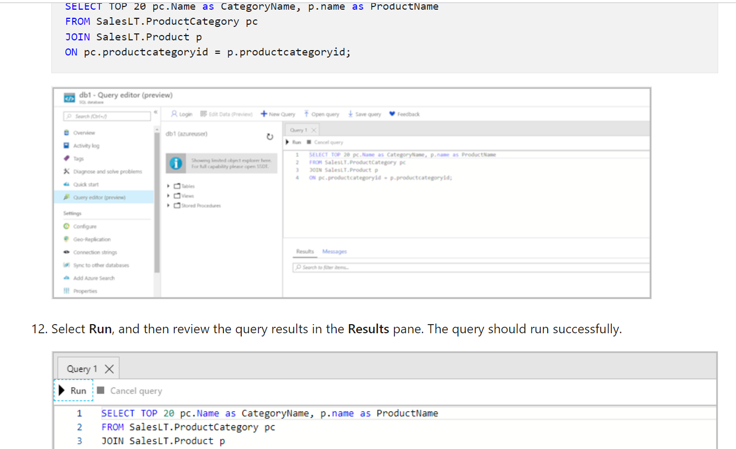

Slide 9
Lab for implementing database azure- pluralsight
https://app.pluralsight.com/labs/detail/1a712608-4299-4dc6-8a14-874859a92a8e
Enrolled through my company capgemini

Slide 10
Serverless computing- Azure feature
Serverless computing enables developers to build applications faster by eliminating the need for them to manage infrastructure. With serverless applications, the cloud service provider automatically provisions, scales and manages the infrastructure required to run the code.

Slide 11
Thank you!!

