Slide 1
Technology Bucket : Healthcare and Biomedical devices Category: Software/Hardware Company Name/ Ministry Name: #Tag Problem Code : Team Leader Name : Subhankar Bhadra College Code :
Idea
Tech Medic center is all about renovating our old medical shop into a new one just imagine of a medical shop where you don't have to stand in queue to buy medicine, where you can get a medicine ATM machine which dispense medicine when the shops are closed, where you can talk and have advice to the doctors any time and where you have had all your regular tests.
Yaa! All these things are possible, it's not virtual.
here are our solutions for the problems:-
Automated medical shop:
Things like a well packaging machine, a robot for better understanding, and a well divided different sections so things are well organized in minimum area.
Medicine ATM machine:
Imagine as an ATM card we will have a medic card too, so that we can have this machine all around the places to help peoples. This won't be such a difficult task because we are just thinking of the devices which are already present with us like - ATM machine, cards already used like Amazon Go.

Slide 2
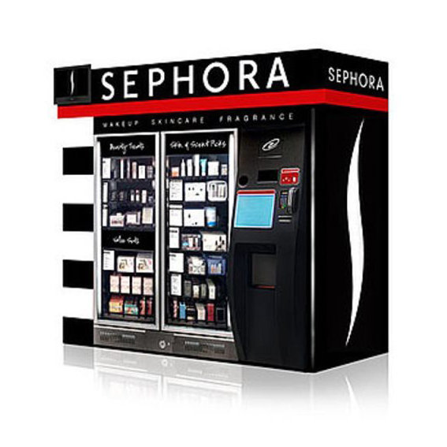
An Ai automated interactive machine:
Thing of a machine which can ask u what are the problems which you are facing and can suggest you medicine, if need can make you talk to a doctor through video calls and many other ways so that a person has not to take medicine without prescription because this will atomically generate an E-prescription.
A thermal machine to conduct daily tests:
Think of the machine which can read a body's general parameters like temperature, blood pressure, sugar, etc. this will help us in our above mention idea too and people will not have to go to some other places for these routine task.

Slide 3
Use Cases
So here comes the problem with our ongoing system of the machine shops:-
The medicine centers are crowded.
Some time the medicine shop is closed.
There are many cases where people do not like to visit doctors and ask for medicine without the prescription.
People have to visit a different centers for the regular checkup as a result they avoid this too.
Lower downtime ensures the machine keeps functioning at all times, thus contributing to the increase in Topline
Dependencies
Medicine Categorization
Demand Prediction
Machine Programming
Health Card
Backend Database

Slide 4
Outcomes
So this project contain few ideas for updating of already what we have and some machine with some advance technologies. This well helps the maters of healthcare till some means. Few problems, which are mentioned can be solved now.
Thank You,
Team: #Tag

