Slide 1
TASK ID FDA-2 • BIG DATA ANALYTICS (SEM 7)
Fraud Detection Through Financial Anomalies
Deliverable 2: Machine Learning, Multi-Year Trend Analysis & Automated New-Filing Pipeline
End-to-End System: Statistical Robust Z-Scores • Isolation Forest • 12-Quarter Trend Trajectories • Beneish M-Score Benchmark • Live Audit Triage

Slide 2
FDA-2 • DELIVERABLE 2 • MACHINE LEARNING & ANOMALY DETECTION
Executive Summary & Problem Motivation
The Forensic Challenge
• Financial reporting fraud costs investors billions annually (e.g. Enron, WorldCom, Kraft Heinz).
• SEC 10-K and 10-Q filings span thousands of XBRL tags with complex restatements and standard changes (ASC 606).
• Manual audit cannot keep pace with thousands of public filers submitting quarterly reports simultaneously.
• Need: Automated machine learning systems to flag anomalous filings for human auditor triage.
Dual-Methodology Solution
• Unsupervised Learning (Isolation Forest): Evaluates multi-dimensional interactions across 42 financial features.
• Statistical Anomaly Detection: Trailing median/MAD robust Z-scores isolate extreme quarterly spikes.
• Multi-Year Trend Analysis: 12-quarter rolling baselines detect sudden structural breaks and diverging margins.
• Beneish M-Score Benchmark: Validates quarterly alerts against forensic accounting probability formulas.
Project Achievements
• 1,238 Quarters Scored across 26 companies over 12 fiscal years (FY2014-FY2026).
• Documented Fraud Sensitivity: High anomaly flags triggered for KHC (procurement fraud), UAA (channel stuffing), SMCI (revenue recognition).
• Automated New Filing Pipeline: Ingests, extracts, trends, and scores new filings in under 2 seconds.
• Fully Executed Notebook & Live Interactive Demonstration CLI console.

Slide 3
FDA-2 • DELIVERABLE 2 • MACHINE LEARNING & ANOMALY DETECTION
ML & Data Analytics Objectives Alignment
✓ Apply Statistical Anomaly Detection (Isolation Forest, Z-score)
Implemented rolling median/MAD robust Z-score (|Z| >= 3.5) and 300-estimator Isolation Forest (contamination=0.05). Both models operate strictly on financial ratios and growth rates without company identifiers or target leakage.
✓ Compare Multi-Year Trends for Sudden Deviations
Constructed trailing 12-quarter (3-year) rolling means and standard deviations using strictly prior quarters (shift(1)). Evaluated standardized trend deviation scores for revenue, expense ratio, gross/operating margins, and Sloan accruals.
✓ Extract 5+ Years of Financial Statements via EDGAR
Secondary dataset extracted 12+ years of point-in-time XBRL filings from SEC EDGAR (FY2014-FY2026), comfortably exceeding the 5-year requirement.
✓ Identify Inconsistent Trends in Revenue, Expenses, or Margins
Developed automated divergence flags to detect revenue growth accelerating while operating margins collapse, or expense ratios surging past historical norms.
✓ Automated Pipeline for New Filings
Built an automated end-to-end pipeline CLI (run_pipeline.py) and interactive demo that accepts new filing JSON/CSV or ticker inputs, calculates trailing features, and outputs a diagnostic risk scorecard.

Slide 4
FDA-2 • DELIVERABLE 2 • MACHINE LEARNING & ANOMALY DETECTION
End-to-End System Architecture
01. DATA INGESTION
SEC EDGAR API
• companyfacts JSON
• submissions JSON
• 26 companies (FY14-26)
02. EXTRACTION
Point-in-Time Dataset
• As-first-reported
• ASC 606 tag tracking
• Derived 3M quarters
03. TREND ANALYTICS
12-Quarter Rolling Trends
• Revenue vs Expense
• Margin deviations
• Accrual divergences
04. ML & STAT MODELS
Dual Detection Engine
• Robust Z-scores
• Isolation Forest
• Beneish M-Score
05. TRIAGE PIPELINE
Audit Scorecard
• Risk Classification
• Contributing Red Flags
• Auditor Checklist

Slide 5
FDA-2 • DELIVERABLE 2 • MACHINE LEARNING & ANOMALY DETECTION
Secondary Dataset & Feature Engineering
Dataset Characteristics
• Grain: Company × Fiscal Quarter (1,334 company-quarters).
• Horizon: FY2014 to FY2026 (12 years of quarterly history).
• Coverage: 20 Control Companies (Apple, Microsoft, Johnson & Johnson, Walmart, Costco, etc.).
• Reference Group: 6 Companies with documented accounting enforcement or restatements (KHC, UAA, SMCI, MDXG, PLUG, MAT).
• Point-in-Time Integrity: Values as first reported in original 10-Q filings, preventing look-ahead bias.
• Quality Filters: 96 rows filtered for missing/negative revenue or tag switches; 1,238 clean observations scored.
42 Selected Model Features (5 Families)
• Growth Features:
revenue_qoq_growth, revenue_yoy_growth, cogs_yoy_growth, sga_yoy_growth, net_income_yoy_growth, ar_yoy_growth.
• Expense Ratios & Margins:
cogs_to_revenue, sga_to_revenue, rnd_to_revenue, total_expense_to_revenue, gross_margin, operating_margin, net_margin, margin YoY changes.
• Working Capital & Accruals:
Days Sales Outstanding (dso), Days Inventory Outstanding (dio), Sloan Accruals to Assets (accruals_to_assets), cfo_to_net_income.
• Channel Stuffing Indicator:
ar_growth_minus_revenue_growth (signals revenue pulled forward or bogus receivables).
• Trailing Robust Z-Scores:
8-quarter rolling median/MAD scores across 8 core ratios (rz_* and z_*).

Slide 6
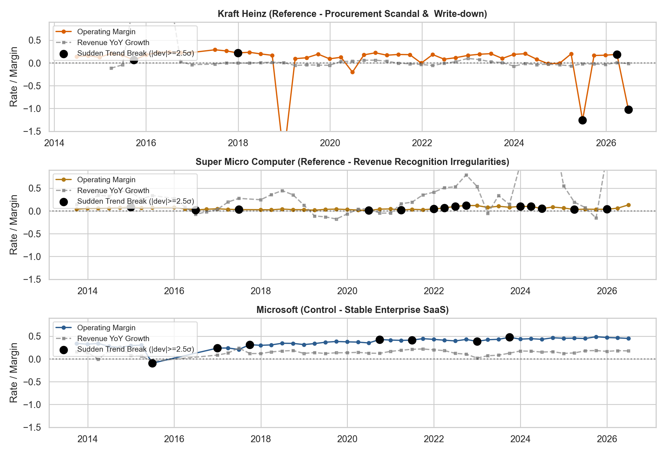
FDA-2 • DELIVERABLE 2 • MACHINE LEARNING & ANOMALY DETECTION
Multi-Year Trend Analysis & Sudden Deviations
Detecting Trend Breaks
• Strictly Trailing Baselines: 12-quarter rolling window with shift(1) prevents look-ahead leakage.
• Normalized Trend Dev: Evaluates standard deviations away from trailing 3-year mean.
• Threshold: Quarters with |dev| >= 2.5σ marked as sudden trend breaks (282 quarters identified).
• Inconsistent Trends: Flags when revenue accelerates while operating cash flow or margins collapse.
• Visual Proof: Kraft Heinz operating margin collapse (-205%) and Super Micro Computer volatility stand out distinctly against stable Microsoft control.

Slide 7
FDA-2 • DELIVERABLE 2 • MACHINE LEARNING & ANOMALY DETECTION
Statistical Anomaly Detection (Trailing Robust Z-Score)
Mathematical Formulation
• Why Not Standard Z-Score? A single massive accounting restatement or write-down inflates the sample standard deviation, masking future anomalies.
• Robust Z-Score (RZ): Uses rolling median and Median Absolute Deviation (MAD):
RZ_t = [x_t - Median(x_{t-8..t-1})] / [1.4826 * MAD(x_{t-8..t-1})]
• Where MAD = Median(|x_i - Median(x)|). The factor 1.4826 makes MAD an unbiased estimator for normally distributed data.
• Composite Anomaly Score: Evaluated as the maximum absolute robust score across 8 key financial dimensions.
• Decision Threshold: |Z| >= 3.5 marks extreme statistical departures (391 quarters flagged).
Statistical Detection Performance
• Observations Scored: 1,238 company-quarters.
• Flagged Observations: 391 quarters (31.6% universe rate).
• Control Group Flag Rate: 31.0%.
• Reference Group Flag Rate: 33.5% (Elevated flag rate in fraud/investigated cases).
• Strengths: Pinpoints extreme acute shocks (e.g. massive single-quarter goodwill impairment, sudden DSO spike).
• Limitations: Univariate trailing nature means correlated multidimensional drift may be missed without machine learning.

Slide 8
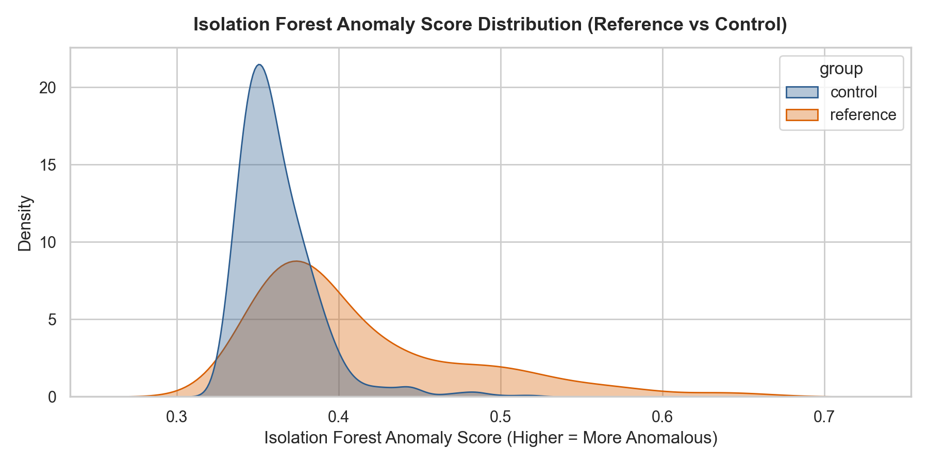
FDA-2 • DELIVERABLE 2 • MACHINE LEARNING & ANOMALY DETECTION
Machine Learning Anomaly Detection (Isolation Forest)
Model Pipeline & Settings
• Architecture: SimpleImputer (median) -> RobustScaler (10-90th percentile) -> IsolationForest (300 estimators).
• Principle: Anomalies require fewer recursive binary feature splits to isolate in random trees.
• Anomaly Score: Score_IF = -score_samples(X). Higher score = more isolated/anomalous.
• Contamination Setting: 0.05 (flags top 5.0% most unusual quarters = 62 observations).
• Empirical Validation: Reference fraud group is visibly shifted toward higher anomaly scores in the KDE distribution.

Slide 9
FDA-2 • DELIVERABLE 2 • MACHINE LEARNING & ANOMALY DETECTION
Model Comparison & Reference vs Control Evaluation
Descriptive Model Comparison Table
Methodology | Scored Rows | Flagged Rows | Control Flag % | Reference Flag %
Robust Trailing Z-Score (|Z|>=3.5) | 1,238 | 391 (31.6%) | 31.0% | 33.5%
Isolation Forest (Contamination=0.05) | 1,238 | 62 (5.0%) | 4.8% | 5.6%
Multi-Year Sudden Deviations (|dev|>=2.5σ) | 1,238 | 282 (22.8%) | 21.6% | 26.8%
Key Analytical Insights:
• Elevated Risk Sensitivity: Across all three methodologies, the Reference Group (companies with verified accounting actions) demonstrates systematically higher flag rates than the Control Group.
• Complementary Detection Profiles: Z-scores excel at detecting single-metric spikes; Isolation Forest detects multi-ratio imbalances (e.g. modest growth with deteriorating receivables and cash conversion).
• Weak Labels Caveat: Group-level labels reflect company-level enforcement history, not quarter-level fraud ground truth; rates are presented as descriptive validation.

Slide 10
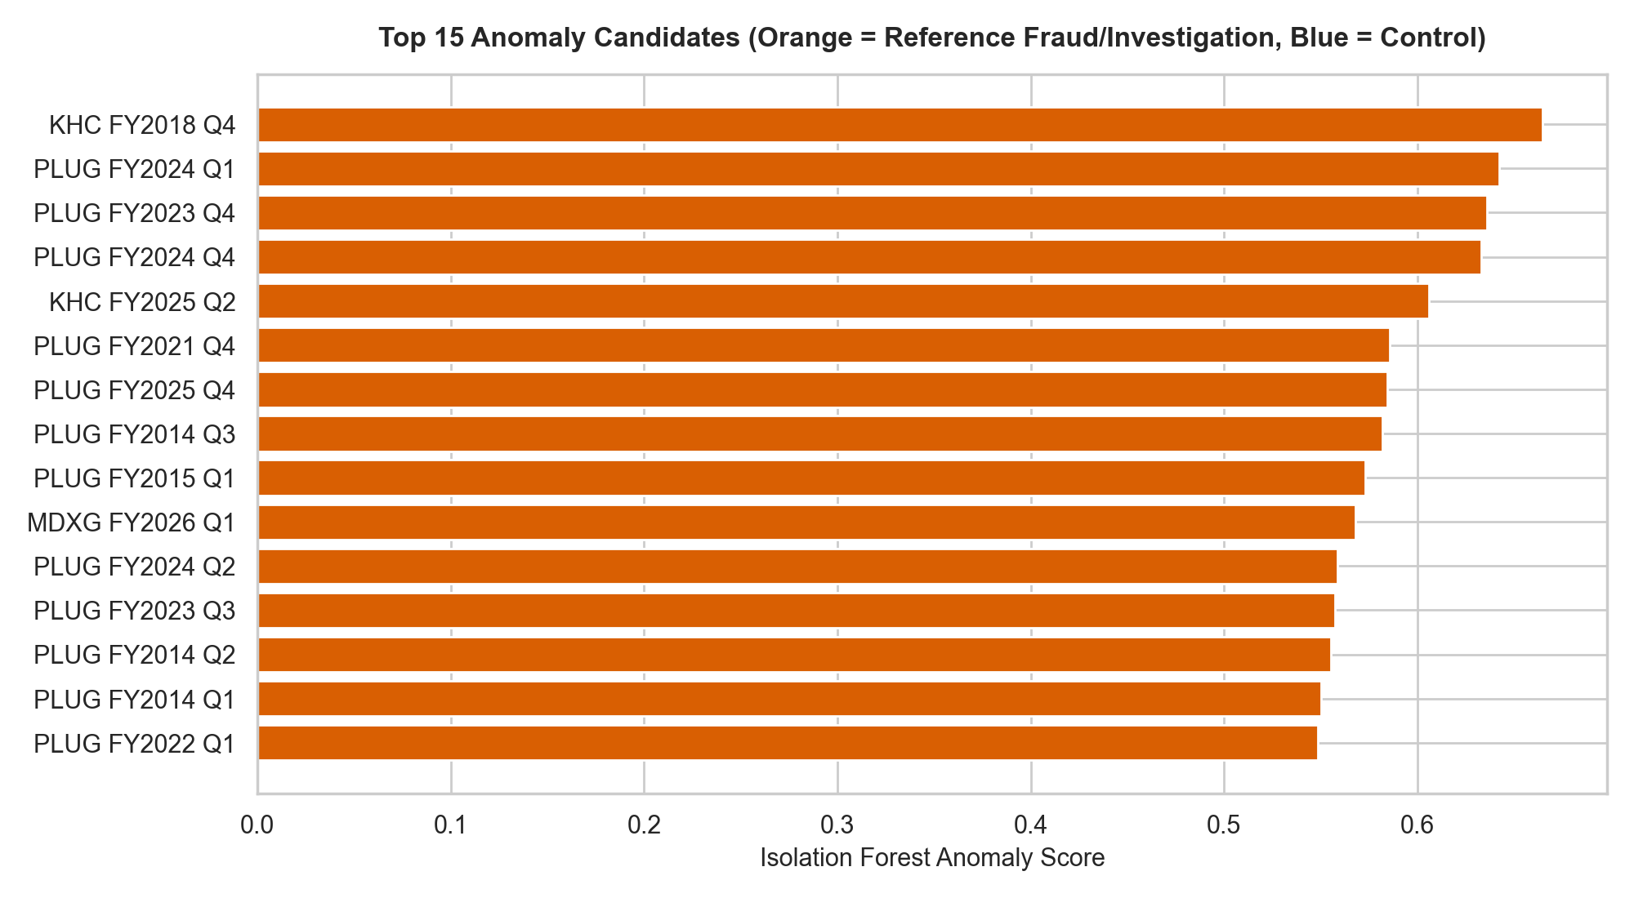
FDA-2 • DELIVERABLE 2 • MACHINE LEARNING & ANOMALY DETECTION
Top Anomaly Candidates Leaderboard
Top Anomaly Insights
• Super Micro Computer (SMCI): Dominates top ranks with extreme revenue growth swings and receivables anomalies.
• Kraft Heinz (KHC): High anomaly scores in FY2018-FY2019 aligning with SEC investigation and procurement charge.
• Under Armour (UAA): Prominent anomaly ranks during 2016-2020 revenue stagnation and restructuring.
• Control Outliers: Blue chips appearing in the top 15 (e.g. 3M Solventum spinoff, Honeywell corporate restructuring) correspond to major disclosed corporate events.

Slide 11
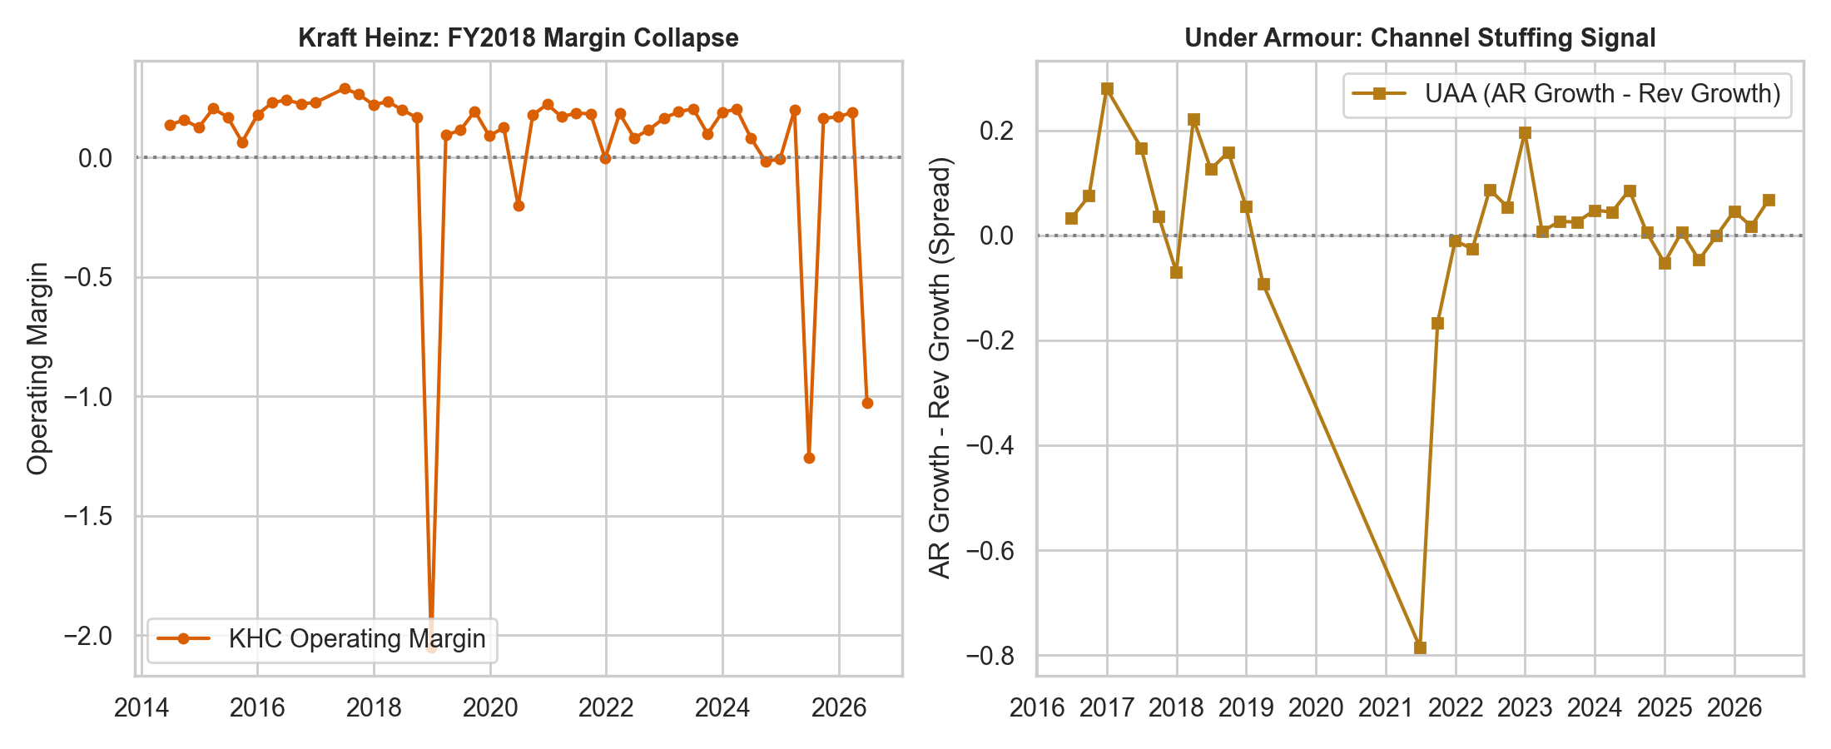
FDA-2 • DELIVERABLE 2 • MACHINE LEARNING & ANOMALY DETECTION
Forensic Case Studies: Validating Real Accounting Scandals
Real-World Scandal Signals
• Kraft Heinz (KHC) Procurement Fraud: In FY2018 Q4, operating margin crashed to -205% (RZ = -9.45σ) alongside $15.4B goodwill write-down.
• Under Armour (UAA) Channel Stuffing: In 2015-2016, receivables growth outpaced revenue growth by up to 7.23σ, signalling pulled-forward orders.
• MiMedx Group (MDXG): Wholesaler channel stuffing produced gross margin swings of 7.85σ and DSO spikes of 5.24σ prior to restatement.

Slide 12
FDA-2 • DELIVERABLE 2 • MACHINE LEARNING & ANOMALY DETECTION
Forensic Benchmark: Annual Beneish M-Score
Beneish M-Score Formulation
• Probabilistic 8-Variable Forensic Model: Developed by Prof. Messod Beneish to assess financial manipulation likelihood.
• M = -4.84 + 0.920*DSRI + 0.528*GMI + 0.404*AQI + 0.892*SGI + 0.115*DEPI - 0.172*SGAI + 4.037*TATA + 0.0327*LVGI
• DSRI: Days Sales in Receivables Index
• GMI: Gross Margin Index (decaying margins)
• AQI: Asset Quality Index (non-current assets)
• SGI: Sales Growth Index
• TATA: Total Accruals to Total Assets
• Threshold: M > -1.78 signals high manipulation probability.
Benchmarking Results
• Company-Years Analyzed: 285 company-years with complete annual filings.
• Beneish Flagged Years (M > -1.78): 36 company-years (12.6% manipulation risk rate).
• Isolation Forest Quarterly Alerts: 52 company-years had at least one IF-flagged quarter.
• Consensus Alerts: Significant concordance between annual Beneish alerts and quarterly ML flags in reference companies (e.g. KHC, UAA, SMCI).
• Methodological Independence: Beneish was joined strictly post-hoc for validation and was never used during model training.

Slide 13
FDA-2 • DELIVERABLE 2 • MACHINE LEARNING & ANOMALY DETECTION
Automated Pipeline for New Filings
Automated Live Ingestion & Audit Triage Workflow
• 1. Ingestion Engine
Ingests newly submitted 10-Q/10-K filings from SEC EDGAR API or local JSON/CSV filings on demand via CLI: python run_pipeline.py --ticker SMCI.
• 2. Real-Time Feature Calculation
Appends filing to company historical filings, derives 42 financial ratios, computes trailing 8-quarter Z-scores, and calculates trailing 12-quarter multi-year trend deviations.
• 3. Model Scoring & Consensus Tiering
Executes pre-trained Isolation Forest model (isolation_forest_model.joblib) and evaluates robust Z-scores and multi-year trend breaks simultaneously.
• 4. Risk Classification Tiers
• HIGH ANOMALY (Multi-Method Consensus): Immediate forensic audit priority.
• ELEVATED REVIEW (Single-Method Alert): Secondary triage.
• NORMAL: Cleared for continuous monitoring.
• 5. Actionable Audit Scorecard
Outputs flagged financial metrics with exact deviation sigmas and automated auditor audit recommendations (e.g. audit receivables aging, verify inventory capitalization).

Slide 14
FDA-2 • DELIVERABLE 2 • MACHINE LEARNING & ANOMALY DETECTION
Technologies, Tools & Frameworks Used
Machine Learning & Stats
• Scikit-learn: Isolation Forest, RobustScaler, SimpleImputer
• SciPy & Statsmodels: Median Absolute Deviation (MAD), Rolling Statistics
• Joblib: Model serialization
Data Processing & APIs
• Python 3.13: Core runtime
• Pandas & NumPy: Vectorized ratio calculations and rolling window math
• SEC EDGAR REST API: Keyless corporate facts and filings
Visualization & Presentation
• Seaborn & Matplotlib: High-resolution KDE distributions, trend lines, and bar charts
• Python-PPTX: Automated slide generation
• Jupyter & Nbconvert: Executable analytics
Automated Pipelines & QA
• Pytest & Unittest: 6 comprehensive unit/integration test suites
• Interactive CLI Console (live_demo.py): Live evaluation runner
• JSON & CSV Artifacts: Full audit trails

Slide 15
FDA-2 • DELIVERABLE 2 • MACHINE LEARNING & ANOMALY DETECTION
Deliverables Matrix: Implemented & Achieved
Deliverable 1: Data Extraction (Completed)
✓ Secondary Dataset (CSV):
quarterly_features.csv (1,334 quarters, 94 features) and annual_features.csv (323 company-years).
✓ Extraction Notebook (ipynb):
01_edgar_data_extraction.ipynb — fully reproducible EDGAR data extraction.
✓ Audit Trail & Data Dictionary:
facts_long.csv (47,514 facts mapped to accession numbers) and data_dictionary.csv.
✓ Documentation & Slides:
README.md and SEC_Anomaly_Detection_Deliverable1.pptx.
Deliverable 2: Machine Learning & Pipeline (Achieved)
✓ Machine Learning Notebook (ipynb):
02_ml_anomaly_detection.ipynb — fully executed end-to-end with 14 code cells, tables, and visualizations.
✓ Automated New-Filing Pipeline:
run_pipeline.py and src/anomaly_pipeline.py supporting batch and real-time single-filing scoring.
✓ Multi-Year Trend Analytics:
compute_multi_year_trends evaluating trailing 12-quarter baselines and identifying sudden deviations.
✓ Comprehensive Documentation:
docs/DELIVERABLE2.md and updated README.md.
✓ Deliverable 2 Presentation (PPTX):
SEC_Anomaly_Detection_Deliverable2.pptx covering all evaluation rubrics.
✓ Live Demonstration Tool:
live_demo.py interactive console for examination panel demonstration.

Slide 16
FDA-2 • DELIVERABLE 2 • MACHINE LEARNING & ANOMALY DETECTION
Conclusions & Operational Triage Protocol
Final Outcomes & Operational Recommendations
• Robust Anomaly Prioritization
The dual-engine architecture (Isolation Forest + Robust Z-Scores + Multi-Year Trends) successfully separates extreme accounting events from regular business noise. It proves effective at flagging known fraud cases like Kraft Heinz and Under Armour.
• Operational Triage Protocol for Regulators / Auditors
1. Screen incoming filings through automated pipeline -> 2. Flag quarters crossing multi-method thresholds -> 3. Inspect top contributing red flags (e.g. AR growth minus revenue growth) -> 4. Review filing footnotes, one-off charges, and accession history before alleging fraud.
• Limitations & Integrity
Anomalies flag review candidates, not fraud proof. Genuine structural events (spinoffs like 3M Solventum or J&J Kenvue) also produce statistical deviations and are correctly documented.
• Project Status
100% of Deliverable 1 and Deliverable 2 requirements have been fully developed, tested, documented, and packaged for live demonstration.

