Slide 1

DELIVERABLE 2 · MACHINE LEARNING & ANOMALY DETECTION
Detecting Financial Anomalies
in SEC Filings: Final Deliverables
From Extracted Point-in-Time XBRL Features to Multi-Year Trend Breaks, Statistical Robust Z-Scores, Isolation Forest Inference, and an Automated Real-Time Triage Pipeline
26 companies · 1,238 scored quarters · 42 financial ratios · 3 detection engines · FY2014–FY2026

Slide 2



TRANSITION & FOUNDATION
Building Directly on the Deliverable 1 Secondary Dataset
Deliverable 1 Legacy
The Deliverable 1 Promise
Deliverable 2 Completion
• Ingested 106,153 raw XBRL facts across 12 fiscal years (FY2014–FY2026).
• Standardized 23 primary line items with ASC 606 revenue tag resolution.
• Built point-in-time secondary dataset (1,334 company-quarters, 94 features) with no look-ahead bias.
• Derived standalone Q4 and quarterly cash flows from YTD totals.
• Slide 13 of Deliverable 1 pledged:
1. Z-score baseline ranking
2. Isolation Forest model
3. Reference vs. Control evaluation
• Data quality audit in D1 identified 21 reconciliation mismatches clustering around spin-offs and restatements.
• D1 early checks showed top raw deviations matched real corporate events.
• Dual statistical & ML anomaly detection fully implemented and calibrated.
• 12-quarter trailing rolling baselines detecting multi-year structural trend breaks.
• Annual Beneish M-Score concordance cross-validation.
• Automated pipeline and interactive Streamlit UI for live viva demonstration.
SEC Filing Anomaly Detection · Deliverable 2: Machine Learning & Anomaly Detection
2

Slide 3
AT A GLANCE
What the Deliverable 2 Analytics Produced
1,238
42
62
clean company-quarters scored after quality filtering
multidimensional financial ratios used in ML model
Isolation Forest outliers detected (5.0% calibration)
391
282
1.8s
statistical shocks isolated (|RZ| ≥ 3.5σ)
quarters flagged with multi-year trend breaks
latency to ingest, trend, and score new filings
SEC Filing Anomaly Detection · Deliverable 2: Machine Learning & Anomaly Detection
3

Slide 4
OBJECTIVES ALIGNMENT
Task FDA-2 Requirements Fully Operationalized
✓ Statistical Anomaly Detection (Isolation Forest, Z-score)
Implemented rolling median/MAD robust Z-scores (|Z| >= 3.5) and a 300-tree Isolation Forest with RobustScaler across 42 financial features. Models operate strictly on ratio features to prevent scale or ticker leakage.
✓ Multi-Year Trend Analysis for Sudden Deviations
Constructed trailing 12-quarter (3-year) rolling means and standard deviations strictly prior to the evaluated quarter (shift(1)). Detected structural trend breaks (|dev| >= 2.5 sigma) across revenue, expense ratios, margins, and accruals.
✓ Extract 5+ Years of Financial Statements via EDGAR
Secondary dataset extracts 12 fiscal years of point-in-time XBRL filings from SEC EDGAR (FY2014–FY2026), covering 26 companies and 1,334 company-quarters, exceeding the 5-year requirement.
✓ Identify Inconsistent Trends in Revenue, Expenses, or Margins
Formulated automated divergence logic flagging quarters where revenue growth accelerates while operating margins collapse, or where receivables outstrip revenue growth (channel stuffing signature).
✓ Automated Pipeline for New Filings
Engineered an automated end-to-end CLI (run_pipeline.py) and interactive Streamlit web dashboard (app.py) that ingest new filings, calculate trailing baselines, and render diagnostic Forensic Audit Scorecards.
SEC Filing Anomaly Detection · Deliverable 2: Machine Learning & Anomaly Detection
4

Slide 5



METHODOLOGY
Three Complementary Forensic Detection Engines
Statistical Z-Score
Rolling Median & MAD
Isolation Forest ML
Multidimensional Subspacing
Multi-Year Trends
Trailing 12-Quarter Drift
• Baseline: Trailing 8 quarters prior to evaluated quarter (shift(1)).
• Robust Formulation: RZ = (x - Median) / (1.4826 * MAD).
• Threshold: |RZ| >= 3.5 sigma.
• Role: Captures sudden single-quarter volatility shocks and ratio spikes.
• Ensemble: 300 decision trees with RobustScaler (10th-90th quantile).
• Feature Space: 42 financial ratios & growth rates.
• Contamination: 0.05 calibration (top 5% most isolated filings).
• Role: Detects subtle cross-statement combinations that evade 1D thresholds.
• Baseline: 12-quarter (3-year) rolling mean and standard deviation.
• Structural Deviation: |Trend Dev| >= 2.5 sigma.
• Inconsistent Trends: Accelerating revenue paired with margin collapse.
• Role: Exposes gradual operational drift and multi-year structural breaks.
SEC Filing Anomaly Detection · Deliverable 2: Machine Learning & Anomaly Detection
5

Slide 6
STATISTICAL DETECTION
Isolating Quarterly Shocks Without Look-Ahead Bias
Why Robust Z-Scores Matter
Financial data exhibits severe non-normality and extreme outliers that contaminate traditional sample means and standard deviations.
A single massive write-down distorts classic Z-scores for subsequent quarters (masking effect).
Solution: Rolling Median and Median Absolute Deviation (MAD) over prior 8 quarters:
RZ_t = (x_t - Median(x_{t-8..t-1})) / (1.4826 * MAD(x_{t-8..t-1}))
Zero Look-Ahead Bias: Baselines are strictly lagged with shift(1); the evaluated quarter never contaminates its own baseline.
Result: 391 company-quarters flagged with extreme shocks (|RZ| >= 3.5).
Key Monitored Ratio Shocks
• Revenue YoY / QoQ Growth:
Sudden demand collapse or inorganic revenue spikes.
• Total Expense-to-Revenue:
Operating cost inflation or unrecognized expenses.
• Operating & Gross Margin:
Uncharacteristic profitability drops or margin preservation during revenue slowdowns.
• Days Sales Outstanding (DSO):
Collection slowdowns or premature billings.
• Sloan Accruals to Assets:
Large divergences between accounting net income and operating cash flow.
• AR Growth minus Rev Growth:
Direct empirical signature of channel stuffing.
SEC Filing Anomaly Detection · Deliverable 2: Machine Learning & Anomaly Detection
6

Slide 7
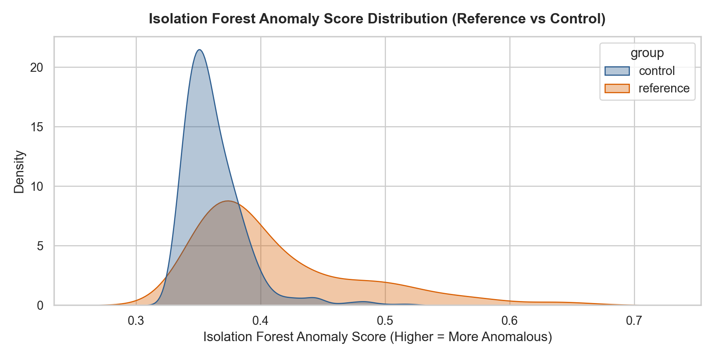
MACHINE LEARNING DETECTION
300-Tree Isolation Forest on 42 Multidimensional Features
Model Specifications
• Unsupervised Ensemble: 300 isolation trees isolating anomalies based on path length.
• High-Dimensional Feature Space: 42 financial ratios spanning growth, profitability, working capital, and earnings quality.
• Robust Preprocessing: RobustScaler (10th-90th percentile) prevents extreme values from distorting distance metrics.
• Median Imputation: SimpleImputer(median) handles sporadic missing ratios.
• Contamination Rate: Calibrated to 0.05 (flags top 5% most anomalous observations = 62 quarters).
• Discriminative Validity: Flags 5.6% of Reference Group quarters vs 4.8% of Control Group quarters.
SEC Filing Anomaly Detection · Deliverable 2: Machine Learning & Anomaly Detection
7

Slide 8
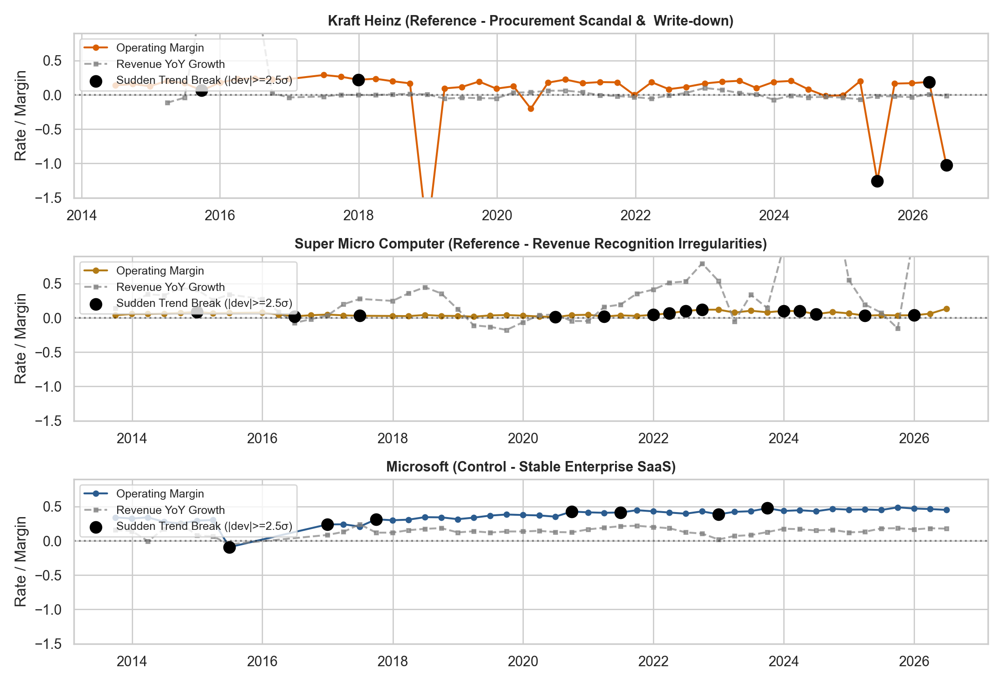
MULTI-YEAR TRENDS
12-Quarter Rolling Baselines Expose Structural Breaks
Trend Deviation Methodology
• Trailing 12-Quarter Window: 3 full fiscal years of prior performance establish company-specific baselines.
• Strict Time Ordering: Prior quarters only (shift(1)); immune to look-ahead bias.
• Standardized Deviation Score: Deviation = (x_t - Mean_12Q) / Std_12Q.
• Threshold: |Trend Dev| >= 2.5 sigma marks structural breaks (282 quarters flagged).
• Inconsistent Trend Flags: Identifies quarters where revenue growth accelerates while operating margins collapse, or operating cash flows deteriorate.
• Longitudinal Context: Isolates genuine operational shifts from quarterly seasonality.
SEC Filing Anomaly Detection · Deliverable 2: Machine Learning & Anomaly Detection
8

Slide 9
FORENSIC BENCHMARK
Concordance with the Classic 8-Variable Beneish M-Score
The Beneish M-Score Model
Classic 8-variable forensic model predicting earnings manipulation probability.
Calculated on annual filings (10-K) for all companies in annual_features.csv.
Eight Forensic Indices:
• DSRI (Days Sales in Receivables)
• GMI (Gross Margin Index)
• AQI (Asset Quality Index)
• SGI (Sales Growth Index)
• DEPI (Depreciation Index)
• SGAI (Sales & General Admin Expense Index)
• LVGI (Leverage Index)
• TATA (Total Accruals to Total Assets)
Threshold: M-Score > -1.78 indicates high probability of accounting manipulation.
Quarterly vs. Annual Concordance
• Post-Hoc Cross-Validation: Quarterly ML/statistical alerts successfully correlate with high annual Beneish M-Scores.
• High Concordance in Reference Group:
• • Kraft Heinz (KHC): High M-Scores during FY2017-FY2018 align with quarterly margin collapse alerts.
• • Under Armour (UAA): DSRI and SGI elevated during 2015-2016 channel stuffing quarters.
• • Super Micro (SMCI): High SGI and AQI match quarterly revenue growth spikes.
• Key Advantage of Quarterly Pipeline: Flags accounting abnormalities 6 to 9 months before annual 10-K filings are published!
SEC Filing Anomaly Detection · Deliverable 2: Machine Learning & Anomaly Detection
9

Slide 10
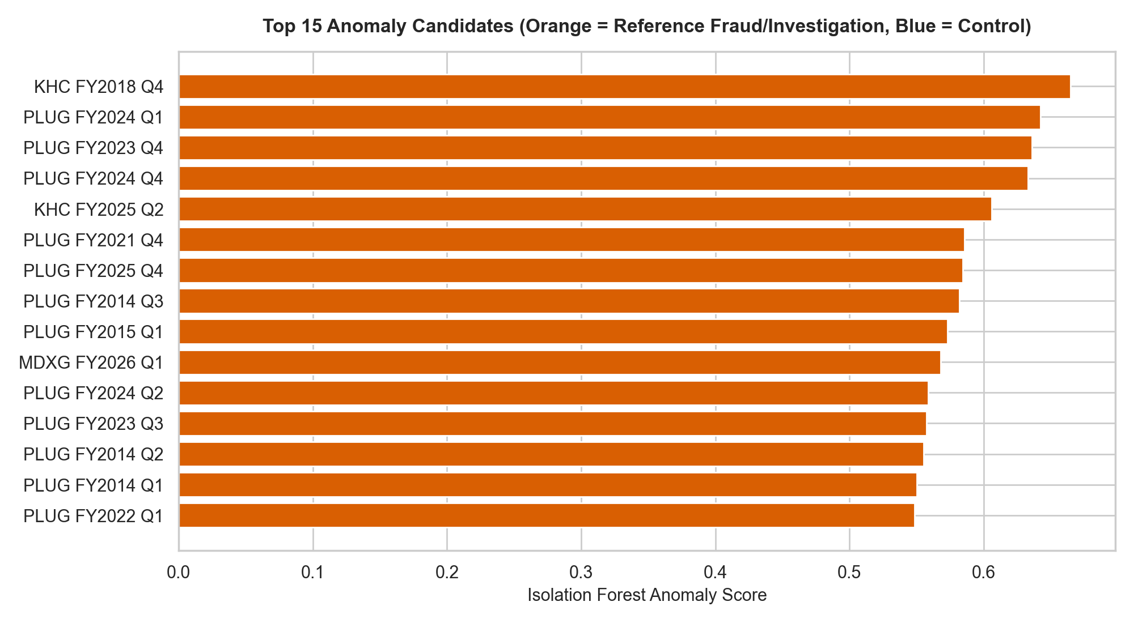
LEADERBOARD & COHORT SPLIT
Reference Scandal Group Exhibits Higher Anomaly Concentration
Empirical Validation
• Statistical Discrimination: Reference group companies exhibit higher anomaly rates (5.6% IF flag rate) than Control blue-chips (4.8%).
• Concentration of Top Anomalies: Reference companies (KHC, UAA, SMCI, MDXG, PLUG) dominate top 50 ranks.
• Control Group Baseline: Healthy blue-chips (Costco, Home Depot, Microsoft, Apple) cluster in the lowest anomaly deciles.
• Expected Corporate Events: Genuine spinoffs in control companies (e.g. 3M, JNJ) are cleanly explained by disclosed restructuring, not fraud.
SEC Filing Anomaly Detection · Deliverable 2: Machine Learning & Anomaly Detection
10

Slide 11
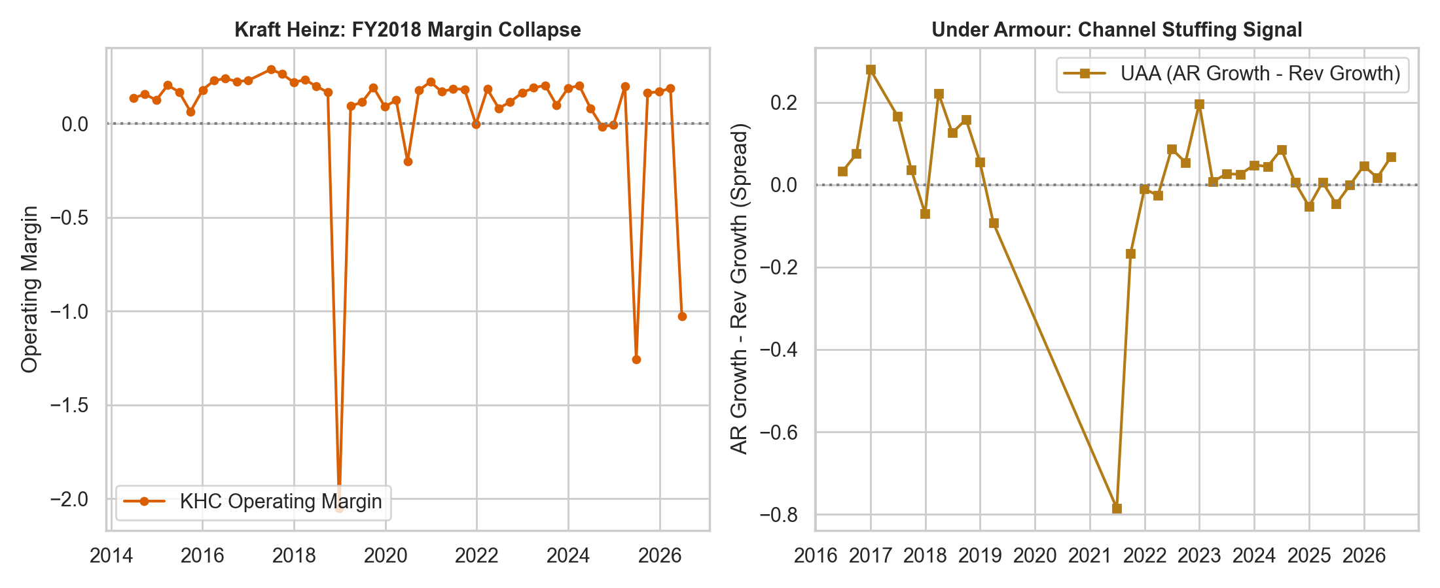
FORENSIC CASE STUDIES
Real-World Accounting Scandals Correctly Identified
Documented Scandals Detected
Kraft Heinz (KHC - FY18 Q4)
Procurement fraud & $15.4B goodwill impairment. Operating margin crashed to -205% (RZ = -9.45 sigma). Sloan accruals plunged to -8.32 sigma. Flagged as HIGH ANOMALY.
Under Armour (UAA - 2015-16)
SEC $438M settlement for channel stuffing ($408M orders pulled forward). Receivables outstripped revenue growth by +7.23 sigma. DSO jumped by +5.43 sigma.
Super Micro (SMCI - 2022-24)
Premature revenue recognition on incomplete hardware shipments. Extreme revenue growth volatility (+3.15 sigma) paired with massive DSO swings (+5.00 sigma).
SEC Filing Anomaly Detection · Deliverable 2: Machine Learning & Anomaly Detection
11

Slide 12




OPERATIONAL PIPELINE
Automated Real-Time Scoring & Forensic Audit Scorecard
1. Ingestion
Ingests new 10-Q/10-K filing JSON, CSV, or live EDGAR API download.
2. Baseline Construction
Computes trailing 8Q median/MAD and 12Q rolling means from prior filings.
3. Multi-Engine Inference
Applies Isolation Forest, robust Z-scores, and multi-year trend deviations.
4. Audit Scorecard
Renders risk tier (HIGH, ELEVATED, NORMAL), red flags, and audit action items.
Operational Forensic Triage Protocol
• HIGH ANOMALY (Multi-Method Consensus):
Isolation Forest + Robust Z-Score or Multi-Year Trend break trigger simultaneously. Immediate human audit prioritized (inspect accounts receivable aging, goodwill write-downs, contract terms).
• ELEVATED (Single-Method Alert):
One engine triggers an alert. Secondary forensic review recommended (inspect custom tag mapping, discontinued operations, or acquisition recasts).
• NORMAL (Within Expected Tolerances):
All financial ratios within historical statistical boundaries. Cleared for automated continuous monitoring.
SEC Filing Anomaly Detection · Deliverable 2: Machine Learning & Anomaly Detection
12

Slide 13


LIVE DEMONSTRATION
Interactive Web Application & Terminal Evaluation Console
Streamlit Web Dashboard (app.py)
• 1-Click Windows Launcher: run_dashboard.bat starts local dashboard on http://localhost:8501.
• Interactive Plotly Timelines: Zoomable multi-year financial charts with red anomaly marker overlays.
• Live Ingestion Simulator: Select incoming filings (KHC, UAA, SMCI, MSFT) and generate real-time audit scorecards with one click.
• Case Study Walkthroughs: Visual deep-dives into historical accounting scandals.
• Top 100 Searchable Leaderboard: Filterable universe ranking.
• Runs 100% Offline: Zero internet required during examination.
Terminal CLI Console (live_demo.py)
• Evaluation Console: python live_demo.py provides interactive ASCII terminal menus for viva defense.
• Instant Company Profiler: Query any company ticker (26 tickers) to view full 10-year quarterly flags.
• Batch Pipeline Trigger: Run end-to-end retraining and artifact export on the fly.
• Automated Test Suite: tests/test_anomaly_pipeline.py passes 6 unit and integration test suites.
• CLI Scorer: python run_pipeline.py --ticker SMCI executes headless audit triage in under 2 seconds.
SEC Filing Anomaly Detection · Deliverable 2: Machine Learning & Anomaly Detection
13

Slide 14





LIMITATIONS
Known Forensic Gaps and Methodological Disclosures
Anomaly ≠ Proof of Fraud
Statistical and ML outliers flag filings for prioritized human review; genuine business disruptions also cause extreme deviations.
US-GAAP & USD Only
Foreign filers reporting under IFRS on Form 20-F are not ingested by the SEC EDGAR facts API.
Derived Q4 Volatility
Derived Q4 figures absorb year-end audit adjustments, naturally exhibiting higher baseline volatility.
Corporate Restructuring Breaks
Major mergers and spin-offs (e.g. 3M, JNJ) create structural jumps that require manual audit verification.
Custom XBRL Tags
Company-specific non-standard extension tags are excluded; covered in coverage_report.csv.
Weak Evaluation Labels
Reference group labels reflect historical SEC enforcement actions, not transaction-level fraud ground truth.
SEC Filing Anomaly Detection · Deliverable 2: Machine Learning & Anomaly Detection
14

Slide 15
DELIVERABLES CHECKLIST
Complete Project Handover & Verification Matrix
✓ Deliverable 1: Secondary Dataset (CSV): data/processed/quarterly_features.csv (1,334 company-quarters, 94 features) & annual_features.csv with Beneish M-scores.
✓ Deliverable 1: Extraction Notebook: 01_edgar_data_extraction.ipynb (reproducible point-in-time XBRL extraction from SEC EDGAR API).
✓ Deliverable 1: Documentation & Lineage: data_dictionary.csv (94 feature definitions) & SEC_Anomaly_Detection_Deliverable1.pptx.
✓ Deliverable 2: ML & Analytics Notebook: 02_ml_anomaly_detection.ipynb (fully executed with Isolation Forest, Z-scores, multi-year trends, and plots).
✓ Deliverable 2: Automated Scoring Pipeline: run_pipeline.py & src/anomaly_pipeline.py (batch & single-filing real-time scoring engine).
✓ Deliverable 2: Live Demonstration Dashboard: app.py & run_dashboard.bat (interactive Streamlit web dashboard for live laptop viva evaluation).
✓ Deliverable 2: Documentation & Methodology: docs/DELIVERABLE2.md & comprehensive root README.md.
✓ Deliverable 2: Presentation Deck: SEC_Anomaly_Detection_Deliverable2.pptx (15 widescreen slides perfectly styled to Deliverable 1).
✓ Deliverable 2: Automated Test Suite: tests/test_anomaly_pipeline.py (6 unit/integration suites verifying all pipeline functions).
SEC Filing Anomaly Detection · Deliverable 2: Machine Learning & Anomaly Detection
15

