Slide 1
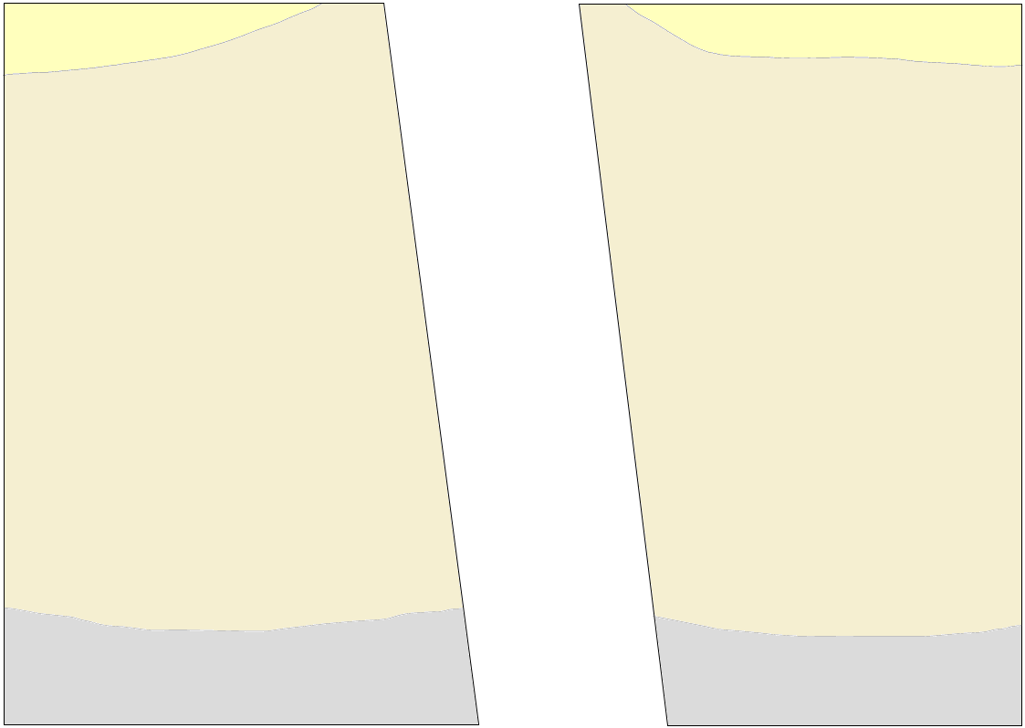
E-W S_{hmax}
Great Artesian Basin
groundwater
Lake Eyre region
Gawler Craton
Mantle derived gases
Earthquake
Sediments
Springs
Crust
Gases
Mantle
Faults

Slide 3
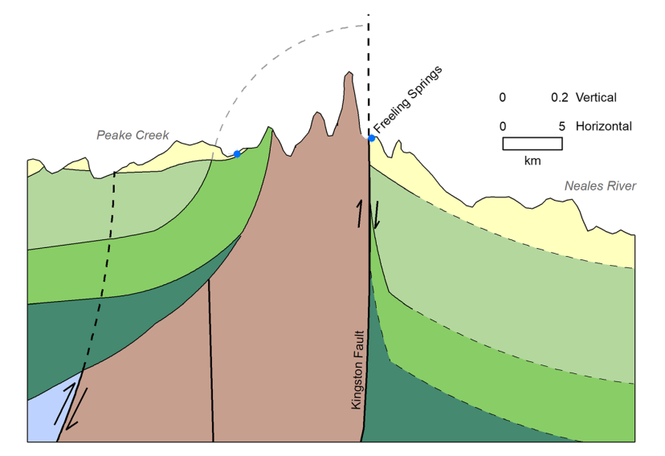
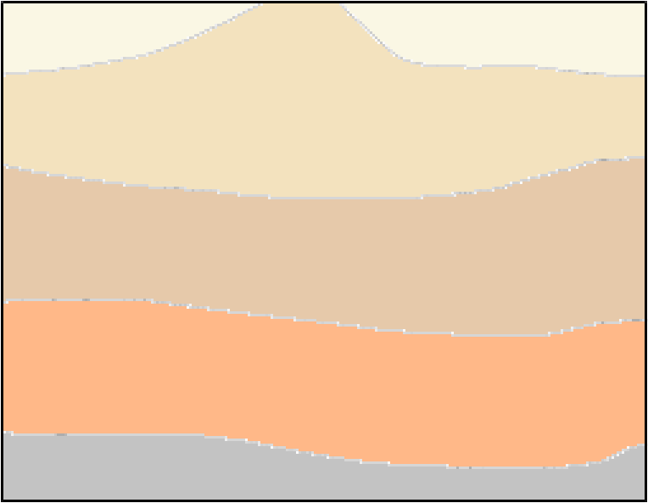


GAB water
Mantle gasses

