Slide 1
5 V
VCC
MN/MX
NC
TEST
HLDA
INTR
INTA
15 MHz
X 1
X 2
8259
RDY1
RDY2
RESET
RESET
8284
CLK
CLK
5 V
F/C
READY
READY
CYNC
AEN 1
AEN 2
5 V
RES
NMI
HOLD
GND
8086 Inputs

Slide 2
LS373
A₁₆-A₁₉ S₆-S₃
A₁₆-A₁₉
BHE’/S₇
BHE’
G
OE’
ALE
8086
LS373
AD₈-AD₁₅
A₈-A₁₅
G
OE’
LS373
AD₀-AD₇
A₀-A₇
G
OE’
System Bus of 8086 (Address)
MN/MX’
5V

Slide 3
LS244
MEMR
RD
LOGIC
CIRCUIT
MEMW
WR
IOR
IO/M
OE’
IOW
8086
LS245
AD₈-AD₁₅
D₈-D₁₅
DT/R’
DIR
OE’
DEN’
LS245
AD₀-AD₇
D₀-D₇
DIR
OE’
MN/MX’
5V
System Bus of 8086(Data + Control)

Slide 4
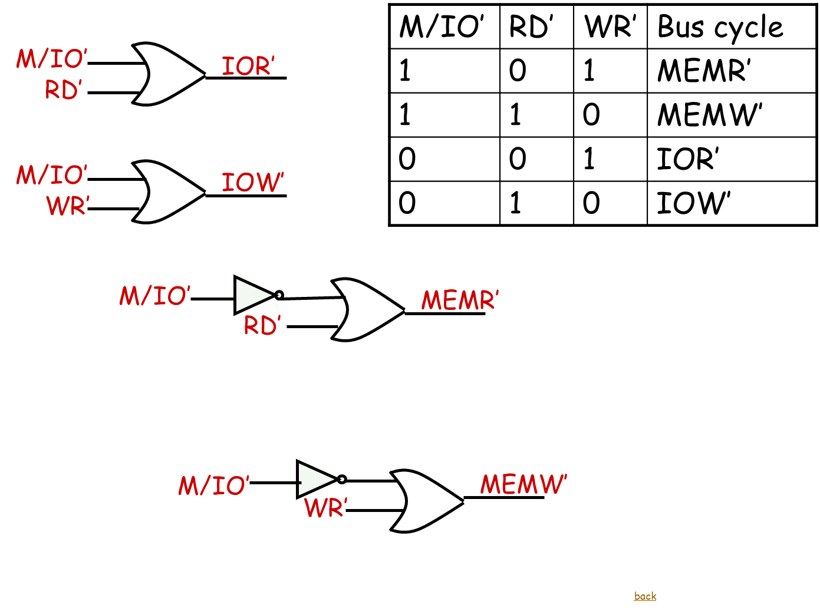

Slide 5
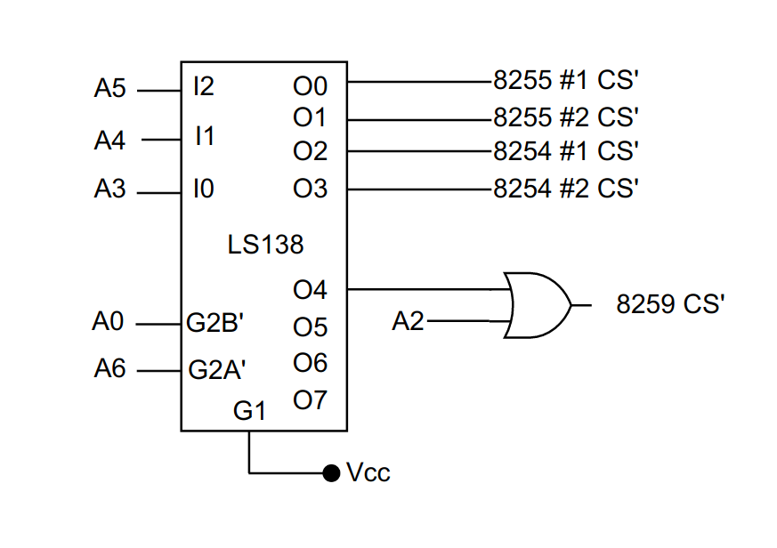
I/O Decoding

Slide 6
LS138
ROM₁
A₁₄ A₁₃ A₁₂
O₀
I₂ I₁ I₀
A₀
MEMR’
RDL’
O₁
RAM
A₀
MEMW’
WRL’
GND
G_{2B}
O₇
ROM₂
BHE’
MEMW’
WRH’
G_{2A} G₁
V_{CC}
BHE’
MEMR’
RDH’
GND
Memory Decoder

Slide 7
A₁
A₁₁
2716_{1E}
A₁
A₁₁
2716_{2E}
A₁
A₁₁
6116_{1E}
A₀
A₁₀
D₀
D₇
D₀
D₇
A₀
A₁₀
D₀
D₇
D₀
D₇
A₀
A₁₀
D₀
D₇
D₀
D₇
WRL’
RDL’
RAM’
WE’
OE’
CS’
RDL’
ROM’₁
OE’
CS’
RDL’
ROM’₂
OE’
CS’
A₁
A₁₁
2716_{1O}
A₁
A₁₁
2716_{2O}
A₁
A₁₁
6116_{1O}
A₀
A₁₀
D₀
D₇
D₈
D₁₅
A₀
A₁₀
D₀
D₇
D₈
D₁₅
A₀
A₁₀
D₀
D₇
D₈
D₁₅
WRH’
RDH’
ROM’₁
WE’
OE’
CS’
RDH’
ROM’₁
OE’
CS’
RDH’
ROM’₂
OE’
CS’
Memory Interfacing

Slide 8
8255 #1 Interface to the processor
A₁
A₀
A₂
A₁
8255 #1 CS’
CS
8255
IOR
RD
IOW
WR
D₀ – D₇
D₀ – D₇
RESET from 8284
RESET

Slide 9
8255 #2 Interface to the processor
A₁
A₀
A₂
A₁
8255 #2 CS’
CS
8255
IOR
RD
IOW
WR
D₀ – D₇
D₀ – D₇
RESET from 8284
RESET

Slide 10
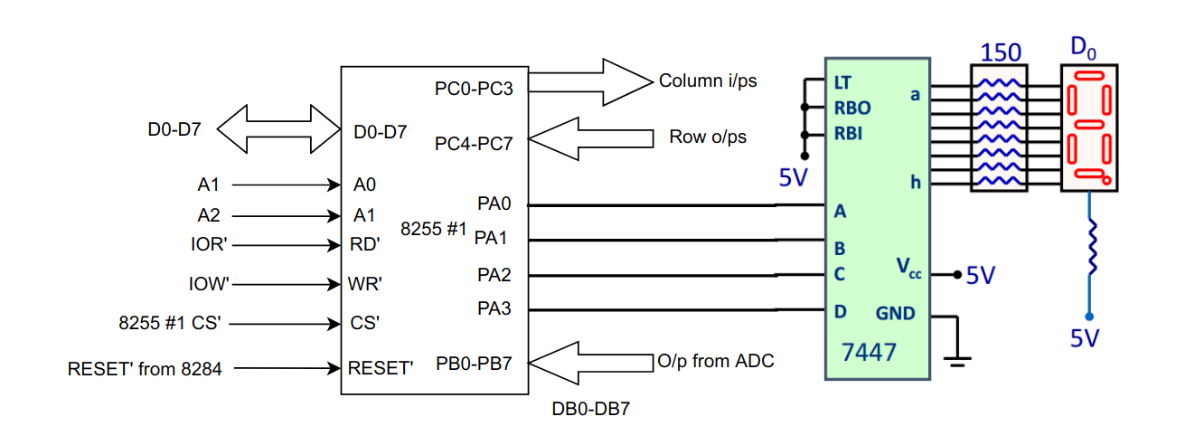
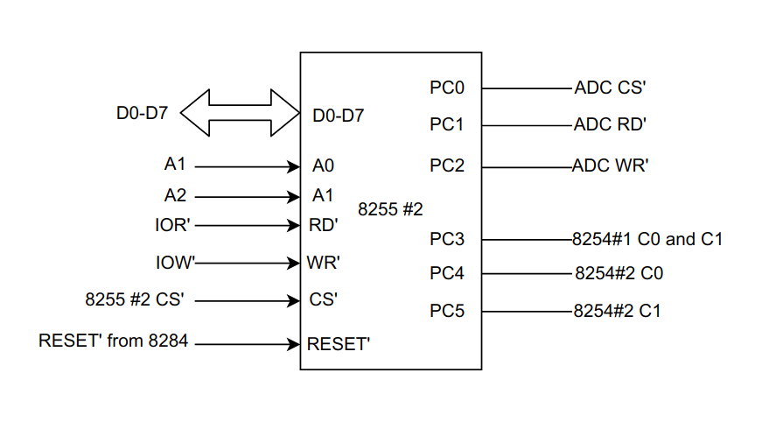
8255 Pin Out

Slide 11
8254 Interface to the processor
A₁
A₀
A₁
A₀
A₂
A₁
A₂
A₁
8254#1 CS’
CS
8254#2 CS’
CS
8254 #1
8254#2
IOR
RD
IOR
RD
IOW
WR
IOW
WR
D₀ – D₇
D₀ – D₇
D₀ – D₇
D₀ – D₇

Slide 12
8254 Counters
5MHz
CLK0
OUT0
GATE0 Mode 3
count=1000
GATE1
Mode 3 CLK1
count=100
OUT1
GATE2 OUT2
Mode 1
CLK2 count=n
n ϵ [1,99]
5KHz
PC0 from 8255 #2
50Hz
5KHz
50Hz
50Hz
PWM of n% duty cycle
5KHz
8254 #1

Slide 13
from 8254#1, Out1
50Hz
CLK0
Mode-2
Count=50
1Hz
from PC1 of 8255#2, BSR
OUT0
GATE0
To IR2 of 8259
from PC2 of 8255#2, BSR
GATE1
Mode-2
Count= n*3600
1<=n<=9
CLK-1
To 8259 IR 0
OUT1
A pulse after hour timer for auto mode expires
5MHz from 8284
CLK2
Mode-3
Count=10
OUT2
500 kHz to Clock of ADC
Vcc
GATE2
8254 #2

Slide 14
FROM OUT1 of 8254 #2 ( a pulse after completion of n-hours set of auto mode
INTR
8259
INT
IR₀
8086
IR₁
IR₂
IR₃
IR₄
IR₅
IR₆
IR₇
EOC from ADC
INTA’
INTA
From OUT0 of 8254 #2: 1Hz interrupt to sense and control the fan speed
A₁
A₀
NC
IOR’
IOW’
8259 CS’
D₀
D₇
RD’
WR’
CS’
D₀
D₇
CAS₀ CAS₁ CAS₂
NC
SP/EN
5V
8259

Slide 15
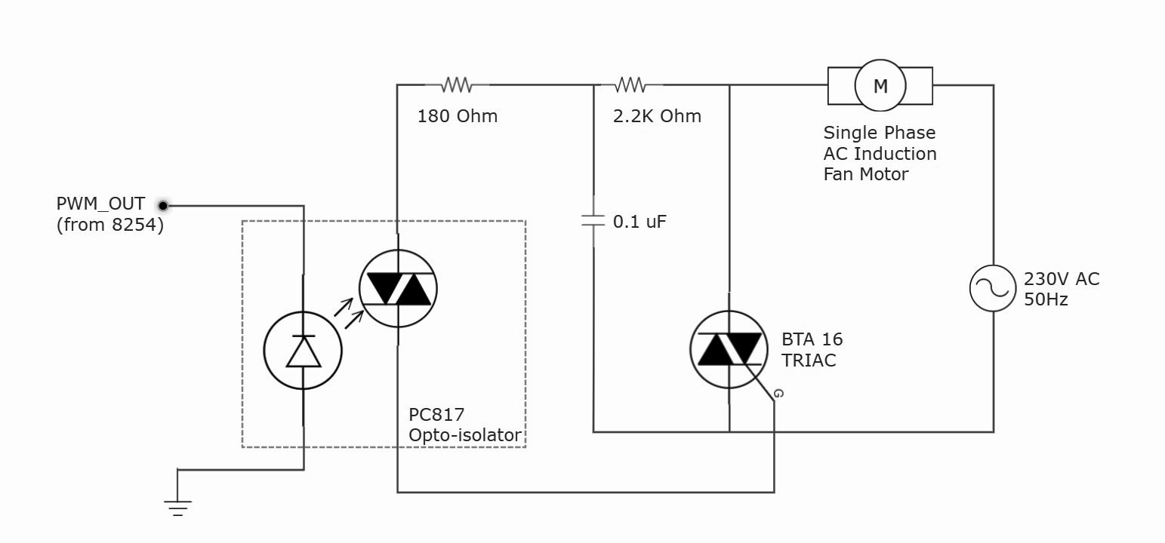
Fan Controller

Slide 16
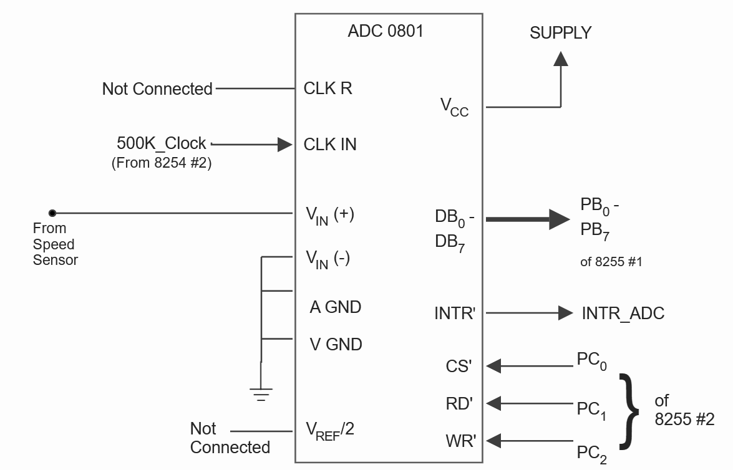
ADC 0801
Circuit reference - Datasheet of ADC 0801

Slide 17
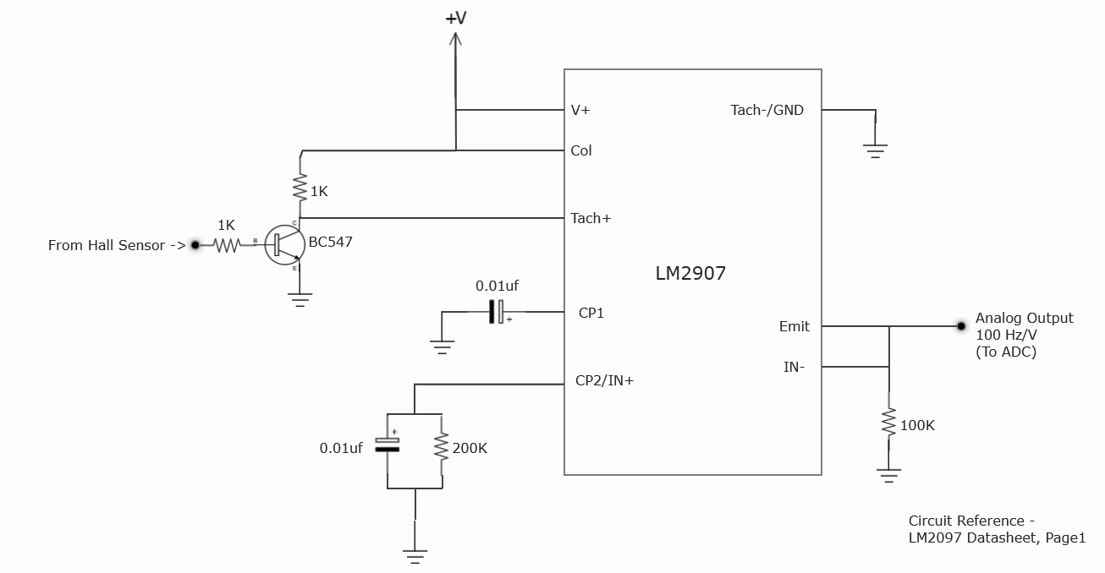
Fan Speed Sensor Ckt diagram

