Slide 1
Optimization and Licensing Assessment (OLA)
IngramMicro.com
Notes:
Today, we’ll review the Optimization and Licensing Assessment for ACC, focusing on how migrating to AWS can drive value, optimize costs, and improve service delivery
fahad

Slide 2
How it looks on AWS.
Migrating to AWS drives sufficient value while improving service delivery.
Here’s how AWS can provide value to <Customer>.
Notes:
AWS is not just a lift-and-shift—it’s about unlocking value.
AWS’s has the ability to improve operational efficiency, enhance security, and provide scalability.
We’ll see how AWS aligns with your business goals and IT strategy, ensuring that your workloads are more resilient, secure, and cost-effective
fahad

Slide 3
Agenda
Executive Summary
Scope of Work
- 32 Windows VMs
- 323 Linux VMs
- 151.1 TB Storage
Key Recommendations
Optimized Cost Estimates
Notes:
fahad

Slide 4
Executive Summary
32 Windows Virtual Machines
100% of servers right-sized
Which Scenario offered the best combination of operational resiliency and Total Cost of Ownership? (TCO)
1 Documents and Artifacts
151.1 TB Storage
Provisioned
3 Year No Upfront Reserved Instance BYOL with instance resizing, on AWS for the Windows/Linux environments offered the best combination of operational resiliency, while generating ~55% savings with a ~$209K annualized spend compared to On Demand License included pricing model.
116 VM’s with less than 20% usage
3 Cloud Operating Models
Notes:
fahad

Slide 5
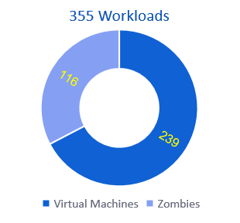
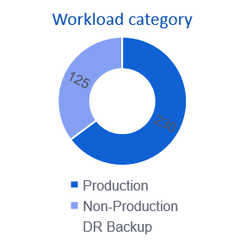
Assessment Scope
Datacenters:
1
Windows OS:
32
SQL Instances:
6
Linux OS:
323
Total Applications:
281
Storage Provisioned
151.1 TB
Assets Collected:
Workshop Findings
Interview findings
Additional Information:
Cloudamize Data Collector
Storage Utilized
61.5 TB
Notes:
fahad

Slide 6

Cost Comparison Summary (Annual)
The Three Year no upfront reserved instance license included will yield the lowest total cost of ownership with savings of ~55% vs On Demand LI pricing model
Recommendation : Consider the 3 year no upfront reserved instance with BYOL SQL option on a shared tenancy model
Notes:
fahad

Slide 7
Expense Summary and Comparison (Annual)
$253K
3 Year No Upfront Reserved Instance BYOL with instance resizing, on AWS for the Windows/Linux environments offered the best combination of operational resiliency, while generating ~55% savings with a $209K annualized spend compared to On Demand LI pricing model.
Notes:
fahad

Slide 8
Cost Comparison Detail (Annual)
 | 3 Year NURI BYOL SQL | 1 Year NURI BYOL SQL | On Demand BYOL | On Demand License Inc.
Compute | $126K | $169K | $235K | $235K
Storage | $67K | $67K | $67K | $67K
Network | $17K | $17K | $17K | $17K
License | - | - | - | $148K
Infrastructure Total | $209K | $253K | $318K | $467K
AWS Business Support | $12K | $17K | $24K | $24K
Annual Total | $221K | $270K | $342K | $491K
Annual Savings | 55% | 46% | 32% | -
Key Recommendation: 3 Year No Upfront Reserved Instance BYOL with instance resizing, on AWS offered the best combination of operational resiliency, while generating ~55% savings with a $221K annualized spend compared to On Demand LI pricing model. (AWS Business Support Included)
Network calc at 10% of 1 YR NURI LI; Business Support calc at 10% of base compute price
Notes:
Clean up Annual Savings percentage on this slide

Slide 9
SQL BYOL Core Reduction
Right-sizing the Ec2 instances reduces SQL Server cores; freeing up licenses for us on other instances. This can result in additional savings on future SQL Server purchases and SA renewals.
 | Standard | Enterprise | Total Cores
Current On-prem SQL cores | 32 | 128 | 160
SQL Cores on Right-Sized Ec2 Instances | 16 | 40 | 56
SQL Cores, post applying “Optimize CPU” configs | 16 | 20 | 36
AWS’s “Optimize CPU” config offering reduces licensable cores. This allows the customization of provisioning additional vCPU’s to Ec2 instances without utilizing additional cores for vCPU based BYOL workloads.
Notes:
angel

Slide 10
SQL BYOL Core Reduction cont.
Reducing and Optimizing SQL BYOL cores is financially advantageous. Saving a total of roughly ~$157K per year on Software Assurance renewals, and ~$848K on being able to reuse those additional SQL Cores in other workloads.
 | Standard | Enterprise | Total
~ Annual SQL SA Savings from BYOL Core optimizations | $6K | $151K | $157K
~ Value of reusable BYOL SQL Licenses (MSRP) | $32K | $817K | $848K
BYOL SA savings realizable at next MSFT true-up or renewal.
MSRP value of reusable BYOL SQL licenses is achieved after implementing SQL Optimize CPU and fully reusing the licenses on other SQL servers.
Software Assurance (SA) savings potential is an estimate. Actual savings depend on your specific Microsoft pricing. SA savings are based on the following MSRP costs: Enterprise $2,793 per 2 cores, Standard $728 per 2 cores.
Notes:
angel

Slide 11
Zombie Server Analysis
Servers that are on, but contain <20% usage
Our assessment identified these as Zombie servers because they are running with extremely low usage. We highly suggest examining the server’s role to validate and justify the server cost in AWS Ec2 to confirm that they can be safely shutdown without impacting production.
Notes:
angel

Slide 12
Zombie Servers Analysis continued.
Top Servers that are on, but contain <5% usage
Servers
Eliminating or consolidating services that are running on these low usage machines can save additional compute costs in AWS. Upwards of roughly $88K when migrating the environment to the AWS Cloud.
Notes:
angel

Slide 13
Microsoft Windows Support
When a Windows Server reaches end-of-support, Microsoft will no longer release updates to address bugs and security vulnerabilities. AWS Application Migration Service (MGN) allows you to upgrade Windows Server operating systems (OS) during migration, streamlining the modernization effort and reducing the time and complexity of your overall migration.
Windows Server Version | Count | OS Support Cycle | End of Support | Risk
<=2012 R2 | 0 | Unsupported | 10/10/2023 | High
2016 | 0 | Extended Support | 01/12/2027 | Medium
2019 | 24 | Extended Support | 01/09/2029 | Medium
2022 | 6 | Supported | 10/14/2031 | Low
2025 | 2 | Supported | 10/10/2034 | Low
Recommendation: compute workload carries a medium risk due to approaching end of support date. Upgrading to latest support version during migration helps mitigate the risk.
Notes:
angel

Slide 14
Would customer benefit from migrating to AWS Cloud at this time?

Slide 15
Yes!
Why the AWS Cloud Is Within Reach for Customer?
Cost Savings
Eliminate Waste, Consolidate and Optimize
Reduce SQL Licensing Cores
Data Protection and High Availability
3-Year NURI Cost Model yields ~55% annual cost savings compared to On Demand pricing model
Eliminating zombie servers and storage, consolidating apps, and right sizing provides a higher yield over time & improves infrastructure optimization
CPU Optimization and utilization reduces the amount of SQL licensing cores, which saves resources and costs.
AWS’s Global Infrastructure and Shared Responsibility Model provides <Customer> with business continuity, compute and data protection, high availability and redundancy.
Notes:
Once in AWS, protecting Data and Compute. High availability, redundancy, RTO/RPO, Cloud Disaster Recovery.

Slide 16
AWS Migration Plan
Assess
Mobilize
Migrate
Migration Acceleration Program (MAP)
Build a TCO and full business case
Perform a high-level electronic discovery
Define the roadmap for each workload
(7 “R” analysis)
Detailed Host Discovery
Build a landing zone
Build a detailed migration plan
CCOE and Governance
Migration workloads
Modernize Cloud Native Services
Reduce and Consolidate
Training and Skills

Slide 17
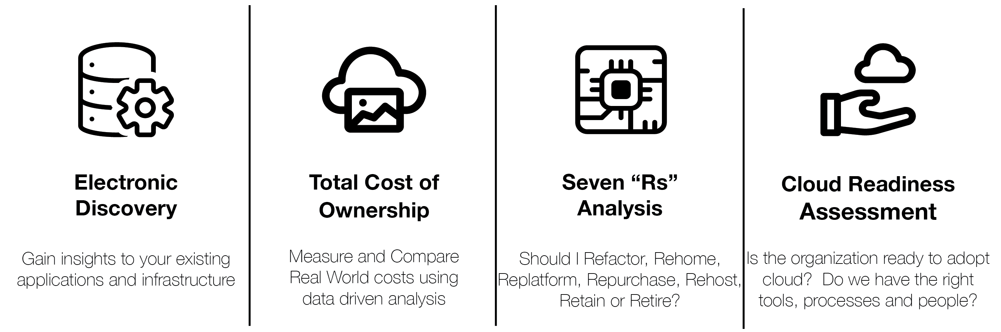
MAP Assess Elements

Slide 18

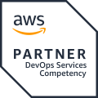

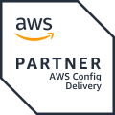




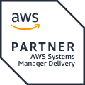
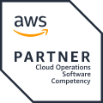
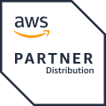



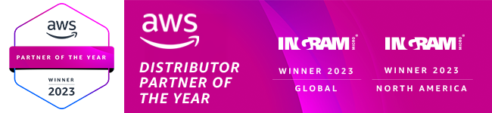
Why Ingram Micro as your Migration Expert?
GLOBAL
Premier Tier Partner
x4
Regional CoE’s
x3
Competency Holder
Experts
x7
Program Enrolments
Professional Services
Enablers
Partners
Global
x240
AWS Technical Individuals
Premier
Managed Services
Certified
x488
AWS Business Individuals
400+
AWS Certifications
Notes:
Ingram Micro is your trusted partner for cloud migrations, combining technical expertise with deep AWS experience.
240+ technical resources, close to 500 business resources who understand your business and with 400+ certifications
We can provide end-to-end support, from assessment through to migration and ongoing optimization.
We can bring all this expertise to support any complex migration project that you plan with your customers.

Slide 19
Ingram Micro helps tame the transition to cloud beyond the technology
Cloud Enablement
AWS Migration Accelerator Program
Cloud FinOps
Generative AI
Cloud Center of Excellence and Governance
Cloud Cost Optimization and Reserved Instance Arbitrage
Notes:
Our services go beyond technology—enabling cloud adoption, FinOps, generative AI, governance, and cost optimization.
We help establish a Cloud Center of Excellence and leverage reserved instance arbitrage to maximize your ROI.

Slide 20
Next Steps
Review the OLA Findings
Develop the migration proposal
Review the migration proposal
Notes:
Post this meeting I will be sharing this deck with you. So, you can review and validate assessment findings.
Additionally, I will also send the SOW for MAP access, so we can sync up in our next call to align on migration priorities and timelines.
Based on your feedback and approval we can schedule a deep-dive workshop for migration planning.

Slide 21
Thank You!
Notes:
We’re excited to help you realize the benefits of AWS and look forward to partnering with you on this transformation

Slide 22
Comparing On-Premise Cost to Cloud is much more than just measuring Compute, Storage and Network
Hidden Costs to On-Premise and Colocation Hosting
Cloud Opportunities for growth and savings
Data Center Facilities and Staffing
Infrastructure Management and Staffing
Hypervisor licensing costs
Electrical Usage and cooling costs
Capacity Planning and Hardware Refresh
Traditional Telecom Complexity
Hardware Maintenance costs
IT Asset Disposal
Software management
Subscription vs perpetual
Business value of agility
Reduce carrying costs of CAPEX
Rapid scale flexibility
Simplified Capacity Planning
Seasonal Variability
Reduced Time to Service/Market
Reduced Disaster Recovery costs
Lower cost for Geographic diversity

Slide 23
FAQ – AWS OLA
Q1: Is moving workloads from on-prem to AWS cheaper?
It can be. While compute, storage, and networking are major factors, true cost comparison must also include operational expenses, such as data center facilities, hardware maintenance, utility bills, cooling, DR, and Resiliency….
AWS helps reduce or eliminate many of these hidden costs, offering long-term efficiency and flexibility.
Q2: Why choose AWS?
AWS provides unmatched scalability, global infrastructure, robust security, and a wide portfolio of services for innovation, modernization, and automation. It's a trusted platform for thousands of enterprise migrations.

Slide 24
FAQ – AWS OLA
Q3: Why can’t I bring all my Microsoft licenses to AWS?
Microsoft licensing terms limit the use of certain on-prem licenses on third-party clouds. Some licenses are eligible under Software Assurance or License Mobility, but others may require purchasing through AWS.
Q4: If I move my workload as-is, can I modernize later?
Yes. Many customers lift-and-shift first for speed and stability, then modernize over time using AWS services like containers, serverless, or managed databases.
Q5: Do I need to migrate all infrastructure services like DNS, Active Directory, and monitoring?
Not necessarily. Some services can remain on-prem or in hybrid mode. However, migrating them can improve performance, reduce latency, and streamline cloud operations.

Slide 25


