Slide 1
MAP Assessment

Slide 2
Agenda
Executive Summary
Assessment Scope
AWS Cost Analysis
AWS Workload (7R) Analysis
Appendix
  Migration Readiness Assessment Findings
  Supporting Materials and Analysis

Slide 3
Executive Summary
<> Windows Machines , <>Linux
Within Application Discovery Scope
<> TB Storage
<> TB Utilized
<> migration
scenario illustrated
(Migrate only)
<> of servers were analyzed and right-sized with <> Servers having less than <> Average CPU Utilization

Slide 4



Assessment Scope
Datacenters:
<>
Assets Collected:
Workshop Findings
Microsoft EA Contracts and Licensing
Interview findings
Windows OS:
<>
Total Cores:
<>
Total Workloads:
<>
Additional Information:
Storage Provisioned
<> TB
Collection Period: Dates
Tools Used:
  Tools used
Storage Utilized
<> TB

Slide 5
Seven “R” Workload analysis

Slide 6
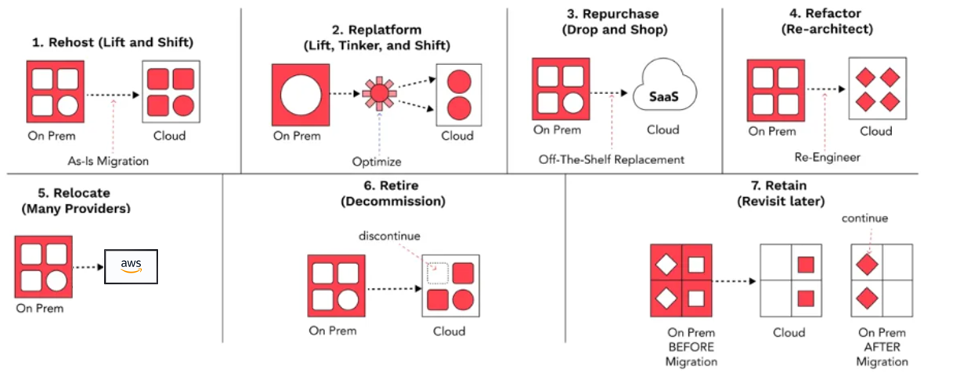


AWS seven “Rs”
Modernizing
Modernizing
Modernizing

Slide 7
MAP Journey based on 7R’s (Migrate)
Strategy | Applications | Total Servers | Description
Rehost
Replatform
Repurchase
Refactor
Relocate
Retire
Retain

Slide 8
7 R Analysis Details
Recommendations for migration to the cloud
Include details on discovered servers, recommended Ec2 instance type, R analysis against each server, Application Grouping, and wave planning info for the groups of applications.

Slide 9
AWS Costs & Migration Savings Details
Migrate to AWS | AWS Costs | Category | Year 1 | Year 2 | Year 3 | Year 4 | Year 5 | Total
 |  | Compute
 |  | Storage
 |  | Network
 |  | AWS Support
 | Partner Funding (If Any)
Savings

Slide 10
MRA Readiness -Recommendations
Key Recommendations
Build and standardize the cloud landing zone.
Establish clear migration processes and best practices.
Upskill teams and formalize Cloud subject matter experts.
Embed security and compliance into all migration phases.
Use the well-established business case to secure executive sponsorship and alignment with all stakeholders.
Example

Slide 11


MRA Executive Summary
Strategy and Desired Outcomes
MRA Objectives
Notes
Notes
Example
Strength
Gaps
Single Threaded Leader
Project Management Capability
Determine Delivery Model & Approach
Managed Service Provider Identified
Migration Funding Commitment
Experience baseline
Key Stakeholder Sign-off
Application Discovery Data

Slide 12

MRA Areas of Focus
Cloud Adoption Framework Perspectives Radar Chart
AWS identified preliminary areas of focus
You're already doing very well in the Business dimension; your definitive strength lies in Value Management, where you're already well-prepared.
Example
We estimate the most initial effort in the Platform dimension; we should especially focus on Application Migration Patterns and improve your capabilities.
In addition to that, in the Operations dimension, Cloud Service Management should receive some attention as well; so let's get started!

Slide 13
MRA Areas of Focus
Mobilize Phase Readiness
Radar Chart
AWS identified preliminary areas of focus
You're already excelling in the Business Case dimension. Keep up the great work!
Put emphasis on improving the Landing Zone dimension to ensure you're well-prepared for a steady and successful cloud migration.
Example
Furthermore, be deliberate in boosting your capabilities in the Migration Process & Experience dimension.

Slide 14
MRA Readiness Scores
Example

Slide 15
Stay On Premise Cost Details
Year |  |  | 1 | 2 | 3 | 4 | 5 | Total
Stay On-premises
 |  | Compute
 |  | Database
 |  | Database licenses
 |  | Storage
 |  | Network
 |  | IT labor
 |  | Other costs

Slide 16
Thank You!

Slide 17
Appendix

Slide 18
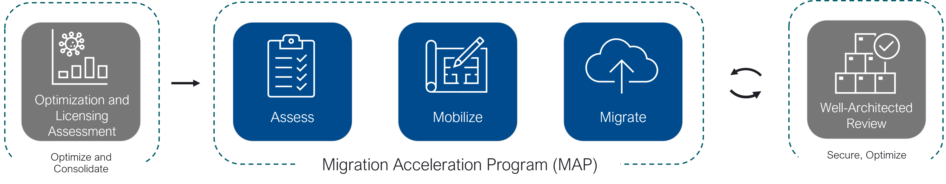
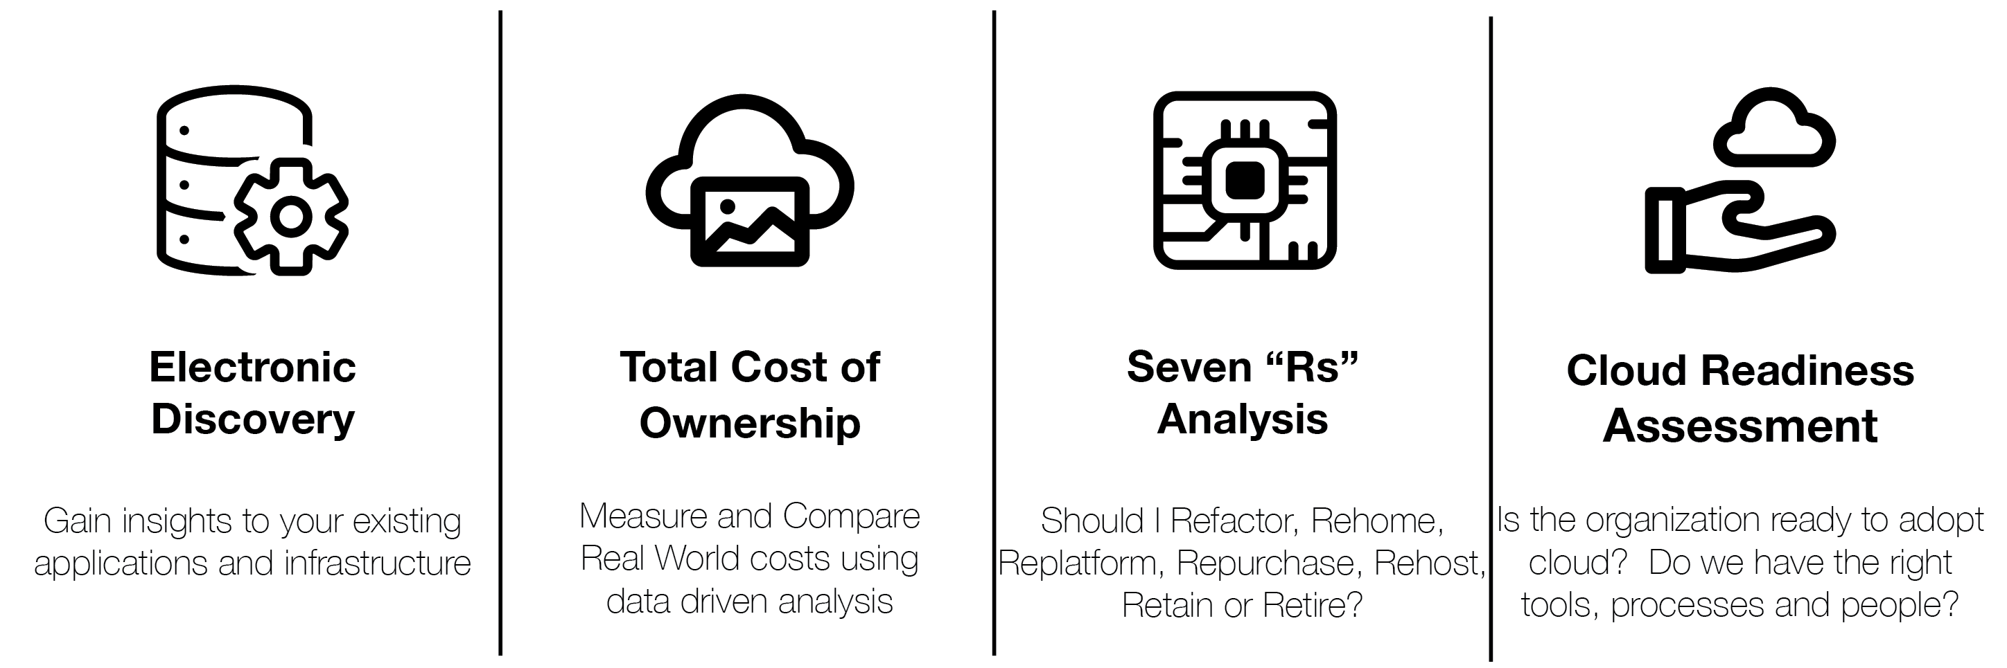
MAP Assess Elements

Slide 19
Comparing On-Premise Cost to Cloud is much more than just measuring Compute, Storage and Network
Hidden Costs to On-Premise and Colocation Hosting
Cloud Opportunities for growth and savings
Data Center Facilities and Staffing
Infrastructure Management and Staffing
Hypervisor licensing costs
Electrical Usage and cooling costs
Capacity Planning and Hardware Refresh
Traditional Telecom Complexity
Hardware Maintenance costs
IT Asset Disposal
Software management
Subscription vs perpetual
Business value of agility
Reduce carrying costs of CAPEX
Rapid scale flexibility
Simplified Capacity Planning
Seasonal Variability
Reduced Time to Service/Market
Reduced Disaster Recovery costs
Lower cost for Geographic diversity
Only pay for what you use
Know where your cloud budget goes
Notes:
Some pro’s about migrating to the cloud. Mainly supporting documents to present to executive team or board.

Slide 20
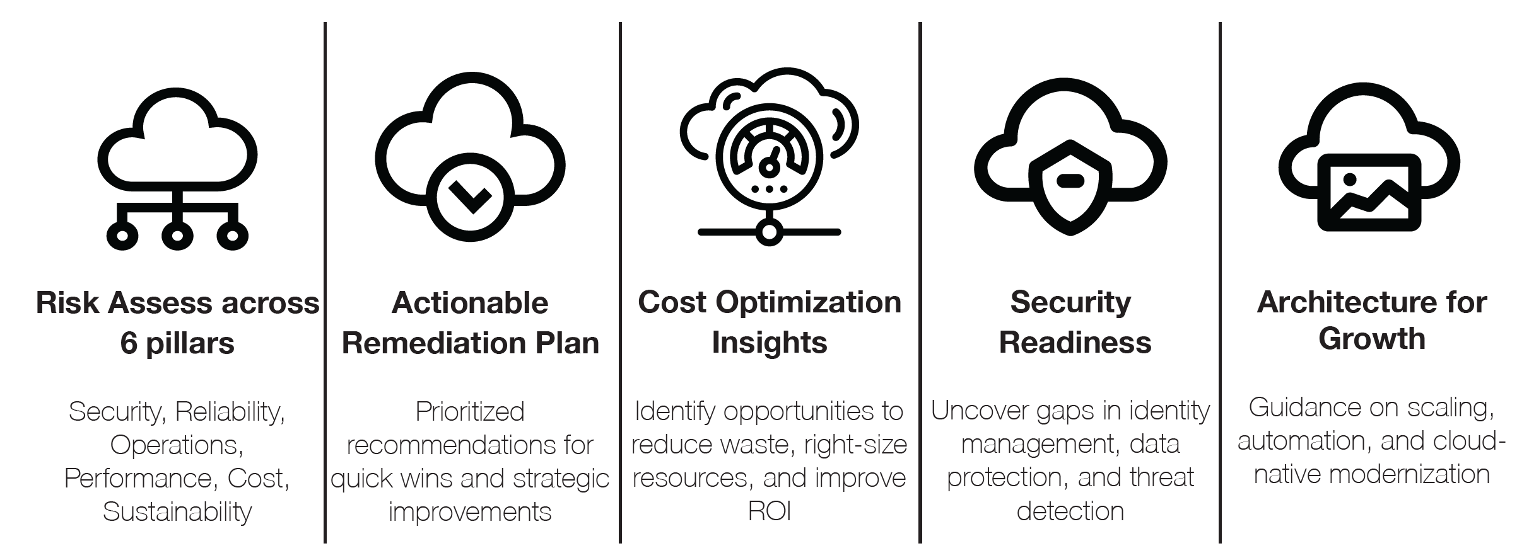
Well Architected Elements

Slide 21

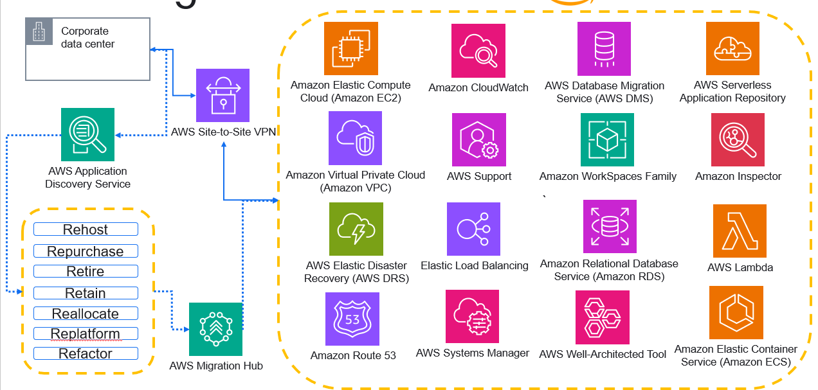
MAP Migration Path
Ingram Micro will work with partner and end customer to identify the optimal migration paths

Slide 22
Windows and SQL BYOL eligibility
Do you want to bring your license for Windows server?
Was the Windows version released before October 1 2019?
N
Y
N
Y
Active Software assurance on SQL license?
You can Bring Windows License to AWS Dedicated Host
You Can't use BYOL
N
Active Software assurance on SQL License?
N
Y
Y
Are all SQL licenses purchased prior Ocober,1 2019 or added as true-up under active enterprise enrolment
You can Bring SQL License to AWS Dedicated Host
Y
N
You can bring your SQL license to AWS SHARED tenancy, DEDICATED Instance or DEDICATED host.
You can't Bring existing SQL license to AWS
Was the SQL version released before October 1 2019?
N
Y

Slide 23
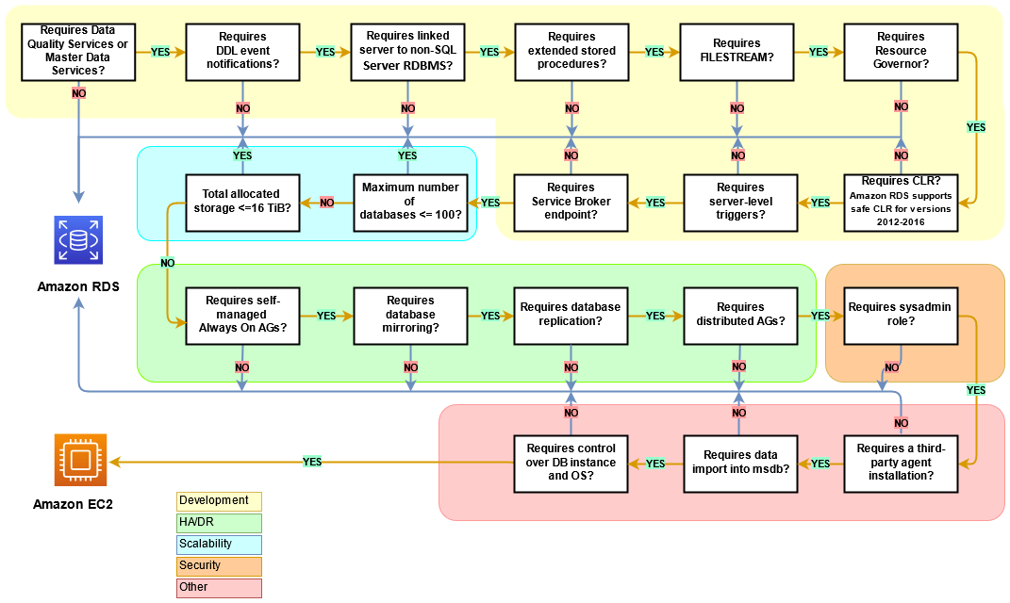
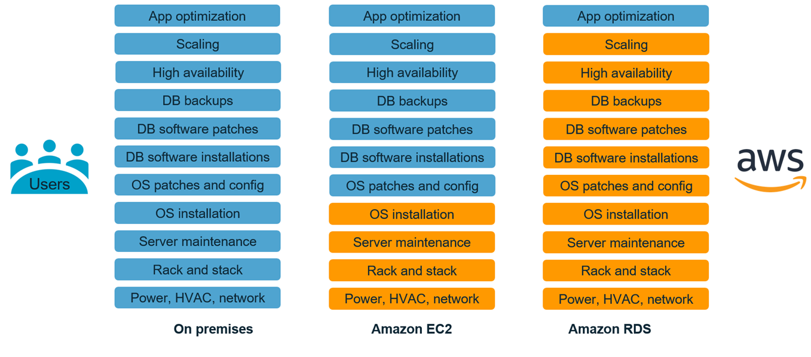
Should I deploy to RDS or EC2 for SQL Server instances?
Decision Tree & Shared Responsibility model

Slide 24




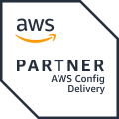











Why Ingram Micro as your Migration Expert?
GLOBAL
Premier Tier Partner
x4
Regional CoE’s
x3
Competency Holder
Experts
x7
Program Enrolments
Professional Services
Enablers
Partners
Global
x240
AWS Technical Individuals
Premier
Managed Services
Certified
x488
AWS Business Individuals
400+
AWS Certifications

Slide 25
Ingram Micro helps tame the transition to cloud beyond the technology
Cloud Enablement
AWS Migration Accelerator Program
Cloud FinOps
Generative AI
Cloud Center of Excellence and Governance
Cloud Cost Optimization and Reserved Instance Arbitrage

