Slide 1
Guidance for using this deck
Delete before using
Target audience: CEO, CTO/Chief Architect, CIO, Managing Director, Business Unit Owners , Security Leader, Network Leader, App Dev Leader, Infrastructure Leader, Operations Leader
Intended purpose: Review MRA results, roadmap and proposal, agree on immediate next steps and appropriate accelerators. (Optional) Review TCO output (if available) taking into account customer confidentiality requirements.
Desired outcome:
  Cloud Adoption Framework (CAF) oriented roadmap of actions based on best practices and customer needs to build complete cloud foundations and active operational excellence in the cloud.
  Defined or ratified scope of cloud migration strategy and next steps in the cloud migration journey including activities related to the closure of the Assess phase.
  AWS ProServe scope of work, plan, and proposal to accelerate the next stage of the migration journey (Mobilize)
Timing: 60-90 minutes
Key messages:
  This session is not only focused on the results of Migration Readiness Assessment but also on identifying and agreeing on the next steps to keep the momentum and accelerate to the next stage of cloud migration or modernization journey.
Notes:
  This slide deck encompasses 2 presentations:
    1) Migration Readiness Assessment (MRA) Workshop Summary – to be used at the end of the MRA event to do the same day playback with high level overview of the results;
    2) Migration Readiness Assessment (MRA) Detailed Results Review – to be used preferably at the end of the MRA event as well (possibly post-workshop - for complex engagements) to conduct a complete review of the MRA results, roadmap, and proposal.
  Please pay close attention to slides with RED banners and tailor the presentation based on results of the MRA.

Slide 2
Migration Readiness Assessment (MRA)
[IMAGE-Company Logo]
Facilitated By
[Customer Name]
Workshop Summary
[Company Name]
[Date]
[Presenter]

Slide 3
How to leverage your MRA results
What an MRA can be used for:
Use the MRA readout as a project kickoff day
Leverage the actions listed to generate a reliable roadmap of immediate actions with owners identified to build momentum and capability for a successful initiative
Use the momentum from the MRA to create a CCOE team and assign action items to the members
Use the assessment rating to build a customized learning and certification plan
What an MRA is not:
A portfolio assessment of applications targeted for the Cloud
A measure of your progress or to be interpreted as timeline for your first migration wave
An evaluation by AWS regarding your staff’s capabilities
An indication of the complexity or difficulty of your migration
Notes:
PRIMARY MESSAGE:
An MRA workshop is a readiness assessment of many of the common factors that slow or stall companies when they migrate at scale. It is not an evaluation of your company’s overall ability to migrate and operate in the Cloud or a gating function for individual groups skilled in launching a given cloud initiative. Many companies that are very knowledgeable about Cloud operations can still be impacted by issues surfaced during the MRA. The purpose of the assessment is to help you identify gaps in your planning and skills, and to address specific known risks encountered previously across Amazon’s extensive experience migrating similar customers at scale.
You should leave the MRA with a clear plan of actions for accelerating your cloud initiative.

Slide 4




Migration Framework
Assess
Mobilize
Migrate & Modernize
Portfolio
Migrate
Discovery & planning | Migration plan | Business case/ Mig. Evaluator | Migration & modernization experience
Skills/center of excellence | Landing zone | Operating model | Security & compliance
Migrate
Rapid discovery
TCO report
Migration Readiness Assessment
Accelerators
Operate &
optimize
Briefings & workshops
Modernize
Immersion day
People
Platform
Create a case for change
Build readiness through experiences
Accelerate transformation at scale
Using a proven framework greatly increases your odds of success and speed to market
Notes:
[MIGRATION JOURNEY]:
PRIMARY MESSAGE: MAP is built on a three-phase journey to systematically help you accomplish the migration journey. MAP starts with the Assess phase that includes a Migration Readiness Assessment (MRA) for your leaders and sponsors along with a Rapid Discovery to support creation of a TCO model to help you build business support for your migration project. The second phase is Mobilize, which includes Mobilize projects identified in the MRA to build your capabilities and get first-hand experience how easy it is to migrate to AWS. Mobilize includes four accelerators pictured here and the level of activity required in these work streams is determined by the readiness levels determined during the MRA. Mobilize activities include the actual migration of a recommended 3-5 applications, which is how your teams build migration capabilities alongside migration experts from AWS or partners. Mobilize typically runs from 2 to 4 months and involves ProServe and/or a partner that prepares you for large-scale migration and operation which is phase three. During Migration and Modernization, you will continue to migrate waves of applications, and operate and optimize your cloud environment and applications.
DETAILED MESSAGE:
We have developed MAP based on previous customer experiences to create an efficient and effective approach to migrations through three phases:
The Assess phase is the beginning of your journey, and sets the foundation for a well-planned and delivered migration. A Migration Readiness Assessment (MRA) completed in the Assess phase helps you determine your organizations capabilities, readiness, and commitment to migrate to the cloud. During the MRA, we also look to quickly follow the assessment with a Rapid Discovery of your portfolio and create a Refined TCO report for the project. We provide discovery and business case tools free of charge during this phase to get the project launched.
After the Assess phase, you progress to the Mobilize phase, which builds capabilities to migrate and operate in the cloud. The focus is on developing a landing zone, operational readiness, cloud skills, a strong migration plan (including initial migrations), and a compelling business case for the migrations. [More Mobilize details if needed]
The Mobilize phase prepares you for the Migrate & Modernize phase, where you deliver large scale migration and cloud operations. After completing the Mobilize phase, migrations can proceed rapidly and efficiently during the last phase, since it builds on established foundational capabilities. Each successive migration establishes a full-scale cloud operating model.
[More Mobilize details to be described as needed]
The Mobilize phase is typically 2 – 4 months (based on your organization’s readiness levels) and is delivered with a selected partner or AWS ProServe resources.
The Mobilize engagement uses Accelerators to deliver the following outputs/outcomes for customers:
Collect inventory and application data to assess the portfolio and develop decision criteria to create initial migration wave plans.
Deploy and validate the landing zone, develop required operating and governance models, and migrate up to 5 applications to the customer production environment.
Gain hands-on experience operating in the cloud to build confidence, skills, and competency for the migration and transformation of the organization.
Define, implement, scale and automate (where applicable), the customer’s security risk and compliance controls on AWS.
Establish the future operating model for cloud and plan, guide and support an efficient progression of the operational model during the migration.
These Accelerators generate early alignment, speed-up requirements gathering, and expedite first migrations to compress the overall engagement timeframe.
The Mobilize Accelerator helps customers establish and exercise an agile program to accelerate cloud operational readiness and cloud migrations. This Accelerator supports the set-up of low-cost collaboration and planning mechanisms that implement and automate many activities within the AWS Cloud Adoption Framework. These mechanisms optimize end-user experience for distributed teams and are foundational to deliver readiness and migration initiatives. The Mobilize Accelerator builds the foundation that all other workstreams leverage to structure and prioritize work, collaborate and document knowledge, and report progress.
The Portfolio Accelerator is a sprint-based, interactive workstream designed to establish decision criteria for application migration candidates and accelerate the development of a migration wave plan.
The Platform & Migration Accelerator deploys and validates the landing zone, develops required operating and governance models, and migrates up to 5 applications to customer production environment. The accelerator leverages Platform and Migration Parties to accelerate application migration, provide hands-on experience operating in the cloud, and build confidence across cross-functional teams. Activities within the Platform & Migration Accelerator are broken into Pre-Party, Party, and Post-Party stages and will conclude with post migration acceptance testing and validation of the landing zone. There is a defined, programmatic approach to successfully organize and plan the accelerator which is detailed in this document.
The People Accelerator advances an enterprise’s ability to create, sustain and govern the change that occurs to enable cloud adoption.
See the internal Mobilize wiki for more details: https://w.amazon.com/bin/view/AWS/Teams/Proserve/Migration/Mobilize/

Slide 5
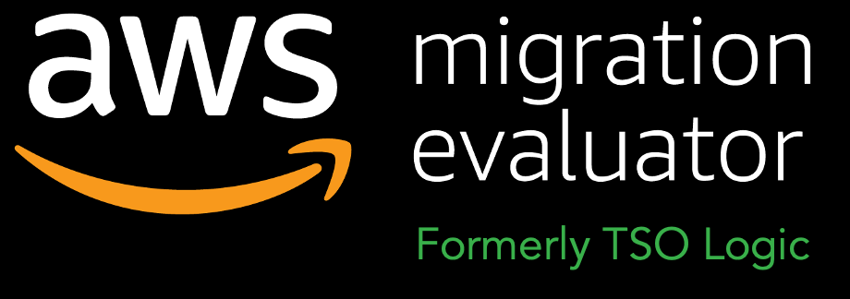

Migration Framework – Assess Phase
Assess
Creating a Case For Change
Establishing Data Requirements and Collecting Data
Evaluating potential third-party license cost savings
Developing a compelling business Case
Aligning on an understanding of the capabilities required
Establishing a Roadmap for the activities to come
Agreeing to a Prioritized List of Actions
Gaining organizational commitment to the journey ahead
Taking the first step
AWS Migration Evaluator
AWS Migration Readiness Assessment
AWS Optimization and License Assessment
Rapid discovery
Business Case
Migration Readiness Assessment
Optimization and License Assessment
Accelerators
Briefings & workshops
Immersion day
Create a case for change
Building momentum with a compelling Business Case and a capability Assessment to address gaps
Notes:
[MIGRATION JOURNEY]:
PRIMARY MESSAGE: MAP is built on a three-phase journey to systematically help you accomplish the migration journey. MAP starts with the Assess phase that includes a Migration Readiness Assessment (MRA) for your leaders and sponsors along with a Rapid Discovery to support creation of a TCO model to help you build business support for your migration project. The second phase is Mobilize, which includes Mobilize projects identified in the MRA to build your capabilities and get first-hand experience how easy it is to migrate to AWS. Mobilize includes four accelerators pictured here and the level of activity required in these work streams is determined by the readiness levels determined during the MRA. Mobilize activities include the actual migration of a recommended 3-5 applications, which is how your teams build migration capabilities alongside migration experts from AWS or partners. Mobilize typically runs from 2 to 4 months and involves ProServe and/or a partner that prepares you for large-scale migration and operation which is phase three. During Migration and Modernization, you will continue to migrate waves of applications, and operate and optimize your cloud environment and applications.
DETAILED MESSAGE:
We have developed MAP based on previous customer experiences to create an efficient and effective approach to migrations through three phases:
The Assess phase is the beginning of your journey, and sets the foundation for a well-planned and delivered migration. A Migration Readiness Assessment (MRA) completed in the Assess phase helps you determine your organizations capabilities, readiness, and commitment to migrate to the cloud. During the MRA, we also look to quickly follow the assessment with a Rapid Discovery of your portfolio and create a Refined TCO report for the project. We provide discovery and business case tools free of charge during this phase to get the project launched.
After the Assess phase, you progress to the Mobilize phase, which builds capabilities to migrate and operate in the cloud. The focus is on developing a landing zone, operational readiness, cloud skills, a strong migration plan (including initial migrations), and a compelling business case for the migrations. [More Mobilize details if needed]
The Mobilize phase prepares you for the Migrate & Modernize phase, where you deliver large scale migration and cloud operations. After completing the Mobilize phase, migrations can proceed rapidly and efficiently during the last phase, since it builds on established foundational capabilities. Each successive migration establishes a full-scale cloud operating model.
[More Mobilize details to be described as needed]
The Mobilize phase is typically 2 – 4 months (based on your organization’s readiness levels) and is delivered with a selected partner or AWS ProServe resources.
The Mobilize engagement uses Accelerators to deliver the following outputs/outcomes for customers:
Collect inventory and application data to assess the portfolio and develop decision criteria to create initial migration wave plans.
Deploy and validate the landing zone, develop required operating and governance models, and migrate up to 5 applications to the customer production environment.
Gain hands-on experience operating in the cloud to build confidence, skills, and competency for the migration and transformation of the organization.
Define, implement, scale and automate (where applicable), the customer’s security risk and compliance controls on AWS.
Establish the future operating model for cloud and plan, guide and support an efficient progression of the operational model during the migration.
These Accelerators generate early alignment, speed-up requirements gathering, and expedite first migrations to compress the overall engagement timeframe.
The Mobilize Accelerator helps customers establish and exercise an agile program to accelerate cloud operational readiness and cloud migrations. This Accelerator supports the set-up of low-cost collaboration and planning mechanisms that implement and automate many activities within the AWS Cloud Adoption Framework. These mechanisms optimize end-user experience for distributed teams and are foundational to deliver readiness and migration initiatives. The Mobilize Accelerator builds the foundation that all other workstreams leverage to structure and prioritize work, collaborate and document knowledge, and report progress.
The Portfolio Accelerator is a sprint-based, interactive workstream designed to establish decision criteria for application migration candidates and accelerate the development of a migration wave plan.
The Platform & Migration Accelerator deploys and validates the landing zone, develops required operating and governance models, and migrates up to 5 applications to customer production environment. The accelerator leverages Platform and Migration Parties to accelerate application migration, provide hands-on experience operating in the cloud, and build confidence across cross-functional teams. Activities within the Platform & Migration Accelerator are broken into Pre-Party, Party, and Post-Party stages and will conclude with post migration acceptance testing and validation of the landing zone. There is a defined, programmatic approach to successfully organize and plan the accelerator which is detailed in this document.
The People Accelerator advances an enterprise’s ability to create, sustain and govern the change that occurs to enable cloud adoption.
See the internal Mobilize wiki for more details: https://w.amazon.com/bin/view/AWS/Teams/Proserve/Migration/Mobilize/

Slide 6
MRA Workstream Summary
Skills & COE
Business Case
Operating Model
Landing Zone
Single Threaded Leader
High Level Business Case
Current Operations Model
Account Design & Configuration
Experience baseline
Key Stakeholder Sign-off
Managed Service Provider Identified
Design or Evolve COE
Migration Funding Commitment
AMI/Patching
Specific Migration Workloads Committed
Backup
Security & Compliance
Asset Management
Security Strategy
People
Application Portfolio Discovery & Planning
Governance, Risk & Compliance
Config Management & Change Management
Application Discovery Data
BCP/DR
3rd Party Risk
Workload Owner Buy-In or Alignment
Service Catalog
Security Reference Architecture
Migration Process & Experience
Cost Management
Logging & Monitoring
Migration Experience
Customer Migration Project Plan
Cloud Ready Operational Processes & Run Books
Lifecycle Security Capabilities
Determine Delivery Model & Approach
CI/CD Pipelines
DevSecOps Principles
Migration
Project Management Capability
Incident Response
Security Operations Playbook
Migration Plan
Green - Readiness maturity needs minimal assistance
Portfolio
Platform
Amber - Need attention to accelerate momentum
Red - Require immediate assistance to unblock progress
Pre-Mobilize/Areas that need attention early-on

Slide 7
MRA Readiness Scores
Notes:
[Key Observations]
[Example]
Strengths
Strong Stakeholder buy-in
Single threaded leader identified and in role to drive progress
Migration Experience
Weaknesses:
Need to build out migration plan to drive energy and direction
Need high-fidelity app data
Need to define future roles and begin training
SLAs and OLAs aren’t well defined
Limited backup, patching, DR/BCP processes and standards
Limited security control mapping and security automation

Slide 8
MRA Readiness Scores
Notes:
[Key Observations]
[Example]
Strengths
Strong Stakeholder buy-in
Single threaded leader identified and in role to drive progress
Migration Experience
Weaknesses:
Need to build out migration plan to drive energy and direction
Need high-fidelity app data
Need to define future roles and begin training
SLAs and OLAs aren’t well defined
Limited backup, patching, DR/BCP processes and standards
Limited security control mapping and security automation

Slide 9

MRA Areas of Focus
Cloud Adoption Framework Perspectives Radar Chart
AWS identified preliminary areas of focus
[Generated from the scores]
[Generated from the scores]
[Generated from the scores]
FACILITATOR: Modify tool generated observations (if required) based on live conversation with the customer
Notes:
PRIMARY MESSAGE:
Areas of focus should be addressed as soon as possible and dictate the structure of the next phase

Slide 10
MRA Areas of Focus
Mobilize Workstream Readiness
Radar Chart
AWS identified preliminary areas of focus
[Generated from the scores]
[Generated from the scores]
[Generated from the scores]
FACILITATOR: Modify tool generated observations (if required) based on live conversation with the customer
Notes:
PRIMARY MESSAGE:
Areas of focus should be addressed as soon as possible and dictate the structure of the next phase

Slide 11
Next Steps
1
Full MRA results readout and roadmap planning
FACILITATOR: Delete this slide if complete readout is delivered on the same day

Slide 12
Migration Readiness Assessment (MRA)
[IMAGE-Company Logo]
Facilitated By
[Customer Name]
Detailed Results Review
[Company Name]
[Date]
[Presenter]

Slide 13
Agenda
MRA results
Actions to Accelerate Momentum
Mobilize your Organization
Next steps

Slide 14


MRA Executive Summary
Strategy and Desired Outcomes
MRA Objectives
[Answer to Q2]
[Answer to Q1]
Strength
Gaps
[Strength]
[Gap]
[Strength]
[Gap]
[Gap]
FACILITATOR: Modify tool generated observations (if required) based on live conversation with the customer
[Gap]

Slide 15
MRA Activity Outputs
Activity 1 – Scope and Mandate
[Answer to Q17]
[Answer to Q18]
FACILITATOR: Modify tool generated observations (if required) based on live conversation with the customer
Activity 2 – Existing Challenges
[Answer to Q19]
[Answer to Q20]
Notes:
[Key Observations]
[Example]
Strengths
Strong Stakeholder buy-in
Single threaded leader identified and in role to drive progress
Migration Experience
Weaknesses:
Need to build out migration plan to drive energy and direction
Need high-fidelity app data
Need to define future roles and begin training
SLAs and OLAs aren’t well defined
Limited backup, patching, DR/BCP processes and standards
Limited security control mapping and security automation

Slide 16
MRA Activity Outputs
Activity 3 – Operating Model
[Answer to Q21]
FACILITATOR: Modify tool generated observations (if required) based on live conversation with the customer
Activity 4 – People Alignment
[Answer to Q22]
Notes:
[Key Observations]
[Example]
Strengths
Strong Stakeholder buy-in
Single threaded leader identified and in role to drive progress
Migration Experience
Weaknesses:
Need to build out migration plan to drive energy and direction
Need high-fidelity app data
Need to define future roles and begin training
SLAs and OLAs aren’t well defined
Limited backup, patching, DR/BCP processes and standards
Limited security control mapping and security automation

Slide 17
MRA Readiness Scores I
Key observations
[Strength]
[Strength]
[Gap]
[Gap]
[Gap]
FACILITATOR: Modify tool generated observations (if required) based on live conversation with the customer
Additional observations and next steps are available in the appendix of this presentation and are used as part of the Mobilize proposal
Notes:
[Key Observations]
[Example]
Strengths
Strong Stakeholder buy-in
Single threaded leader identified and in role to drive progress
Migration Experience
Weaknesses:
Need to build out migration plan to drive energy and direction
Need high-fidelity app data
Need to define future roles and begin training
SLAs and OLAs aren’t well defined
Limited backup, patching, DR/BCP processes and standards
Limited security control mapping and security automation

Slide 18
MRA Readiness Scores II
Key observations
[Strength]
[Strength]
[Gap]
[Gap]
[Gap]
Additional observations and next steps are available in the appendix of this presentation and are used as part of the Mobilize proposal
FACILITATOR: Modify tool generated observations (if required) based on live conversation with the customer
Notes:
[Key Observations]
[Example]
Strengths
Strong Stakeholder buy-in
Single threaded leader identified and in role to drive progress
Migration Experience
Weaknesses:
Need to build out migration plan to drive energy and direction
Need high-fidelity app data
Need to define future roles and begin training
SLAs and OLAs aren’t well defined
Limited backup, patching, DR/BCP processes and standards
Limited security control mapping and security automation

Slide 19
MRA Observations & Actions – Business Case
Readiness Activity
Phase
Observations
Actions & Next Steps
High Level Business Case
Pre-Mobilize
Key Stakeholder Sign-off
Pre-Mobilize
FACILITATOR: This “Business Case” slide is a placeholder slide. Replace with the most pertinent slide from the appendix with the workstream summary for your customer based on the biggest painpoint or priority area of action.
Or review all detailed outcomes and actions as best fitted for the audience and agenda.
Migration Funding Commitment
Pre-Mobilize
Specific Migration Workloads Committed
Pre-Mobilize

Slide 20
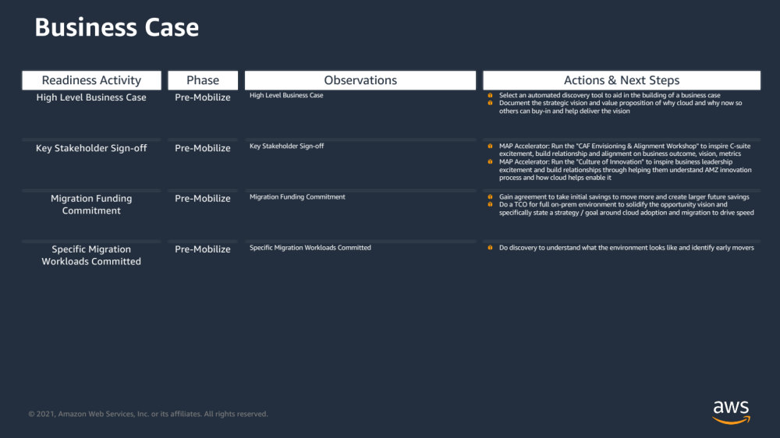
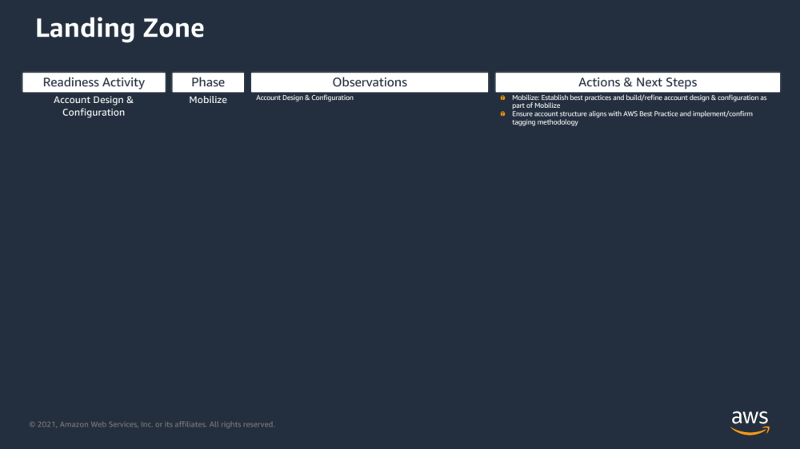
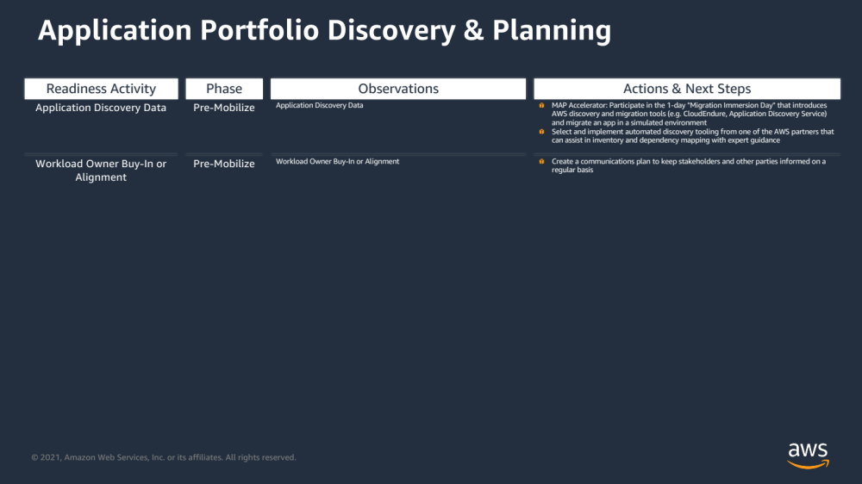
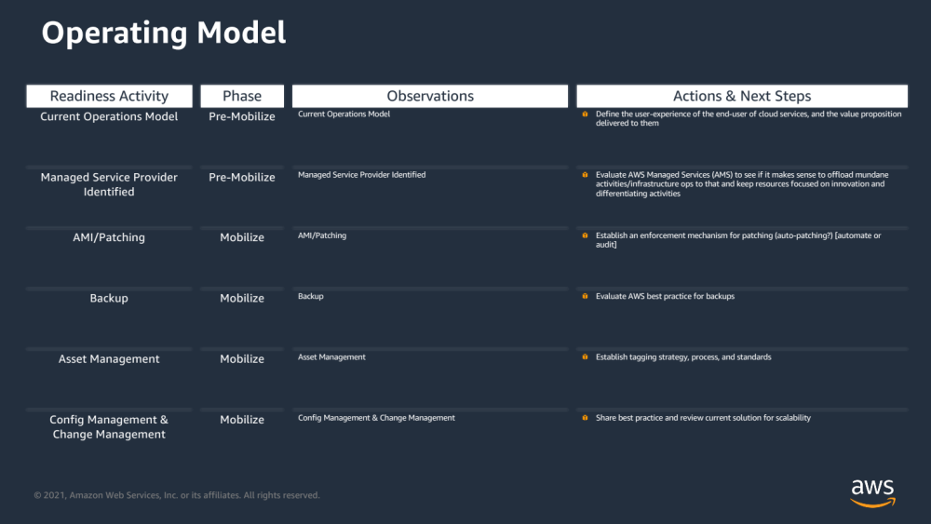
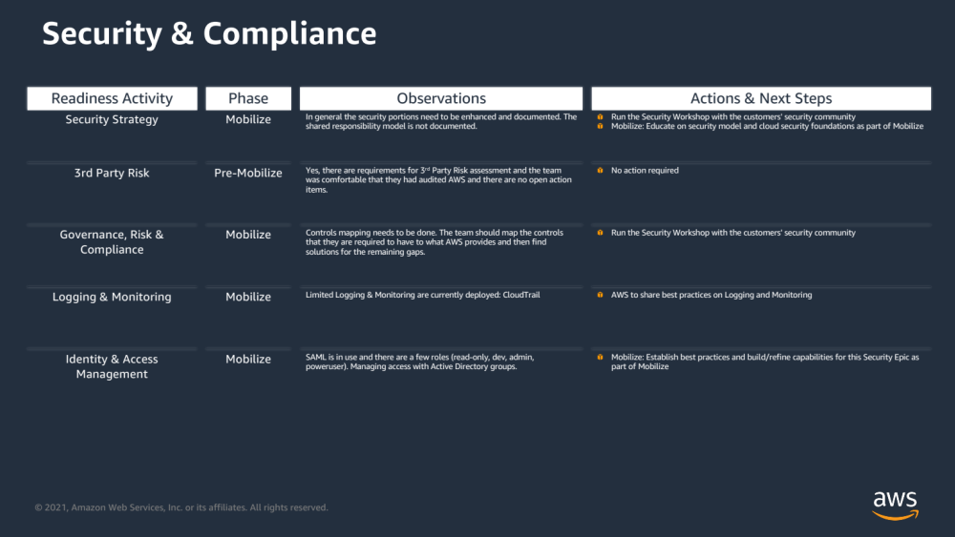
MRA Observations & Actions – All Workstreams
Additional observations and next steps are available in the appendix of this presentation
and are used as part of the Mobilize proposal

Slide 21
MRA Prioritized List of Actions
Objective | Action
Create and communicate a Business Case | Share the initial business case with the broader team to build consensus and buy-in AND/OR MAP Accelerator: Start the “Rapid Migration Business Case” engagement with AWS Cloud Economics team, including TSO Logic based infrastructure discovery, software licensing optimization, and TCO saving estimation
Have the initiative Leader named | Customer to identify a single threaded leader who has authority within the organization to increase decision velocity and identify key stakeholders across the value chain
Build a CCoE | Engage AWS to build/refine CCOE functions AND/OR MAP Accelerator: Run the "CCOE Foundations" interactive workshop to provide leaders with insights on the value of a CCoE function, mechanisms for success, how it evolves over time, and how to utilize it as a lever in driving change in how organizations think, behave, decide, and innovate using Cloud.
Ensure right skills to support the initiative | Identify a training leader to help drive initiative AND/OR Engage the AWS Training team for a learning needs assessment
Accelerate to the next phase and change the way you work | EBA Accelerator: Conduct the “Platform Party” to stress test and validate the AWS landing zone and move your first applications (for customers not leveraging ProServe led Mobilize but using prescriptive guidance from AWS via EBA) OR (for customers that will engage AWS ProServe for Mobilize) MAP Accelerator: Conduct the “Pre-Mobilize EBA” to define and baseline the landing zone architecture design or to test and validate the landing zone and migration factory (for customers that already have a platform built)
Assure security is considered at front of the initiative | MAP Accelerator: Run the "Security Briefing" to educate key stakeholders on security model and cloud security foundations AND/OR Get the 3rd party risk assessment completed. Engage AWS as needed to ensure passage
Determine preferred operating model | Evaluate AWS Managed Services (AMS) to see if it makes sense to offload mundane activities/infrastructure ops to that and keep resources focused on innovation and differentiating activities
Get discovery tooling in place | Select and implement automated discovery tooling from one of the AWS partners that can assist in inventory and dependency mapping with expert guidance AND/OR MAP Accelerator: Participate in the 1-day "Migration Immersion Day" that introduces AWS discovery and migration tools (e.g. CloudEndure, Application Discovery Service) and migrate an app in a simulated environment
Determine and engage partners involved in the initiative | Confirm decision regarding roles of internal teams, Partner, and AWS, and involve Partner (if applicable) in the migration strategy and planning as early as possible
Identify first movers | Identify initial movers (generally require App Owner who is a promoter and an App that is not complex)
FACILITATOR: This table is prepopulated based on AWS best practices and addresses common critical gaps to ensure the customer can move quickly to Mobilize and Migrate. Delete only those which may have been completed or are not applicable, and/or modify/add based on MRA workshop observations.

Slide 22

Post-MRA Cloud Migration Journey
Mobilize
Migration
&
Modernization
Assess
FACILITATOR: Update the timeframe headings based on MRA recommended next steps
Next 1-4 Weeks
Work on prioritize list of actions
Build knowledge and skills on key migration topics prior to committing to the Mobilize phase
Next 2-4 Months
Establish foundation and build a Migration Plan with the methodology, processes, tools and resources to accelerate your migration to the AWS platform
Next 4 – N Months
Batch migration using migration factory concept
Continuous service improvement by gap analysis and remedies
Notes:
PRIMARY MESSAGE:
AWS is committed to deliver high-level guidance, information on best practices, whitepapers, and other publicly available AWS materials to help drive resolution. Customer needs to move to migration/modernization right after Mobilize to take full advantage of Mobilize investment.

Slide 23
Agenda
MRA results
Actions to Accelerate Momentum
Mobilize your Organization
Next steps

Slide 24


Post-MRA Cloud Migration Journey – Assess Phase
Create and sustain momentum with accelerators that address critical path items, catalyze your team in to action and delivery capability quickly
Weekly Customer Executive Meeting
Sprint 1
Sprint 2
Sprint 3
Sprint 4
People
Mobilize Accelerator
Platform
Migration & Modernization
Portfolio
Identify single threaded leader
CCOE Foundations
Engage the AWS Training team for a learning needs assessment
Document CCOE roles & responsibilities
Pre-Mobilize EBA
Procure Tools
& Deploy Delivery Kits
Load Tailored Backlogs
Weekly Sprint Cadence (Stand-ups, Demo, Retro, Planning)
FACILITATOR: (Pick one of 3 based on delivery model) Modify based on MRA recommended actions: add/delete workstreams, workshops, briefings and otherwise based on focus areas from the recommendations, and high level critical actions for the customer to visualize MRA Prioritized List of Actions from slide 16. Highlight accelerators from AWS (EBA Parties, Workshops, Briefings) that are intended to create and sustain the momentum.
Sprint Ceremonies Begin
Establish platform requirements
Network Baseline Design
3rd party risk assessment
Security Baseline Design
Evaluate AWS AMS
Current State Discovery
Ops Baseline Design
Migration Immersion Day
Determine Delivery Model
Identify Pilot Apps
Install an automated discovery tool
Week
Rapid Migration Business Case
Share Initial Business Case
FACILITATOR: Use this slide for customers which will engage with AWS ProServe for Mobilize and which don’t have a scalable and secure platform (LZ, Sec, Ops) built
Notes:
PRIMARY MESSAGE:
AWS is committed to deliver high-level guidance, information on best practices, whitepapers, and other publicly available AWS materials to help drive resolution.

Slide 25
Post-MRA Cloud Migration Journey – Assess Phase
Create and sustain momentum with accelerators that address critical path items, catalyze your team in to action and delivery capability quickly
Weekly Customer Executive Meeting
Sprint 1
Sprint 2
Sprint 3
Sprint 4
People
Mobilize Accelerator
Platform
Migration & Modernization
Portfolio
Identify single threaded leader
CCOE Foundations
Engage the AWS Training team for a learning needs assessment
Document CCOE roles & responsibilities
Pre-Mobilize EBA
Procure Tools
& Deploy Delivery Kits
Load Tailored Backlogs
Weekly Sprint Cadence (Stand-ups, Demo, Retro, Planning)
FACILITATOR: (Pick one of 3 based on delivery model) Modify based on MRA recommended actions: add/delete workstreams, workshops, briefings and otherwise based on focus areas from the recommendations, and high level critical actions for the customer to visualize MRA Prioritized List of Actions from slide 16. Highlight accelerators from AWS (EBA Parties, Workshops, Briefings) that are intended to create and sustain the momentum.
Sprint Ceremonies Begin
Validate platform requirements
Network Baseline Validation
Stress test foundational platform and migration factory
3rd party risk assessment
Security Baseline Validation
Evaluate AWS AMS
Ops Baseline Validation
Migration Immersion Day
Migration Factory Validation
Determine Delivery Model
Identify Pilot Apps
Install an automated discovery tool
Week
Rapid Migration Business Case
Share Initial Business Case
FACILITATOR: Use this slide for customers which will engage with AWS ProServe for Mobilize and which already have an existing scalable and secure platform (LZ, Sec, Ops) built
Notes:
PRIMARY MESSAGE:
AWS is committed to deliver high-level guidance, information on best practices, whitepapers, and other publicly available AWS materials to help drive resolution.

Slide 26
Post-MRA Cloud Migration Journey – Assess Phase
Create and sustain momentum, address critical path items, catalyze your team in to action and delivery capability quickly
Weekly Customer Executive Meeting
Sprint 1
Sprint 2
Sprint 3
Sprint 4
People
Platform, Ops and Security
Migration & Modernization
Portfolio
Review COE & Org Structure
Identify Resources
Affirm COE Governance Model and Structure
Platform
Party
FACILITATOR: (Pick one of 3 based on delivery model) Modify based on MRA recommended actions: add/delete workstreams, workshops, briefings and otherwise based on focus areas from the recommendations, and high level critical actions for the customer to visualize MRA Prioritized List of Actions from slide 16. Highlight accelerators from AWS (EBA Parties, Workshops, Briefings) that are intended to create and sustain the momentum.
Establish Landing Zone Requirements
Confirm pre-req platform needs to accommodate
Review Sec Controls & Translation to Cloud
Identify New Cloud Security Controls & Requirements
Operations Integration Assessment
Evaluate AWS AMS
Assess Native cloud and 3rd Party Tools
Determine App Candidates for Party
Identify Pilot Apps
Document Dependencies and Cloud Design
Map Dependencies, SMEs and Migration Types
Review existing Inventory
Install an automated discovery tool
Rapid Migration Business Case
FACILITATOR: Use this slide for customers which do not know yet if they will leverage AWS ProServe led Mobilize but will benefit from prescriptive guidance provided by AWS via EBA
Notes:
PRIMARY MESSAGE:
AWS is committed to deliver high-level guidance, information on best practices, whitepapers, and other publicly available AWS materials to help drive resolution.

Slide 27
Agenda
MRA results
Actions to Accelerate Momentum
Mobilize your Organization
Next steps

Slide 28
Mobilize Overview
Goals
Build or validate AWS foundational environment to support targeted workloads and future initiatives
Establish governance and security posture
Scale enterprise operations to AWS
Identify migration patterns
Define team model and agile work streams
Develop cost and resource model for the migration of a defined portfolio
Mobilize
Outcomes
Platform
Landing Zone with security controls
Adapted operational procedures
Portfolio
7R disposition & decision criteria
App discovery & migration Wave Plan
Migration
3-5 applications migrated to AWS
Hands-on migration experience & patterns for use to scale migrations
People
CCoE structure, skills, & staffing
Organization change management plan(s)
Portfolio
Migrate
Discovery & planning | Migration plan | Business case/ Mig. Evaluator | Migration & modernization experience
Skills/center of excellence | Landing zone | Operating model | Security & compliance
People
Platform
Enable readiness for a mass migration, modernization or greenfield
Notes:
PRIMARY MESSAGE: The Mobilize Phase helps customers establish and exercise an agile program to accelerate cloud operational readiness and cloud migrations. This engagement supports the set-up of low-cost collaboration and planning mechanisms that implement and automate many activities within the AWS Cloud Adoption Framework. These mechanisms optimize end-user experience for distributed teams and are foundational to deliver readiness and migration initiatives. This engagement builds the foundation that all other workstreams leverage to structure and prioritize work, collaborate and document knowledge, and report progress.
The Mobilize Phase has the following objectives:
Ensure high visibility with Executive Sponsor.
Leverage agile methodologies, project control, business communication plan, and deliver the migration plan.
Work with key stakeholders to assemble project teams, assign responsibilities, and develop schedules to ensure timely project completion, while minimizing risk to maximize customer success.
DETAILED MESSAGE:
The Mobilize phase is typically 2 – 4 months (based on your organization’s readiness levels) and is delivered with a selected partner or AWS ProServe resources.
The Mobilize engagement uses Accelerators to deliver the following outputs/outcomes for customers:
Collect inventory and application data to assess the portfolio and develop decision criteria to create initial migration wave plans.
Deploy and validate the landing zone, develop required operating and governance models, and migrate up to 5 applications to the customer production environment.
Gain hands-on experience operating in the cloud to build confidence, skills, and competency for the migration and transformation of the organization.
Define, implement, scale and automate (where applicable), the customer’s security risk and compliance controls on AWS.
Establish the future operating model for cloud and plan, guide and support an efficient progression of the operational model during the migration.
These Accelerators generate early alignment, speed-up requirements gathering, and expedite first migrations to compress the overall engagement timeframe.
The Mobilize Accelerator helps customers establish and exercise an agile program to accelerate cloud operational readiness and cloud migrations. This Accelerator supports the set-up of low-cost collaboration and planning mechanisms that implement and automate many activities within the AWS Cloud Adoption Framework. These mechanisms optimize end-user experience for distributed teams and are foundational to execute readiness and migration initiatives. The Mobilize Accelerator builds the foundation that all other workstreams leverage to structure and prioritize work, collaborate and document knowledge, and report progress.
The Portfolio Accelerator is a sprint-based, interactive workstream designed to establish decision criteria for application migration candidates and accelerate the development of a migration wave plan.
The Platform & Migration Accelerator deploys and validates the landing zone, develops required operating and governance models, and migrates up to 5 applications to customer production environment. The accelerator leverages Platform and Migration Parties to accelerate application migration, provide hands-on experience operating in the cloud, and build confidence across cross-functional teams. Activities within the Platform & Migration Accelerator are broken into Pre-Party, Party, and Post-Party stages and will conclude with post migration acceptance testing and validation of the landing zone. There is a defined, programmatic approach to successfully organize and plan the accelerator which is detailed in this document.
The People Accelerator advances an enterprise’s ability to create, sustain and govern the change that occurs to enable cloud adoption.

Slide 29
Post-MRA Cloud Migration Journey – Mobilize Phase
The timeline below serves as a first iteration of the recommended Mobilize engagement timeline which may need modifications.
Weekly Customer Executive Meeting
Sprint 0
Sprint 1
Sprint 2
Sprint 3
Sprint 4
Sprint 5
Sprint 6
Sprint 7
Sprint 8
Sprint 9-n
Launch Ready Planning (LRP)
Mobilize Accelerator
Procure Tools
& Deploy Delivery Kits
Load Tailored Backlogs
Weekly Sprint Cadence (Stand-ups, Demo, Retro, Planning)
Sprint Ceremonies Begin
People Planning
Leadership Alignment & Stakeholder Assessment
2-Day People Party
Case for Change
Org Change Readiness
OCM Risk Mitigation Strategy
Strategic Communications Delivery
People Accelerator
OCM Strategy & Plan
FACILITATOR: (Pick one of 2 based on delivery model) Modify based on MRA recommended next steps
Platform Planning
Platform Buildout or Platform Validation
Includes Landing Zone, Security, and Operations
Platform Party
Promote 1st app to Dev
Platform Party Remediation
Security Jam
&
Operations Game Day
Platform Baselined
Platform Optimization Activities
Platform Accelerator
Migration Accelerator
Migration Planning
Migration Patterns Analysis
Migration Factory Deployment
Pilot Applications Design Baselined
Migration Factory Testing
Migration Preparation Work
Move
Party
1st App in Prod
Migration Prep
Move
Party
n App in Prod
Migration Prep
Move
Party
n App in Prod
Validate Pilot Applications Discovery & Design
Portfolio Accelerator
Portfolio Planning
Discovery Acceleration & Planning
(DAP)
Pilot Application Discovery & Design
Pilot Application Discovery & Design (continued)
Wave Plan Draft
Continuous Data Enrichment and Validation
App/Infra 7R Disposition, Categorization and Prioritization
Wave Plan Baselined
FACILITATOR: Use this slide for customers which will engage with AWS ProServe for Mobilize
Notes:
PRIMARY MESSAGE:
Mobilize provides customers flexibility and we work with customers to tailor the engagement based on the customer's desired business outcomes. The timeline below serves as a template or starting point that should be modified and tailored based on customer requirements.

Slide 30
Post-MRA Cloud Migration Journey – Mobilize Phase
The timeline below serves as first iteration of the recommended EBA engagement, which will adapt as we work together
Post-MRA Platform Party
Week 1
Week 2
Week 3
Week 4
Week 5
Week 6
Week 7
Week 8
Continued….
Platform Party
Update business case based on metrics and results of Learned from Party
Migration Party
Refine Business Case with Party Results and Socialize with Key Stakeholders (IT & Business)
Migration Parties
Or
Modernize Parties
Business Case Validation and Cloud Cost Optimization
Business Case
People Party
Training plan for CCOE
Execute Skills and Training Plan
Stakeholder Enablement
Continue Skills Development of COE and Build Organizational Training Plan
Application Owner Engagement
People
FACILITATOR: (Pick one of 2 based on delivery model) Modify based on MRA recommended next steps
Landing Zone backlog
Iterate Integration and Security of environment
Scale Landing Zone
Scale Landing Zone
Ongoing Security Controls Development & Automation
Platform
Ops Playback and Assessment
MVP Ops Functions
Define Required Security Epics
Enable Platform to Support Migration Application Backlog And App Prioritization
Operations / Automation / LZ Management / Security Control Automation / AWS Service events failure Ops
Migration
Migration Pattern Designs
Build Backlog for Upcoming Party
Migration Pattern Designs
Build Backlog for Upcoming Party
Migrate, Refactor and Modernize Workloads
Portfolio
Discovery Acceleration & Planning
(DAP)
Wave Plans Established
Discovery per Migration Plan
Ongoing Discovery per Migration Wave
FACILITATOR: Use this slide for customers which don’t know yet if they will leverage AWS ProServe led Mobilize but will benefit from prescriptive guidance provided by AWS via EBA
Notes:
PRIMARY MESSAGE:
We work with customers to tailor the engagement based on the customer's desired business outcomes. The timeline below serves as a template or starting point that should be modified and tailored based on customer requirements.

Slide 31
Mobilize Cost Breakdown by Scope
Accelerator Scope | Daily Rate¹ | Total Days | Total Fees
Portfolio Accelerator
Platform Accelerator (LandingZone, Security, Operations)
Migration Accelerator
People Accelerator
Mobilize Accelerator (Engagement Manager, PM, CDA)
Mobilize Sub-total
Portfolio Tools for Discovery & Analysis³
Collaboration Tools⁴
MAP $ for $ funding² |  |  | ($###,###)
Grand Total
FACILITATOR: Use breakdown by scope or by role as appropriate
¹Daily Rate is based on an 8 hour workday.
²Preliminary estimate and MAP funding subject to AWS financial approval
³ <customer> to purchase Portfolio Tools for Discovery and Analysis, which includes licenses and Partner Professional Services, in the AWS Marketplace
⁴ <customer> to either purchase or extend existing Jira and Confluence licenses
Days are for estimation purposes. Customers will be billed at the equivalent hourly rate, based on actual hours worked
Excludes Expenses to be estimated at 15% (There will be no expenses if all work is done remotely)
Mobilize engagement is using Delivery Kits and Best Practices

Slide 32
Mobilize Cost Breakdown by Role
Resource | Daily Rate¹ | Total Days | Total Fees
Practice Manager
Engagement Manager
Platform Lead
Security Lead
Operations Lead
Migration Lead
People & Change Lead
Mobilize Sub-total
Portfolio Tools for Discovery & Analysis³
Collaboration Tools⁴
MAP $ for $ funding² |  |  | ($###,###)
Grand Total
FACILITATOR: Use breakdown by scope or by role as appropriate
¹Daily Rate is based on an 8 hour workday.
²Preliminary estimate and MAP funding subject to AWS financial approval
³ <customer> to purchase Portfolio Tools for Discovery and Analysis, which includes licenses and Partner Professional Services, in the AWS Marketplace
⁴ <customer> to either purchase or extend existing Jira and Confluence licenses
Days are for estimation purposes. Customers will be billed at the equivalent hourly rate, based on actual hours worked
Excludes Expenses to be estimated at 15% (There will be no expenses if all work is done remotely)
Mobilize engagement is using Delivery Kits and Best Practices

Slide 33
Agenda
MRA results
Actions to Accelerate Momentum
Mobilize your Organization
Next steps
Notes:
What we are going to walk through today

Slide 34
Next Steps
 | Action | Owner | Target Date
1 | Review detailed workstreams recommended actions and assign owners | <customer stakeholder> | <target date>
2 | Evaluate AWS Managed Services (AMS) to see if it makes sense to offload mundane activities/infrastructure ops | <customer stakeholder> | <target date>
3 | Schedule “CCOE Foundations”, “Security Briefing” workshops | <AWS stakeholder> | <target date>
4 | Schedule Experience Based Acceleration party | <AWS stakeholder> | <target date>
5 | Create a mechanism to track post-MRA actions to closure | <customer stakeholder> | <target date>
6 | Schedule a meeting with the CEO to present the business case | <customer stakeholder> | <target date>
7 | Review Mobilize proposal and sign the SOW | <customer stakeholder> | <target date>
8 | Discuss Mobilize start date | <AWS stakeholder> | <target date>
9 | Sign up for the MAP incentive program as soon as possible to avoid migrating outside the program terms | <customer stakeholder> | <target date>
FACILITATOR: Example inputs only. Modify based on actual MRA workshop observations, prioritized actions, and campaign requirements. Discuss and fill out owners and completion target dates. Align account team and customer on means to maintain momentum and assure actions on both sides are not lost and have a mechanism for tracking.
Notes:
PRIMARY MESSAGE:

Slide 36
Appendix
References
AMS Qualification
MRA Observations & Actions
MRA Questionnaire Summary

Slide 37
Quick References
Outcome | APG Public Reference | Key Potential Actions | AWS Offerings
Start with Migrating at scale in mind! | APG Large Migration Guidance | Understand the guidance around migrating at scale for a large migration as you begin your Assess and Mobilize Phase activities
Have a business case! | APG Cost Guidance | Share the initial business case with the broader team to build consensus and buy-in AND/OR MAP Accelerator: Start the ”Rapid Migration Business Case” engagement with AWS Cloud Economics team, including Migration Evaluator based infrastructure discovery, software licensing optimization, and TCO saving estimation | https://aws.amazon.com/migration-evaluator/
Have a Leader named! | APG Organization Guidance | Customer to identify a single threaded leader who has authority within the organization to increase decision velocity and identify key stakeholders across the value chain | https://aws.amazon.com/training/classroom/aws-cloud-essentials-for-business-leaders/
Build a CCoE! | APG People Guidance | Engage AWS to build/refine CCOE functions AND/OR MAP Accelerator: Run the "Cloud Center of Excellence (CCoE) Educational Workshop" to educate leaders on the value of a CCOE function, and provides best practice insights on structure maturation, and initial steps to optimal decision-making and functionality | https://docs.aws.amazon.com/whitepapers/latest/public-sector-cloud-transformation/building-a-cloud-center-of-excellence-ccoe-to-transform-the-entire-enterprise.html
Ensure right skills! | APG Mobilization Guidance | Identify a training leader to help drive initiative AND/OR Engage the AWS Training team for a learning needs assessment | https://aws.amazon.com/training/teams/learning-needs-analysis/
Gain experience and change the way you work! | APG Landing Zone Guidance | EBA Accelerator: Conduct the "Platform Party" to stress test and validate the AWS landing zone and move your first applications (for customers not leveraging ProServe led Mobilize but using prescriptive guidance from AWS via EBA) AND/OR, MAP Accelerator: Participate in the 1-day "Migration Immersion Day" that introduces AWS discovery and migration tools (e.g. CloudEndure, Application Discovery Service) and migrate an app in a simulated environment | https://aws.amazon.com/solutions/implementations/customizations-for-aws-control-tower/
Assure security is considered at front of the initiative! | APG Account Security Guidance | MAP Accelerator: Run the "Security Briefing" to educate key stakeholders on security model and cloud security foundations AND/OR Get the 3rd party risk assessment completed. Engage AWS as needed to ensure passage | https://aws.amazon.com/security/
Determine preferred operating model! | APG Operating Model Guidance | Evaluate AWS Managed Services (AMS) to see if it makes sense to offload mundane activities/infrastructure ops to that and keep resources focused on innovation and differentiating activities | https://aws.amazon.com/managed-services/
Get discovery tooling in place! | APG Portfolio Discovery Guidance | Select and implement automated discovery tooling from one of the AWS partners that can assist in inventory and dependency mapping with expert guidance AND/OR, MAP Accelerator: Participate in the 1-day "Migration Immersion Day" that introduces AWS discovery and migration tools (e.g. CEMF/MGN, Application Discovery Service) and migrate an app in a simulated environment | https://aws.amazon.com/application-discovery/
Determine and engage partners involved in the initiative! | APG Partner Guidance | Confirm decision regarding roles of internal teams, Partner, and AWS, and involve Partner (if applicable) in the migration strategy and planning as early as possible | https://aws.amazon.com/partners/featured/migration/
Identify first movers! | APG Migrate Guidance | Identify initial movers (generally require App Owner who is a promoter and an App that is not complex)
Have a Modernization Strategy! | APG Modernize Guidance | Engage with AWS to 1/ conduct a Windows Migration and Modernization Assessment AND/OR 2/an Application Modernization Assessment AND/OR 3/ apply AWS Database Migration Assessment Framework to seek ways to modernize your IT landscape to achieve your business objectives. | https://aws.amazon.com/enterprise/modernization/
Make sure there is a follow-up on the actions identified! | APG Project Governance Guidance | Create a mechanism to track post-MRA actions to closure | https://docs.aws.amazon.com/prescriptive-guidance/latest/large-migration-governance-playbook/task-project-management.html

Slide 38
Appendix
References
AMS Qualification
MRA Observations & Actions
MRA Questionnaire Summary

Slide 39
AWS Managed Services – just the right thing for you?
What is AWS Managed Services (AMS)?
AWS Managed Services (AMS) helps customers adopt AWS at scale and operate more efficiently and securely. AMS provides proactive, preventative, and detective capabilities that raise the operational bar and help reduce risk without constraining agility. AMS extends the customer’s team with operational capabilities including monitoring, incident detection and management, security, patch, backup, and cost optimization.
FACILITATOR: This slide will show a score of 0% unless AMS is assigned as a recommended action and the assessment is marked as complete before generating the report.
Who is AMS for?
AMS is appropriate for enterprise customers who want to make cloud ops more predictable so they can focus on more important business priorities. Whether it’s a staff or skill gap, the desire to stay on top of security alerts, operating new workloads, and more, AMS augments the customer team’s cloud operations capabilities.
0%
Would AMS be useful for me?
Based on your fit score, AMS may still be an interesting option for you. Please contact your AWS Account Team to explore this option further.
AMS Fit Score

Slide 40
Appendix
References
AMS Qualification
MRA Observations & Actions
MRA Questionnaire Summary

Slide 41
Business Case
Category | Summary Observations | Actions & Next Steps
High Level Business Case
Key Stakeholder Sign-off
Migration Funding Commitment
Specific Migration Workloads Committed

Slide 42
Migration Project Plan
Category | Summary Observations | Actions & Next Steps
Determine Delivery Model & Approach
Project Management Capability
Migration Plan

Slide 43
Skills & COE
Category | Summary Observations | Actions & Next Steps
Single Threaded Leader
Experience baseline
Design or Evolve COE

Slide 44
Landing Zone
Category | Summary Observations | Actions & Next Steps
Account Design & Configuration

Slide 45
Application Portfolio Discovery & Planning
Category | Summary Observations | Actions & Next Steps
Application Discovery Data
Workload Owner Buy-In or Alignment

Slide 46
Migration Process & Experience
Category | Summary Observations | Actions & Next Steps
Migration Experience

Slide 47
Operating Model
Category | Summary Observations | Actions & Next Steps
Current Operations Model
Managed Service Provider Identified
AMI/Patching
Backup
Asset Management
Config Management & Change Management
BCP/DR
Service Catalog
Cost Management
Cloud Ready Operational Processes & Run Books
CI/CD Pipelines
Incident Response

Slide 48
Security & Compliance
Category | Summary Observations | Actions & Next Steps
Security Strategy
Security Reference Architecture
3rd Party Risk
Governance, Risk & Compliance
Logging & Monitoring
Lifecycle Security Capabilities
DevSecOps Principles
Security Operations Playbook

Slide 49
Appendix
References
AMS Qualification
MRA Observations & Actions
MRA Questionnaire Summary

Slide 50
Scope – Goals
# | Question | Response | Comments
Q1 | Describe the scope for this MRA. What is being considered in scope and what is out of scope?
Q2 | What are the organization's target outcomes (business and/or IT) that are in focus for this cloud initiative? What are the primary drivers of these objectives?

Slide 51
Scope – Technical
# | Question | Response | Comments
Q3 | How many servers and applications are in scope of this initiative?
Q4 | Do you have workloads that require specific security architecture considerations (for example, PCI, SOC2, NIST, HITRUST, FedRAMP High, CJIS, ITAR, EAR, or others)?
Q5 | Are there application requirements (fault tolerance, performance, resiliency, DR,etc.) that require Multi-AZ or multi-Region architectures?
Q6 | What tools do you use for project management? Specifically, is Jira or Confluence in use, and which teams have been onboarded? Has the Draw.io plugin been activated?
Q7 | Are VMware Cloud workloads being considered as part of this migration? (Additional questions in Optional section)
Q8 | Is storage being considered as part of this migration? (Additional questions in Optional section)
Q9 | Are Microsoft workloads being considered as part of this migration? (Additional questions in Optional section)
Q10 | Is network transformation being considered as part of this migration? (Additional questions in Optional section)
Q11 | Are databases being considered as part of this migration? (Additional questions in Optional section)
Q12 | Are on-premise appliances considered in order to meet one of the following requirements : low latency, local processing needs for technical reasons such as data gravity, or data residency? (Additional questions in Optional section)
Q13 | Are SAP workloads being considered as part of this migration? (Additional questions in Optional Section)
Q14 | Are there applications that are part of this migration effort with legacy characteristics that may prevent you from fully leveraging cloud benefits post migration? (Additional questions in Optional Section)
Q15 | Are there applications that are part of this migration effort which you sell to other parties that you plan on evolving your licensing model for (eg perpetual to subscription)? (Additional questions in Optional Section)
Q16 | Is Data Analytics/AI/ML workloads considered as part of this migration?If yes, do you have a specific use case identified for initial POC?

Slide 52
EBA Activities – Activity 1
# | Question | Response | Comments
Q17 | Describe the current strategy, mandate for cloud, and level of commitment and communication (for example, is there a time-based specific value driver, pending datacenter closure, publicly communicated objective, sustainability target, or others?)
Q18 | What is the scope and intent of this initiative (for example, lines of business, regions, application types, and/or intent to learn, test, pilot, or accelerate at scale)?

Slide 53
EBA Activities – Activity 2
# | Question | Response | Comments
Q19 | Are there any friction points concerning enterprise, technology, applications, process, or people which may potentially stall this initiative?
Q20 | Are there aspects of your organization and culture which you think will help move this initiative forward?

Slide 54
EBA Activities – Activity 3
# | Question | Response | Comments
Q21 | Do you have a defined target to shift the operating model for infrastructure, operating systems, or platforms in this move to cloud?

Slide 55
EBA Activities – Activity 4
# | Question | Response | Comments
Q22 | Who are the members of the current cloud team? What are their roles, responsibilities, and authorities? Does your cloud team have a strong mix of different perspectives?

Slide 56
Business Case - High Level Business Case
# | Question | Response | Comments
Q26 | Do you have a business case that articulates the cloud program objectives around all areas of value, including sustainability improvements? Has the business case been communicated to all leadership stakeholders?
Q29 | Does your IT strategy explicitly state the cloud's role and how it is tied to your business objectives? Where do you want to invest in infrastructure innovation vs. application outcomes?
Q33 | Does your business case account for the facility closure(s) and asset liquidation anticipated with going off premises? Is there a plan and owner for this IT infrastructure disposal project?

Slide 57
Business Case - Key Stakeholder Sign-off
# | Question | Response | Comments
Q27 | Do all your key stakeholders support the business case and the commitment to migration? Example stakeholders: CFO, COO, CISO, and so on.

Slide 58
Business Case - Migration Funding Commitment
# | Question | Response | Comments
Q28 | Have you made a funding commitment for your resources and AWS resources to work on migration or modernization? Has the funding been reviewed by AWS or a partner?

Slide 59
Business Case - Specific Migration Workloads Committed
# | Question | Response | Comments
Q25 | Have you defined and committed specific workloads for the initiative? Is the scope documented and communicated to all stakeholders? Are there defined first-movers or pilot applications? Do the initial workloads help accelerate attainment of your sustainability objectives?

Slide 60
Migration Project Plan - Determine Delivery Model & Approach
# | Question | Response | Comments
Q54 | Have you determined the migration or modernization delivery partner and approach?

Slide 61
Migration Project Plan - Project Management Capability
# | Question | Response | Comments
Q53 | Do you have mature and disciplined project and program management capabilities? What type of project management methodologies do you use (for example, agile, scrum, waterfall)?

Slide 62
Migration Project Plan - Migration Plan
# | Question | Response | Comments
Q55 | Do you have a detailed cloud migration or modernization plan? Has it been communicated to the impacted workload owners?

Slide 63
Skills & COE - Single Threaded Leader
# | Question | Response | Comments
Q44 | Have you assigned, empowered, and enabled a single-threaded senior leader (STL) to oversee the cloud initiative or program? Have you engaged continuous improvement and organizational change experts to assist the STL with the change?

Slide 64
Skills & COE - Experience Baseline
# | Question | Response | Comments
Q39 | Have you invested in any cloud-native architectures or DevOps practices? Are those responsible for running the services involved in building the service?
Q40 | Do you incorporate modern AI for DevOps solutions to build applications faster and more securely with AI coding companion?
Q46 | Have you identified the cloud skills and competencies to enable resources in your organization? Has a training plan been established and rolled out? Have you conducted a learning needs analysis across your organization as it relates to cloud skills?
Q47 | How would you rate your organization's AI literacy and readiness to adopt generative AI technologies?

Slide 65
Skills & COE - Design or Evolve COE
# | Question | Response | Comments
Q42 | Has a dedicated cloud team been formed with formalized role definitions and strong support and governance from the CIO? Is your cloud team inclusive of the various business and IT views of the company (such as regional representation, line-of-business representation, and so on)?
Q43 | Have the roles and responsibilities of operations or other non-CoE teams been clarified or redefined in the cloud context?

Slide 66
Landing Zone - Account Design & Configuration
# | Question | Response | Comments
Q41 | How closely do your current AWS accounts and foundational architecture follow AWS best practices around security, account management/governance, and operations, and align with workloads in scope of this initiative and future growth? Do you use standardized templates for infrastructure services, and manage infrastructure as code with full lifecycle management?

Slide 67
Application Portfolio Discovery & Planning - Application Discovery Data
# | Question | Response | Comments
Q36 | Do you have standard architectures? Are they consistently applied to applications and services in your existing environments and AWS? Is there a defined role and individual responsible for enforcing these?
Q37 | Do you have documented data flow and integration points for applications in scope? Does this documentation reflect performance, utilization, and dependencies in addition to data flow?
Q48 | Do you have an up-to-date and reliable application inventory with accurate metadata on the applications? Where is this information stored and how is it maintained?
Q49 | In order to produce accurate estimates of migration costs, it is important to have good baseline data: Do you have a complete and accurate accounting and configuration data set? Do you have the ability to report and track on all resources deployed in the cloud?
Q50 | Do you have a DB migration and modernization strategy that accounts for your existing vendor relationships and licensing agreements? Is your IT spend for DB activities well understood and in line with expectations?
Q51 | Do you have an application migration and modernization strategy that accounts for the rearchitecting of monolithic, legacy, or self-managed applications? Is there a re-architecture strategy in place to leverage modern cloud native paradigms such as server-less to improve agility / lower costs? Are there any significant/foundational tech decisions/changes that are currently under consideration?

Slide 68
Application Portfolio Discovery & Planning - Workload Owner Buy-In or Alignment
# | Question | Response | Comments
Q23 | Is your IT organization run as a federation of groups or as a centralized organization? The more distributed it is, the more difficult migration coordination will be, assuming the scope spans these distributed groups.
Q35 | Have you identified the owners of workloads targeted for cloud migration or modernization, and are there clear lines of accountability and responsibility for those owners? Have those owners been bought in to the migration program?
Q45 | Have you communicated the migration/modernization goals and the corresponding benefits, priorities, and timeline to the entire organization? Have you defined performance goals for leaders who are involved in the cloud transformation? Have you cascaded these performance goals to the managers of your organization?

Slide 69
Migration Process & Experience - Migration Experience
# | Question | Response | Comments
Q38 | Do you have experience migrating or modernizing workloads in the cloud? Have you leveraged automated migration tools such as MGN?

Slide 70
Operating Model - Current Operations Model
# | Question | Response | Comments
Q52 | Do your infrastructure, applications and services have well-defined SLAs and OLAs? Have you examined support options and selected an AWS or third-party support option that considers your tolerance for downtime and vendor responsiveness?

Slide 71
Operating Model - Managed Service Provider Identified
# | Question | Response | Comments
Q24 | Do you have one or more managed service providers who handle the workloads in scope for migration or modernization? What is their current role -- application operator and infrastructure operations? Is it clear what their roles will be post migration? Is there a desire to alter the insourcing/outsourcing philosophy?

Slide 72
Operating Model - AMI/Patching
# | Question | Response | Comments
Q66 | Do you currently have automated patching capabilities? Do you have a patching approach tailored to managing instances in AWS?

Slide 73
Operating Model - Backup
# | Question | Response | Comments
Q62 | Have your backup processes been tailored to take advantage of AWS storage services (such as Amazon S3)?

Slide 74
Operating Model - Asset Management
# | Question | Response | Comments
Q68 | If you use an IT Service Management tool such as ServiceNow, do you have an integration strategy defined with AWS services?
Q69 | Do you have a tagging strategy (allocating the cost for each line of business) defined and enforced for AWS resources? Do you understand how it helps control and monitor AWS spend?

Slide 75
Operating Model - Config Management & Change Management
# | Question | Response | Comments
Q64 | Have your change and configuration management processes been adjusted for cloud infrastructure and applications (for example, usage of Amazon Machine Images (AMIs) and golden AMIs)?
Q65 | Do you have a code deployment policy tailored to AWS application stacks (for example, a CI/CD pipeline tailored to AWS)?

Slide 76
Operating Model - BCP/DR
# | Question | Response | Comments
Q61 | Has your business continuity plan been adjusted or enhanced to account for cloud capabilities?

Slide 77
Operating Model - Service Catalog
# | Question | Response | Comments
Q57 | Do you leverage code to instantiate standard architectures? Do you have a service catalog that allows users to see and request service offerings? Is your infrastructure managed through coding or scripting frameworks? Are your configuration management systems updated as changes occur in the environment?

Slide 78
Operating Model - Cost Management
# | Question | Response | Comments
Q30 | How will you allocate and manage cloud costs? Will it be through centralized billing, or bill back or show back to application teams? What is your current practice for on-premises systems?
Q31 | Are your cost reporting requirements defined and documented? Do AWS run costs need to be ingested into your accounting and cost reporting systems? Are requirements for financial governance (allocation, chargeback, showback) documented?
Q32 | How familiar are you with the controls that need to be in place with your local team to control and monitor your AWS spend? What is your local teams’ level of cloud finance and economics experience?

Slide 79
Operating Model - Cloud Ready Operational Processes & Run Books
# | Question | Response | Comments
Q59 | Do you have well-documented operational processes and runbooks? Have your operational processes and runbooks been tailored to AWS?
Q60 | Do you test your operational capabilities at a regular cadence to ensure that people, processes, and tools are being tailored to AWS (chaos testing)?

Slide 80
Operating Model - CI/CD Pipelines
# | Question | Response | Comments
Q56 | Do you apply CI/CD or application lifecycle management (ALM) practices across the application portfolio? Do you have DevOps capabilities and automated deployment and/or automated builds? How are these releases integrated with your change management process?
Q58 | Do you have automated unit or product testing across key applications or critical functionality?

Slide 81
Operating Model - Incident Response
# | Question | Response | Comments
Q63 | Have your incident and problem management processes been adjusted for infrastructure and services running in the cloud?

Slide 82
Security & Compliance - Security Strategy
# | Question | Response | Comments
Q70 | Have your security policies been updated to accommodate the usage of AWS, and are they aligned to the operating model?
Q71 | Has your security leadership (CISO or equivalent) signed off on AWS adoption, and have they provided input to migration/modernization discussions?
Q72 | Do you have clearly defined security, risk, and compliance (SRC) governance guiding principles to oversee the implementation of the cloud strategy?
Q73 | Has your infrastructure security approach been modified for AWS? This includes creating custom templates to configure AWS services to meet requirements, implementing security architecture patterns and security operations plays as code, crafting custom security solutions from AWS services, using patch management strategies like blue/green deployments, reducing the exposed attack surface, and validating the efficacy of deployments.

Slide 83
Security & Compliance - Security Reference Architecture
# | Question | Response | Comments
Q74 | Have your identity and access management approach and integration been completed with AWS accounts? This would include entitlement mapping/grants/audit, secret material management, enforcing separation of duties and least privilege access, just-in-time privilege management, and reducing reliance on long-term credentials.

Slide 84
Security & Compliance - 3rd Party Risk
# | Question | Response | Comments
Q34 | Security-sensitive customers often have a third-party risk assessment process to practice continuous due diligence on their information supply chain. Do you have third-party risk certifications? If so, has AWS been verified as a supplier?

Slide 85
Security & Compliance - Governance, Risk & Compliance
# | Question | Response | Comments
Q75 | Control framework mapping (assurance framework and security requirements) helps you gain a better understanding of security capabilities provided by AWS. Do you understand control framework mapping and the shared responsibility model per AWS documentation and services?
Q76 | Do you have a risk framework such as the NIST CSF or ISO 31000:2018 that you are applying to your cloud adoption (processes associated with Security Steering Committee, IT Governance Board, etc.)? Are there any gaps in oversight?
Q77 | Is the organization's business environment well understood, prioritized, and incorporating security risk to critical functions and dependencies for delivery of services?
Q78 | Are you able to adjust the SRC risk appetite and SRC risk tolerance levels for your cloud initiative(s) to meet your business goals? Can you share the methodology for adjusting risk tolerance?
Q79 | Do you currently leverage a framework/methodology to evaluate criteria such as policy, regulation, and performance to make decisions?
Q80 | Are their data governance policies and practices in place? What are the relevant regulations or compliance requirements (for example, GDPR, HIPAA, PCI-DSS)?

Slide 86
Security & Compliance - Logging & Monitoring
# | Question | Response | Comments
Q67 | Do your performance and operational health dashboards include cloud-based infrastructure and applications? Which tools or capabilities exist for logging, aggregating logs, and log analysis? Which tools are used for monitoring and performance management? Do you utilize any synthetic transactions and monitoring capabilities?

Slide 87
Security & Compliance - Lifecycle Security Capabilities
# | Question | Response | Comments
Q81 | How do you currently control ingress/egress from your corporate network, and do you use any network appliances?
Q82 | Have you determined how to leverage the encryption in transit and encryption at rest capabilities of AWS? Will AES-256 satisfy your encryption at rest requirements?

Slide 88
Security & Compliance - DevSecOps Principles
# | Question | Response | Comments
Q83 | Are your security capabilities automatically implemented through automation and DevOps capabilities?

Slide 89
Security & Compliance - Security Operations Playbook
# | Question | Response | Comments
Q84 | Are your cloud security operations and processes tested?

