Slide 1
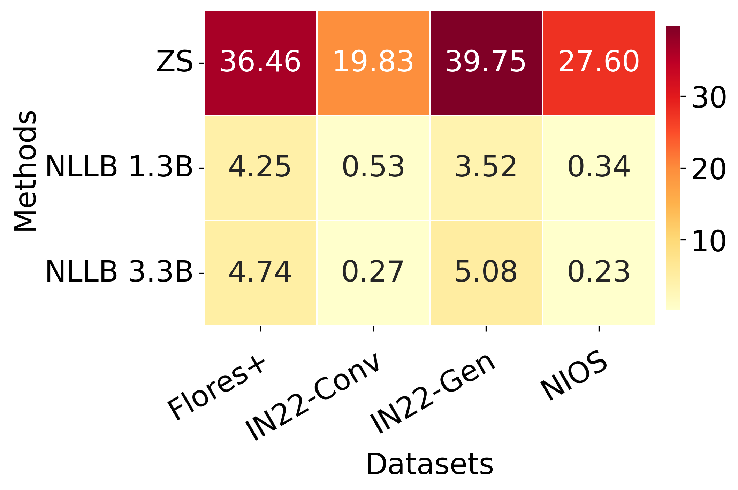
Hallucination Heatmap

