Slide 1
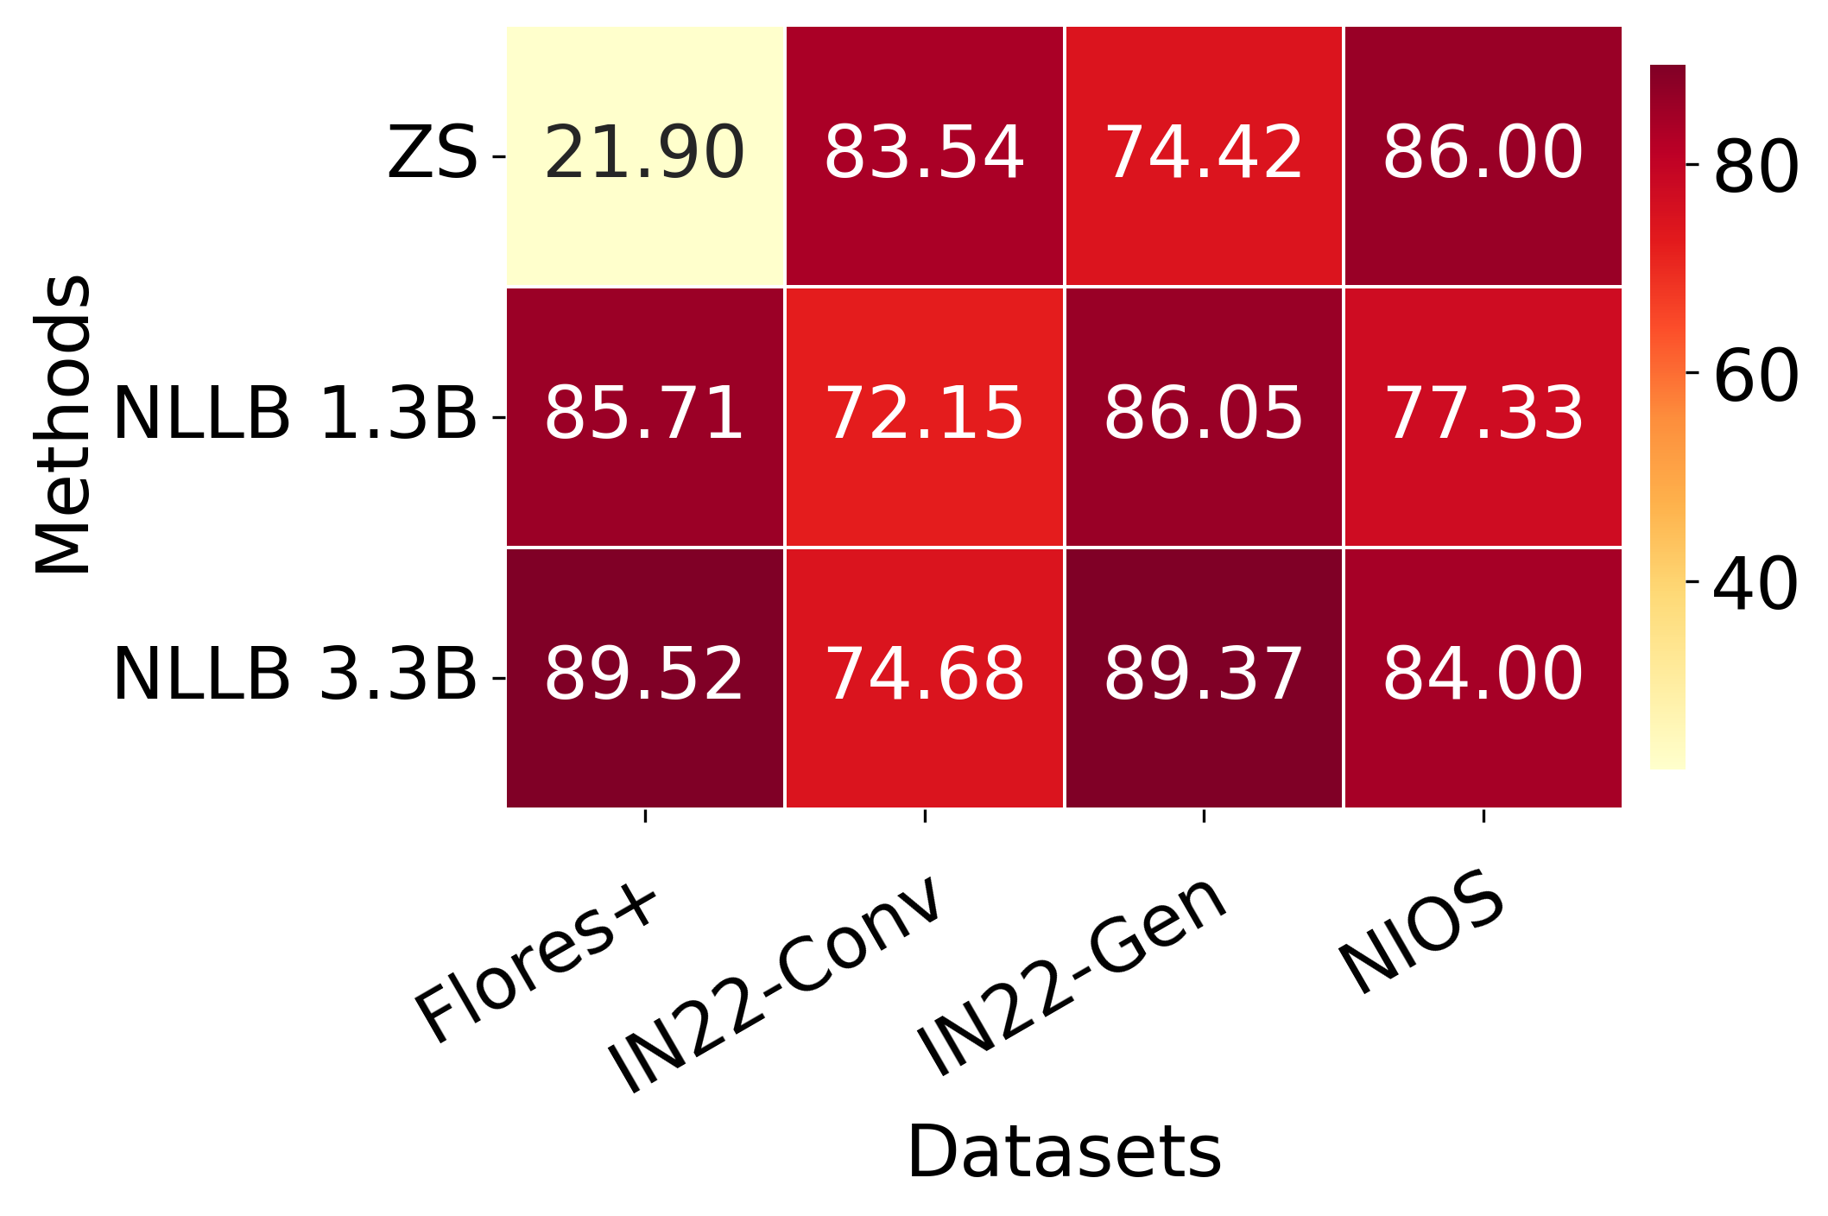
Numeral Accuracy Heatmap

