Slide 1
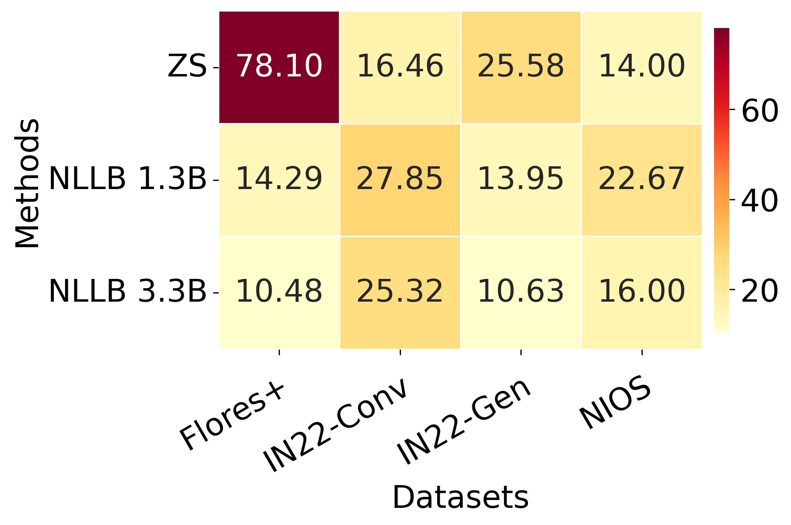
Numeral Error Rate Heatmap

