Slide 1
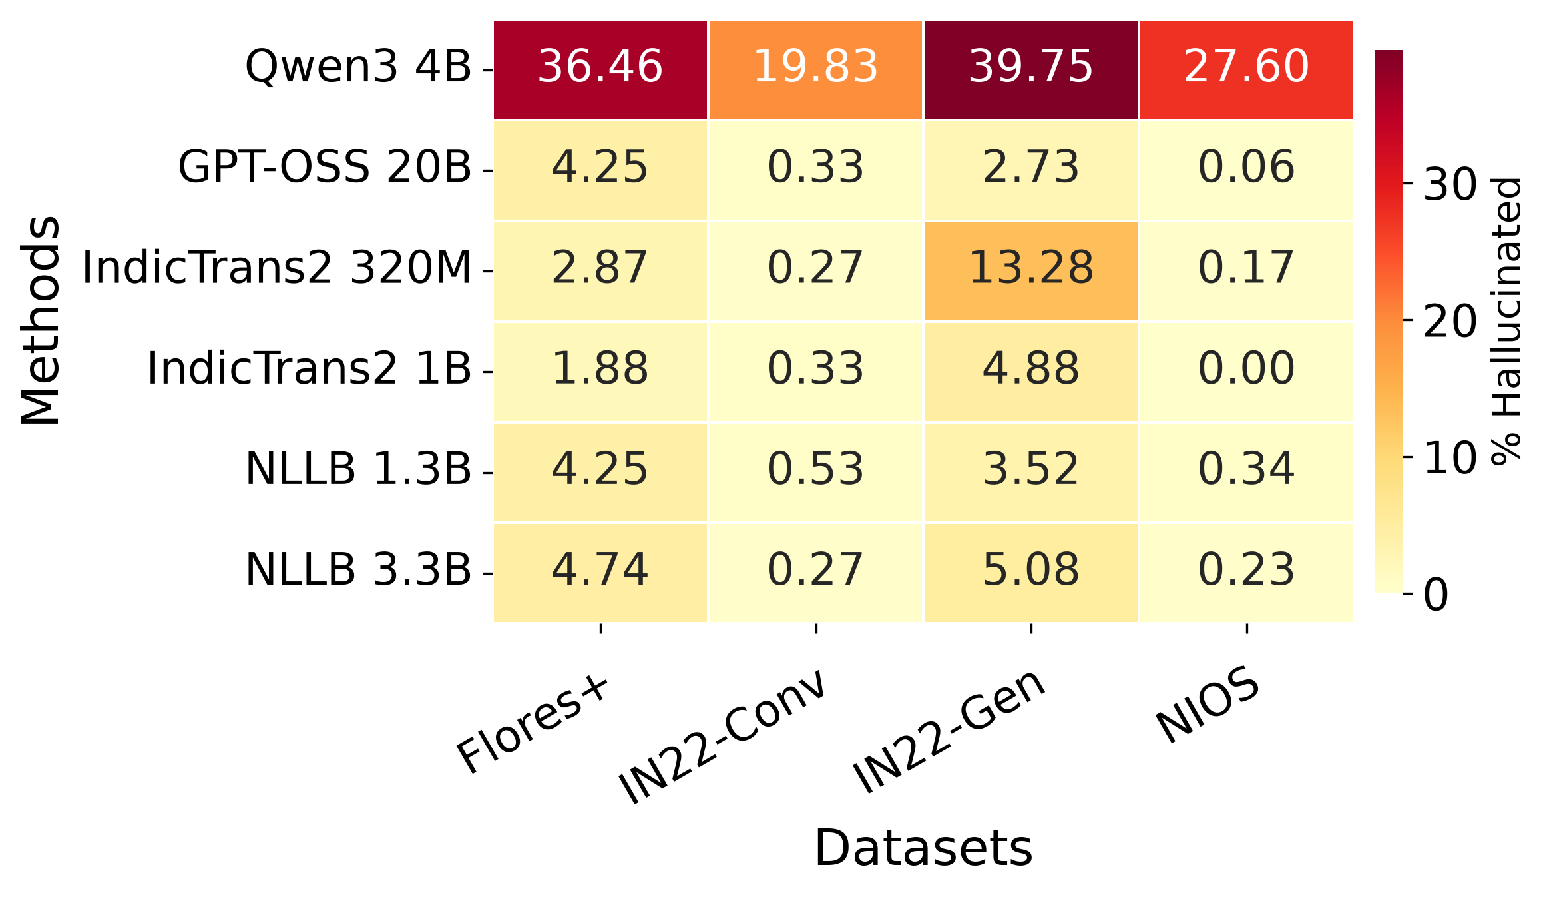
Script Hallucination Heatmap (%)

