Slide 1

ARM Assembly Language Programming
Amrita School Of Engineering, Bangalore Campus

Slide 2
PREVIOUSLY
Programmer’s Model
Instruction Set

Slide 3
TODAY…
Data processing instruction

Slide 4
DATA PROCESSING INSTRUCTION
Basically operations are arithmetic, logical or movement of data.
All operands are 32 bit wide
If any result is obtained that is 32 bit wide stored in destination register.
3 address instruction format.

Slide 5
ADDITION
ADD r0,r1,r2 ;r0 = r1 + r2
ADC r0,r1,r2 ;r0 = r1 + r2 + C( where is C??)
SUB r0,r1,r2 ;r0 = r1 - r2
SBC r0,r1,r2 ;r0 = r1 - r2 + C - 1 (B=~C)
RSB r0,r1,r2 ; r0 = r2 – r1;
RSC r0,r1,r2 ;r0 = r2 – r1 + C -1

Slide 6
BIT WISE LOGICAL OPERATION
AND r0,r1,r2 ;r0 = r1 & r2
ORR r0,r1,r2 ;r0 = r1 | r2
EOR r0,r1,r2 ;r0 = r1 ^ r2
BIC r0,r1,r2 ;r0 = r1 &(~r2)
  BIC – Bit Clear

Slide 7
REGISTER MOVEMENT OPERATIONS
MOV r0,r1 ;r0 ← r1
MVN r0,r1 ;r0 ← (~r1)
  Move negated

Slide 8
COMPARISON OPERATION
These instruction does not produce result instead they set conditional codes(N, Z, C, V)
CMP r1,r2 ;set cc on r1 – r2
CMN r1,r2 ;set cc on r1 + r2
TST r1,r2 ;set cc on r1 & r2 (bit test)
TEQ r1,r2 ;set cc on r1 ^ r2 (test equal)

Slide 9
IMMEDIATE OPERANDS
ADD r3,r3,#1
AND r8,r7,# &FF
# notation used for immediate field
& notation is used for representing hexadecimal numbers
How many bit immediate possible ??
  Covered later…

Slide 10
SHIFTED REGISTER OPERANDS
ADD r3,r2,r1,LSL #3 ;r3 = r2 + (8xr1)
Various shifting operations are
  LSL – logical shift left
  LSR – logical shift right
  ASL – Arithmetic shift left = LSL
  ASR – Arithmetic shift right
  ROR – Rotate right
  RRX – Rotate right extended by 1 place
Register values can be used to specify the number of bits to be shifted
  ADD r5,r5,r3, LSL r2 ; r5 = r5+r3x(2^r2)

Slide 11
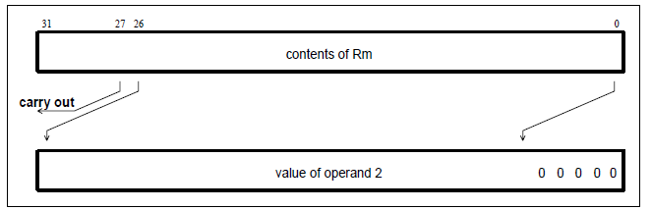
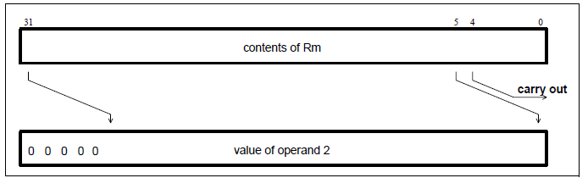
SHIFTING
Logical Shift Left
Logical Shift Right

Slide 12
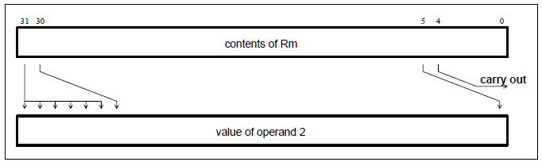
CONTD…
Arithmetic Shift Right

Slide 13
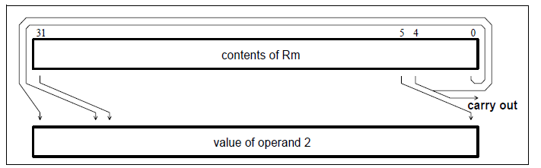
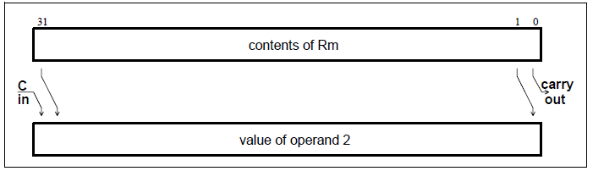
CONTD…
Rotate Right
Rotate Right Extended

Slide 14
SETTING THE CONDITION CODES
Any data processing instruction can set the condition codes if programmer wishes to
Just add ‘S’ in the instruction
S stands for set condition code
ADDS r2,r2,r0
Arithmetic instruction set – N,Z,C,V
Logical and move instruction set – N,Z

Slide 15
CONDITION EXECUTION
An unusual feature for ARM instruction is that every instruction can be executed conditionally
Similar to conditional branches ARM extends this to all its instruction
To execute an instruction conditionally, simply postfix it with the appropriate condition

Slide 16
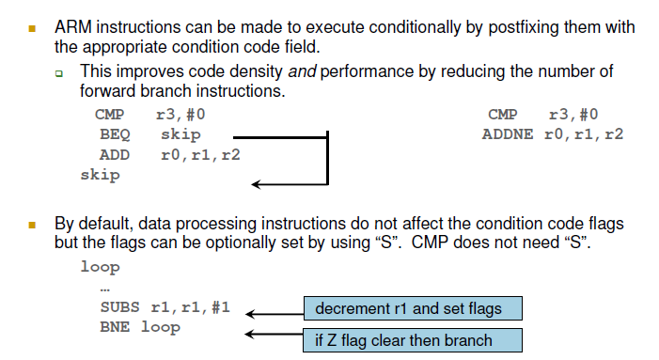
CONTD…

Slide 17
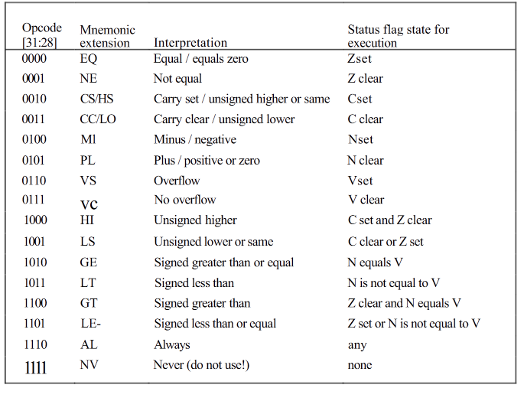
COND FIELD
A.A. Nippun Kumaar,ASE Bangalore

Slide 18
COND FIELD
NV: The 'never' condition (NV) should not be used - there are plenty of other ways to write no-ops (instructions that have no effect on the processor state) in ARM code.
The reason to avoid the 'never' condition is that (read the book page no. 125 just before table 5.3)

Slide 19
COND FIELD
Alternative mnemonics: There is more than one way to interpret the condition field.
CS or HS:Both cause the instruction to be executed only if the C bit in the CPSR is set.
  The alternatives are available because the same test is used in different circumstances. If you have previously added two unsigned integers and want to test whether there was a carry-out from the addition, you should use CS.
  If you have compared two unsigned integers and want to test whether the first was higher or the same as the second, use HS.
The alternative mnemonic removes the need for the programmer to remember that an unsigned comparison sets the carry on higher or the same.

Slide 20
EXAMPLES OF CONDITIONAL EXECUTION
Use a sequence of several conditional instructions
if (a==0) func(1);
Set the flags, then use various condition codes
if (a==0) x=0;
if (a>0) x=1;
Use conditional compare instructions
if (a==4 || a==10) x=0;
CMP r0,#0
MOVEQ r0,#1
BLEQ func
CMP r0,#0
MOVEQ r1,#0
MOVGT r1,#1
CMP r0,#4
CMPNE r0,#10
MOVEQ r1,#0

Slide 21
EXAMPLE: CONDITIONAL INSTRUCTION
(Later)
true block
MOVLT r0,#5 ; generate value for x
ADRLT r4,x ; get address for x
STRLT r0,[r4] ; store x
ADRLT r4,c ; get address for c
LDRLT r0,[r4] ; get value of c
ADRLT r4,d ; get address for d
LDRLT r1,[r4] ; get value of d
ADDLT r0,r0,r1 ; compute y
ADRLT r4,y ; get address for y
STRLT r0,[r4] ; store y
We will revisit this slide.

Slide 22
INSTRUCTION ENCODING

Slide 23
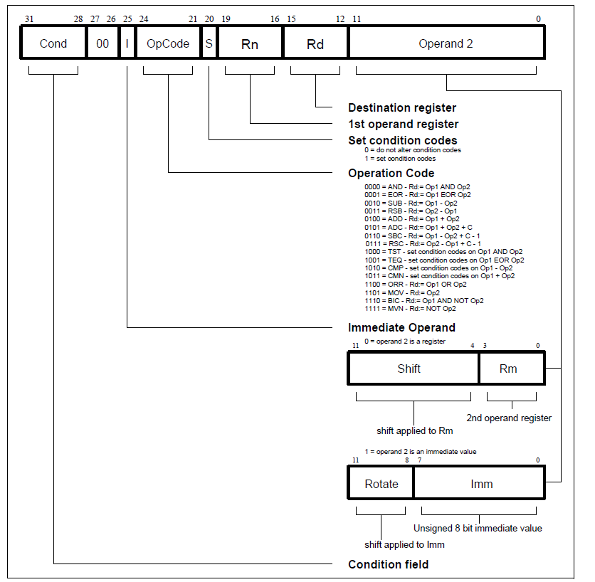

Slide 24

ARM IMMEDIATE VALUE ENCODING
The ARM instruction set encodes immediate values in an unusual way.
Despite only using 12 bits of instruction space, the immediate value can represent a useful set of 32-bit constants.
ARM doesn't use the 12-bit immediate value as a 12-bit number. Instead, it's an 8-bit number with a 4-bit rotation, like this:

Slide 25
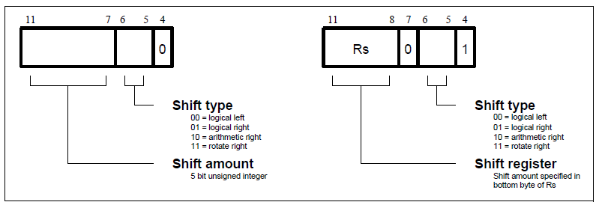
SHIFTING (When second operand is register)

Slide 26
SHIFT AMOUNT
Only the least significant byte of the contents of Rs is used to determine the shift amount. Rs can be any general register other than R15.
If this byte is zero, the unchanged contents of Rm will be used as the second operand, and the old value of the CPSR C flag will be passed on as the shifter carry output.
If the byte has a value between 1 and 31, the shifted result will exactly match that of an instruction specified shift with the same value and shift operation.

Slide 27
SPECIAL CASE
LSL #0 is a special case, where the shifter carry out is the old value of the CPSR C flag. The contents of Rm are used directly as the second operand.
LSR #0 & ASR #0 is Equated to LSL #0 by assembler
If shift value is greater than or equal to 32 ??

Slide 28
CONTD…
LSL by 32 has result zero, carry out equal to bit 0 of Rm.
LSL by more than 32 has result zero, carry out zero.
LSR by 32 has result zero, carry out equal to bit 31 of Rm.
LSR by more than 32 has result zero, carry out zero.
ASR by 32 or more has result filled with and carry out equal to bit 31 of Rm.

Slide 29
CONTD…
ROR by 32 has result equal to Rm, carry out equal to bit 31 of Rm.
ROR by n where n is greater than 32 will give the same result and carry out as ROR by n-32; therefore repeatedly subtract 32 from n until the amount is in the range 1 to 32 and see above.
(take a small example and work it out as HW)

Slide 30
MULTIPLY
Difference from other Arithmetic instruction
  Immediate second operand are not supported
  Result register must not be same as first source register
  Multiply give 64bit result, least 32 bit is stored in result register rest is ignored
  However multiply long instruction can store all 64 bit result.

Slide 31
CONTD…
The Basic ARM provides two multiplication instructions.
Multiply
  MUL{<cond>}{S} Rd, Rm, Rs ; Rd = Rm * Rs
Multiply Accumulate - does addition for free
  MLA{<cond>}{S} Rd, Rm, Rs,Rn ; Rd = (Rm * Rs) + Rn

Slide 32
MULTIPLY-LONG AND
MULTIPLY-ACCUMULATE LONG
Instructions are
  MULL which gives RdHi,RdLo:=Rm*Rs
  MLAL which gives RdHi,RdLo:=(Rm*Rs)+RdHi,RdLo
However the full 64 bit of the result now matter (lower precision multiply instructions simply throws top 32bits away)
  Need to specify whether operands are signed or unsigned
Therefore syntax of new instructions are:
  UMULL{<cond>}{S} RdLo,RdHi,Rm,Rs
  UMLAL{<cond>}{S} RdLo,RdHi,Rm,Rs
  SMULL{<cond>}{S} RdLo, RdHi, Rm, Rs
  SMLAL{<cond>}{S} RdLo, RdHi, Rm, Rs

Slide 33
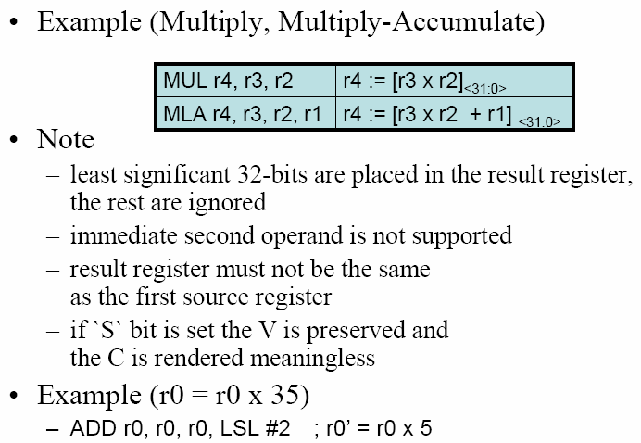
EXAMPLE

Slide 34
EXAMPLE (quick Quiz)
Can you do r0 = 5 r0
Can you do r0 = 7 r0
ADD r0, r0, r0, LSL #2 :=5xr0
RSB r0, r0, r0, LSL #3 : = 7xr0

Slide 35
SUMMARY
MUL r4,r3,r2 ; r4 = r3 x r2 [31:0]
MLA r4,r3,r2,r1; r4 = r3 x r2 +r1 [31:0]
UMULL; rdHi:rdLo = Rm x Rs
UMLAL; rdHi:rdLo += Rm x Rs
SMULL; rdHi:rdLo = Rm x Rs
SMLAL; rdHi:rdLo += Rm x Rs

Slide 36
THANK YOU

