Slide 1





Meeting Memory
v4 — Complete Overview
Business case, architecture, code, and live proof — one fully local pipeline, zero cloud inference.
Business
Architecture
Memory
Proof
What's next
Shubham Gaur · July 2026

Slide 2
EXECUTIVE SUMMARY
What This Is, In One Slide
A meeting-memory system: Gmail, Calendar, and Jira flow in through Airbyte, get turned into a queryable knowledge graph, and feed back into Jira and an autonomous coding agent
Runs entirely on one MacBook — no cloud LLM, no cloud database, no per-token billing after the Airbyte sync
The graph doesn't just store meetings — it computes influence (PageRank), remembers durable facts, decays stale context, recognizes workflows, and answers natural-language questions, grounded in real data
4
$0
126
12
iterations to get here
marginal cost / meeting
automated tests
Docker/agent services
Meeting Memory v4 — Complete Overview
2 / 27

Slide 3
WHY THIS EXISTS
The Problem, in Business Terms
Lost institutional knowledge
Manual reconciliation tax
Cloud LLM spend + exposure
Decisions and commitments live in scattered docs and Slack threads, then vanish. Nobody can reconstruct who agreed to what.
Someone re-reads transcripts to write Jira tickets. Every hour spent here is an hour not spent building.
Every extraction call to a hosted model is a per-token bill AND a copy of your meeting content leaving the building.
Meeting Memory v4 — Complete Overview
3 / 27

Slide 4
HISTORY
Four Iterations to Get Here
v1
Python + Obsidian vault
Manual notes, no structure, nothing queryable
v2
n8n + Confluence + Jira
Workflow automation, still no graph, no memory
v3
Airbyte Cloud + Render + Groq + Memgraph Cloud
First real graph — but 4 paid cloud services, data left the building on every call
v4
Airbyte Cloud + local Postgres + LM Studio + local Memgraph
Same ingestion backbone, everything else pulled onto one Mac
v3 → v4 is not a rewrite — it's every cloud dependency swapped for a local equivalent, one at a time.
Meeting Memory v4 — Complete Overview
4 / 27

Slide 5
BUSINESS CASE
Why Fully Local — What v3 Cost Us
Removed since v3
What that buys
Render.com — paid hosting, gone
Groq API — per-token billing, gone
Memgraph Cloud — managed DB fee, gone
Neon Postgres — managed DB fee, gone
ngrok — tunnel dependency, gone
Ollama — replaced by LM Studio
Slack connector — no signal, cut
Zero marginal cost per extraction — no per-token bill, ever
No meeting content leaves the Mac after the Airbyte sync — nothing to review for a data-processing agreement
No cloud outage takes the pipeline down mid-demo
Airbyte Cloud is the one dependency kept — because it's the right tool for ingestion, not a cost center
Meeting Memory v4 — Complete Overview
5 / 27

Slide 6




BUSINESS CASE
Why Airbyte Stays
300+ connectors, zero code
Gmail, Calendar, and Jira are all production connectors — no auth boilerplate, no pagination logic, no schema maintenance to own.
Incremental + Append+Dedup
Every sync moves only new data. processed_flag gives the graph builder exactly-once semantics on top of that.
Webhook-driven, fully automated
Airbyte fires a webhook on sync completion — the transform service wakes up and the graph updates with zero manual trigger.
Bidirectional, not just a source
Airbyte also reads Jira issues back in — the same sync that pulls meetings closes the loop on ticket status.
Meeting Memory v4 — Complete Overview
6 / 27

Slide 7
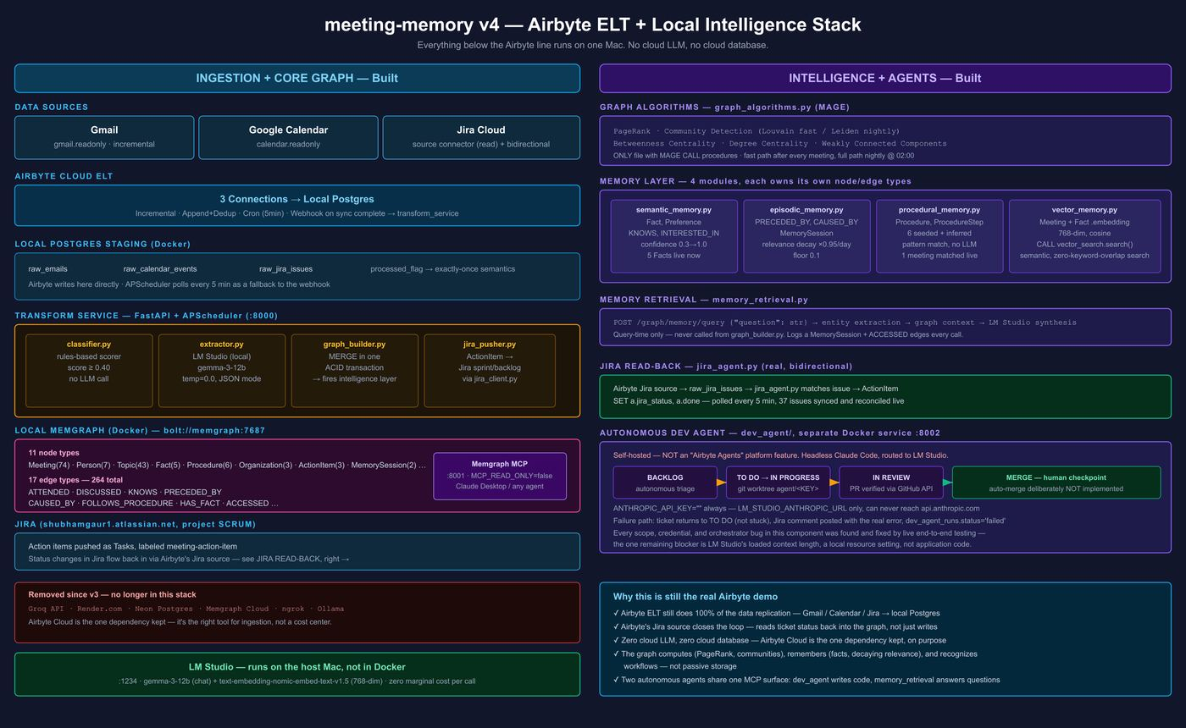
Meeting Memory v4 — Complete Overview
7 / 27

Slide 8
SYSTEM DESIGN
Architecture — Services & Ports
Postgres
:5432
transform_service
FastAPI :8000
Memgraph
Bolt :7687
Lab :3000
MCP :8001
LM Studio
:1234 (host)
dev_agent :8002 (own service, polls Jira via REST, opens PRs via GitHub API)
MEMGRAPH_HOST=memgraph MEMGRAPH_PORT=7687
LM_STUDIO_BASE_URL=http://host.docker.internal:1234/v1
LM_STUDIO_MODEL=gemma3-12b
LM_STUDIO_EMBEDDING_MODEL=text-embedding-nomic-embed-text-v1.5
POSTGRES_HOST=postgres POSTGRES_PORT=5432
Data flow
Airbyte Cloud → Postgres (raw_emails, raw_calendar_events, raw_jira_issues)
APScheduler polls every 5 min + POST /webhook/airbyte on sync complete
graph_builder.py: classify → extract → MERGE Cypher tx → algorithms → memory → Jira push
processed_flag column gives exactly-once semantics per row
Meeting Memory v4 — Complete Overview
8 / 27

Slide 9
SCHEMA
Graph Data Model
Node types (11)
Edge types (17)
Meeting {id, date, title, kind,
platform, duration_minutes,
relevance_weight, embedding[768]}
Person {email, name, pagerank_score,
community_id, betweenness_centrality}
Topic, Decision, ActionItem, Organization
Fact {id, text, confidence, embedding}
Preference {category, value, confidence}
Procedure, ProcedureStep, MemorySession
ATTENDED {role} DISCUSSED PRODUCED
ASSIGNED_TO WORKS_AT FOLLOWS_UP
HAS_FACT PREFERS
KNOWS {weight} INTERESTED_IN {weight}
PRECEDED_BY {gap_days}
CAUSED_BY {confidence}
FOLLOWS_PROCEDURE {confidence}
HAS_STEP NEXT_STEP {condition}
ACCESSED
All nodes: id (uuid5, deterministic) · created_at · updated_at
Writes: MERGE only, never CREATE, for uniquely-keyed nodes.
Multi-node writes batched in one Cypher transaction (ACID).
Constraints: UNIQUE on Meeting.id, Person.email, Topic.name,
Decision.id, ActionItem.id, Organization.domain,
Fact.id, Preference.id, Procedure.id, ProcedureStep.id,
MemorySession.id
KNOWS is stored in one canonical direction
(lexicographic email order) — query with (a)-[:KNOWS]-(b)
Meeting Memory v4 — Complete Overview
9 / 27

Slide 10
TRANSFORM_SERVICE/
Ingestion Pipeline — Real Code
classifier.py
classify(text, meta) -> float — rules-based, no LLM. Threshold: score >= 0.40 proceeds.
extractor.py
extract_meeting() — LM Studio JSON-mode, temperature=0.0, @with_retry(max_attempts=3, base_delay=2.0)
graph_builder.py
process_email/process_calendar_event — single try block: classify → extract → graph → algorithms → memory → Jira
memgraph_client.py
The ONLY file with Cypher. upsert_meeting_graph() batches Meeting+Person+Org+Topic+Decision+ActionItem in one tx()
MERGE (m:Meeting {id: $id})
ON CREATE SET m.created_at = $now, m.relevance_weight = 1.0
SET m.title = $title, m.kind = $kind, m.embedding = $vec ...
// Person, Org, Topic, Decision, ActionItem MERGEs follow,
// all inside the same tx.run() block — commit or rollback together
Meeting Memory v4 — Complete Overview
10 / 27

Slide 11
GRAPH_ALGORITHMS.PY — ONLY FILE WITH MAGE CALL
Graph Algorithms — Actual MAGE Calls
CALL pagerank.get()
YIELD node, rank SET node.pagerank_score = rank
CALL community_detection.get() -- fast path (Louvain)
YIELD node, community_id SET node.community_id = community_id
CALL igraphalg.community_leiden() -- nightly path (accurate)
YIELD node, community_id SET node.community_id = community_id
CALL betweenness_centrality.get()
YIELD node, betweenness_centrality SET node.betweenness_centrality = ...
CALL degree_centrality.get()
YIELD node, degree AS degree_centrality SET node.degree_centrality = ...
CALL weakly_connected_components.get()
YIELD node, component_id SET node.wcc_id = component_id
Trigger points
Fast path — after every processed meeting, in graph_builder.py's try block
Full path — nightly cron, 02:00, via APScheduler in main.py lifespan
Each CALL wrapped in its own try/except — one algorithm failing never aborts the others
result.consume() called explicitly — the async driver defers execution otherwise, misattributing errors to the next statement
Meeting Memory v4 — Complete Overview
11 / 27

Slide 12
NOT A MOCKUP — REAL OUTPUT, THIS SESSION
Graph Algorithms — Live Results
PageRank leaderboard
Community detection
person pagerank community
Femi Oduwole 0.0047 11
Matteo Vaiente 0.0045 4
Matteo 0.0045 4
Femi Oduwole 0.0037 4
Mark Johnston 0.0037 4
Phil Loranger 0.0037 4
Jacob Barka 0.0037 11
community members
5 42
4 22
11 17
-1 11
9 9
6 6
Real clusters, not one blob or all-singletons — Louvain found actual structure in 74 real meetings.
MATCH (p:Person) WHERE p.pagerank_score IS NOT NULL
RETURN p.name, p.pagerank_score ORDER BY ... DESC
This ran live in this session via graph_algorithms.run_fast_algorithms() — the exact function graph_builder.py calls after every real meeting.
Femi Oduwole appears twice — same person, two attendee records from different meetings, not deduplicated on name. Real data, real rough edge.
Meeting Memory v4 — Complete Overview
12 / 27

Slide 13
SEMANTIC_MEMORY.PY · EPISODIC_MEMORY.PY
Memory — The Actual Formulas
Fact confidence
Relevance decay
ON CREATE f.confidence = 0.3
ON MATCH f.confidence = min(1.0,
f.confidence + 0.1)
-- nightly consolidation:
WHERE f.source_count % 3 = 0
SET f.confidence = min(1.0,
f.confidence + 0.2)
-- nightly, decay_relevance():
SET m.relevance_weight = CASE
WHEN relevance_weight IS NULL
THEN 1.0
WHEN relevance_weight <= 0.1
THEN 0.1 -- floor
ELSE relevance_weight * 0.95
END
KNOWS / INTERESTED_IN: ON MATCH SET weight = weight + 1, pure Cypher, no LLM call
PRECEDED_BY.gap_days = (date($meeting_date) - date(prior.date)).day
(Memgraph has no duration.inDays — use date subtraction)
Preference: starts 0.5, same +0.1 reconfirm rule
CAUSED_BY: only when follow_up_needed=true, capped at 1 link/meeting, >50% word overlap required
Meeting Memory v4 — Complete Overview
13 / 27

Slide 14
VECTOR_MEMORY.PY
Vector Search — Real Cypher
CREATE VECTOR INDEX meeting_embedding_idx
ON :Meeting(embedding)
WITH CONFIG {"dimension": 768,
"capacity": 2048,
"metric": "cos"}
CALL vector_search.search(
$index_name, $limit, $query_vector)
YIELD node, similarity, distance
RETURN node.id, similarity
ORDER BY similarity DESC
Pipeline
embed_text() → LM Studio /v1/embeddings, text-embedding-nomic-embed-text-v1.5, 768-dim
embed_meeting() writes Meeting.embedding on ingestion
embed_facts_for_meeting() embeds only Facts missing embeddings — idempotent
graph_algorithms.vector_search() is the only place CALL vector_search.* appears
backfill_embeddings() — one-off, for pre-existing data
Meeting Memory v4 — Complete Overview
14 / 27

Slide 15
DEV_AGENT/ — SEPARATE DOCKER SERVICE, :8002
Dev Agent — State Machine
BACKLOG
TO DO
IN PROGRESS
IN REVIEW
MERGED
description != ''
no skip label
autonomous
triage
git worktree
agent/<KEY>
PR opened
GitHub verified
human
checkpoint
ANTHROPIC_API_KEY="" # LM Studio only, never api.anthropic.com
LM_STUDIO_ANTHROPIC_URL=http://host.docker.internal:1234
DEV_AGENT_MAX_ATTEMPTS=1 DEV_AGENT_MAX_TURNS=40
DEV_AGENT_TIMEOUT_SECONDS=1800 DEV_AGENT_POLL_MINUTES=10
PR verification is independent — GitHub API confirms the PR exists, never trusts the agent's own claim
Failure path: ticket returns to TO DO (not stuck in IN PROGRESS), Jira comment posted, dev_agent_runs.status='failed'
Auto-merge deliberately NOT implemented — human review is the one remaining checkpoint
Meeting Memory v4 — Complete Overview
15 / 27

Slide 16
THE GAP DEV_AGENT DOESN'T COVER
Action Agent — What It Solves
dev_agent only works engineering tickets — real code changes, a real PR. Every meeting also produces action items that aren't code: "follow up with Matteo", "share the webhook docs", "review the budget adjustments"
Those got pushed to Jira by jira_pusher.py, labeled meeting-action-item, and then — nothing. dev_agent correctly skips them. Nobody else was working them.
action_agent.py closes that gap: it picks up exactly the tickets dev_agent is designed to ignore, drafts the real deliverable grounded in graph context, and hands it to a human to approve
Two agents, zero overlap
dev_agent engineering tickets -> git worktree, PR, IN REVIEW
action_agent everything else -> drafted comment, IN REVIEW
Meeting Memory v4 — Complete Overview
16 / 27

Slide 17
TRANSFORM_SERVICE/ACTION_AGENT.PY — THE ONLY FILE USING AIRBYTE-AGENT-SDK
Action Agent — Pipeline
FIND
GUARD
CONTEXT
DRAFT
COMMENT
TRANSITION
To Do +
meeting-action-item
marker comment?
skip to transition
memory_retrieval
.full_memory_query()
LM Studio
(local, temp=0.0)
post_draft()
ADF + marker
To Do ->
In Review
Airbyte Agents SDK is a tool layer, not a hosted brain
BYO-LLM by design — the SDK gives typed Jira operations (search, comment, transition); LM Studio does 100% of the reasoning. No exception to the no-cloud-LLM rule.
Idempotency: ACTION_AGENT_MARKER in the comment body gates retries — a partial failure (comment posted, transition didn't) re-enters at TRANSITION, never double-drafts
AIRBYTE_AGENTS_CLIENT_ID/SECRET are deliberately separate from AIRBYTE_CLIENT_ID/SECRET (Airbyte Cloud ELT) — different product, credentials never conflated
Meeting Memory v4 — Complete Overview
17 / 27

Slide 18
TASK-LEVEL REVIEW APPROVED EVERY TASK. LIVE TESTING DIDN'T LIE.
Built With Rigor, Not Just Built
6 tasks, 6 reviews
Every task passed spec + quality review against mocked tests
Live run: instant failure
'Issue' object has no attribute 'get' — first real Jira call, first try
Root cause found
The SDK returns typed Pydantic models. Dicts AND MagicMock both silently support .get() — every mock hid the exact mismatch
Fixtures rebuilt, fixed for real
Tests now construct real SDK model instances. 126/126 green, then a live run against the real board succeeded
AttributeError: 'Issue' object has no attribute 'get'
# find_eligible_tickets: rec.get("fields") -> rec.fields
# has_agent_draft: comment.get("body") -> getattr(comment, "body", None)
# transition_to_review: t.get("to") -> getattr(t, "to", None)
Meeting Memory v4 — Complete Overview
18 / 27

Slide 19
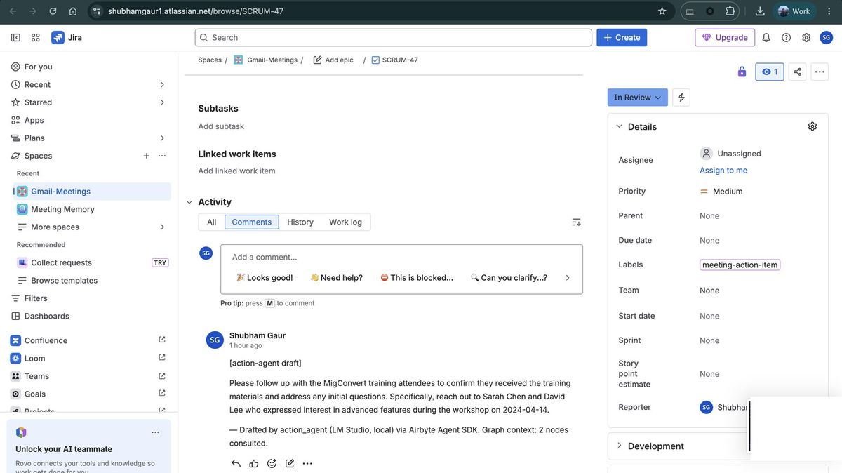
REAL TICKET, REAL BOARD — SHUBHAMGAUR1.ATLASSIAN.NET
Live Proof — Jira
SCRUM-47 — before -> after
To Do -> In Review
labels: meeting-action-item
+1 comment: [action-agent draft]
What the agent actually wrote
“Reach out to Sarah Chen and David Lee who expressed interest in advanced features during the workshop on 2024-04-14.”
Real names, real date — from 2 graph nodes consulted, not generic filler
Meeting Memory v4 — Complete Overview
19 / 27

Slide 20
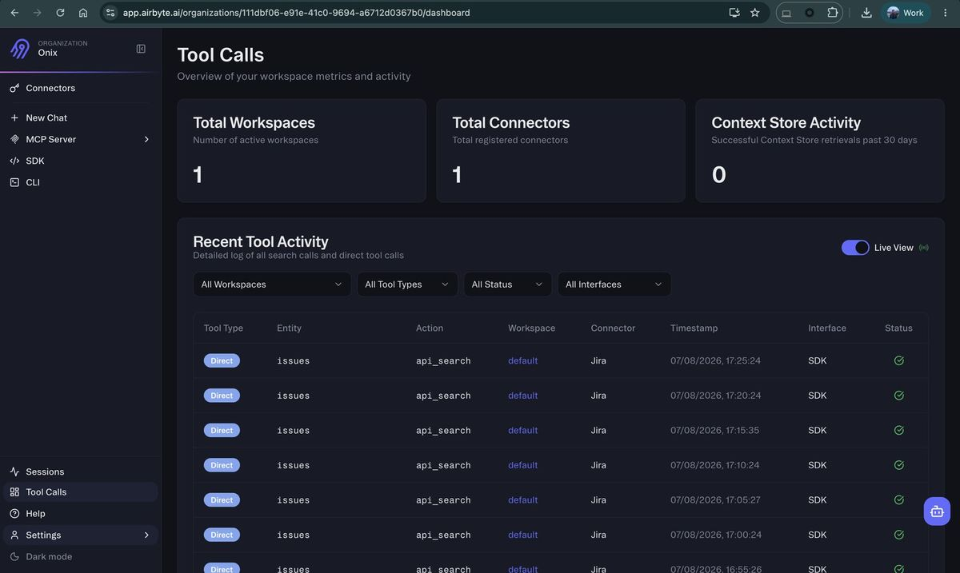
APP.AIRBYTE.AI — ORG ONIX, TOOL CALLS (NOT SESSIONS)
Live Proof — Airbyte Agents Dashboard
Every SDK call, logged by Airbyte
issues / api_search
issue_comments / list
issue_comments / create
issue_transitions / list
issue_transitions / create
“Sessions” tracks Airbyte's own web-chat UI — a different feature. “Tool Calls” is what our SDK code triggers, and it's exactly what we wanted to see.
Meeting Memory v4 — Complete Overview
20 / 27

Slide 21
JIRA_PUSHER.PY · JIRA_AGENT.PY · ACTION_AGENT.PY · MCP SERVERS
Bidirectional Jira, One-Turn Agent Access
Jira loop — three components now
MCP tool surface
jira_pusher.py ActionItem -> Jira issue
Airbyte Jira src -> raw_jira_issues (Postgres)
jira_agent.py issue -> ActionItem.jira_status
action_agent.py drafts + resolves the rest
memgraph MCP (MCP_READ_ONLY=false)
run_query, get_schema,
get_node_neighborhood,
search_node_vectors, get_page_rank
jira MCP
jira_get, jira_post,
jira_put, jira_patch, jira_delete
All Jira REST calls live in jira_client.py — no exceptions. action_agent.py is the only one using the Airbyte Agent SDK instead.
One conversation, both MCPs — Claude Desktop hits Memgraph + Jira in the same turn
Meeting Memory v4 — Complete Overview
21 / 27

Slide 22
CLAUDE.MD — ENFORCED BY CONVENTION, NOT A LINTER
Module Boundaries & Absolute Rules
graph_algorithms.py is the ONLY file with MAGE CALL procedures
memgraph_client.py is the ONLY file with Cypher (plus the memory modules for their own node types)
db.py is the ONLY file with SQL
jira_client.py is the ONLY file with Jira REST calls (dev_agent and transform_service both use it)
action_agent.py is the ONLY file using airbyte-agent-sdk
action_agent.py must NEVER be called from graph_builder.py — memory_retrieval is query-time only
All Cypher writes: MERGE, never CREATE, for uniquely-keyed nodes
Multi-node writes: single Cypher transaction, never sequential driver calls
httpx.AsyncClient only — never synchronous requests
@with_retry(max_attempts=3, base_delay=2.0) on all external calls
dev_agent never defaults is_engineering_task to True when missing — fail safe
Auto-merge is not implemented — do not add it without explicit go-ahead
Meeting Memory v4 — Complete Overview
22 / 27

Slide 23

QUALITY & OPERABILITY
Testing & Ops
Testing
Ops surface (Makefile)
126 automated tests across 12 files, one per build phase (phase14 → phase27)
pytest + pytest-anyio, mocked Memgraph driver and LM Studio client — no live services needed to run the suite
Every new memory/algorithm module shipped with its own test file the same session it was written
make test runs the full suite inside the transform_service container
make up / down / logs / shell
make test # full pytest suite
make setup-memgraph # idempotent schema
make trigger # fire pipeline manually
make backfill # reprocess raw rows
make health # 3-service status check
make dev-agent-trigger / -triage / -runs
Meeting Memory v4 — Complete Overview
23 / 27

Slide 24
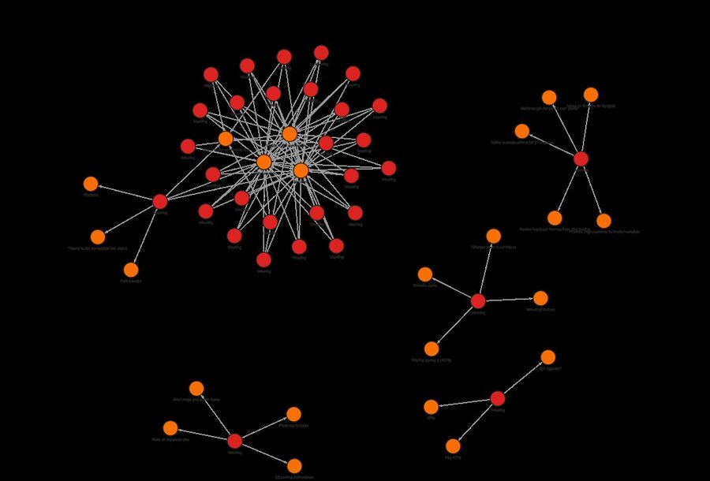
NOT A MOCKUP
This Is the Live Graph
"Who is responsible for testing automation?"
"Femi leads the QA automation initiative"
similarity = 0.649, cosine metric, zero keyword overlap
Live numbers, this session
126/126 tests passing
266 edges, 13 relationship types
74 meetings · 43 topics · 7 people
vector index size: 74 + 5 (Meeting+Fact)
MATCH (m:Meeting)-[r:DISCUSSED]->(t:Topic) RETURN m, r, t — 162 edges
Meeting Memory v4 — Complete Overview
24 / 27

Slide 25
LIVE STATUS
What's Working Right Now
126
74
266
768
tests passing
meetings
edges
embed dims
GET /graph/insights/influential | /communities | /bridges
GET /graph/search/meetings?q= | /graph/search/facts?q=
POST /graph/memory/query {"question": str}
GET /graph/memory/person/{email} | /graph/procedures
POST /webhook/airbyte — triggers full pipeline end to end
docker compose up — that's the entire deployment.
Meeting Memory v4 — Complete Overview
25 / 27

Slide 26



CLOSING
What This Demonstrates
A cost story, not just a tech demo
Four cloud services removed since v3 — zero marginal cost per meeting processed
Airbyte as the backbone — twice over
Airbyte Cloud does the ELT; Airbyte Agents gives action_agent its Jira tool layer. Two real products, both kept on purpose
Graph-native, self-aware memory
Not just storage — the graph ranks, remembers, decays, and reasons about itself
Three autonomous systems, one philosophy
dev_agent (code), action_agent (everything else), memory_retrieval (Q&A) — all autonomous up to a human checkpoint, never past it
Meeting Memory v4 — Complete Overview
26 / 27

Slide 27
WHERE THIS CAN GO
Built to Extend, Not Just to Demo
More Airbyte sources plug into the same classify → extract → graph flow with no architecture change
graph_algorithms.py, memory modules, and vector search are all additive layers on the same node/edge schema — nothing upstream was rewritten to add them
The MCP surface means any future agent gets read+write graph access on day one, not as a follow-up integration
docker compose up — that's the entire deployment.
Questions?
Shubham Gaur · meeting-memory-v4
Meeting Memory v4 — Complete Overview
27 / 27

