Slide 1





Meeting Memory
v4 — Graph Intelligence Layer
Advanced algorithms · semantic, episodic & procedural memory · vector search — built on the local-first pipeline, fully grounded, nothing leaves the Mac.
Algorithms
Semantic
Episodic
Procedural
Vector
Shubham Gaur · July 2026

Slide 2




WHERE WE LEFT OFF
The Pipeline You've Already Seen
Gmail · Calendar · Jira
This session adds
Airbyte Cloud, 3 connectors, incremental sync
5 graph algorithms
Durable fact memory
Temporal event chains
Auto-detected workflows
Semantic vector search
One NL query interface
Local Postgres
Docker, exactly-once processing
LM Studio + Gemma3:12b
Local extraction, zero cloud inference
Local Memgraph
Person · Meeting · Topic · Decision · ActionItem graph
Meeting Memory v4 — Graph Intelligence Layer
2

Slide 3
SYSTEM DESIGN
Full Architecture — Updated
Gmail
Calendar
Jira
Airbyte
Cloud
Local
Postgres
Transform
Service
LM Studio
gemma3 + nomic-embed
Memgraph 3.11.0 (memgraph-mage)
Memgraph Lab
3.11.0
Memgraph MCP
graph_algorithms.py — MAGE CALL procedures (only place)
semantic_memory.py — Fact, Preference, KNOWS
episodic_memory.py — PRECEDED_BY, decay, sessions
procedural_memory.py — Procedure, ProcedureStep
vector_memory.py — embeddings + vector_search
Standalone container · localhost:3000 · visual query + graph view
Docker sidecar · Claude Desktop / any agent, read+write
100% local — docker compose up. Zero cloud inference after Airbyte sync.
Meeting Memory v4 — Graph Intelligence Layer
3

Slide 4

WHAT'S NEW
The Graph Got Smarter
Same ingestion pipeline. Five new capabilities computed on top of it, automatically.
Advanced Algorithms
Semantic Memory
Episodic Memory
PageRank, community detection, betweenness & degree centrality — who actually matters.
Durable facts and preferences that persist and gain confidence over time.
Temporal chains between meetings, plus automatic relevance decay.
Procedural Memory
Vector Search
Memory Retrieval
Recognizes known workflows and discovers new recurring patterns on its own.
Semantic — not keyword — search over every meeting summary and fact.
One natural-language interface over all four layers, fully grounded.
Meeting Memory v4 — Graph Intelligence Layer
4

Slide 5
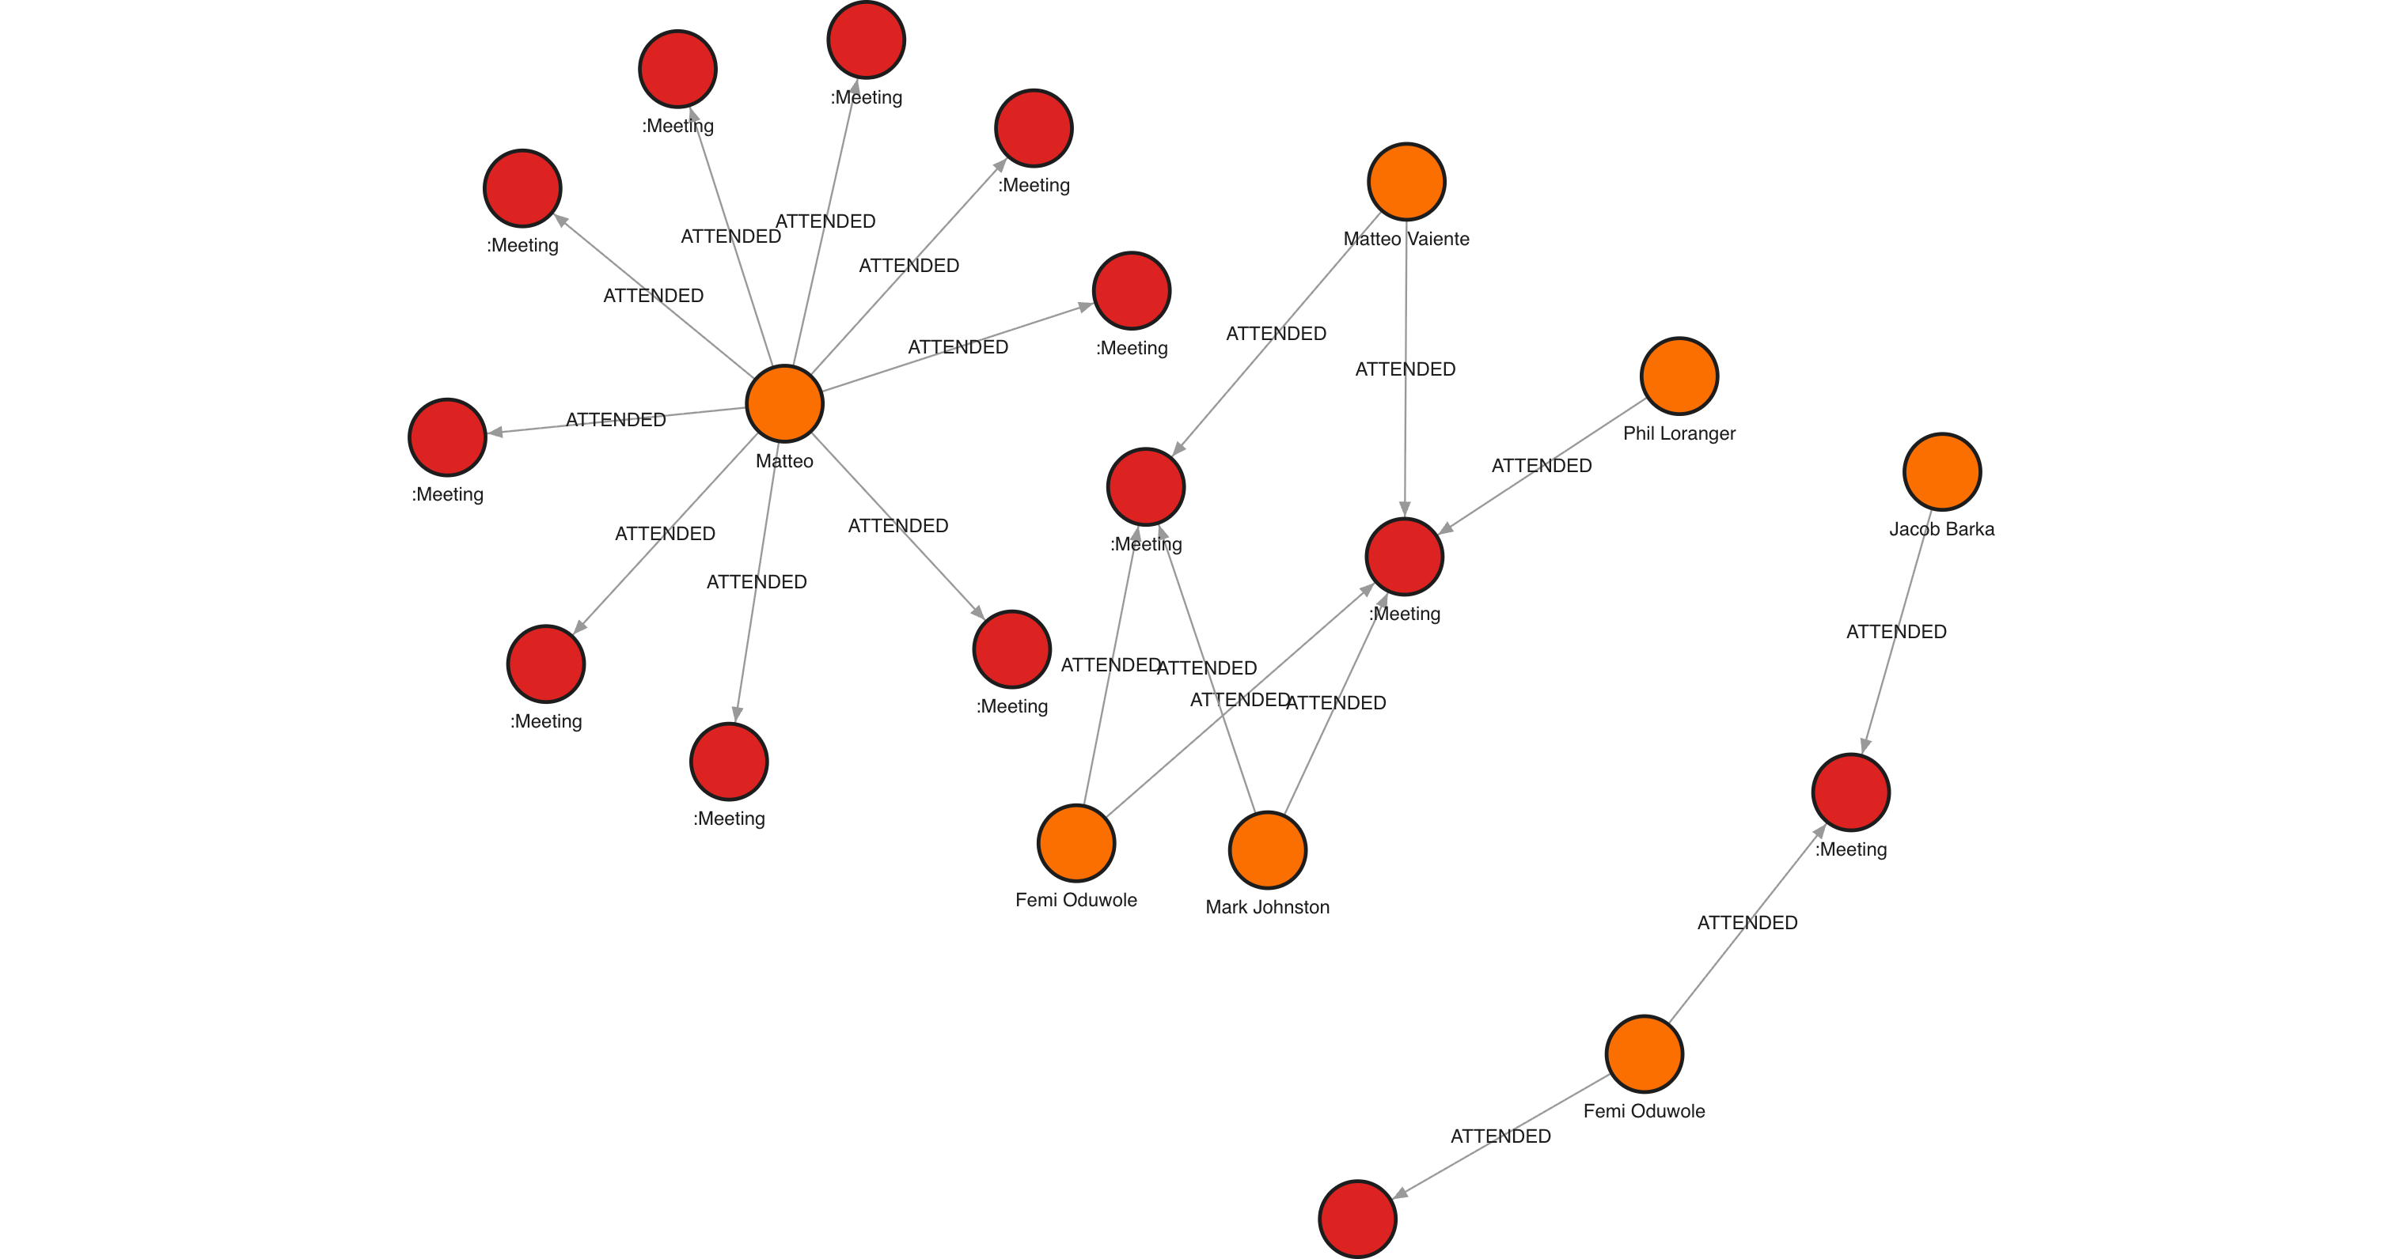
GRAPH ALGORITHMS
Who Actually Matters Here?
PageRank — the same algorithm Google used for web pages — applied to meeting attendance. Not “who attends the most meetings,” but “who's central to the meetings that matter.” Community detection groups people into teams automatically, no org chart required.
Top by PageRank (live)
1. Femi Oduwole — 0.00474
2. Matteo Vaiente — 0.00459
3. Mark Johnston — 0.00369
Real query · people sized/colored by PageRank, connected to their meetings
Meeting Memory v4 — Graph Intelligence Layer
5

Slide 6
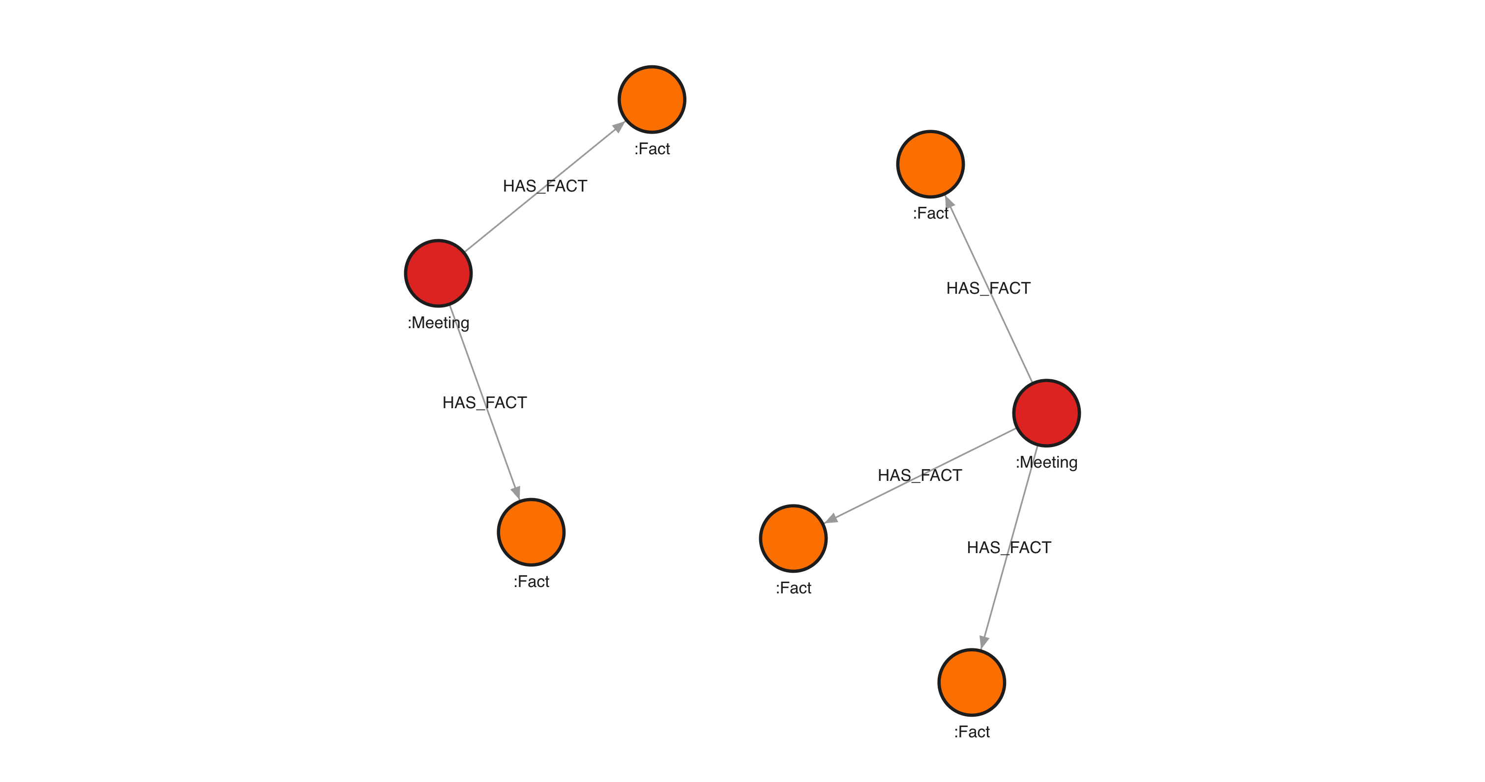
SEMANTIC MEMORY
The Graph Remembers Facts, Not Just Events
Every meeting summary is run through the local LLM to extract durable facts — not what happened, but what's now permanently true. Confidence rises every time a fact gets independently reconfirmed.
Live facts in the graph
“Femi leads the QA automation initiative”
“The QA AI pilot is ongoing at Canadian Blood Services”
“Jacob will own the integration with the test suite”
Real query · MATCH (m:Meeting)-[:HAS_FACT]->(f:Fact)
Meeting Memory v4 — Graph Intelligence Layer
6

Slide 7
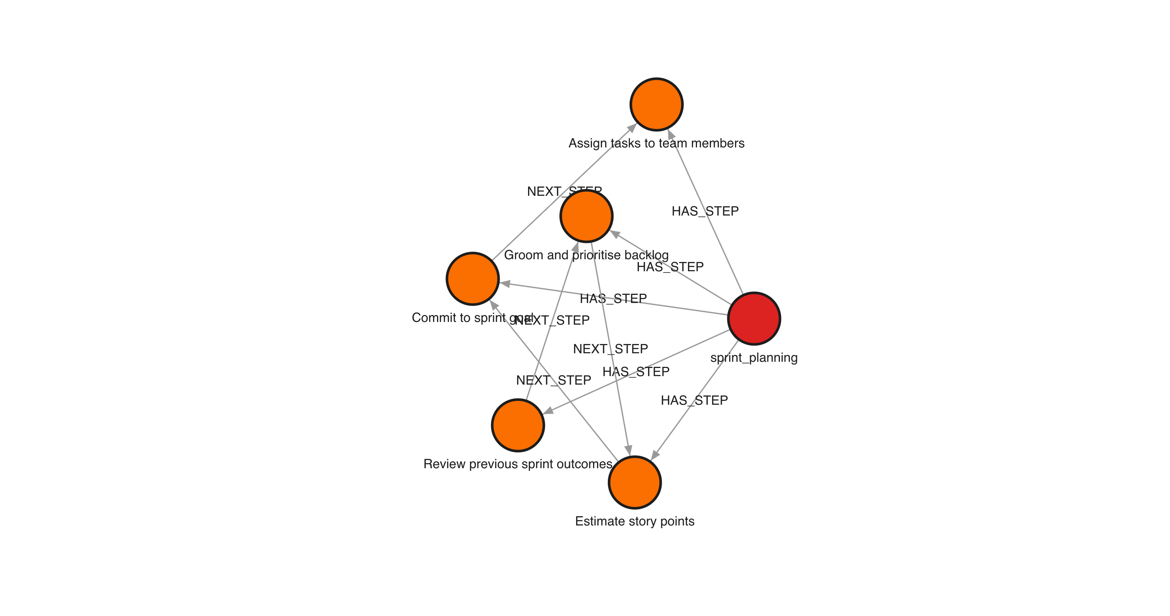
EPISODIC & PROCEDURAL MEMORY
Time-Aware, and It Recognized Our Process
Meetings chain together over time — this standup followed that one, three days apart — and relevance decays automatically, 5% per day. On top of that, the graph matched a real 2-person meeting to the “one-on-one” workflow with zero manual input, and can discover entirely new recurring patterns on its own.
1 real meeting auto-matched to one_on_one
6 known workflow templates seeded · discovery job runs nightly
Real query · sprint_planning procedure and its ordered steps
Meeting Memory v4 — Graph Intelligence Layer
7

Slide 8
VECTOR SEARCH
It Understands Meaning, Not Keywords
The question asked:
"Who is responsible for testing automation?"
Top match (65% similarity, zero keyword overlap):
"Femi leads the QA automation initiative"
No word in the question appears in the fact. This is semantic understanding, not search-and-highlight.
Every meeting summary and every fact is embedded (768-dim, LM Studio's nomic-embed-text) the moment it's written. Two MAGE vector indexes power nearest-neighbor search directly in Memgraph.
Meeting Memory v4 — Graph Intelligence Layer
8

Slide 9
BRINGING IT TOGETHER
One Natural-Language Interface, Fully Grounded
POST /graph/memory/query
{ "question": "What does Matteo discuss in his standups?" }
Grounded answer:
"Matteo participates in daily CBS Standups on several dates: 2026-02-03, 2026-02-24, and 2026-03-02. These standups occur on Email."
1. Extract entities
2. Assemble context
3. Synthesize
4. Log session
Meeting Memory v4 — Graph Intelligence Layer
9

Slide 10
UNDER THE HOOD
Tech Stack — Updated
Graph Engine
LLM Inference
New Modules
Memgraph 3.11.0 (memgraph-mage)
MAGE: pagerank, community_detection,
betweenness/degree centrality, WCC,
vector_search, node_similarity
Memgraph Lab 3.11.0 (standalone)
LM Studio — 100% local
google/gemma-3-12b (chat/extraction)
text-embedding-nomic-embed-text-v1.5
768-dim embeddings, cosine similarity
OpenAI-compatible API, one shared client
graph_algorithms.py
semantic_memory.py
episodic_memory.py
procedural_memory.py
vector_memory.py · memory_retrieval.py
Meeting Memory v4 — Graph Intelligence Layer
10

Slide 11
LIVE STATUS
What's Working Right Now
99
74
6
768
tests passing
meetings in graph
known workflow templates
embedding dimensions
Node counts (live)
74 Meeting
43 Topic
26 ProcedureStep
7 Person
6 Procedure
5 Fact
2 MemorySession
2 Preference
Meeting Memory v4 — Graph Intelligence Layer
11

Slide 12
RUNBOOK
Demo Walkthrough (~12 min)
0:00
Frame it
“The graph got smarter without touching ingestion.”
1:00
Advanced Algorithms
GET /graph/insights/influential — who actually matters
3:00
Semantic Memory
Facts + KNOWS — durable knowledge, not transient notes
5:00
Episodic Memory
Temporal chains + relevance decay
6:30
Procedural Memory
Auto-matched a real 1:1, zero manual input
8:30
Vector Search
“who's responsible for testing automation?” — the wow moment
11:00
Memory Retrieval
One NL query ties all four layers together
Meeting Memory v4 — Graph Intelligence Layer
12

Slide 13


CLOSING
What This Demonstrates
Fully local
Algorithms, memory, and vector search all run on-Mac. Zero data leaves the machine after Airbyte sync.
Native graph intelligence
MAGE algorithms compute influence and structure directly in Memgraph — no separate analytics pipeline.
Grounded, not hallucinated
Every NL answer traces back to real graph nodes, logged as an auditable MemorySession.
Agent-ready today
Everything shown is already queryable by Claude Desktop or any agent via the MCP server, zero extra work.
Meeting Memory v4 — Graph Intelligence Layer
13

Slide 14
Questions?
docker compose up — that's the entire deployment.
Shubham Gaur · meeting-memory-v4

