Slide 1

We
A digital marketplace for offline consumption

Slide 2
Our Mission
Our Vision
Our vision is to create a world where the online and offline worlds combine to form a seamless shopping experience.
Empower all offline stores with a digital channel and tools so that they can provide a unique multi-channel shopping experience. We believe that it is by empowering and supporting offline shops and services with an open digital platform and tools we can achieve our vision.

Slide 3
Problems: Offline Stores Now
Lack of modernization at scale
Lack of integration of digital and in store operations.
Inability to provide personalized shopping experience.
Limitations in terms of product selections.
Difficulty in browsing for products and services.
Unwillingness to reveal quantity of inventory .
Not willing to bear cost of maintaining a web presence.
Absence of alternative fulfilment options.

Slide 4
Problems: Offline Consumers
Products are still absent from the web
Lack of personalized experience
Ease of transaction still an issue with offline stores

Slide 5
Solution: Our Concept
An open digital channel for offline stores where they can setup a digital version of their store.
Cloud based financial ledger
An online marketplace for shoppers which enables offline consumption.
One click to buy from multiple stores.
Location based shopping.
Buy from a closed store.
Automatic order distribution system.

Slide 6
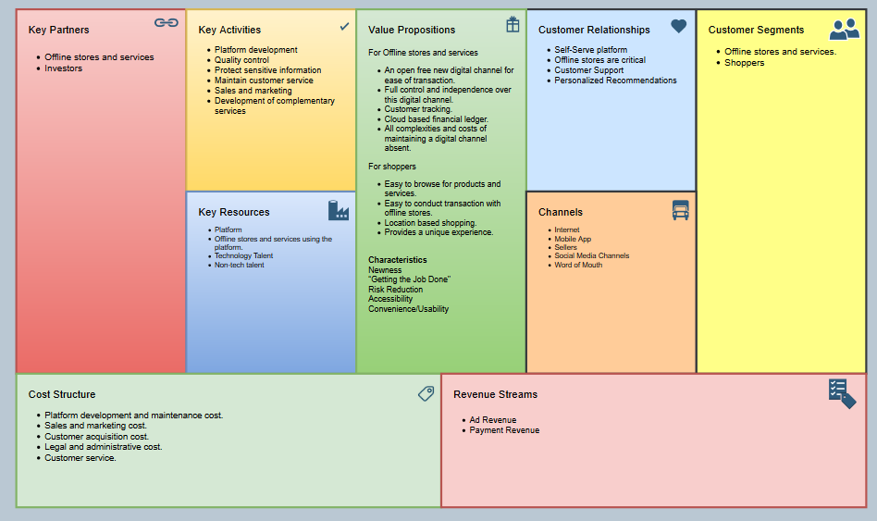
Business Model Canvas

Slide 7
Business Model Moats

Slide 8
Project Timeline
STAGE 01
Focus on getting shop online including verification, basic information and real time shop availability broadcast feature.
Enabling product listing , digital shop maintenance tools and quality control. Constant feedback from sellers for iterations on the seller side.
STAGE 03
Introduction of payment infrastructure and buy online and pickup from store option. Feedback from both seller and customer.
STAGE 02
STAGE 04
STAGE 05
Further iterations and expansion of categories and network. Continued feedback and improvement of core product
Stable version of core product .

Slide 9
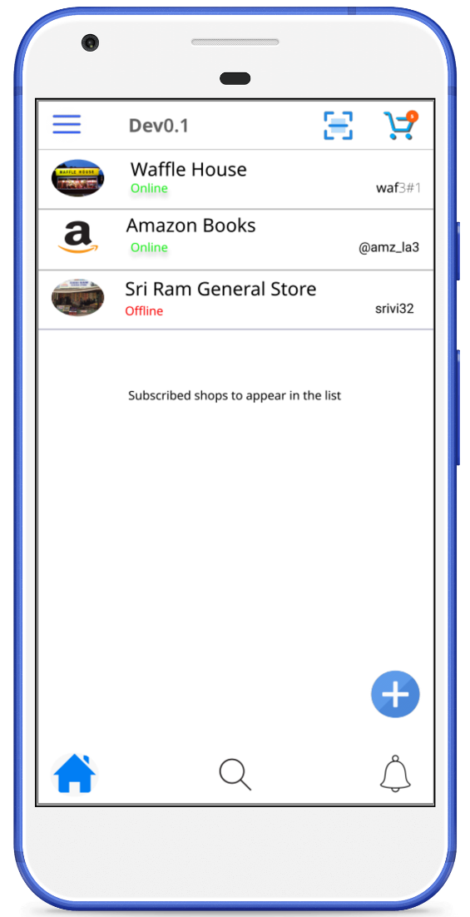
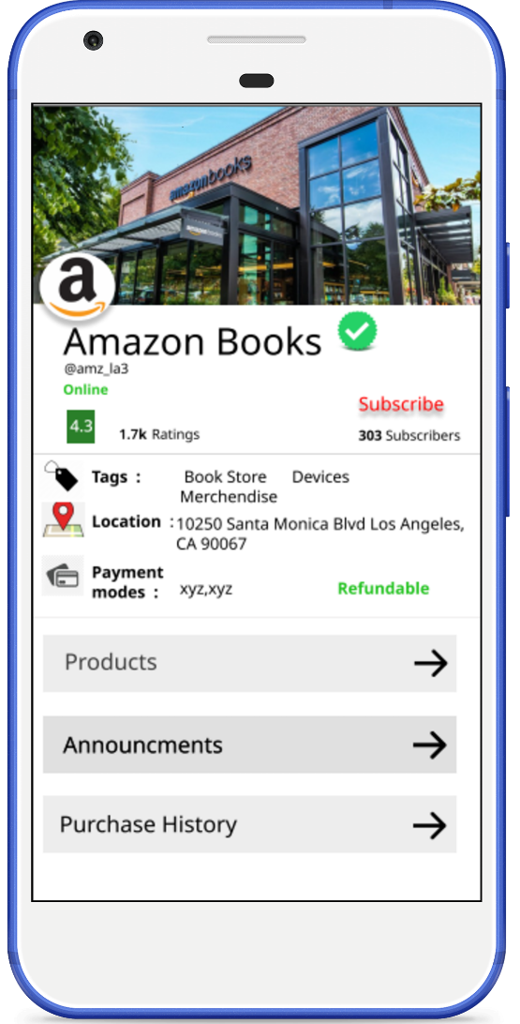
Product

Slide 10
User Benefits

Slide 11
Technology

Slide 12
Market Size

Slide 13
Financials

Slide 14
Competition & Alternatives

Slide 15
Future

Slide 16
Team

