Slide 1
CAPSTONE PROJECT
Students’ Early Attrition Modelling for
Clearwater State University
Submitted By - Shubham Kumar

Slide 2
INDEX
1. OBJECTIVE
2. INSIGHTS
3. MODEL
4. RECOMMENDATION

Slide 3
OBJECTIVE :
Identify key drivers of early attrition
Build predictive model to identify students with
higher early attrition risk
Recommend appropriate interventions based on the analysis

Slide 4
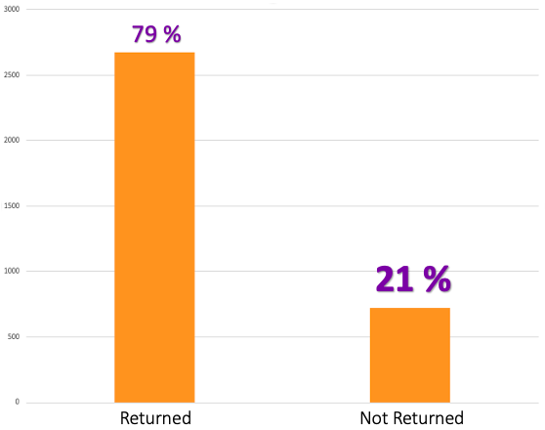
INSIGHTS
Total 3400 Students took admission and started their courses
2677 (79 %) of total students returned for second year and 723 (21 %) didn’t return
Out of 21% who didn’t return 14 % are females and 7 % are males
7%
Males
14%
Females

Slide 5
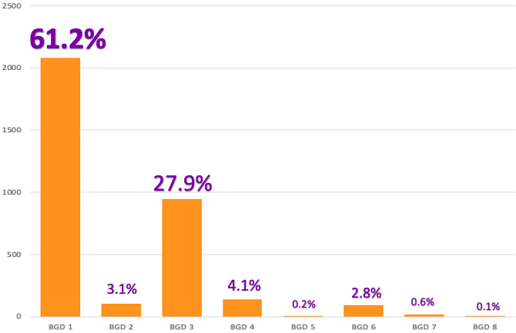
Student Background
89.1 % of total students are from BGD 1 and 3

Slide 6
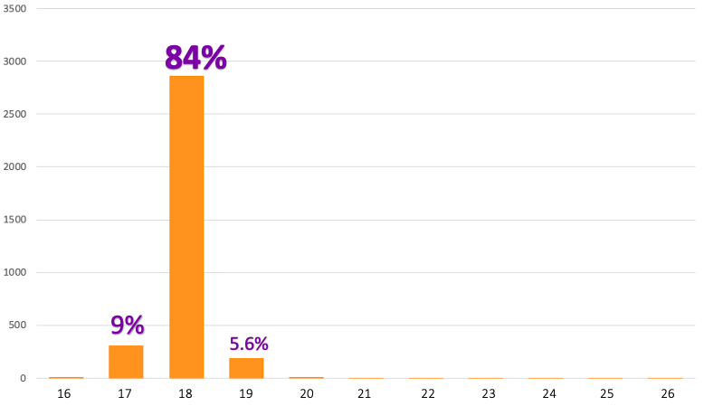
Student Age
98.5 % of total students have age in the range 17-19
Age

Slide 7
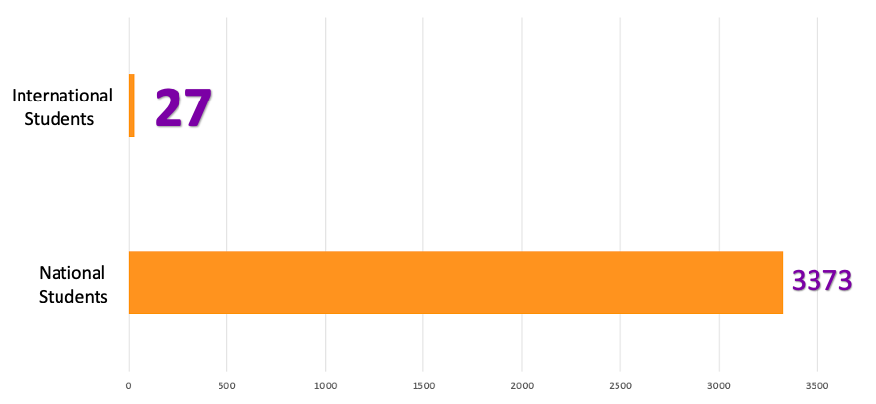
International Students
Only 27 students are International students

Slide 8
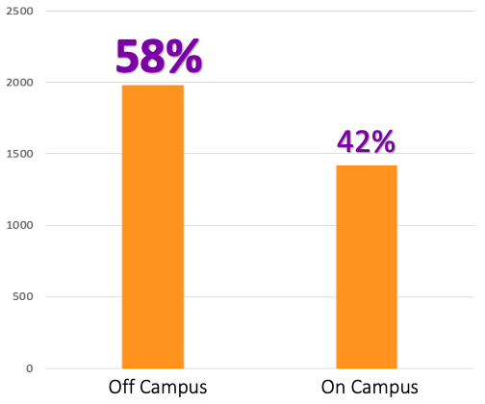
Housing Station
42 % students lives in University Campus while 58 % students lives outside University

Slide 9
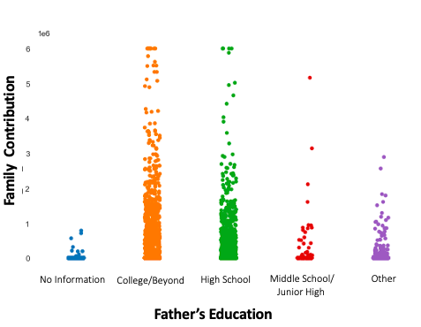
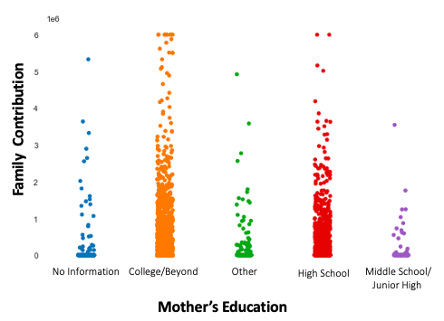
Family Contribution v/s Parents Education
Parents with higher educational level are contributing more financially

Slide 10
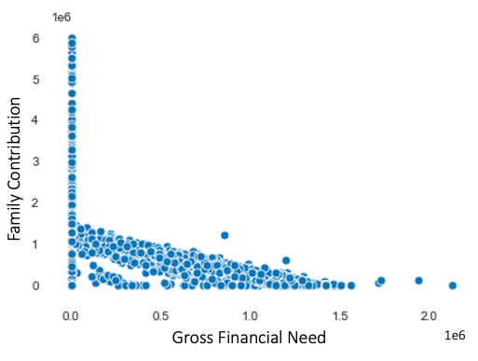
Family Contribution v/s Gross Financial Need
With increasing Gross Financial need , Family contribution is decreasing

Slide 11
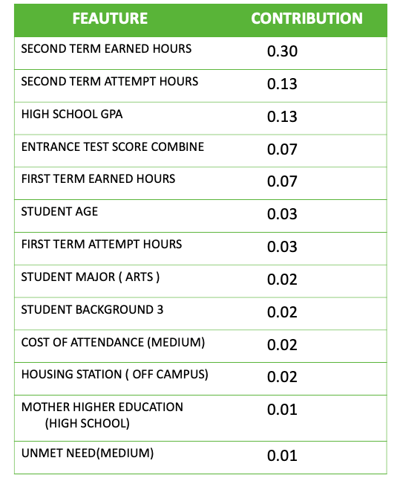
Model – Gradient Boosting Classifier
Important Features
Accuracy : 0.78
Model is able to predict the attrition risk with 78%
accuracy

Slide 12
Recommendations

Slide 13
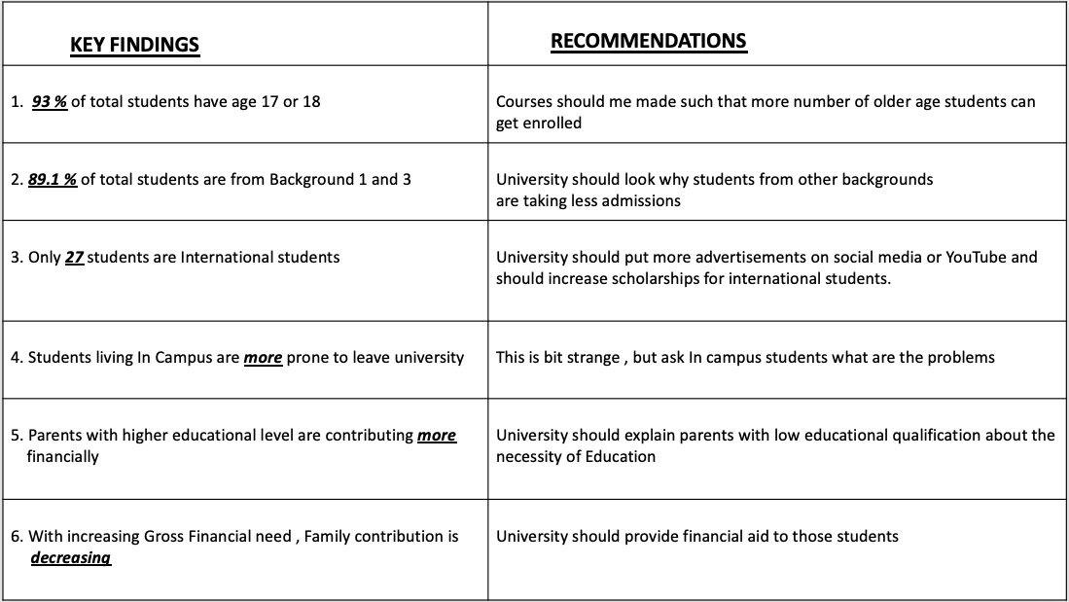

Slide 14
Thank You

