Slide 1
DATA MINING
SUBMITTED BY :
SHUBHAM GUPTA, SUMAN CHATTERJEE, SIDDHARTH TIU
SUBMITTED TO :
Dr. A.C.S. Rao

Slide 2
1. What is Data Mining
3
Data mining is the process of discovering interesting patterns (or knowledge) from large amounts of data.
The data sources can include databases, data warehouses, the Web, other information repositories, or data that are streamed into the system dynamically.

Slide 3
Why Data Mining
Credit ratings/targeted marketing:
Given a database of 100,000 names, which persons are the least likely to default on their credit cards?
Identify likely responders to sales promotions
Fraud detection
Which types of transactions are likely to be fraudulent, given the demographics and transactional history of a particular customer?
Customer relationship management:
Which of my customers are likely to be the most loyal, and which are most likely to leave for a competitor? :

Slide 4
Data mining
Process of semi-automatically analyzing large databases to find patterns that are:
valid: hold on new data with some certainity
novel: non-obvious to the system
useful: should be possible to act on the item
understandable: humans should be able to interpret the pattern
Also known as Knowledge Discovery in Databases (KDD)

Slide 5
Applications
Banking: loan/credit card approval
predict good customers based on old customers
Customer relationship management:
identify those who are likely to leave for a competitor.
Targeted marketing:
identify likely responders to promotions
Fraud detection: telecommunications, financial transactions
from an online stream of event identify fraudulent events
Manufacturing and production:
automatically adjust knobs when process parameter changes
Notes:
Any area where large amounts of historic data that if understood
better can help shape future decisions.

Slide 6
Applications (continued)
Medicine: disease outcome, effectiveness of treatments
analyze patient disease history: find relationship between diseases
Molecular/Pharmaceutical: identify new drugs
Scientific data analysis:
identify new galaxies by searching for sub clusters
Web site/store design and promotion:
find affinity of visitor to pages and modify layout

Slide 7
Data Mining Techniques
Classification
Clustering
Regression
Association Rules

Slide 8
Classification Models
Neural networks
Statistical models – linear/quadratic discriminants
Decision trees
Genetic models

Slide 9
Decision Trees

Slide 10
Technique for Classification
Decision-Tree Classifiers
Job
Job
Engineer
Doctor
Carpenter
Income
Income
Income
>100K
<30K
>50K
<40K
>90K
<50K
Bad
Good
Bad
Good
Bad
Good
Predicting credit risk of a person with the jobs specified.

Slide 11
Decision trees
Tree where internal nodes are simple decision rules on one or more attributes and leaf nodes are predicted class labels.
Salary < 1 M
Prof = teacher
Age < 30
Good
Bad
Bad
Good

Slide 12
Decision Trees
A decision tree T encodes d (a classifier or regression function) in form of a tree.
A node t in T without children is called a leaf node. Otherwise t is called an internal node.

Slide 13
Internal Nodes
Each internal node has an associated splitting predicate. Most common are binary predicates. Example predicates:
Age <= 20
Profession in {student, teacher}
5000*Age + 3*Salary – 10000 > 0

Slide 14
Leaf Nodes
Consider leaf node t:
Classification problem: Node t is labeled with one class label c in dom(C)
Regression problem: Two choices
Piecewise constant model: t is labeled with a constant y in dom(Y).
Piecewise linear model: t is labeled with a linear model Y = y_{t} + Σ a_{i}X_{i}

Slide 15
Example
Encoded classifier:
If (age<30 and carType=Minivan) Then YES
If (age <30 and (carType=Sports or carType=Truck)) Then NO
If (age >= 30) Then YES
Age
<30
>=30
Car Type
YES
Minivan
Sports, Truck
YES
NO

Slide 16
Why Decision Tree Model?
Relatively fast compared to other classification models
Obtain similar and sometimes better accuracy compared to other models
Simple and easy to understand
Can be converted into simple and easy to understand classification rules

Slide 17
Pros and Cons of decision trees
Pros
Reasonable training time
Fast application
Easy to interpret
Easy to implement
Can handle large number of features
Cons
Cannot handle complicated relationship between features
simple decision boundaries
problems with lots of missing data

Slide 18
Consumer Profiling
Businesses need to effectively leverage available data to improve customer acquisition and retention. We will explore how analytics tools such as decision trees can help with customer acquisition.

Slide 19
EXAMPLE
A manufacturer of home improvement equipment wants to identify which existing customers are best candidates for a new product they are developing. A decision tree such as the one shown below

Slide 20
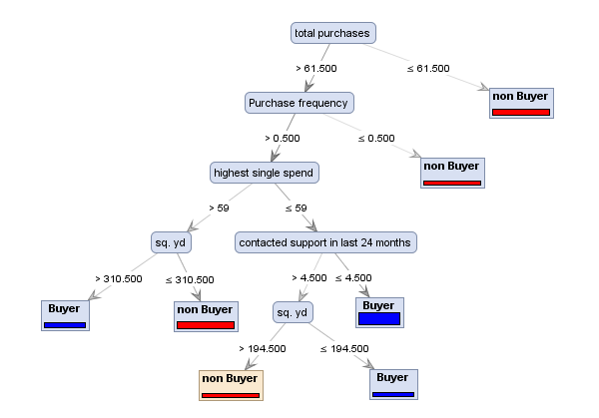

Slide 21
Clustering
Group Data into Clusters
Similar data is grouped in the same cluster
Dissimilar data is grouped in the same cluster
How is this achieved ?
K-Nearest Neighbor
A classification method that classifies a point by calculating the distances between the point and points in the training data set. Then it assigns the point to the class that is most common among its k-nearest neighbors (where k is an integer).(2)
Hierarchical
Group data into t-trees

Slide 22
Regression
“Regression deals with the prediction of a value, rather than a class.” (1, P747)
Example: Find out if there is a relationship between smoking patients and cancer related illness.
Given values: X1, X2... Xn
Objective predict variable Y
One way is to predict coefficients a0, a1, a2
Y = a0 + a1X1 + a2X2 + … anXn
Linear Regression

Slide 23
Association Rules
“An association algorithm creates rules that describe how often events have occurred together.” (2)
Example: When a customer buys a hammer, then 90% of the time they will buy nails.

Slide 24
Advantages of Data Mining
Provides new knowledge from existing data
Public databases
Government sources
Company Databases
Old data can be used to develop new knowledge
New knowledge can be used to improve services or products
Improvements lead to:
Bigger profits
More efficient service

Slide 25
Uses of Data Mining
Sales/ Marketing
Diversify target market
Identify clients needs to increase response rates
Risk Assessment
Identify Customers that pose high credit risk
Fraud Detection
Identify people misusing the system. E.g. People who have two Social Security Numbers
Customer Care
Identify customers likely to change providers
Identify customer needs

Slide 26
Relationship with other fields
Overlaps with machine learning, statistics, artificial intelligence, databases, visualization but more stress on
scalability of number of features and instances
stress on algorithms and architectures whereas foundations of methods and formulations provided by statistics and machine learning.
automation for handling large, heterogeneous data

Slide 27
THANK YOU

