Slide 1

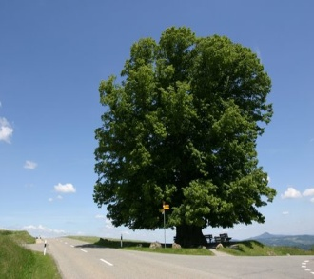
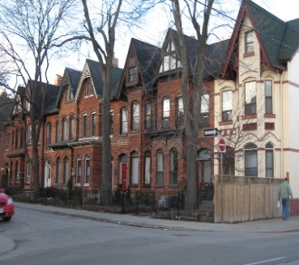

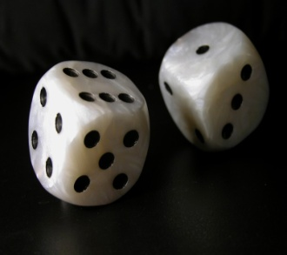
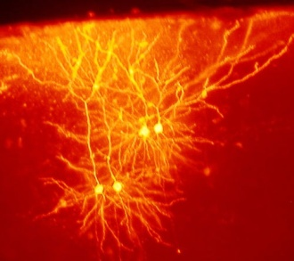


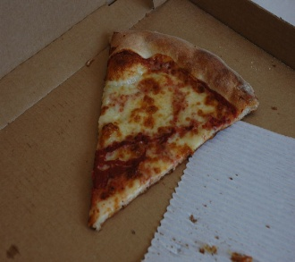
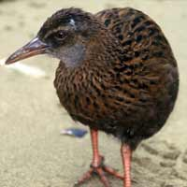
“Classifiers”
Under the guidance of
Prof. A.C.S Rao
I
R & D project by
Shubham Gupta
Bethu Si Sampath
IIT(ISM) Dhanbad

Slide 2
Overview

Slide 3

Introduction to Classification

Slide 4
What is classification?
A machine learning task that deals with identifying the class to which an instance belongs
A classifier performs classification
Classifier
Test instance
Attributes
(a1, a2,… an)
( Perceptive inputs )
Discrete-valued
(Class label)

Slide 5
Classification learning
Training
phase
Testing
phase
Learning the classifier
from the available data
‘Training set’
(Labeled)
Testing how well the classifier
performs
‘Testing set’

Slide 6
Generating datasets
Methods:
  Holdout (2/3rd training, 1/3rd testing)
  Cross validation (n – fold)
    Divide into n parts
    Train on (n-1), test on last
    Repeat for different combinations

Slide 7
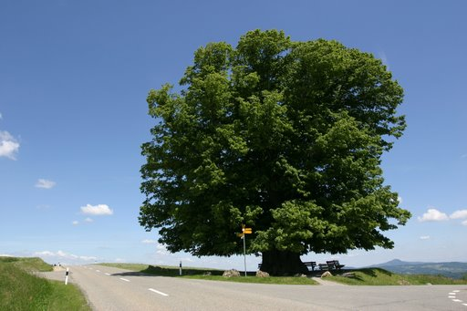
Decision Trees

Slide 8
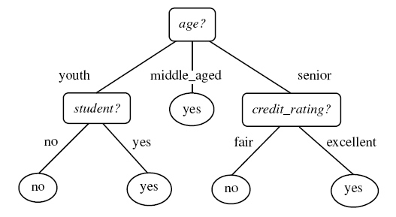
Example tree
Intermediate nodes : Attributes
Edges : Attribute value tests
Leaf nodes : Class predictions
Example algorithms: ID3, C4.5, SPRINT, CART
Diagram from Han-Kamber

Slide 9
Decision Tree schematic
Training data set
a1 a2 a3 a4 a5 a6
a1 a2 a3 a4 a5 a6
X
Y
Z
Impure node,
Select best attribute
and continue
Impure node,
Select best attribute
and continue
Pure node,
Leaf node:
Class RED

Slide 10

Support vector
machines

Slide 11
Support vector machines
Basic ideas
Margin
“Maximum separating-margin classifier”
+1
Support vectors
-1
Separating hyperplane : wx+b = 0

Slide 12
Support vector machine
Logistic regression:
Support vector machine:

Slide 13
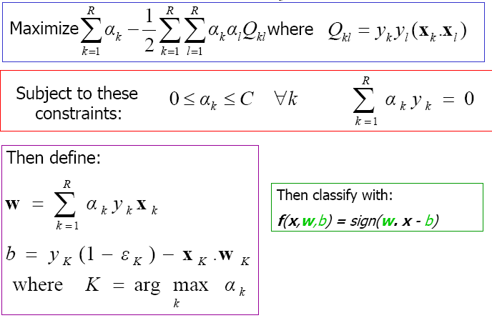
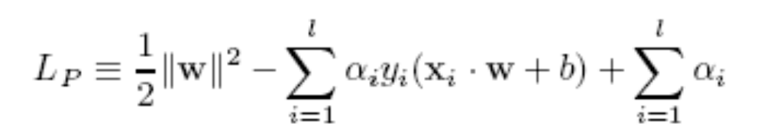
SVM training
Problem formulation
Minimize (1 / 2) || w ||²
w.r.t. (y_{i} ( w x_{i} + b ) – 1) >= 0 for all i
Lagrangian multipliers are
zero for data instances other
than support vectors
Dot product of xk and xl

Slide 14



Focussing on dot product
For non-linear separable points,
we plan to map them to a higher dimensional (and linearly separable) space
The product can be time-consuming. Therefore, we use kernel functions

Slide 15

Kernel functions
Without having to know the non-linear mapping, apply kernel function, say,
Reduces the number of computations required to generate Q kl values.

Slide 16


Testing SVM
SVM
Class
label
Test instance

Slide 17

SVM Issues
SVMs are immune to the removal of
non-support-vector points
What if n-classes are to be predicted?
Problem : SVMs deal with two-class classification
Solution : Have multiple SVMs each for one class

Slide 18
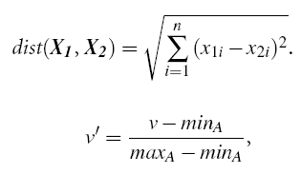
K-NN classifier schematic
For a test instance,
Calculate distances from training pts.
Find K-nearest neighbours (say, K = 3)
Assign class label based on majority

Slide 19
K-NN classifier Issues
How good is it?
Susceptible to noisy values
Slow because of distance calculation
  Alternate approaches:
  Distances to representative points only
  Partial distance
Any other modifications?
Alternatives:
Weighted attributes to decide final label
Assign distance to missing values as <max>
K=1 returns class label of nearest neighbour
How to determine value of K?
Alternatives:
Determine K experimentally. The K that gives minimum
error is selected.
How to make real-valued prediction?
Alternative:
Average the values returned by K-nearest neighbours
How to determine distances between values of categorical
attributes?
Alternatives:
Boolean distance (1 if same, 0 if different)
Differential grading (e.g. weather – ‘drizzling’ and ‘rainy’ are
closer than ‘rainy’ and ‘sunny’ )

Slide 20

Decision Lists

Slide 21
Decision Lists
A sequence of boolean functions that lead to a result
if h1 (y) = 1 then set f (y) = c1
else if h2 (y) = 1 then set f (y) = c2
…. else set f (y) = cn
f ( y ) = cj, if j = min { i | hi (y) = 1 } exists
0 otherwise

Slide 22
Decision List example
Class label
Test instance
( h i , c i )
Unit

Slide 23


Decision List learning
R
S’ = S
- Qk
( h k, )
1 / 0
If
(| Pi| - pn * | Ni |
>
|Ni| - pp *|Pi| )
then 1
else 0
For each hi,
Qi = Pi U Ni
( hi = 1 )
Set of candidate
feature functions
Select hk, the feature
with
highest utility
U i = max { | Pi| - pn * | Ni | , |Ni| - pp *|Pi| }

Slide 24
Difference between decision lists and decision trees:
Lists are functions tested sequentially (More than one
attributes at a time)
Trees are attributes tested sequentially
Lists may not require a ‘complete’ coverage for values
of an attribute.
All values of an attribute correspond to atleast one
branch of the attribute split.

Slide 25

Probabilistic
classifiers

Slide 26
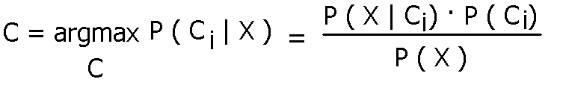
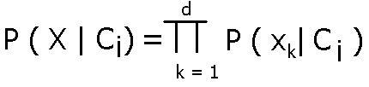
Probabilistic classifiers : NB
Based on Bayes rule
Naïve Bayes : Conditional independence assumption

Slide 27
Naïve Bayes Issues
How are different types of attributes
handled?
Discrete-valued : P ( X | Ci ) is according to
        formula
Continous-valued : Assume gaussian distribution.
      Plug in mean and variance for the attribute
      and assign it to P ( X | Ci )
Problems due to sparsity of data?
Problem : Probabilities for some values may be zero
Solution : Laplace smoothing
For each attribute value,
update probability m / n as : (m + 1) / (n + k)
where k = domain of values

Slide 28
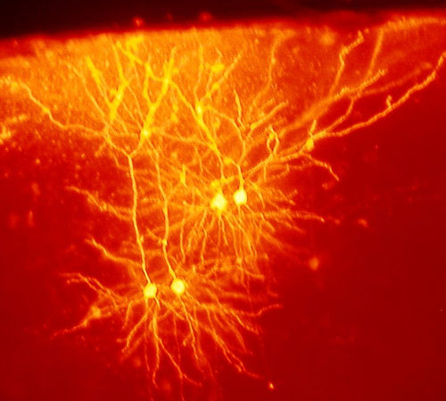
Artificial
Neural Networks

Slide 29
Artificial Neural Networks
Based on biological concept of neurons
Structure of a fundamental unit of ANN:
w0
threshold
w1
input
output: : activation function
p (v) where
p (v) = sgn (w₀ + w₁x₁ + … + w_{n}x_{n} )
wn

Slide 30
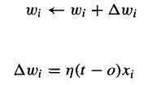
Perceptron learning algorithm
Initialize values of weights
Apply training instances and get output
Update weights according to the update rule:
Repeat till converges
Can represent linearly separable functions only
n : learning rate
t : target output
o : observed output

Slide 31


Sigmoid perceptron
Basis for multilayer feedforward networks

Slide 32
ANN Issues
Addition of momentum
But why?
Choosing the learning factor
A small learning factor means multiple iterations
required.
A large learning factor means the learner
may skip the global minimum
What are the types of learning
approaches?
Deterministic: Update weights after summing up
Errors over all examples
Stochastic: Update weights per example
Learning the structure of the network
Construct a complete network
Prune using heuristics:
  Remove edges with weights nearly zero
  Remove edges if the removal does not affect
  accuracy

Slide 33
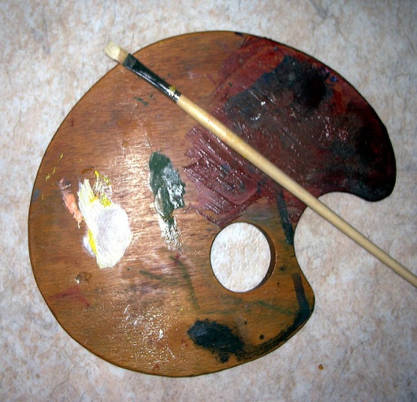
Combining
classifiers

Slide 34
Combining Classifiers
‘Ensemble’ learning
Use a combination of models for prediction
Goal : An improved combined model

Slide 35
Dimensionality reduction
High dimensions : Computational complexity
Number of attributes of
a data instance
instance x in p-dimensions
s = Wx W is k x p transformation mtrx.
instance x in k-dimensions
k < p

Slide 36
Key References
Data Mining – Concepts and techniques; Han and Kamber, Morgan Kaufmann publishers, 2006.
Machine Learning; Tom Mitchell, McGraw Hill publications.
Data Mining – Practical machine learning tools and techniques; Witten and Frank, Morgan Kaufmann publishers, 2005.

Slide 37
end of slideshow

