Slide 1

Advancements in Brain Tumor Detection using Digital Image Processing
SRM INSTITUTE OF SCIENCE AND TECHNOLOGY
SCHOOL OF COMPUTING
DEPARTMENT OF COMPUTING TECHNOLOGIES
21CSE251T – DIGITAL IMAGE PROCESSING- MINI PROJECT
RA2211003011758
Shubham Jain
RA2211003011772
Vidhi Singh
RA2211003011783
Harshit
Guide name: Dr. Deepajothi S
Designation: Associate Professor Department: CTECH

Slide 2
Advancements in Brain Tumor Detection using Digital Image Processing
Abstract and Objectives
In recent years, image processing has emerged as a pivotal tool in medical research and diagnosis, offering non-invasive techniques for comprehensive internal anatomy examination. This presentation delves into a project aimed at leveraging MATLAB's graphical user interface (GUI) for the detection of brain tumors using MRI scans.
The utilization of 3D models derived from these scans facilitates in-depth analysis, leading to improved patient treatment outcomes, the development of enhanced medical equipment, and more accurate diagnoses. By examining the integration of MATLAB GUI with medical imaging data, this project underscores the potential for innovative approaches in brain tumor detection, contributing to advancements in healthcare technology and patient care.

Slide 3
Advancements in Brain Tumor Detection using Digital Image Processing
Introduction
A brain tumor is an abnormal mass of tissue in which cells grow and replicate uncontrollably, seemingly unfettered by normal cell regulatory processes. The extraction and analysis of brain tumors are difficult jobs in medical image processing due to the complexity of the brain image. In medical image processing, segmentation is extremely significant. As a result, MRI (magnetic resonance imaging) has emerged as a valuable medical diagnostic tool for brain and other medical images. This project explores a specific use case wherein MATLAB GUI is employed to analyze MRI scans of brain tumor patients.

Slide 4
Advancements in Brain Tumor Detection using Digital Image Processing
Existing System
Brain tumors pose a significant health challenge, requiring precise and timely identification for optimal management. Before the widespread adoption of MATLAB for medical image processing tasks. Traditional diagnostic approaches often entail invasive procedures or rely on manual interpretation of imaging data, leading to potential inaccuracies and delays in treatment initiation. Some of the common methods and systems used before MATLAB include:
Manual Segmentation: This approach involves manual delineation of tumor boundaries by radiologists or trained technicians. It is a time-consuming process prone to human error and subjectivity.
Semi-Automated Software: Early software tools provided semi-automated segmentation capabilities, allowing users to interactively guide the segmentation process. However, these tools often lacked robustness and required significant user intervention.
Custom Scripting: Some researchers and institutions developed custom scripts or algorithms using programming languages like C/C++ for image analysis tasks.

Slide 5
Advancements in Brain Tumor Detection using Digital Image Processing
Proposed System
Recent developments in medical imaging, particularly the integration of image processing algorithms with GUI platforms such as MATLAB, offer a promising avenue for more efficient and accurate tumor detection.
Efficiency and Automation: MATLAB offers a wide range of built-in functions and toolboxes specifically designed for image processing tasks, including segmentation. These functions enable automated or semi-automated segmentation of brain tumors, significantly reducing the time and effort required compared to manual approaches.
Robustness and Accuracy: MATLAB's advanced algorithms and techniques for image analysis result in more robust and accurate segmentation results compared to manual or semi-automated methods. The ability to fine-tune parameters and customize algorithms allows for better adaptation to diverse imaging datasets and tumor characteristics.
User-Friendly Interface: MATLAB GUI provides an intuitive and interactive platform for medical image analysis, allowing users to visualize, manipulate, and analyze data with ease. This user-friendly interface enhances usability and accessibility, making it suitable for clinicians and researchers with varying levels of expertise.

Slide 6
Literature Review
Author | Investigator | Title | Source | Findings of the study
Swapnil R.Telrandhe | [1] | segmentation methods for medical image analysis | International Research Publication House | Proposed tumor detection inside which Segmentation separates an image into parts of regions or objects. In this it has to segment the item from the background to browse the image properly and classify the content of the image strictly. During this framework, edge detection is a vital tool for image segmentation. In this paper their effort was made to study the performance of most commonly used edge detection techniques for image segmentation and additionally the comparison of these techniques was carried out with an experiment.

Slide 7
Literature Review
Author | Investigator | Title | Source | Findings of the study
Malathi Hong-Long | [2] | BRAIN TUMOR DETECTION USING IMAGE PROCESSING | International Research Publication House | Proposed approach by desegregation wave entropy based mostly spider net plots and probabilistic neural network for the classification of Brain MRI. Proposed technique uses two steps for classification one is wavelet entropy based mostly spider net plot for feature withdrawal and probabilistic neural network for classification.

Slide 8
Literature Review
Author | Investigator | Title | Source | Findings of the study
Sanjeev Thakur | [3] | A Survey on Brain Tumor Detection Using Image Processing Techniques | IEEE 7th International Conference on Cloud Computing, Data Science & Engineering | This review surveys the various techniques that are part of Medical Image Processing and are prominently used in discovering brain tumors from MRI Images. Based on that research this Paper was written listing the various techniques in use. A brief description of each technique is also provided. Also of All the various steps involved in the process of detecting Tumors, Segmentation is the most significant.

Slide 9
Literature Review
Author | Investigator | Title | Source | Findings of the study
A.Jordan | [4] | A Brain Tumor Detection Using Image Processing | IEEE 10th International Conference | MRI images are more susceptible to noise and other environmental disturbances. Therefore, it becomes difficult for doctors to determine the tumor and its causes. So, we came up with a system in which the system will detect a brain tumor from images. Here we are converting an image to a grayscale image. We apply filters to the image to remove noise and other environmental clutter from the image. The system will process the selected image using preprocessing steps. At the same time, different algorithms are used to detect the tumor from the image.

Slide 10
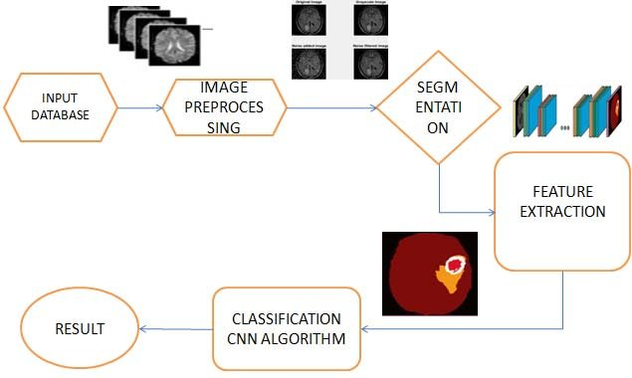
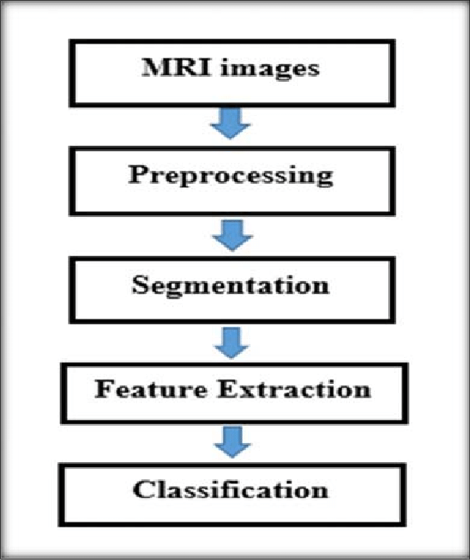
Architecture Diagram

Slide 11
Modules
MATLAB - MATLAB is a proprietary multi-paradigm programming language and numeric computing environment. MATLAB allows matrix manipulations, plotting of functions and data, implementation of algorithms, creation of user interfaces, and interfacing with programs written in other languages.
Image Processing ToolBox - ​Image Processing Toolbox provides a comprehensive set of reference-standard algorithms and workflow apps for image processing, analysis, visualization, and algorithm development. You can perform image segmentation, image enhancement, noise reduction, geometric transformations, and image registration using deep learning and traditional image processing techniques. The toolbox supports processing of 2D, 3D, and arbitrarily large images.
Statistics and Machine Learning Toolbox - Statistics and Machine Learning Toolbox provides functions and apps to describe, analyze, and model data. You can use descriptive statistics, visualizations, and clustering for exploratory data analysis; fit probability distributions to data; generate random numbers for Monte Carlo simulations, and perform hypothesis tests. Regression and classification algorithms let you draw inferences from data and build predictive models either interactively, using the Classification and Regression Learner apps, or programmatically, using AutoML.

Slide 12
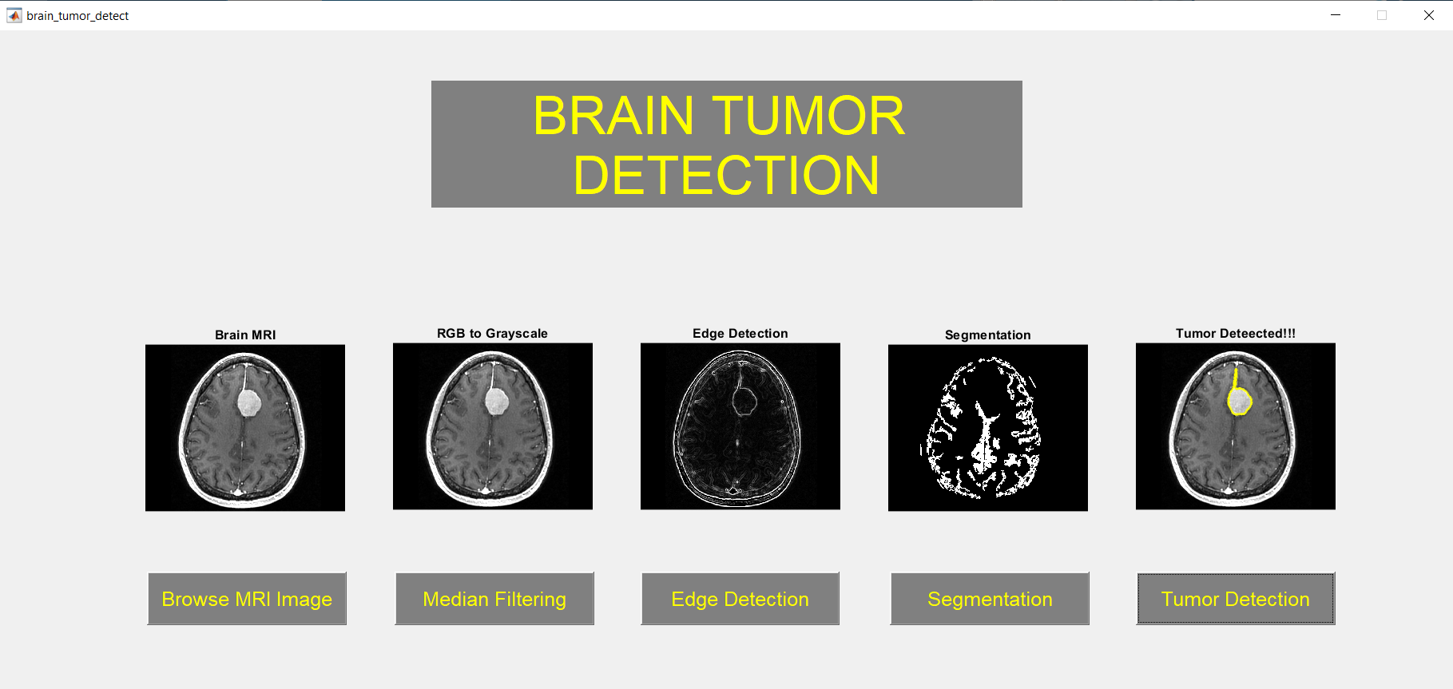
Sample Snapshot

Slide 13
Conclusion
In conclusion, the adoption of MATLAB, particularly through its graphical user interface (GUI), represents a significant advancement in the field of medical image processing, particularly in the context of brain tumor detection. This project has underscored the challenges posed by traditional systems, including manual segmentation and semi-automated software, and highlighted the inefficiencies inherent in these approaches.
As such, the advancements offered by MATLAB in brain tumor detection hold immense promise for improving diagnostic accuracy, treatment planning, and patient outcomes. By continuing to innovate and refine image processing techniques within MATLAB's framework, researchers and clinicians can further advance the frontiers of medical imaging, ultimately enhancing the quality of care for patients afflicted with brain tumors and other neurological disorders.

Slide 14
References
Detection of Brain Tumor Using Digital Image Processing(Journal of Health & Medical Informatics) https://www.hilarispublisher.com/open-access/detection-of-brain-tumor-using-digital-image-processing.pdf
Brain Tumor Detection using Image Processing (Research Gate) https://www.researchgate.net/publication/352390016_Brain_Tumor_Detection_using_Image_Processing
Brain Tumor Detection Using Deep Learning(BVM College) https://bvmengineering.ac.in/NAAC/Criteria1/1.3/1.3.4/18CP814_Thesis.pdf
BRAIN TUMOR DETECTION USING IMAGE PROCESSING (International Research Publication House) https://www.ripublication.com/irph/ijisaspl2019/ijisav11n1spl_05.pdf

