Slide 1
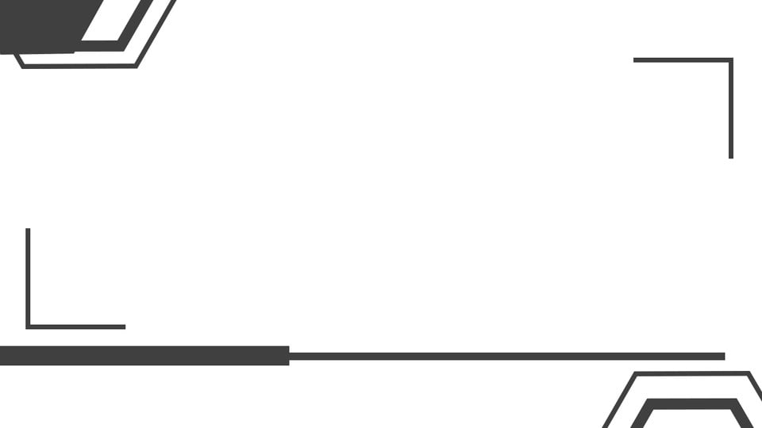
RAISE_DONATION
SCHOOL OF COMPUTER SCIENCE & I.T (D.A.V.V)
Indore(M.P)
BCA VI PROJECT PRESENTATION
ON
“The Online Donating Site”
PRESENTED BY : RAVINDRA RAGHUWANSHI (1710148) Guided by : er. Hitesh ninama
Shubham kumar jha (1710163)

Slide 2


Slide 3


Slide 4
INTRODUCTION
The system is Online Donating Site called as RAISE_DONATION.
This system is a solution for managing & donating the stuffs or resources.
This system centralizes all by providing features to its Users, Donors, and NGOs.
System provides the direct communication platform between Donors and NGOs.
Online Donating site is web-based software that helps to donate resources like food, clothes, books online.

Slide 5


Slide 6

Different sectors:
There is no system for donating more than one type stuffs like food, clothes, books .
Communication:
There is no system which connects one NGO to other NGO.
Human Efforts:
When computerized system is not implemented large amount of human efforts is required to personally go to place and donate anything.
Time Wastage:
When a computerized system is not there large amount of time is wasted in going to NGO’s at various unknown location.
Difficult To find trusted NGOs:
When donor is not having the knowledge of any NGO’s regarding their working or existence ,it become difficult for donor to trust them.
Difficult to Donate
No system or sector provide one place or platform to do donation, charity or to raise fund at one place specially in an online mode .
PROBLEM STATEMENT
6

Slide 7
PROPOSED SOLUTION
Online Donating site allow Donors through Internet to register and donate stuffs or resources like food, clothes, books and money.
Online Donating site allow Ngo to request from other Ngo and user as well.
And this also allow NGOs to register themselves so that they can reach at those places where there is any requirement of food, clothes, books etc.
Donors have an option of pickup and doorstep. So he/she can donate according to their convenience. If they have a more quantity (based on our terms & condition), Ngo will reach out at their location to pickup according to the time given to the donors.
Any visitor after registering onto the site can request for any requirements, so the ngos will be informed to fulfill that requirement if possible.

Slide 8

REQUIREMENTS

Slide 9
REQUIREMENTS
Functional
Non Functional
This system should allow the administrator and user to manage their respective functionality.
This system should allow the administrator and user to insert, update and delete the details.
This system should allow the user to view the essential details associated to him .
This system should allow the administrator to manage the verification process of any user.
This system should allow the user to register as per their requirement and type.
This system should allow the user to send and receive requests.
This system should allow the user to make any transaction after a complete verification and assure the security of their data.
Usability
We get the responses within the seconds.
The web application has a simple, user friendly interface so user can save time and without any complexity and confusion.
Reliability
The website is more reliable because of the qualities that are inherited from the platform. The code built by using HTML and CSS at frontend is more reliable
Supportability
The website is designed to be the cross platform supportable. The system is supported on a wide range of hardware and any software platform which is having any web server installed into the system.
Security
It will allow to changes and updates only by admin permission.

Slide 10


Slide 11
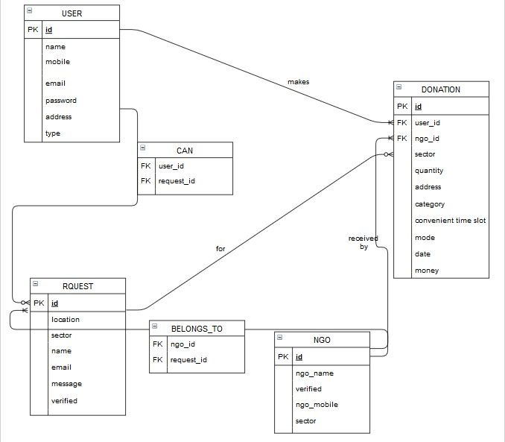
ER Diagram

Slide 12
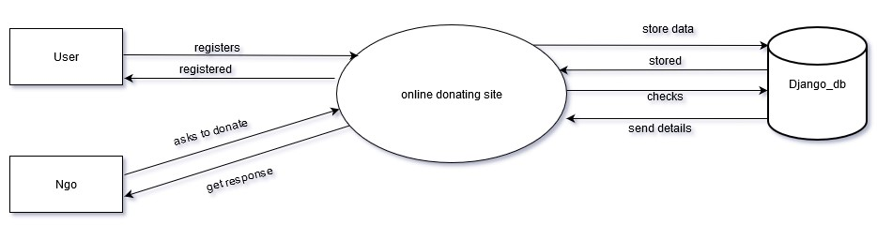
LEVEL-0 or Context level DFD

Slide 13
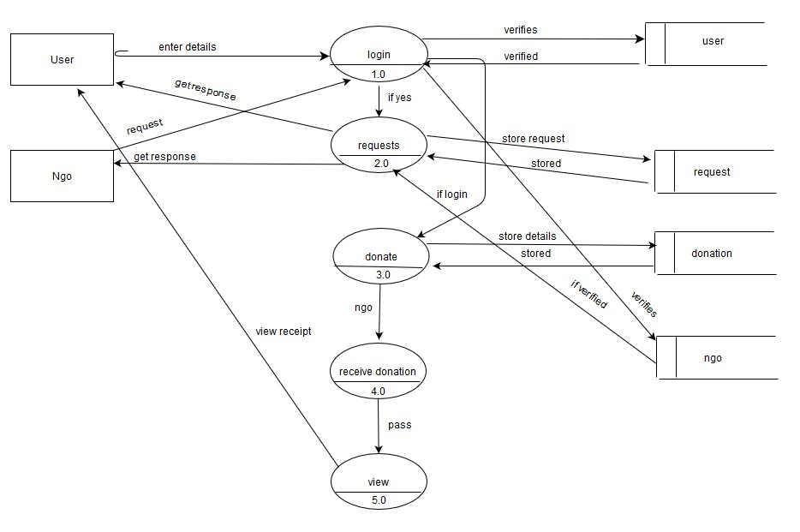
LEVEL-1 DFD

Slide 14
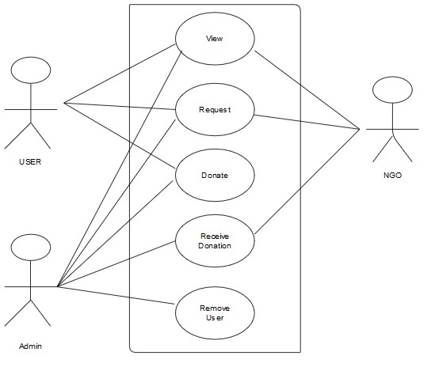
USE CASE DIAGRAM

Slide 15
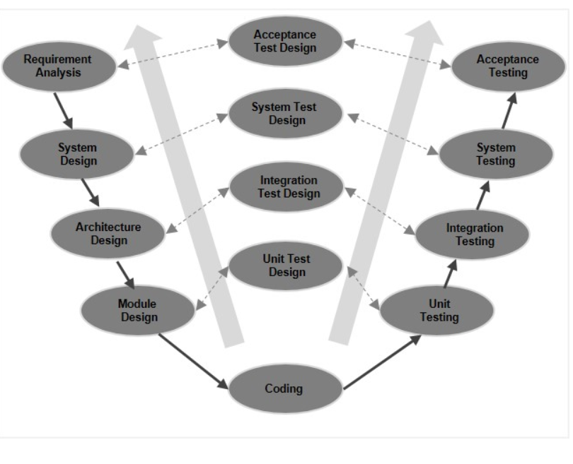
Software Development Methodology
The choice of software development model would be “V Model” .
V- model means Verification and Validation model. Just like the waterfall model, the V-Shaped life cycle is a sequential path of execution of processes
Under the V-Model, the corresponding testing phase of the development phase is planned in parallel. So, there are Verification phases on one side of the ‘V’ and Validation phases on the other side. The Coding Phase joins the two sides of the V-Model.
V MODEL

Slide 16




TOOLS REQUIRED
HTML
CSS
JAVASCRIPT
DJANGO
(python)
MySQL DBMS
FRONTEND
FRONTEND
FRONTEND
BACKEND LANG.
DATABASE

Slide 17


Slide 18
OUTCOMES
1.
Donor and Ngo both can request for anything with each others. Notification and email would be sent to each other about the request.
2.
Donor can view their past donation history.
Ngo can also check their account of donation.
3.
Donor will be directly connected with Ngo via this system. And vice versa
4.
5.
Donor would be rewarded on the basis of his/her past donations.
System will show up all the contribution and donation made by all Donors which helps in maintaining & analysing the data.

Slide 19
FUTURE SCOPE
1. Indroducing the gateway method in payment procedure.
3. Verification of user and ngo would be done automatically.
5. By expanding the area for users and ngos.
2. User can donate multiple stuffs at a time.
4. Adding a GPS feature for locating the area for any requirement.

Slide 20


Slide 21
LIMITATIONS
1.
2.
3.
4.
5.
6.
No gateway method for payment procedure.
Ngo can’t donate to other ngos through this system.
User requests has to be verified manually by Ngo
User can donate only one type of stuff at a time.
User can only request and donate on the day he/she asks or requests.
Verification of Ngo would be done manually by admin.

Slide 22

LESSON LEARNED
Things we learned while making this system are:
How to use the frameworks like Django to build the website.
How to implement and automate the system for day to day life activties.
Understanding the needs of end user.
Sending signals or notifications from one user to multiple user at a time.
Learned how to use email and otp features for any process.
Learned how to manage the database efficiently to reduce the time complexity.

Slide 23

REFERENCES
Books:
Learn Python the Hard Way (3rd Edition): The J2EE Technology Web Tier, author Jayson Falkner and Kevin Jones.
Fundamentals of Database Systems, Sixth Edition author Shamkant B. Navathe.
Websites:
http://www.stackoverflow.com
https://www.geeksforgeeks.org
https://docs.djangoproject.com
http://www.w3schools.com

Slide 24
Thanks!

