Slide 1

Walchand College Of Engineering, Sangli.
Department of Information Technology
(Second Year Information Technology
Academic Year: (2017-2018)

Slide 2
S.P.C.S
A Project under the guidance of - Ms. Amruta Khot
Presented by:-
Aditya Chaturvedi (2015BEN055)
Yash Singh (2015BIT052)
Shubham Kalyankar (2015BIT053)

Slide 3
S.P.C.S
Signature based Packet Classification System

Slide 4


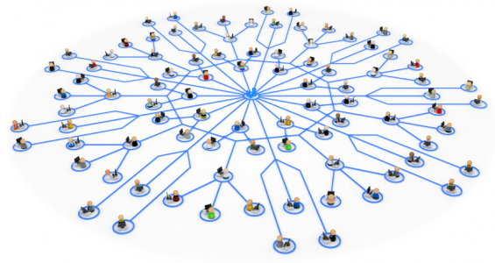



NETWORK

Slide 5

Domain

Slide 6

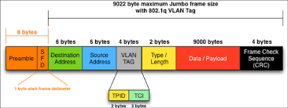
S.P.C.S

Slide 7
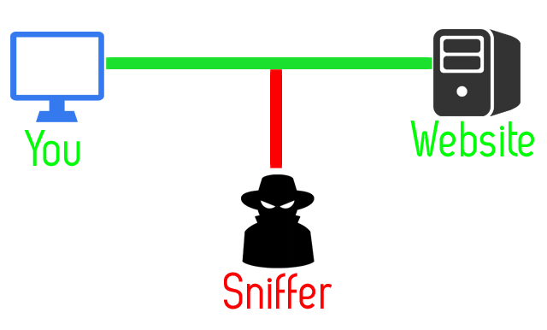



Malicious!!
Training SPCS by Dataset
S.P.C.S
Sniffer’s Packet Header Info

Slide 8

Introduction:
An Intrusion detection system (IDS) is a device or software application that monitors a network or systems for malicious activity or policy violations.
Intrusion Detection System does the following task:
● Monitors and analyzes data packets on a network to look for suspicious activity
● Large scale servers can monitor backbone network links
● Small scale systems can monitor local routers/switches
● Two major approaches:
○ Signature based
○ Anomaly detection based

Slide 9
S.P.C.S
Packet Analyzer
Self-made
Packet Information Tracker
Builds Dataset of Packet
Collects Header Information by decoding Ethernet Frame
Signature based Classification of Packets
Judges packets on the basis of Header Information
Based on various Machine Learning Classification Algorithms
Trainable
Can be updated for any type of Malicious packets

Slide 10
Goal:
The goal of our project is to design and build a Packet Analyzer and a Signature-based intrusion detection system by classifying data packets on a network into “Malicious” or “Normal” formulated on Packet Header information.

Slide 11
Project Objectives:
To build a packet analyzer
To make a pattern based recognition system
To classify packets according to various algorithms
Technology:
Python
Machine learning classification algorithms
KDD 99 Dataset

Slide 12
Methodology:
Building a packet analyzer using socket programming for reading packet header information like version, header length, various flags, Source and Destination address
Gaining header information of various packets which are entering the system captured by the packet analyzer
Classifying the packet on the basis of its header information, classification done using various machine learning algorithms like SVM, neural network, Decision tree on the basis of a standard dataset (KDD 99)

Slide 13
Applications:
Developing a system which will classify packets on the basis of a pattern from previously known dataset rather than a rule based system
Developing a personalized dynamic packet analyzer which will conduct real-time analysis of the packets entering the system

Slide 14
Thank You…..!!!

