Slide 1
Presentation on Project on FDI Investments

Slide 2
Case-Study
In this case study, we will explore the FDI dataset and analyze it from the perspective of a business. We shall look at various sectors to determine which sector will prove most beneficial to collaborate with, for the company.

Slide 3
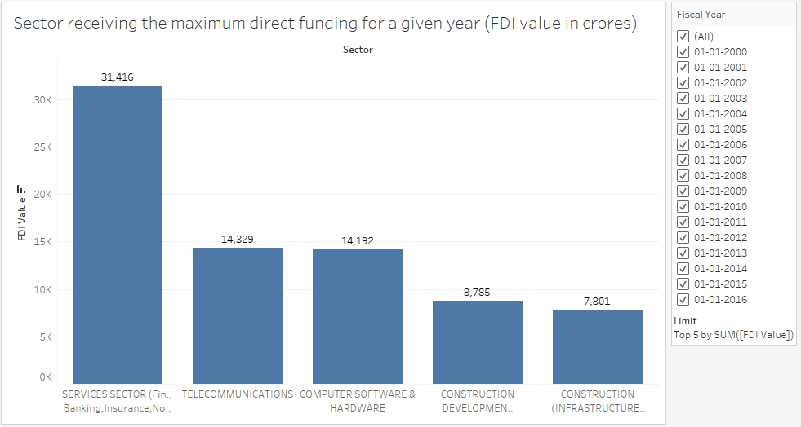
Business Problems
1. Which sector receive the maximum direct funding for a given year?

Slide 4
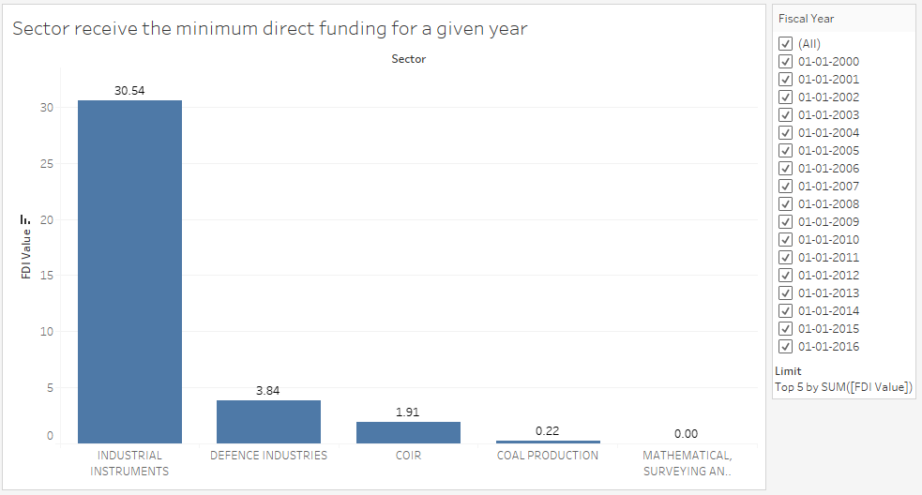
. 2. Which sector receive the minimum direct funding for a given year?
.

Slide 5
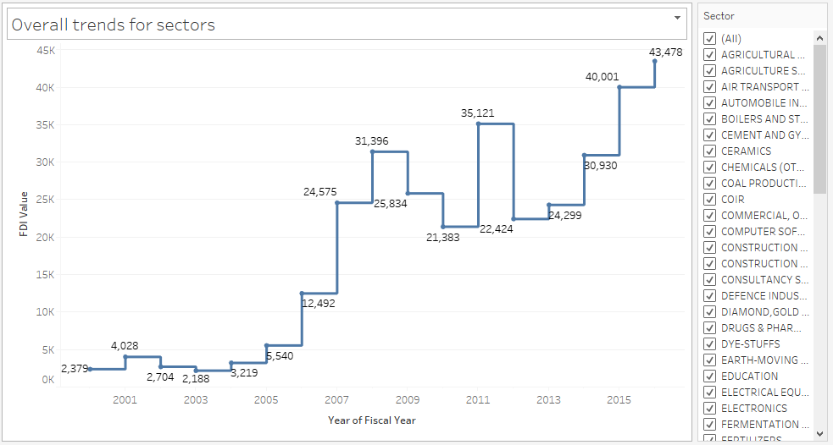
3. Is there a trend for direct investments for individual sectors?

Slide 6
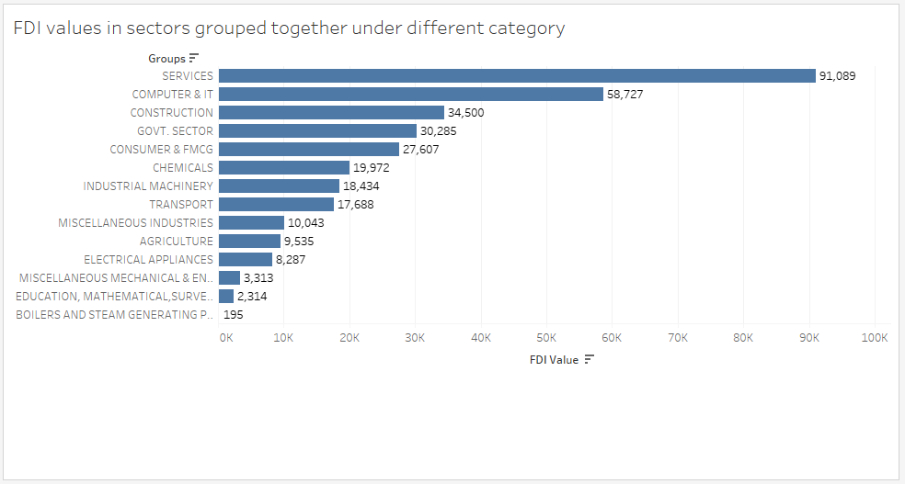
4. In what fashion can the sectors be grouped for comparison?

Slide 7
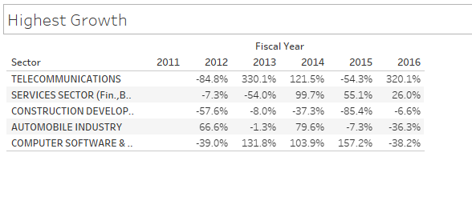
5. Which sectors reported highest growth in past 5 years?

Slide 8
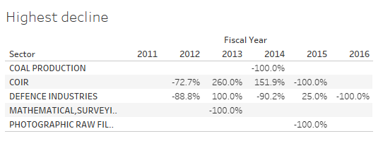
6. Which sectors reported highest decline in the past 5 years?

Slide 9
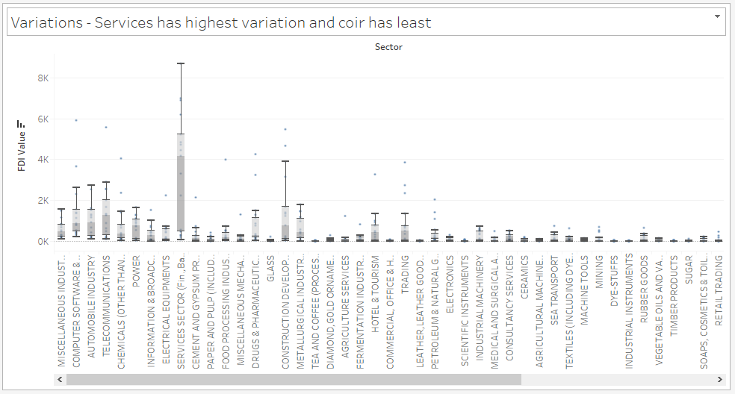
7. Which sectors reported the most variation overall?

Slide 10
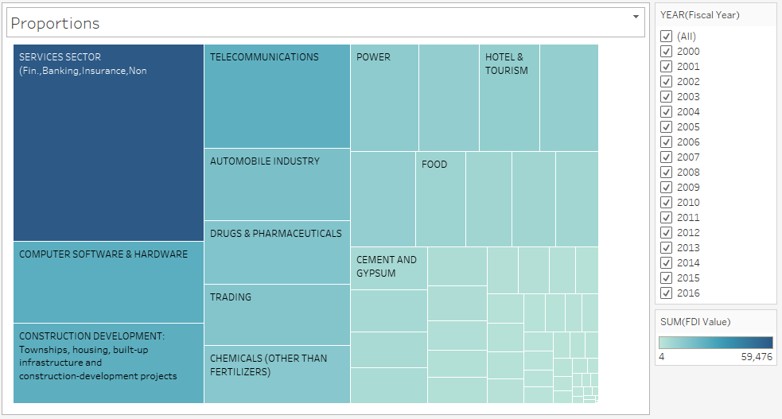
8. What is the proportion of investment between sectors from the FDI perspective?

Slide 11
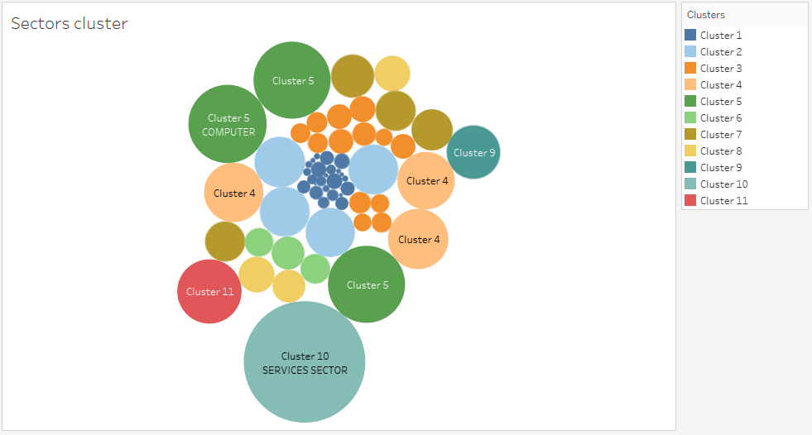
9. Are there any specific clusters present in the data?

Slide 12
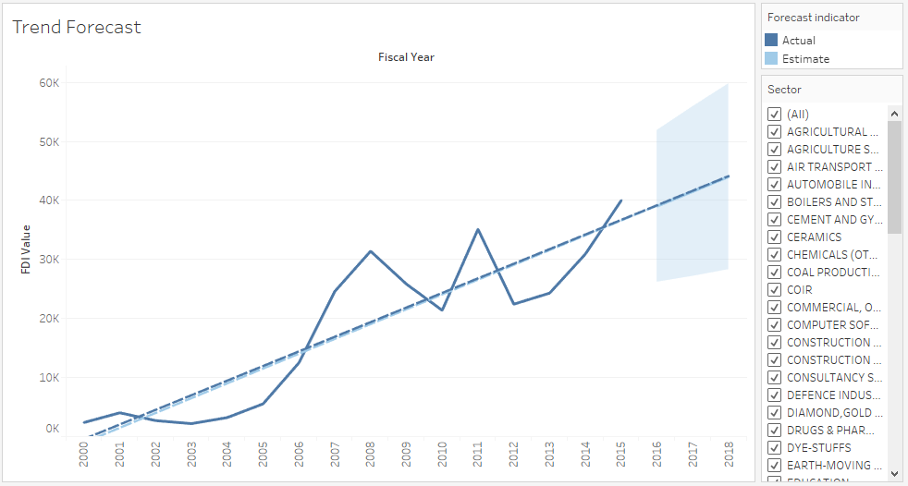
10. Can we forecast trend for following year?

Slide 13
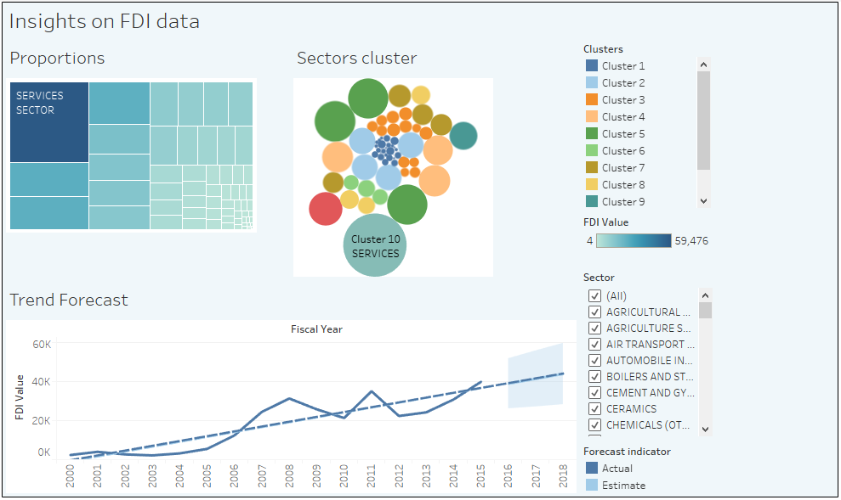
Final Dashboard 1

Slide 14
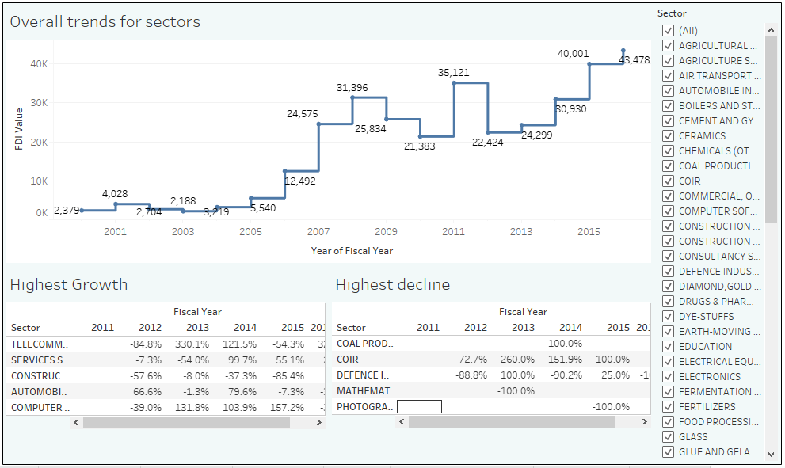
Final Dashboard 2

