Slide 1
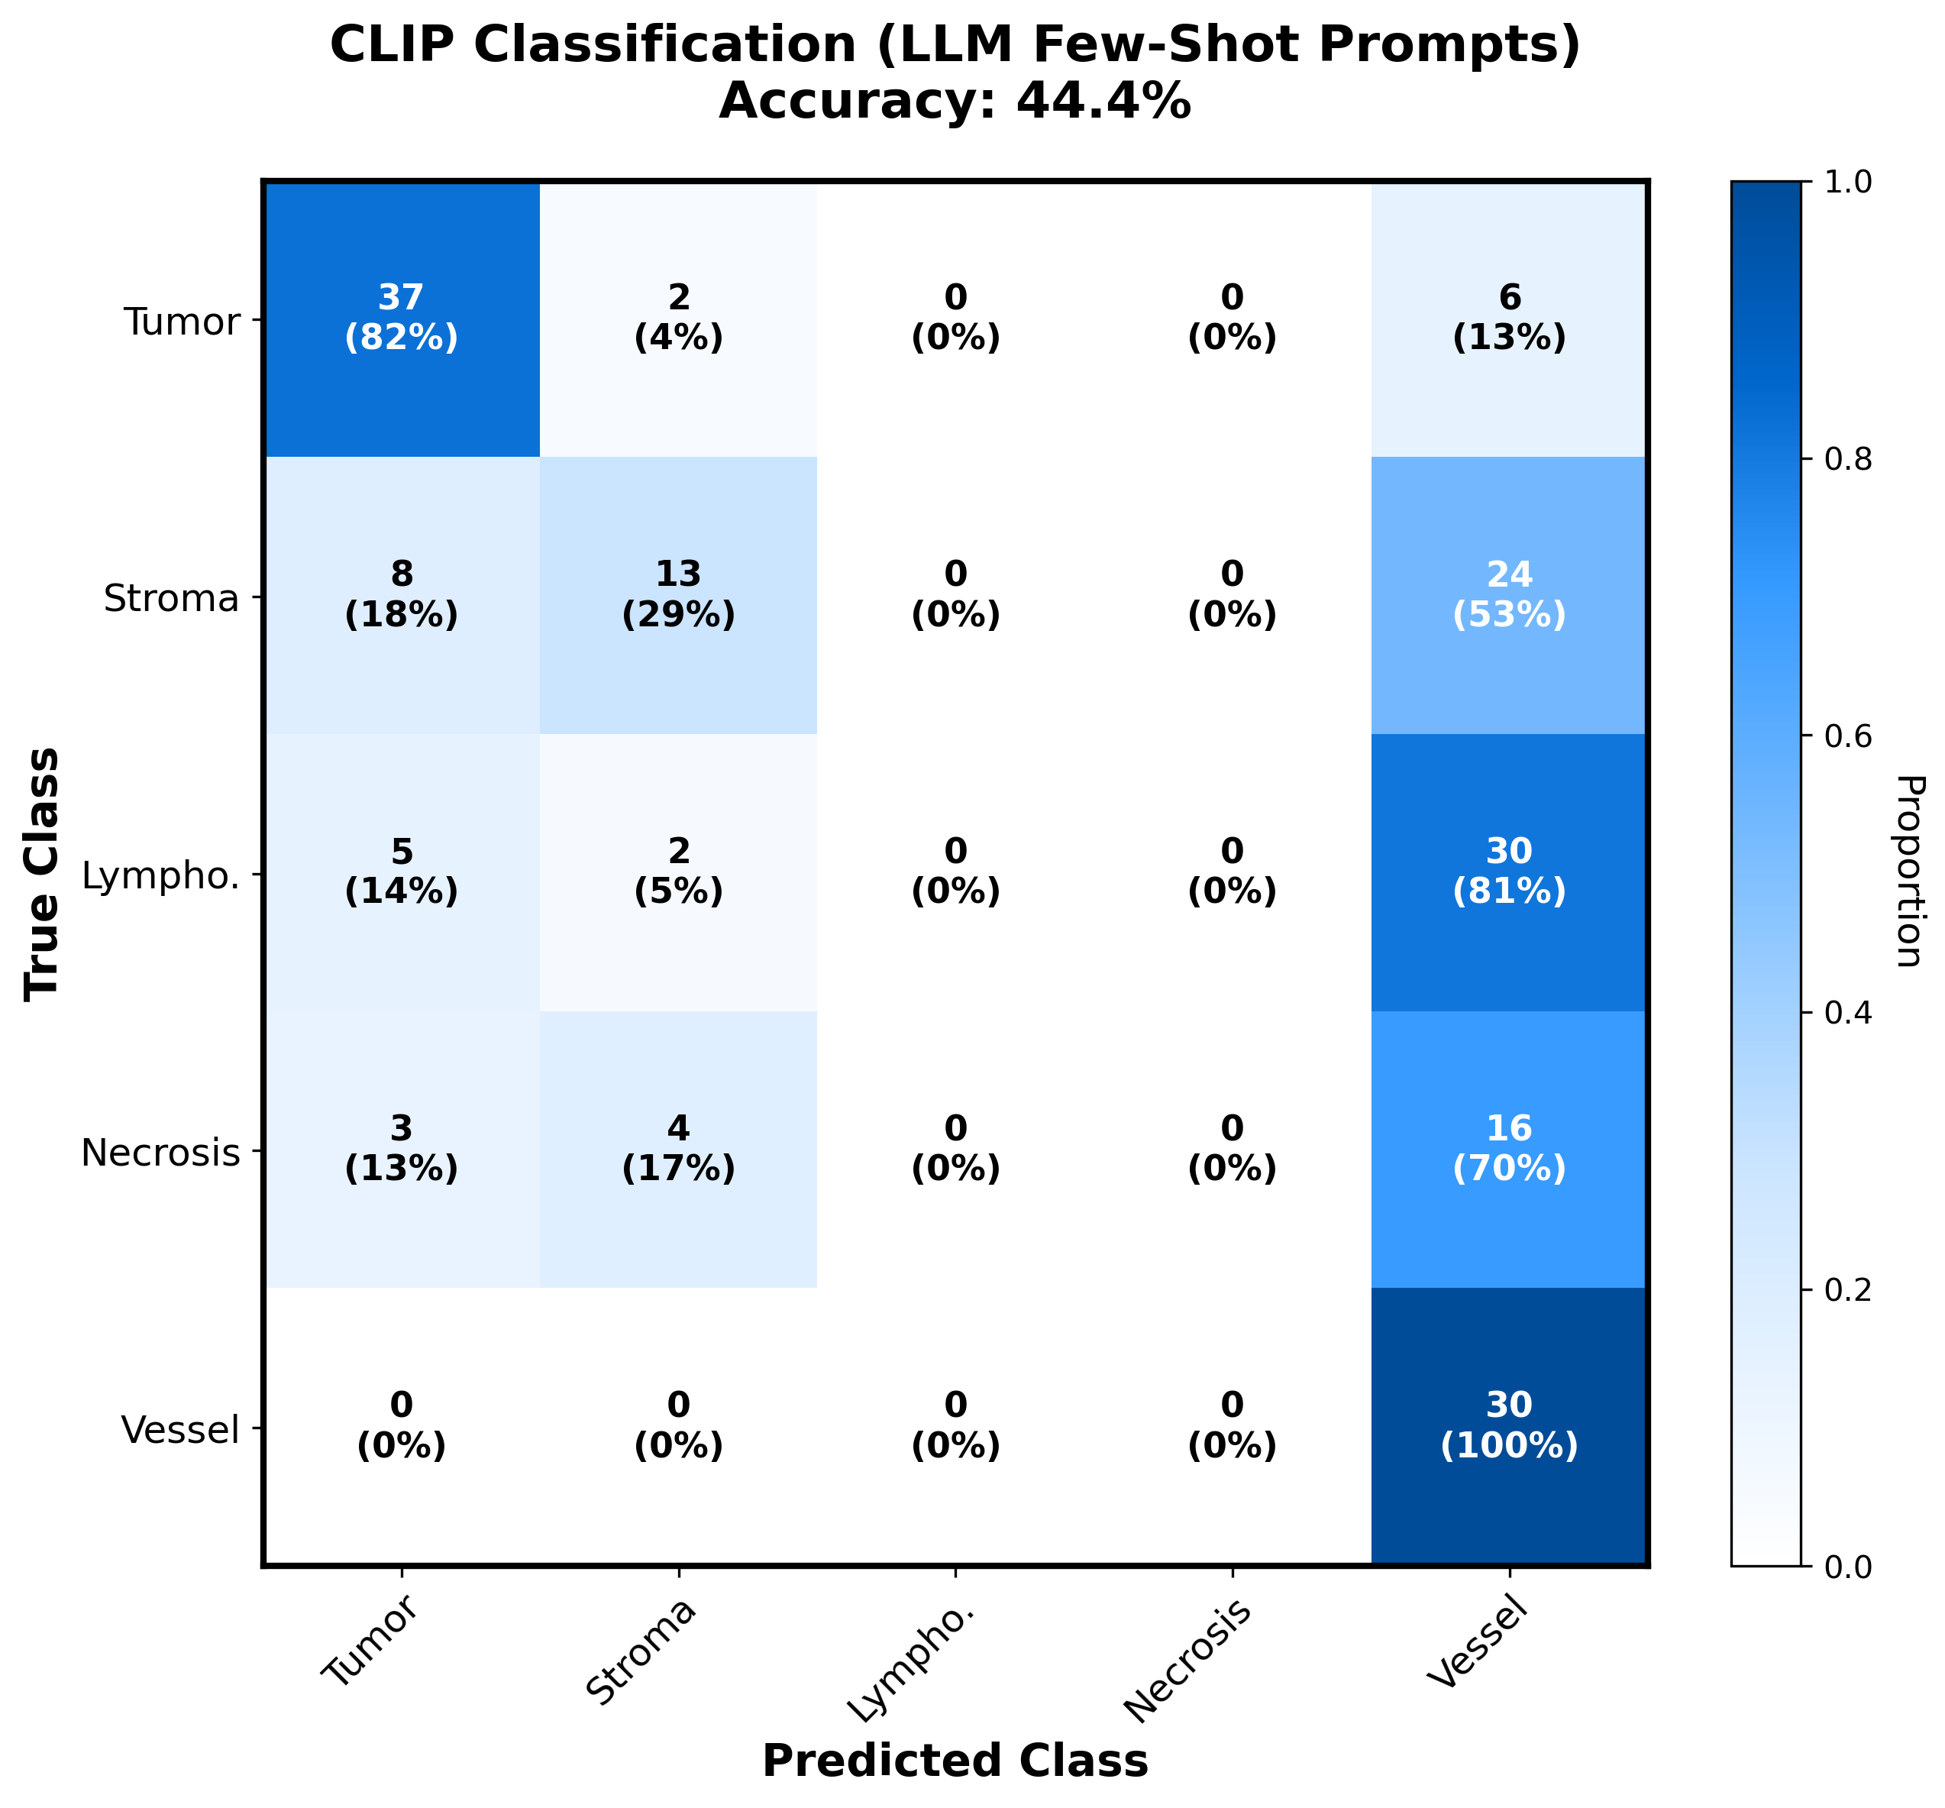
CLIP Classification: Confusion Matrix Analysis
Key Findings:
✓ Tumor: 82% recall (best)
✓ Blood Vessel: 100% recall
✗ Lymphocyte: 0% recall
✗ Necrosis: 0% recall
→ Heavy bias toward vessel
Why?
• Vessel has distinctive shape
• Lymph/Necrosis textures are subtle
• CLIP prefers structural cues

Slide 2
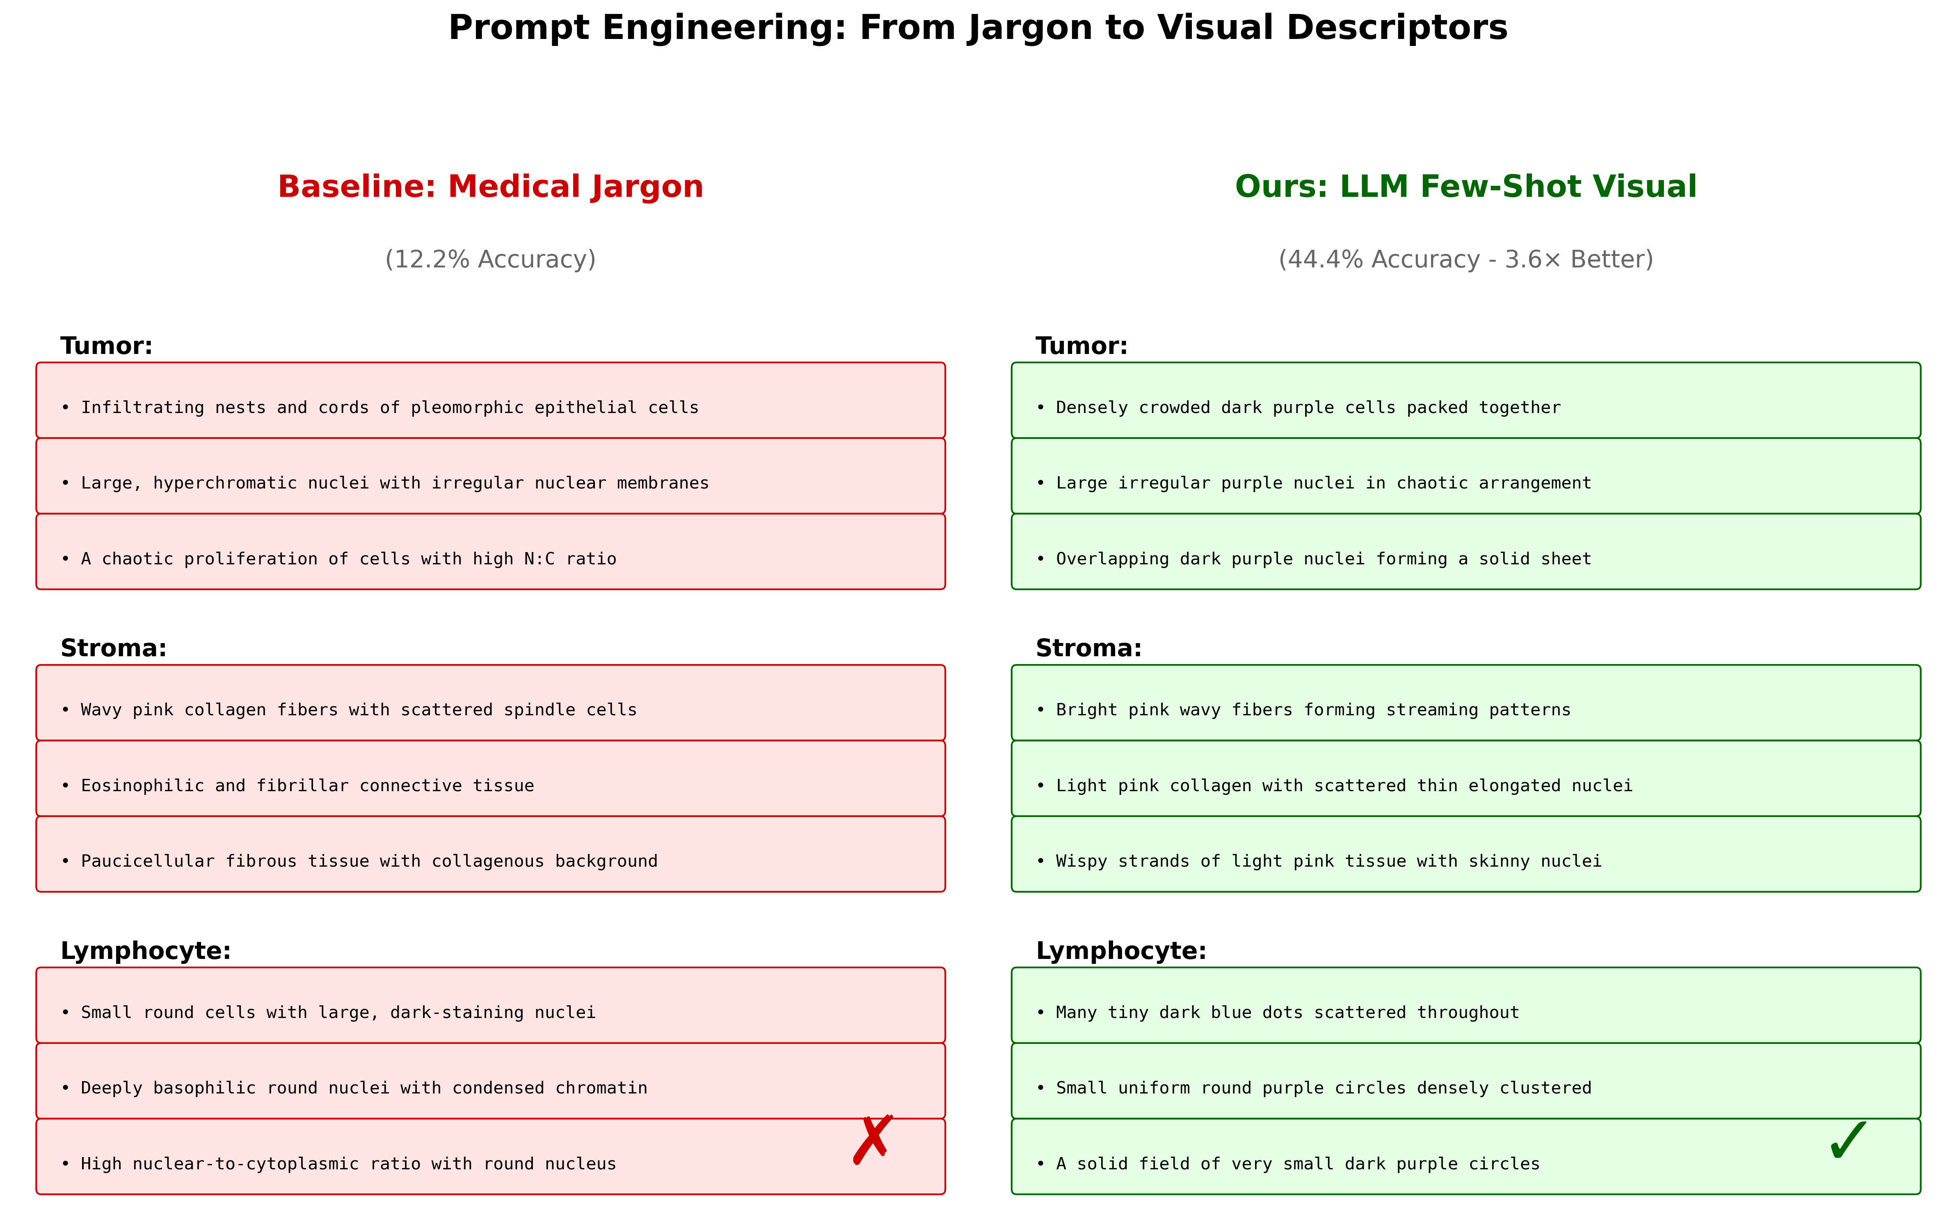
Prompt Engineering: The Key to CLIP Performance

Slide 3
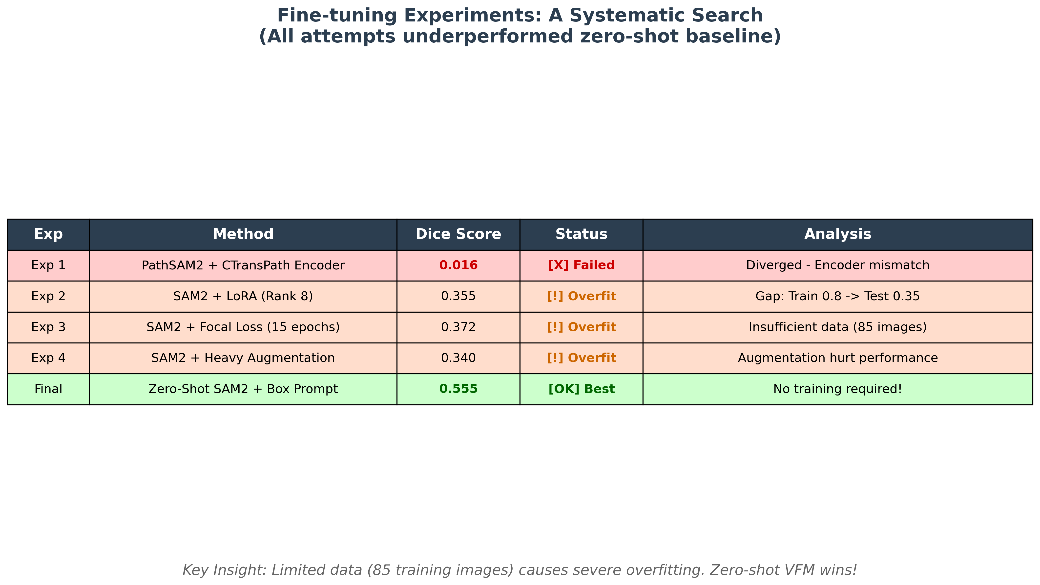
Fine-tuning Attempts: Systematic Failure Analysis

